Slide 1
Spring Beans & Intro to Spring Web
Spring MVC

Slide 2
Spring Beans
Beans are the core building block of a Spring application
Contain Business Logic
Configuration
Connection Objects
Etc…
Beans are managed by the BeanFactory (ApplicationContext)

Slide 3
Bean Lifecycle
Pre-Initialization
Instantiation : Spring IoC Container creates instance of Bean
Populate Properties : container injects dependencies
Set Bean Name
Any ‘ApplicationContextAware’ or ‘BeanNameAware’ methods are called
Bean is Created
Any ‘@PostConstruct’ or ‘InitializingBean’ methods are called
Any Custom Initialization methods are called
Bean is Ready to Use
Bean is in use
Pre-Destruction
Any ‘@PreDestroy’ or ‘DisposableBean’ methods are called
Any Custom Destroy methods are called
Bean is Destroyed

Slide 4
Scopes of Spring Beans
Singleton (default)
Single bean is created and shared across the entire Spring IoC Container
Prototype
A new instance of the bean is created each time it is requested from the container
Request
A single instance of the bean is created for each HTTP request. (typical for web applications)
Session
A single instance of the bean is created for each HTTP session by the same user.
Application
A single instance of the bean is created for the lifecycle of the entire web application
Any of these scopes can be configured using the ‘@Scope’ annotation or adding the ‘scope’ attribute in an XML configuration.

Slide 5
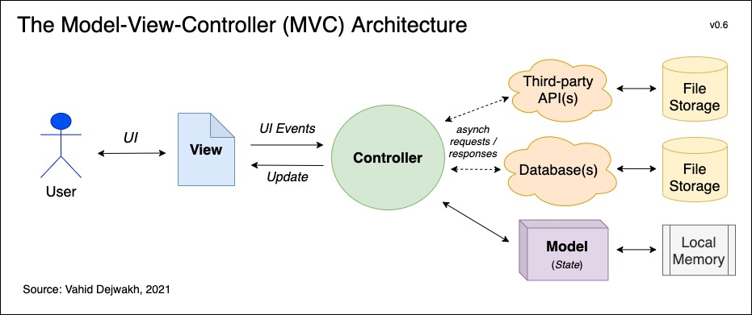
Model-View-Controller (MVC)
MVC is an architectural design pattern which separates an application into three components:
Model : Component responsible for data-related logic
View : Component responsible for all UI logic and User interfacing
Controller : Component which enables interconnection between view and model.

Slide 6
Spring MVC
Spring MVC is part of the Spring Web Module and is designed to provide a clean configuration and integration of a Model-View-Controller pattern.
The main components of MVC are:
DispatcherServlet : Acts as a front controller (single point of entry) to intercept and handle requests
Controller : Processes the request and executes Business Logic
HandlerMapping : Determines which controller method should handle an incoming request.
ViewResolver : Resolves Logical view names which are returned by the controllers
Model : Holds the data to be displayed by the view
NOTE: although we will be interacting with Spring Web and MVC, we will not have a view in our examples

