Slide 1
Introduction to Spring
Inversion of Control & Dependency Injection

Slide 2
What is Spring?
Powerful & Widely used framework to build Java Applications
Three core building blocks of Enterprise-Level Spring Applications:
Web Layer : Handles user requests & responses
Service Layer : Encapsulates business logic & connections web and data access layers
Data Access Layer : interacts with database and/or external data sources. Retrieves and Persists data.

Slide 3
The Spring Framework
The Spring Framework is a comprehensive infrastructure of tools built to support the development of Java Applications
Enables development of loosely coupled, easily testable and scalable applications.
Provides capabilities such as Dependency Injection, Aspect Oriented Programing and more
Configuration can be a bit verbose and often requires a lot of XML configuration (although annotation-based configuration is also available).
Useful when you have specific needs that require detailed setup and customization

Slide 4
Inversion of Control (IoC)
Design principle which shifts the control of object creation and management from the application to a container or framework.
i.e. IoC is about outsourcing the creation and management of objects to a container instead of manually creating the objects and managing them.
Spring IoC container creates and manages objects for each layer of the application
IoC automatically injects dependencies into appropriate components, which enables decoupling between layers
Decoupling improves maintainability, scalability and testing
With Spring IoC, developers can focus on writing layer-specific logic without worrying about cross-layer dependency management.

Slide 5
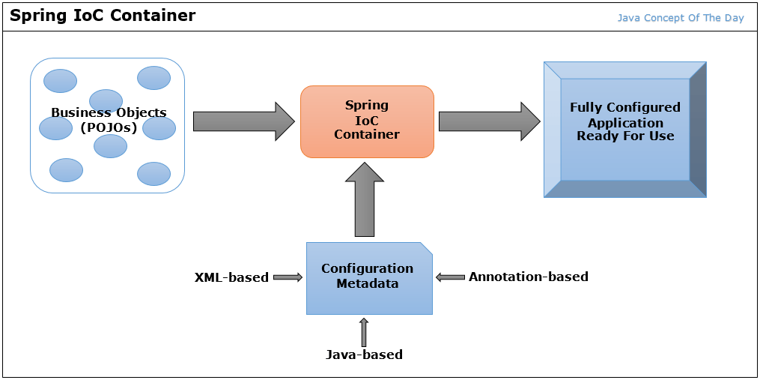
Inversion of Control (IoC)

Slide 6
BeanFactory
The BeanFactory is an interface which serves as the foundation for the IoC Container.
Responsible for managing and providing instances of beans
Beans are objects which are instantiated, configured and managed by the IoC container.
Beans are the core build block of Spring applications, containing business logic, configurations, connections, etc…
The BeanFactory is the central registry for bean definitions. It will create and initialize beans based on provided definitions

Slide 7
ApplicationContext
The ApplicationContext is an interface which extends the BeanFactory in spring to provide a broader range of functionalities to support an application.
Supports advanced dependency injection, automatically wiring and resolving dependencies between objects.
The ApplicationContext allows for flexible application configuration using:
XML File Configuration
Spring Annotation Configuration
Java-code Configurations
The ApplicationContext performs eager initialization of beans by default (all beans are configured upfront).

Slide 8
Dependency Injection (DI)
Design pattern (and a form of IoC) wherein an Object’s dependencies are “injected” into it by an external source (IoC Container), rather than the object itself creating them.
DI promotes loose coupling and improves maintainability and scalability of your code
In Spring DI is achieved using:
Constructor Injection: Dependencies are injected through the constructor of the class
Requires: Parameterized constructor
Setter Injection: Dependencies are injected through setter methods of the class
Requires: No-arg constructor & field setter method
Field Injection: Dependencies are injected directly into the fields of the class.
Requires: No-arg constructor & no setter method
Spring’s IoC Container injects dependencies based on the configured beans

