Slide 1
Student Attrition
Report

Slide 2
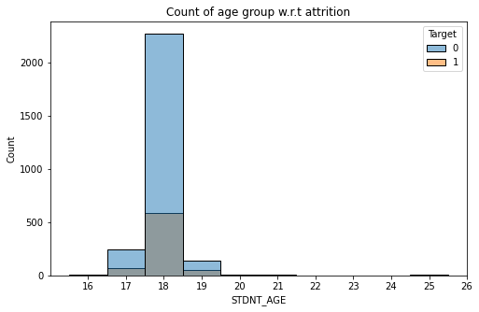
Student Age vs Attrition
Attrition increases as we stray away from the age of 18
Although this graph may give a false impression that attrition is higher for students having 18 years of age
Once we see the values in percentage it is clear that attrition is less for students with 18 yrs of age

Slide 3
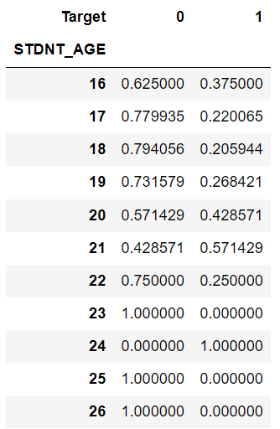
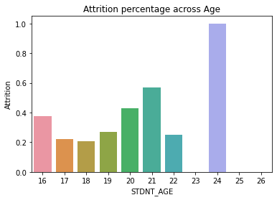
Continuation

Slide 4
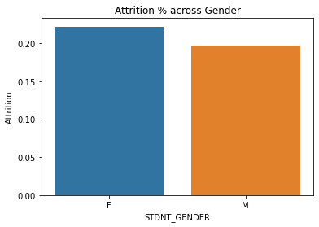
Student Gender vs Attrition
We can see that there are lot more Female students than there are male students
Females do tend to attrite more than their male counterparts
There is about 3 percentage difference in attrition between them

Slide 5
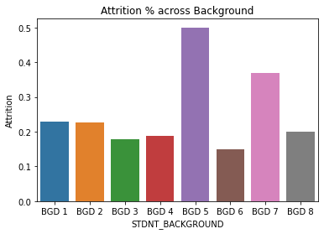
Student Background vs Attrition
Considerable amount of students are from BGD 1
About 61% of students are from BGD 1
Attrition from BGD 5 is high however there are only 8 students from this background

Slide 6
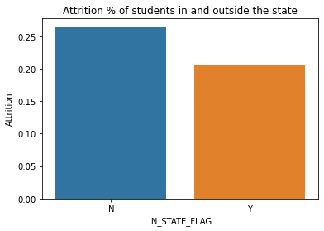
In State vs Attrition
Students who are from outside the state of university are more likely to attrite than those that are from the same state
However only 10% of the students are from outside the state

Slide 7
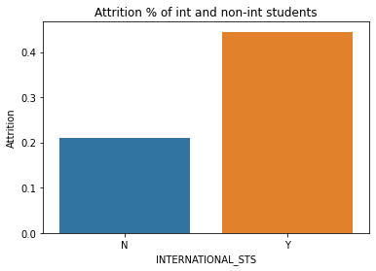
International Status vs Attrition
International Students tend to attrite more than regional ones
However the percentage of international students is very slim at 0.7% of the total students
Since the number is very low this may not be important at the modeling stage

Slide 8
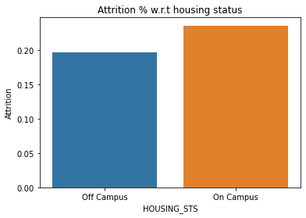
Housing Status vs Attrition
There is slightly more number of students who are from off campus
Attrition rates are high for students who are staying on campus

Slide 9
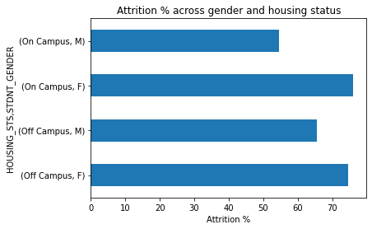
Housing Status vs Gender vs Attrition
Females do tend to attrite more on as well as off campus
On campus attrition for males are comparatively low

Slide 10
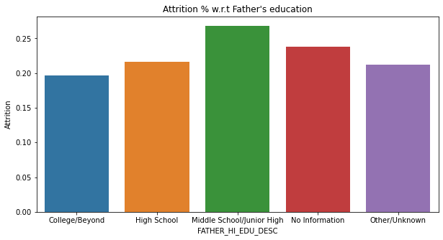
Father’s Education vs Attrition
Attrition is high for students whose father’s have Middle school education
Students whose fathers have College and beyond education have less attrition
Mother’s education doesn’t show any pattern with attrition

Slide 11
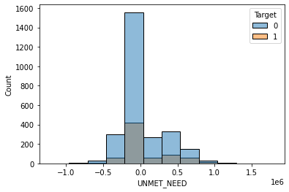
Unmet Need vs Attrition
Even if the unmet needs are none there is attrition, this points to the fact that money problem isn’t the sole reason for attrition
However a percentage view of the attrition would reveal that attrition increases as we deviate from zero

Slide 12
Model
I have used extreme boosting algorithm to model this dataset
So that on each iteration it corrects or gives more importance to wrongly predicted values in the previous iteration
I had to remove a major chunk of variables to clean the dataset
Combined some features to form new ones
Even though most of machine learning models did give similar results
XGboost model had the highest area under the curve
And performed hyperparameter tuning with Optuna to get the best hyper-parameters

Slide 13
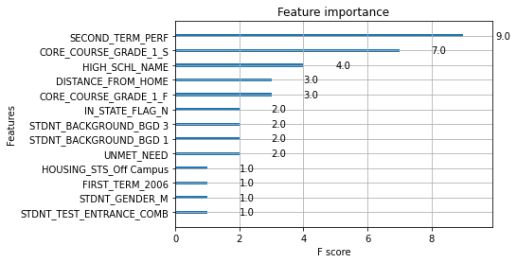
Feature Importance

Slide 14
Continuation
Second Term performance is a major predictor of attrition according to the model
It is obtained by dividing hours earned by hours attempted by the student in the second year
Closely followed by the grades obtained in second year for core course
Name of high schools the student attended is also an important predictor according to the model
Distance from home and grades obtained in first year for core course shares similar importance

Slide 15
Recommendations
We could set up a system to monitor student’s grades as they progress through with their education
And intervene with helpful resources such as selected tutoring for students that are falling behind
Optimally scheduling classes to increase the attendee rate
And if one were to skip a lecture, they should be informed of the time when this lecture would be taken again
Profiling applications by which high schools each student have attended and distance from home could aid in selection process
Giving out weekend projects and assigning groups could be a great way to counter on-campus attrition

