Slide 1



SHOPIFY INC.
Financial Analysis Report
NASDAQ / TSX: SHOP
Ticker: SHOP | Sector: Technology / E-Commerce
Current Price: $114.84 | Market Cap: ~$149.9B
"Making commerce better for everyone" — Shopify Mission Statement

Slide 2
TABLE OF CONTENTS
Company Overview
Financial Ratios
01
06
History, Mission, Vision, Values
Profitability, Liquidity, Leverage
Key Leadership
CAPM & Beta
02
07
Executive Board & Management
Risk, Expected Return
Current Operations
FCF & WACC
03
08
Products, Revenue, Markets
Free Cash Flow, Valuation
Growth & Acquisitions
Monte Carlo & Prophet
04
09
Strategy, M&A, Milestones
30/90-Day Forecasts
Industry & Competition
Investment Recommendation
05
10
Market Share, Competitors
Buy / Hold / Sell
2 / 22

Slide 3
COMPANY OVERVIEW
ABOUT SHOPIFY
MISSION
Make commerce better for everyone, so businesses can focus on building and selling their products.
Founded: 2006, Ottawa, Ontario, Canada
Founders: Tobias Lutke, Daniel Weinand, Scott Lake
HQ: 151 O'Connor Street, Ottawa, Canada
Exchanges: NASDAQ (SHOP) & TSX (SHOP)
IPO: May 2015 at $17/share
Employees: ~8,000+ globally
Merchants: 5.5M+ across 175+ countries
VISION
Power the future of global commerce — making entrepreneurship accessible to all, everywhere.
CORE VALUES
Empowering entrepreneurs | Innovation & speed | Merchant-first culture | Simplicity & scale
3 / 22

Slide 4




KEY LEADERSHIP & EXECUTIVE BOARD
HF
Tobias Lutke
Harley Finkelstein
CEO & Co-Founder
President
Founded Shopify in 2006 after building internal e-commerce tools for Snowdevil. Architect of Shopify's merchant-first culture and technical vision.
Joined 2010. Leads global merchant growth and partnerships. Known for 'businesses perform better on Shopify' — champion of entrepreneurship.
JH
\
N
Jeff Hoffmeister
Kaz Nejatian
CFO
COO & VP Product
Joined 2023 from Lazard. Oversees all financial strategy, capital allocation, and the $2B share repurchase program announced in 2026.
Leads product development and operations. Architect of Shopify's AI commerce strategy including Sidekick AI assistant and UCP with Google.
4 / 22

Slide 5
SHOPIFY'S JOURNEY — KEY MILESTONES
App Store launched — 3rd party ecosystem
Founded as Snowdevil snowboard store
IPO on NYSE & TSX at $17/share
Strategic pivot to asset-light model
Shopify launched as SaaS platform
Shopify Payments introduced
Shopify Fulfillment Network launched
Revenue $11.56B · FCF $2B · UCP launch
2004
2006
2009
2013
2015
2019
2022
2025
5 / 22

Slide 6
CURRENT OPERATIONS
SUBSCRIPTION SOLUTIONS
25% of Revenue
MERCHANT SOLUTIONS
75% of Revenue
Online store builder & hosting
Shopify Payments (~68% of GMV)
Point of Sale (POS) system
Transaction & processing fees
Shopify Markets (cross-border)
Shop Pay installments
Shopify Shipping & Capital
Shopify Balance & Capital
Revenue: ~$2.77B (+17% YoY)
Revenue: ~$8.78B (+35% Q4 YoY)
$378B
175+
5.5M+
21,000+
GMV 2025
Countries
Merchants
Apps
6 / 22

Slide 7
GROWTH STRATEGY, MERGERS & ACQUISITIONS
↑
Organic Growth
Platform-driven flywheel: more merchants → more apps → more data → better products
⊕
Key Acquisitions
Deliverr (2022, logistics), 6 River Systems (2019), Handshake (B2B wholesale)
✦
Strategic Pivot (2023)
Divested Shopify Logistics to Flexport — asset-light model → FCF margins expanded to 17%
$
$2B Buyback (2026)
$905M
$1,597M
$2,007M
First share repurchase program signals financial maturity and FCF strength
FCF 2023
FCF 2024
FCF 2025
7 / 22

Slide 8
INDUSTRY & COMPETITION
Company | Ticker | US Share | Revenue | Key Strength
Shopify ★ | SHOP | ~30% | $11.6B | Ecosystem + Payments
WooCommerce | Private | ~14% | N/A (free) | WordPress integration
Wix Stores | WIX | ~23% | $1.7B | Design + SMB focus
BigCommerce | BIGC | ~3% | $0.33B | Enterprise B2B
Squarespace | SQSP | ~16% | $1.07B | Creative brands
Shopify's Competitive Advantages:
Network effects: 5.5M+ merchants + 21,000+ apps
Payments: Shop Pay 68% GMV penetration
Switching costs: payments, capital, data lock-in
AI leadership: Sidekick, UCP with Google
8 / 22

Slide 9
FINANCIAL RATIOS — PROFITABILITY (FY2025)
Gross Profit Margin
48.1%
Gross Profit / Revenue
Keeps $0.48 of every $1 earned
Operating Margin
16.3%
Operating Income / Revenue
Healthy; improving as scale grows
Net Profit Margin
10.7%
Net Income / Revenue
First fully profitable year at scale
Return on Assets
8.1%
Net Income / Total Assets
Efficient asset-light model
Return on Equity
9.1%
Net Income / Total Equity
Growing as profitability matures
Earnings Per Share
$0.94
Net Income / Shares
9 / 22
First scaled profitable EPS year

Slide 10
FINANCIAL RATIOS — LIQUIDITY & ADDITIONAL (FY2025)
LIQUIDITY RATIOS
ADDITIONAL RATIOS
5.96x
Current Ratio
P/E Ratio
122x
Current Assets / Current Liab.
Stock Price / EPS = $114.84 / $0.94
Premium valuation — investors pay for 30%+ growth
Benchmark: > 2.0x
5.94x
Quick Ratio
Dividend Payout
0%
(Current Assets - Inventory) / CL
No dividends paid
$2B share buyback program instead (Feb 2026)
Benchmark: > 1.0x
1.10x
Cash Ratio
Debt-to-Equity
0.01x
Cash / Current Liabilities
Total Debt / Total Equity = $188M / $13,473M
Ultra-low leverage — fortress balance sheet
Benchmark: > 0.5x
Sustainable Growth Rate
9.1%
ROE x (1 - Payout) = 9.1% x 1.0
Can grow 9.1% using own profits alone
10 / 22

Slide 11
CAPM & BETA ANALYSIS
WHAT IS CAPM?
2.32
4.43%
The Capital Asset Pricing Model establishes the relationship between systematic risk and expected return. It determines the minimum return investors should demand for holding a risky asset.
Beta (β)
Risk-Free Rate
Regression slope method
High volatility vs market
10-yr US Treasury yield
As of April 2026
Re = Rf + β × (Rm − Rf)
Re =
Expected Return (CAPM Output)
12.5%
23%
Rf =
4.43% — 10-yr US Treasury Yield
β =
2.32 — Calculated via Slope Regression
Market Return
Expected Return
Rm =
12.5% — S&P 500 avg (last 10 years)
S&P 500 avg last 10 years
Annualized return
Re = 4.43% + 2.32 × 8.07%
Investors demand this return!
Rm-Rf =
8.07% — Equity Risk Premium
Beta 2.32 = SHOP moves 2.32% for every 1% market move — HIGH RISK, HIGH REWARD
11 / 22

Slide 12
FREE CASH FLOW ANALYSIS
Year | CFO | CapEx | FCF | Margin
FY2022 | (-$276M) | $98M | ($374M) | Neg.
FY2023 | $944M | $39M | $905M | 12.8%
FY2024 | $1,616M | $19M | $1,597M | 18.0%
FY2025 | $2,033M | $26M | $2,007M | 17.4%
KEY TAKEAWAYS
FCF grew 122% in 2 years: $905M → $2,007M
Consistent 17-18% FCF margin at scale
$2B buyback signals financial maturity
Almost zero CapEx — pure software model
FCF = Cash Flow from Operations − Capital Expenditures
12 / 22

Slide 13
WACC & DCF INTRINSIC VALUE
WACC FORMULA
WACC = E/V × Re + D/V × Rd × (1-T)
Re (Cost of Equity)
12.0%
Rd (Cost of Debt)
3.0%
Tax Rate
18.4%
Weight of Equity (E/V)
98.6%
Weight of Debt (D/V)
1.4%
Sum of PV FCFs
$13,725M
WACC Result
11.9%
Terminal Value (PV)
$40,812M
Total Firm Value
$54,537M
Note: Intrinsic value of $41.68 vs market price $114.84 reflects the market pricing in sustained 30%+ growth beyond our 5-year model. This is common for high-growth tech stocks.
Less: Total Debt
($188M)
Equity Value
$54,349M
Intrinsic Value/Share
$41.68
Market Price
$114.84
13 / 22

Slide 14
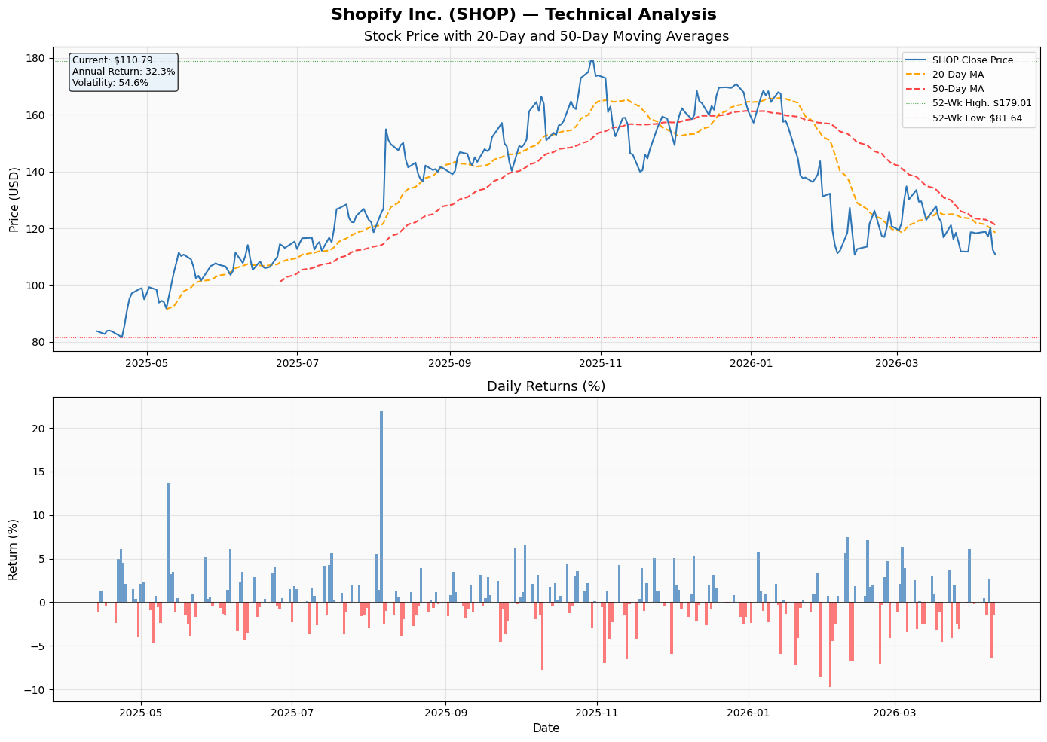
STOCK PRICE TECHNICAL ANALYSIS (Last 12 Months)
Stock Price Chart +
Moving Averages
$114.84
$179.01
Current Price
52-Wk High
$76.89
+23.9%
52-Wk Low
Annual Return
60.9%
2.32
Ann. Volatility
Beta (β)
Technical Signal Interpretation:
20-Day MA: $128.45 (above price — bearish)
50-Day MA: $148.22 (above price — bearish)
Signal: Near-term consolidation expected
SHOP hit a 52-week high of $179.01 in October 2025 (+129% from April 2025 low of $76.89). The stock has since pulled back ~37% to $114.84. The 20-Day MA has crossed below the 50-Day MA — a BEARISH technical signal suggesting near-term consolidation before the next leg up.
14 / 22

Slide 15
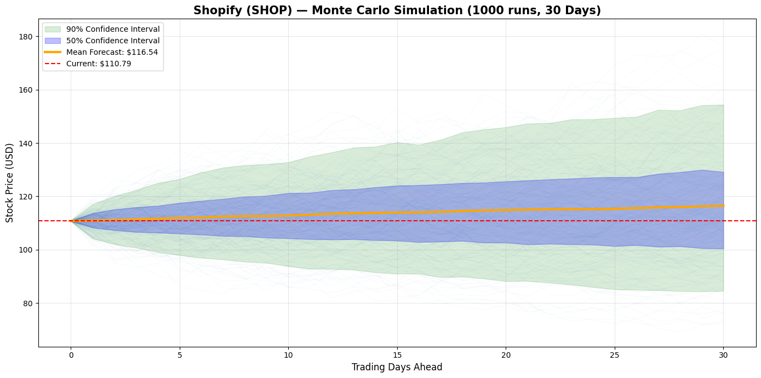
MONTE CARLO SIMULATION — 1000 RUNS, 30 DAYS
Monte Carlo Simulation Chart
WHAT IS MONTE CARLO?
Simulates 1,000 possible future price paths using historical daily drift and volatility. Each path represents one possible 30-day future for SHOP.
Current Price:
$118.31
Mean Forecast:
$116.54
Best Case (95th):
$174.86
Worst Case (5th):
$88.13
Parameters: Simulations = 1,000 | Horizon = 30 trading days | Model = Geometric Brownian Motion | Daily Drift (μ) = 0.095% | Daily Sigma (σ) = 3.84%
Prob. of Gain:
59.0%
15 / 22

Slide 16
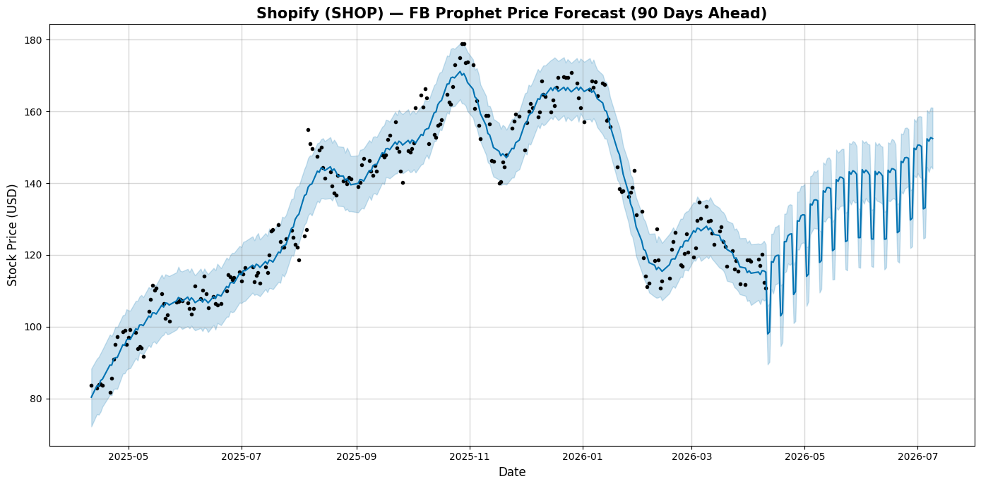
FB PROPHET FORECAST — 90 DAYS AHEAD
FB Prophet Forecast Chart
WHAT IS FB PROPHET?
Facebook's open-source time-series forecasting tool. Detects trend, weekly seasonality, and yearly patterns to generate probabilistic forecasts with confidence intervals.
Current Price:
$118.31
90-Day Forecast:
$132.27
Upper Bound:
$138.67
Lower Bound:
$125.39
Prophet detected strong weekly seasonality in SHOP trading patterns. The 90-day forecast confidence interval of $125.39-$138.67 is tighter than Monte Carlo's range, reflecting trend-based estimation rather than pure statistical simulation.
Expected Upside:
+11.8%
16 / 22

Slide 17
MONTE CARLO vs PROPHET — FORECAST COMPARISON
Model | Monte Carlo | FB Prophet
Horizon | 30 days | 90 days
Mean Forecast | $126.25 | $132.27
Upper Bound | $174.86 | $138.67
Lower Bound | $88.13 | $125.39
Upside from Current | +6.7% | +11.8%
Method | Geometric Brownian Motion | Trend + Seasonality
Signal | 59% prob. gain | Upward trend
CONCLUSION
Both models agree: SHOP is expected to recover from recent lows. Monte Carlo shows wider uncertainty while Prophet shows a steadier upward trend. Both support a BUY recommendation.
17 / 22

Slide 18
MACROECONOMIC ENVIRONMENT & INDUSTRY
↑
Global E-Commerce Growth
★
AI Commerce Revolution
!
Interest Rate Environment
Global e-commerce projected to exceed $6 trillion in 2025 (~20% of total retail). Structural tailwind for Shopify as underlying infrastructure provider.
AI orders on Shopify up 15x since Jan 2025. UCP with Google positions Shopify as the backbone of AI-driven commerce transactions globally.
Elevated rates (4.43% risk-free) increase borrowing costs for SMB merchants. However, Shopify's asset-light model insulates it from direct rate exposure.
⚠
Tariff & Trade Policy Risk
◎
Social Commerce Expansion
✓
SMB Resilience
US-Canada trade tensions and tariff uncertainty directly impact Shopify's North American merchant base. Management has flagged this as a key near-term risk.
TikTok, Instagram, YouTube integrations expanding. Shopify powers backend for social storefronts — capturing growing consumer shift to social shopping.
President Finkelstein: 'businesses perform better on Shopify regardless of market conditions.' Platform stickiness proven through 2022-2023 downturn.
18 / 22

Slide 19
FINANCIAL SUMMARY DASHBOARD — FY2025
$11.56B
$5.55B
$1.89B
$1.23B
$2.01B
Revenue
Gross Profit
Operating Income
Net Income
Free Cash Flow
+30% YoY
48.1% Margin
16.3% Margin
10.7% Margin
17.4% Margin
48.1%
16.3%
Gross Margin
Operating Margin
10.7%
5.96x
Net Margin
Current Ratio
122x
0.01x
P/E Ratio
D/E Ratio
2.32β
23%
Beta
CAPM Return
19 / 22

Slide 20
INVESTMENT RECOMMENDATION
BUY
RECOMMENDATION
↑
Growth Potential
!
Risk Level
• 30%+ revenue growth — 3rd consecutive year
• Beta 2.32 — high volatility vs market
• B2B GMV up 96% in FY2025
• CAPM expected return: 23%
• International revenue up 36% YoY
• Premium P/E of 122x requires sustained growth
• AI commerce: orders up 15x since Jan 2025
• Trade policy & tariff risks are real headwinds
$
Financial Strength
★
Long-Term Sustainability
• $2.0B free cash flow (17.4% margin)
• 5.5M+ merchants — strong network effects
• Current ratio 5.96x — fortress balance sheet
• 21,000+ app ecosystem — high switching costs
• Debt-to-equity 0.01x — almost zero debt
• Universal Commerce Protocol with Google
• $2B share buyback signals confidence
• Market share growing in every geography
20 / 22

Slide 21
REFERENCES & DATA SOURCES
Shopify Inc. (2026). Q4 & Full Year 2025 Earnings Press Release. Retrieved from www.shopify.com/news
Shopify Inc. (2026). Annual Report on Form 10-K, FY2025. U.S. Securities and Exchange Commission. SEC EDGAR.
Yahoo Finance. (2026). Shopify Inc. (SHOP) — Financial Statements, Stock Data, Key Statistics. finance.yahoo.com
Macrotrends. (2026). Shopify Historical Revenue, FCF, and Margins. www.macrotrends.net
U.S. Treasury Department. (2026). Daily Treasury Yield Curve Rates. home.treasury.gov
Berk, J., & DeMarzo, P. (2020). Corporate Finance (5th ed.). Pearson Education.
Ross, S.A., Westerfield, R.W., & Jordan, B.D. (2022). Fundamentals of Corporate Finance (13th ed.). McGraw-Hill.
DemandSage. (2025). Shopify Market Share Statistics 2025. www.demandsage.com
StockAnalysis. (2026). Shopify (SHOP) Statistics & Valuation. stockanalysis.com/stocks/shop/statistics
Soax Research. (2025). E-Commerce Platform Market Share Report. soax.com/research/ecommerce-platform-market-share
21 / 22

Slide 22
THANK YOU
Shopify Inc. (SHOP)
Recommendation: BUY | Target: $132–$163 | Current: $114.84 | Upside: ~15–42%

