Slide 1
ETL Project Glassdoor Data Science Job Skill Database
Presented by
Saurabh Bhatt
Lidio Meireles
Pavitra Mohan Bagirthi
Christopher Reutz

Slide 2
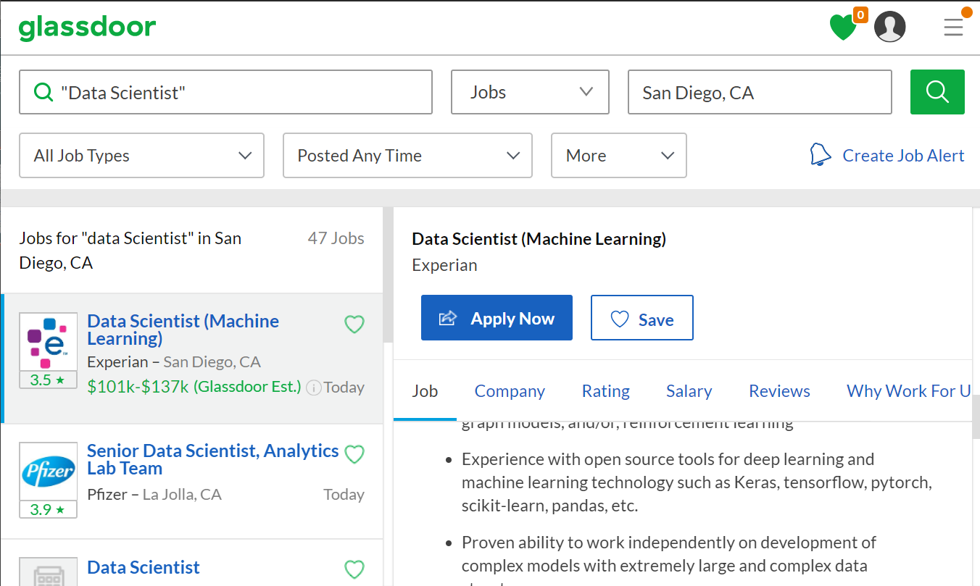
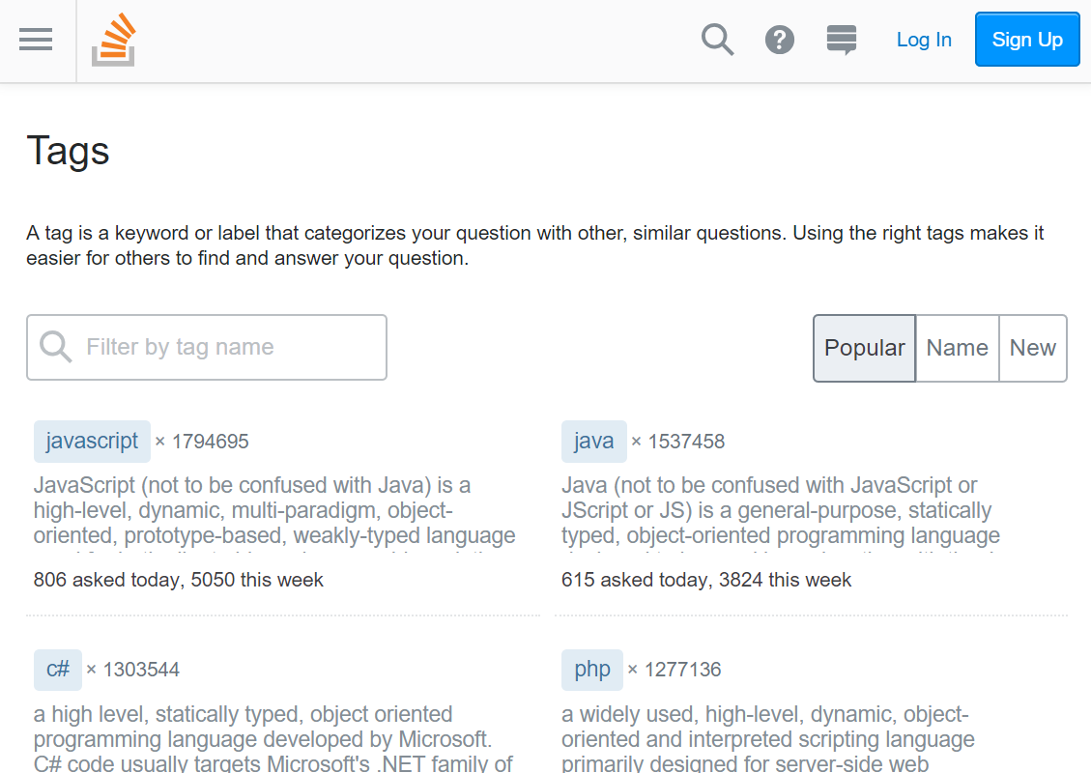
2. Match tags to job descriptions
1. Extract skills/tags from StackOverflow

Slide 3
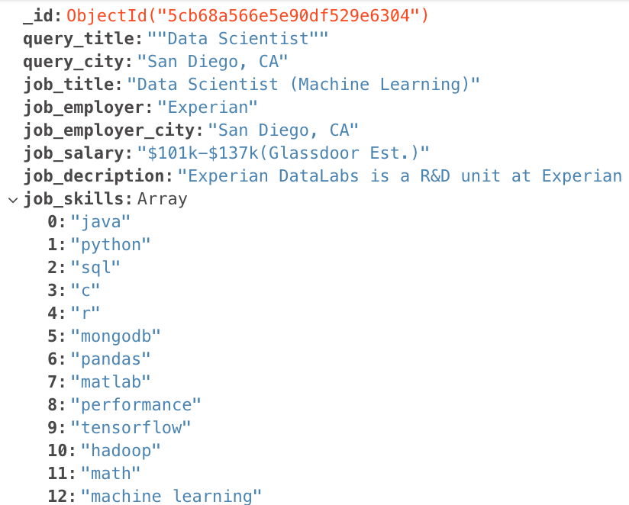
MongoDB representation (.json)

Slide 4
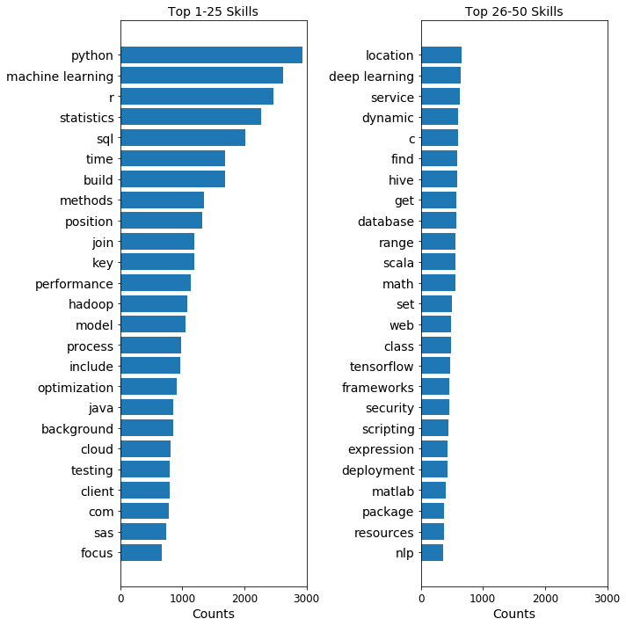
Most Frequent Skills in “Data Scientist” Job Descriptions

