Slide 1
ETL Project Glassdoor Data Science Job Skill Database
Presented by
Saurabh Bhatt
Lidio Meireles
Pavitra Mohan Bagirthi
Christopher Reutz

Slide 2
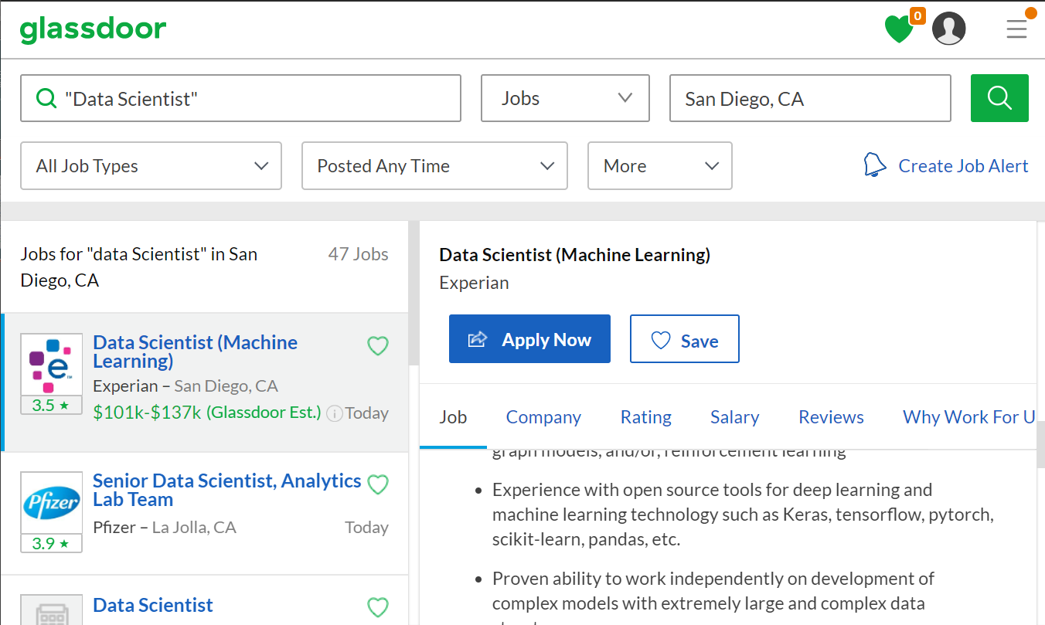
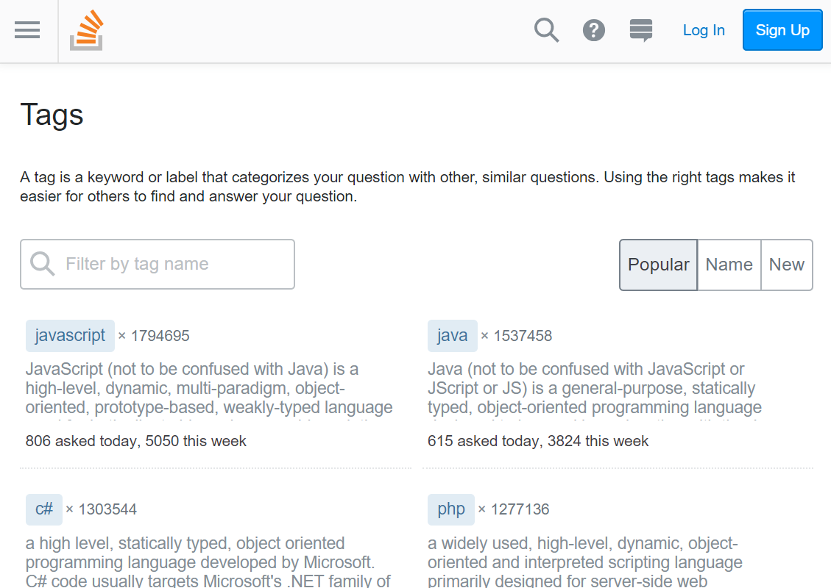

Slide 3
MongoDB representation (.json)
{"_id":"5cb41a93349d6f2e6df9ce44",
"query_title":"Data Scientist",
"query_city":"San Diego, CA",
"job_title":"Data Scientist (Machine Learning)",
"job_employer":"Experian",
"job_employer_city":"San Diego, CA",
"job_salary":"$101k-$137k(Glassdoor Est.)",
"job_description":"Experian DataLabs is a R&D unit at Experian ... open source
tools for deep learning and machine learning technology such
as Keras, tensorflow, pytorch, scikit-learn, pandas, ...
Python, R, Java, C++, ... data analysis ... associated companies...",
"job_skills":["python","java","r","sql","pandas","c","mongodb","tensorflow“,…]
}

Slide 4
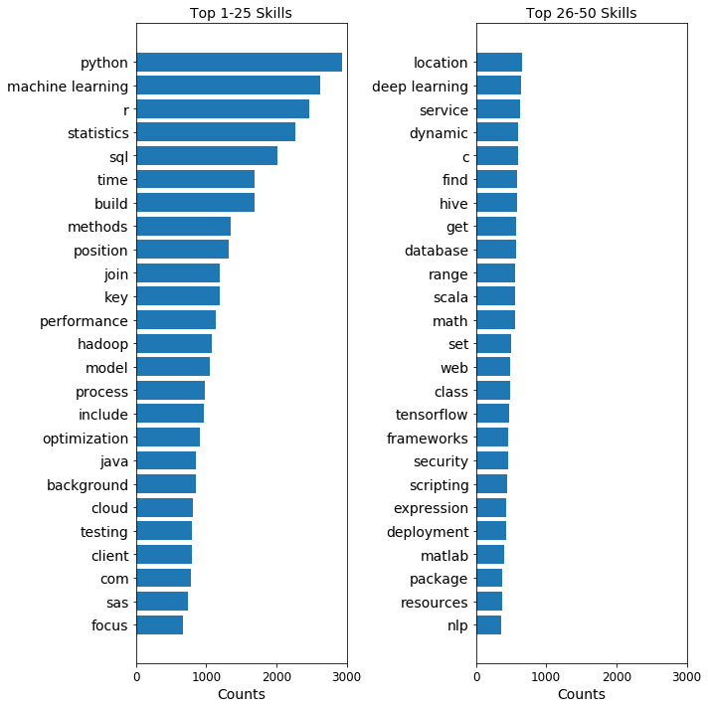
Top “Data Scientist” skills list in Glassdoor

