Slide 1

SPRINT
FOOD FLAG
Android App to mitigate hunger .
Idea Conceived and Developed by : Joby John TKM23MCA-2034
Guided By: Proff. Sheera
08/11/2024

Slide 2
01
Introduction
CONTENTS
02
Components
03
what I solved /How I Achieved it
04
Retrospective

Slide 3
YOUR
LOGO
01
INTRODUCTION
Food Flag :- Food Flag an innovative app dedicated to eliminating hunger and closing the gap between possible donor and accepter of food, It features user login, raising and catching flags, direction using maps. The system includes user registration, restaurant registartion and signIn, a hoist flag menu, Dashboard and a Caught Flag section.

Slide 4
YOUR
LOGO
PROBLEM STATEMENT
Be able to donate food anytime
Be able to get food anywhere.
“Anonymously”

Slide 5
YOUR
LOGO
GAP IDENTIFIED
This is completely a novel idea.
Haven’t found ‘ANY’ platform that offers such a service.
No platform focuses on people around us, instead is either on NGO’s or for other financilaly weak countries.

Slide 6
Working of Food Flag
01
02
Restaurants
Client
Raise a flag
Raise vegetarian Flag.
Raise Non-Vegetarian Flag.
Pay and Raise
Pay restaurant money.
Restaurant raises on users behalf.
Accept a flag
Catch a flag of choice from map.
Redeem it at User’s location or Restaurants location.
Delete Own Flag
Delete the flag the user himself raised.
Create a Flag
Scan and Create Flag of set amount for a User.
Verify and Donate a Flag
Verify if the flag is authentic and provide meal of that sum.

Slide 7
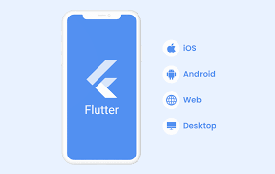


Components
01
Flutter: An open-source UI toolkit by Google for building natively compiled applications for mobile, web, and desktop from a single codebase.
Flutter: An open-source UI toolkit by Google for building natively compiled applications for mobile, web, and desktop from a single codebase.
Firebase: A platform developed by Google that provides various tools and services for building and managing mobile and web applications, including real-time databases, authentication, and cloud functions.
Google Maps API: A set of programming interfaces that allows developers to embed Google Maps into their applications, providing access to mapping, geolocation, and location-based services.
Firebase: A platform developed by Google that provides various tools and services for building and managing mobile and web applications, including real-time databases, authentication, and cloud functions.

Slide 8
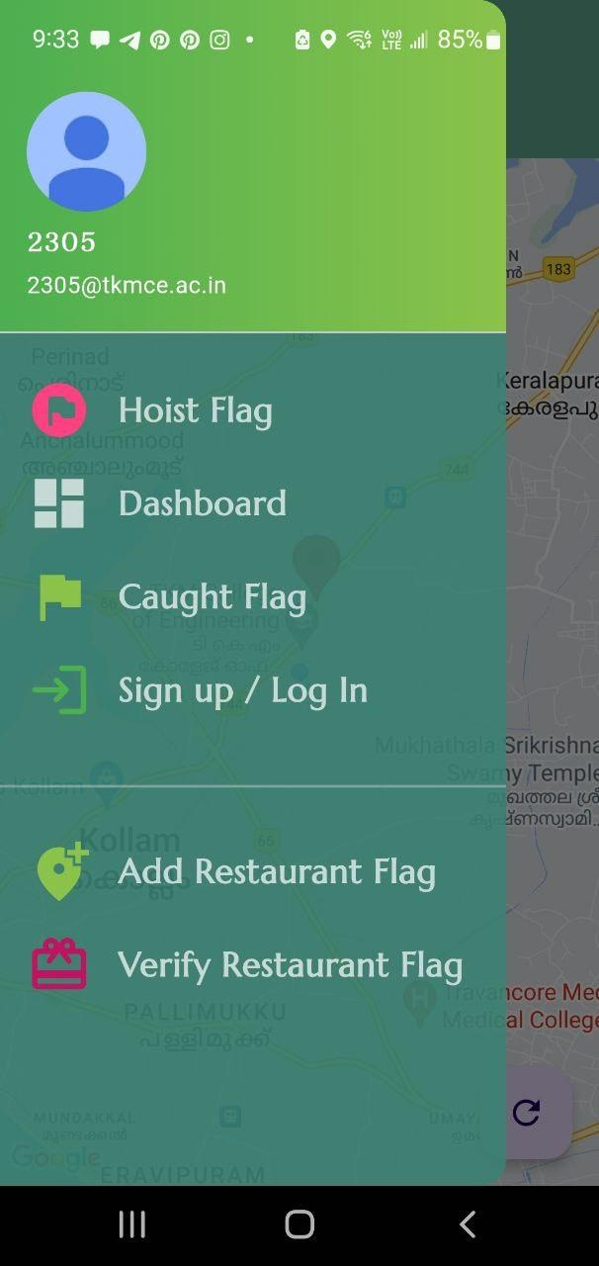
Drawer
03
Dashboard
01
Shpws current user standings
Account info
04
retriev infromation from google accounts and display
Caught Flag
Get status of current caught flag
02
Hoist Flag
05
Sign in/up
Raise flag for logged in users
Sign in using google
07
06
Verify Restaurant Flag
Add Restaurant Flag
Do 4-step verification and grant meal of flag amount
Verify user and raise user’s flag

Slide 9
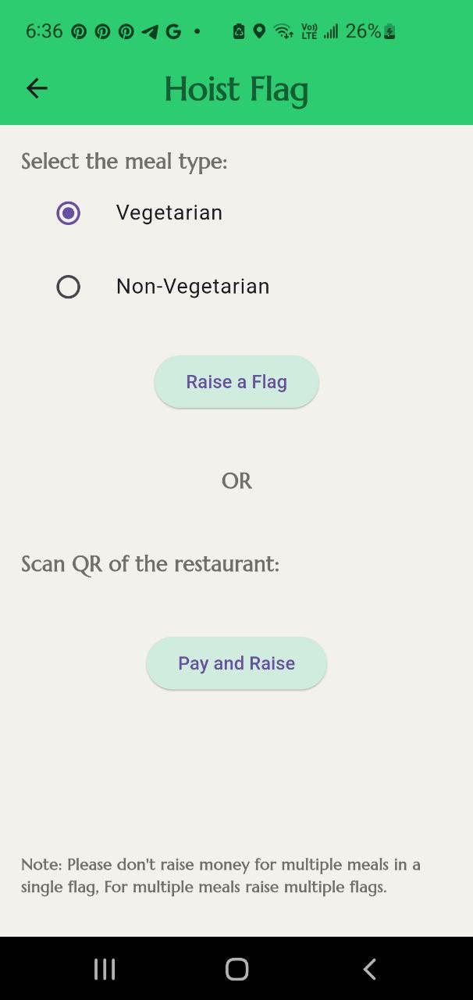
Hoist Flag
01
02
Hoist Page
To raise restaurant flags
Sections to raise different types of flag
Pay and raise
03
Self prepared section
To raise self prepared meal

Slide 10
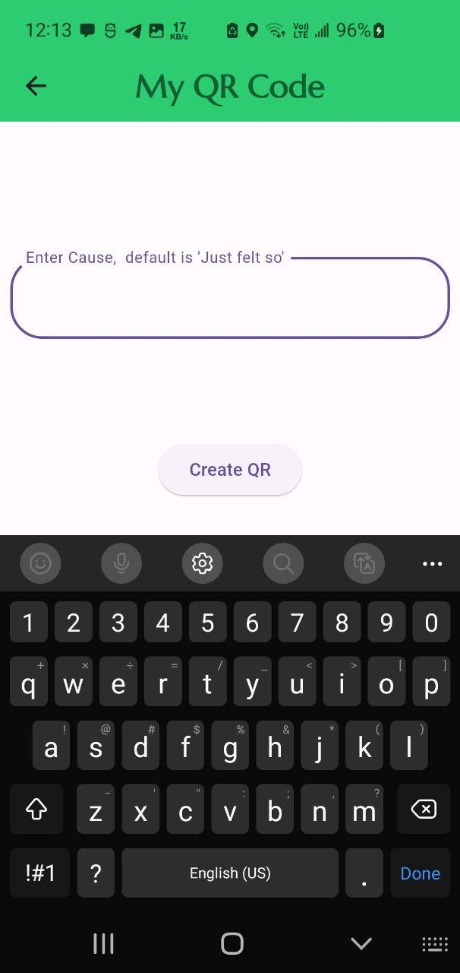
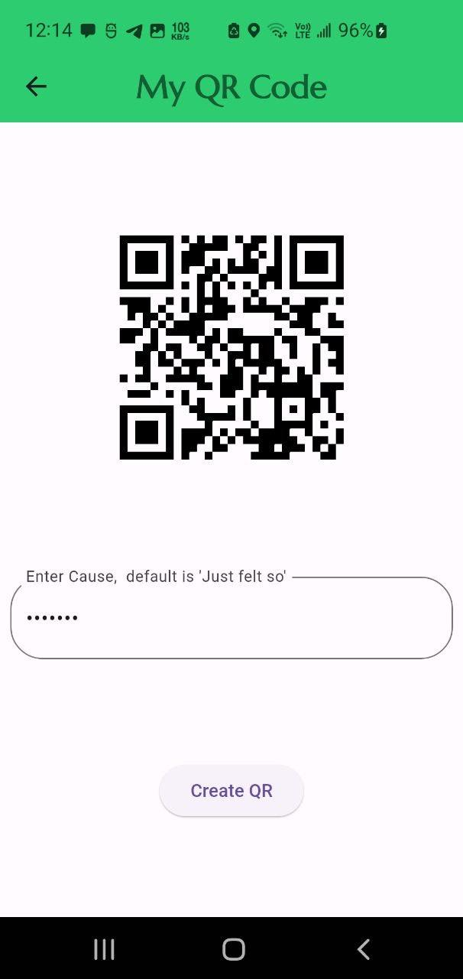
My QR Code
01
02
Cause
Create QR
Enter the reason , the cause of raising this flag , eg. Birthday, Anniversary etc.
Generate a QR code with enough details inorder for user to be verified by Restaurant.

Slide 11
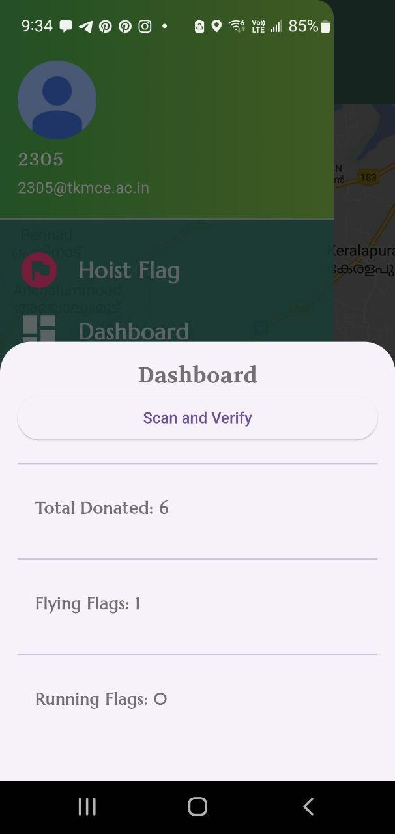
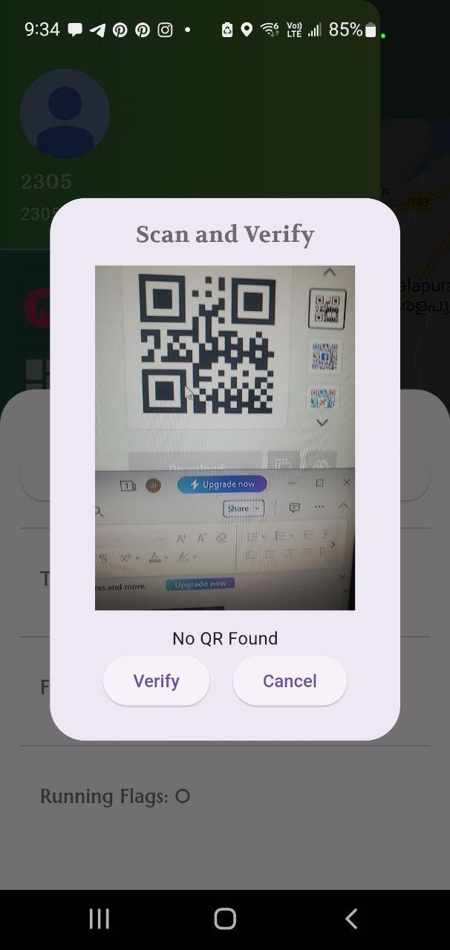
Dashboard
01
02
Scan and Verify
Meals Donated
Verify authenticity of the QR code provided, for self-prepared meals
Keeps track of how many meals have the user donated till the moment.
03
04
Flying Flags
Running Flags
Displays number of flags that are currently present in the map, yet to claim.
Flags that are being claimed and on the way to be redeemed.

Slide 12
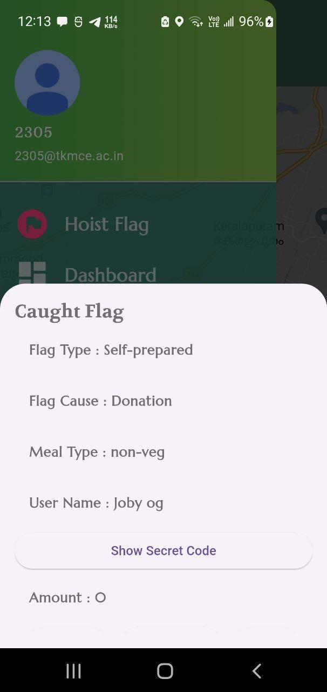
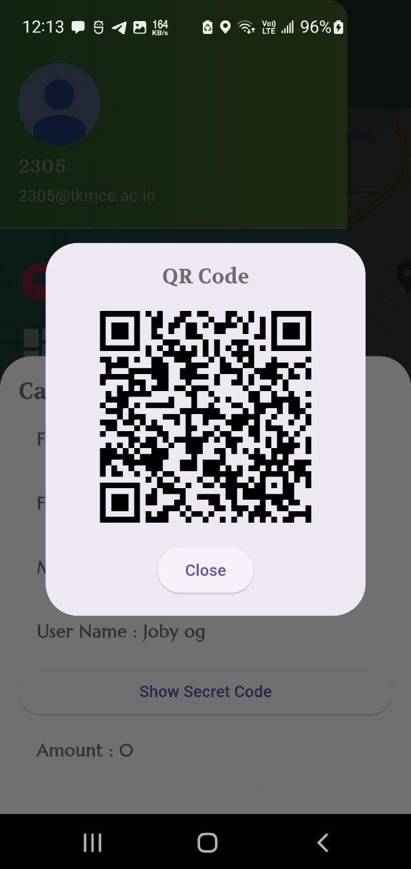
Caught Flag
01
Details about the flag
Sections corresponding to details of the claimed flag
04
Show Sceret code
Shows QR code to the creator to verify and issue meal.

Slide 13
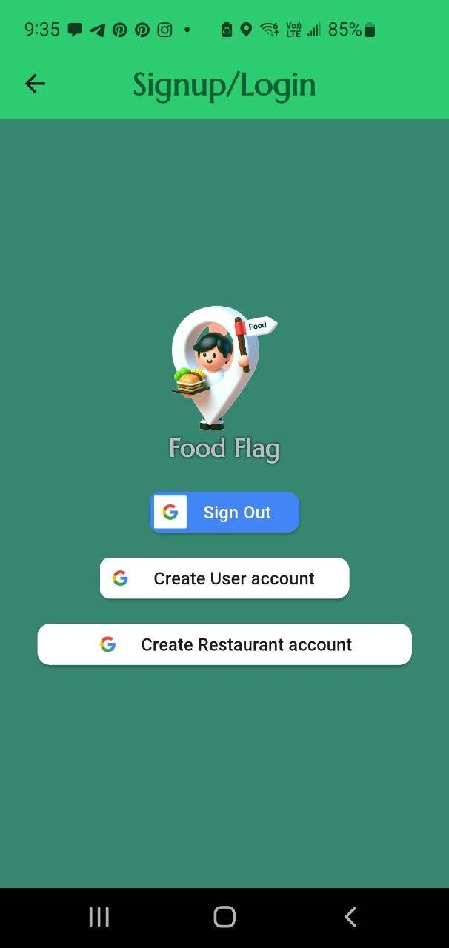
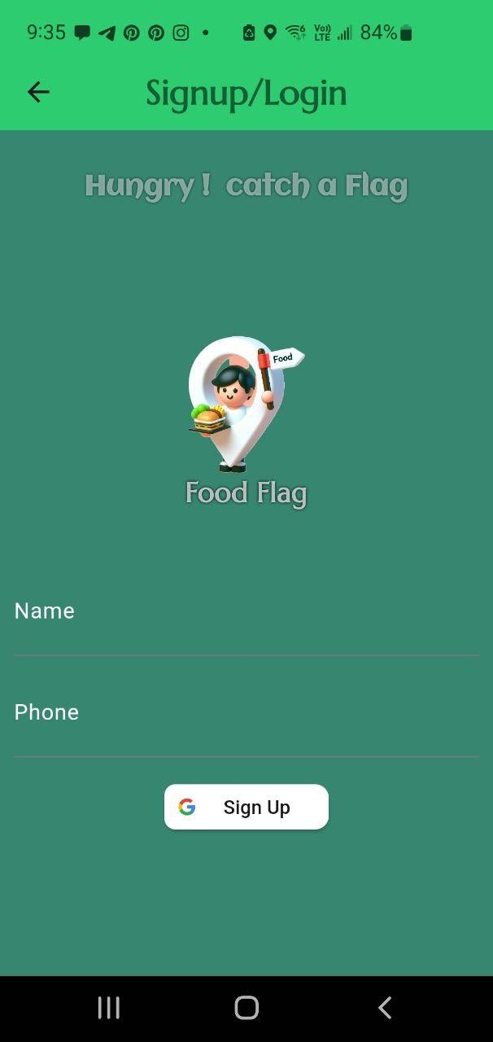
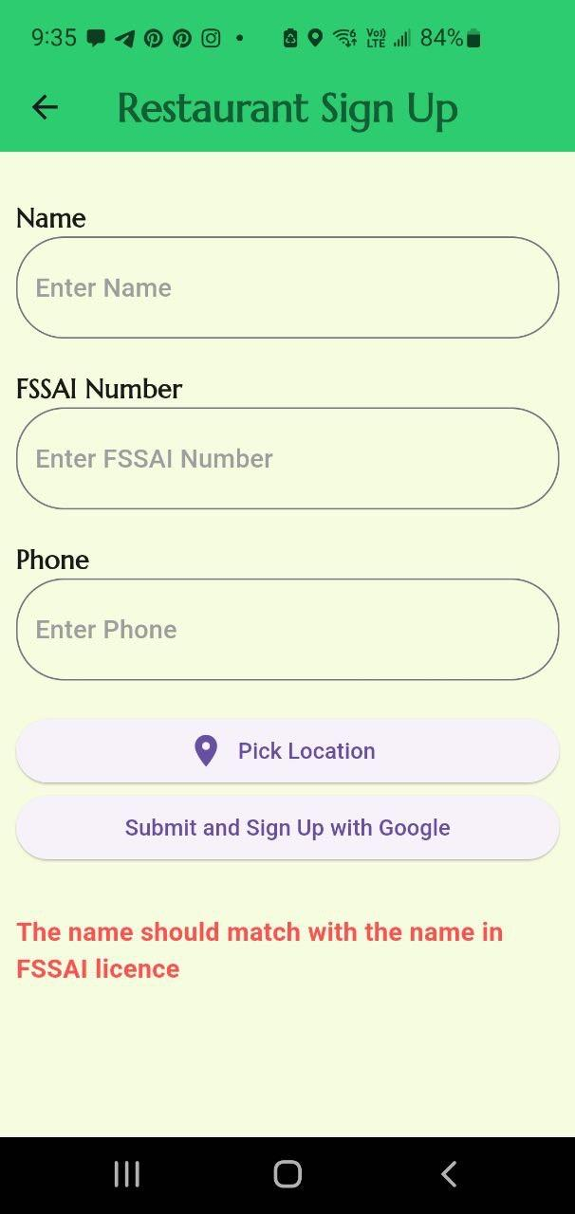
SignUp/Login
02
01
Create User account
SignUp/Login
To create a user account
Sign in using Google auth
03
Restaurant Signup
Creates Restaurant account

Slide 14
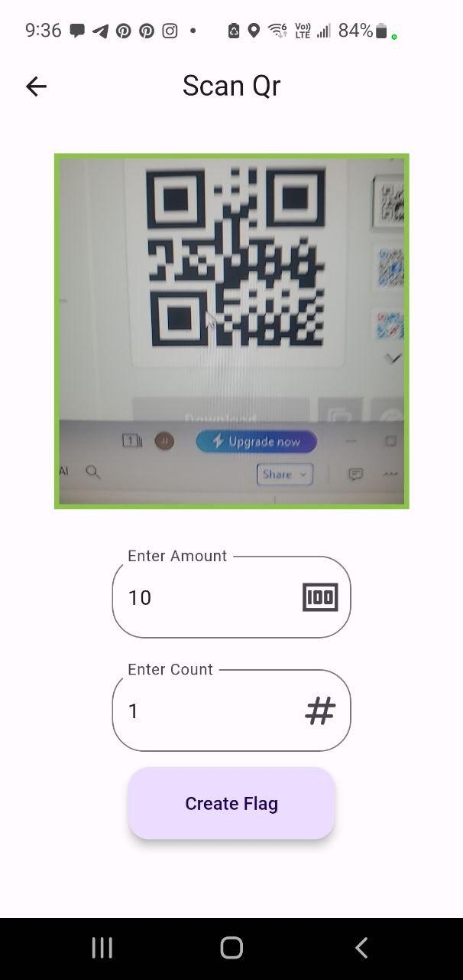
Create Restaurant Flag
01
02
Scan QR
Create Flag
Scans and Verifies users QR code
Cretes set number of flags for set amount.

Slide 15
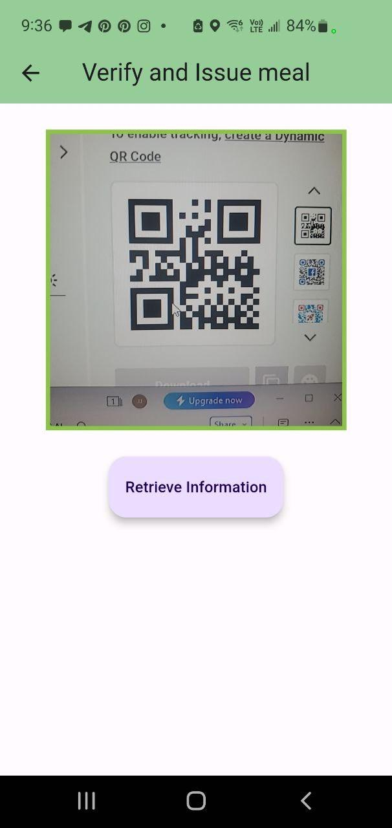
Verify Restaurant Flag
01
02
Scan QR
Retrieve information
Scans and Verifies provided marker code
Verifies if the code is valid based on multiple factors, and provides option to issue meal.

Slide 16
Future Enhancements
02
04
7Km Notifictions
Streaks
Provide notification to users if a flag is raised within 7Km radius of their location
Provide streaks like snapchat to encourage giving back habit, Also to include achievements
01
03
7Km radius
OTP Verification
Optimise fetching flags to reduce cost by fetching only flags within 7km radius.
Provide OTP verification for enhanced authenticity.

Slide 17
THANKS FOR
WATCHING

