Slide 1
Chapter 3: Image Enhancement in the Spatial Domain

Slide 2
Principle Objective of Enhancement
Process an image so that the result will be more suitable than the original image for a specific application.
The suitableness is up to each application.
A method which is quite useful for enhancing an image may not necessarily be the best approach for enhancing another images

Slide 3
2 domains
Spatial Domain : (image plane)
Techniques are based on direct manipulation of pixels in an image
Frequency Domain :
Techniques are based on modifying the Fourier transform of an image
There are some enhancement techniques based on various combinations of methods from these two categories.

Slide 4
Good images
For human visual
The visual evaluation of image quality is a highly subjective process.
It is hard to standardize the definition of a good image.
For machine perception
The evaluation task is easier.
A good image is one which gives the best machine recognition results.
A certain amount of trial and error usually is required before a particular image enhancement approach is selected.

Slide 5
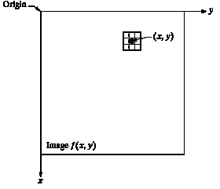
Spatial Domain
Procedures that operate directly on pixels.
g(x,y) = T[f(x,y)]
where
f(x,y) is the input image
g(x,y) is the processed image
T is an operator on f defined over some neighborhood of (x,y)

Slide 6
Mask/Filter
Neighborhood of a point (x,y) can be defined by using a square/rectangular (common used) or circular subimage area centered at (x,y)
The center of the subimage is moved from pixel to pixel starting at the top of the corner
 | •
(x,y)

Slide 7
Point Processing
Neighborhood = 1x1 pixel
g depends on only the value of f at (x,y)
T = gray level (or intensity or mapping) transformation function
s = T(r)
Where
r = gray level of f(x,y)
s = gray level of g(x,y)

Slide 8
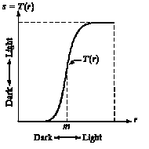
Contrast Stretching
Produce higher contrast than the original by
darkening the levels below m in the original image
Brightening the levels above m in the original image

Slide 9
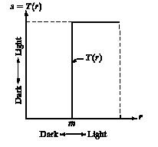
Thresholding
Produce a two-level (binary) image

Slide 10
Mask Processing or Filter
Neighborhood is bigger than 1x1 pixel
Use a function of the values of f in a predefined neighborhood of (x,y) to determine the value of g at (x,y)
The value of the mask coefficients determine the nature of the process
Used in techniques
Image Sharpening
Image Smoothing

Slide 11
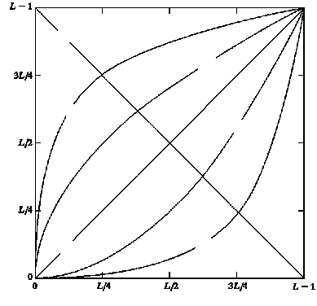
3 basic gray-level transformation functions
Negative
Linear function
Negative and identity transformations
Logarithm function
Log and inverse-log transformation
Power-law function
n^{th} power and n^{th} root transformations
nth root
Log
nth power
Output gray level, s
Identity
Inverse Log
Input gray level, r

Slide 12
Identity function
Output intensities are identical to input intensities.
Is included in the graph only for completeness.
Negative
nth root
Log
nth power
Output gray level, s
Identity
Inverse Log
Input gray level, r

Slide 13
Image Negatives
An image with gray level in the range [0, L-1] where L = 2^{n} ; n = 1, 2…
Negative transformation :
s = L – 1 –r
Reversing the intensity levels of an image.
Suitable for enhancing white or gray detail embedded in dark regions of an image, especially when the black area dominant in size.
Negative
nth root
Log
nth power
Output gray level, s
Identity
Inverse Log
Input gray level, r

Slide 14
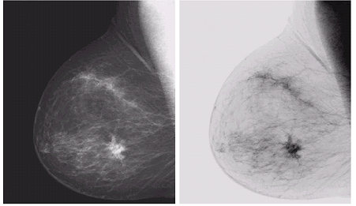
Example of Negative Image
Original mammogram showing a small lesion of a breast
Negative Image : gives a better vision to analyze the image

Slide 15
Code for Negative Image
% Image Negative
fname='Fig0304(a)(breast_digital_Xray).tif';
A=imread(fname);
info=imfinfo(fname);
rows=info.Height;
cols=info.Width;
figure, imshow(A);
title('Original Image');
B=uint8(zeros(size(A)));
for i=1:rows,
for j=1:cols,
B(i,j)=255-double(A(i,j));
end
end
figure, imshow(B);
title('Negative Image');

Slide 16
Log Transformations
s = c log (1+r)
c is a constant and r ≥ 0
Log curve maps a narrow range of low gray-level values in the input image into a wider range of output levels.
Used to expand the values of dark pixels in an image while compressing the higher-level values.
Negative
nth root
Log
Output gray level, s
nth power
Identity
Inverse Log
Input gray level, r

Slide 17
Log Transformations
It compresses the dynamic range of images with large variations in pixel values
Example of image with dynamic range: Fourier spectrum image
It can have intensity range from 0 to 10⁶ or higher.
We can’t see the significant degree of detail as it will be lost in the display.

Slide 18
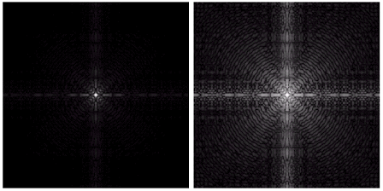
Example of Logarithm Image
Fourier Spectrum with range = 0 to 1.5 x 10⁶
Result after apply the log transformation with c = 1, range = 0 to 6.2

Slide 19
Code for Logarithm Image
% Log Transform
fname=imread('Fig0305(a)(DFT_no_log).tif');
A=imread(fname);
figure, imshow(A);
title('Original Image');
c=1;
B=c*log(1+abs(double(A)));
figure, imshow(B,[]);
title('Log Transform');

Slide 20
Inverse Logarithm Transformations
Do opposite to the Log Transformations
Used to expand the values of high pixels in an image while compressing the darker-level values.

Slide 21
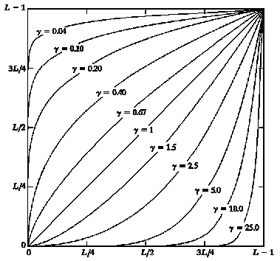
Power-Law Transformations
s = cr^{γ}
c and γ are positive constants
Power-law curves with fractional values of γ map a narrow range of dark input values into a wider range of output values, with the opposite being true for higher values of input levels.
c = γ = 1  Identity function
Output gray level, s
Input gray level, r
Plots of s = cr^{γ} for various values of γ
(c = 1 in all cases)

Slide 22
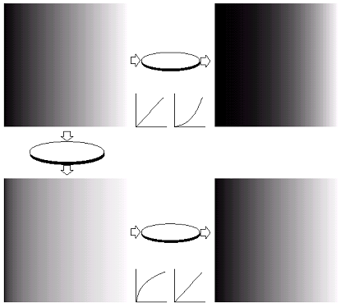
Gamma correction
Cathode ray tube (CRT) devices have an intensity-to-voltage response that is a power function, with γ varying from 1.8 to 2.5
The picture will become darker.
Gamma correction is done by preprocessing the image before inputting it to the monitor with s = cr^{1/γ}
Monitor
Gamma
correction
γ = 2.5
Monitor
γ =1/2.5 = 0.4

Slide 23
Code for Gamma correction
% Power-Law Transformation
fname='f307a.jpg';
A=imread(fname);
figure, imshow(A);
title('Original Image');
c=1;
r=4;
B=c*power((double(A)),r);
figure, imshow(B,[]);
title('Image as viewed on monitor');
c=1;
r=0.25;
C=c*power((double(A)),r);
figure, imshow(C,[]);
title('Gamma Correction');
c=1;
r=4;
D=c*power((double(C)),r);
figure, imshow(D,[]);
title('Image as viewed on monitor');

Slide 24
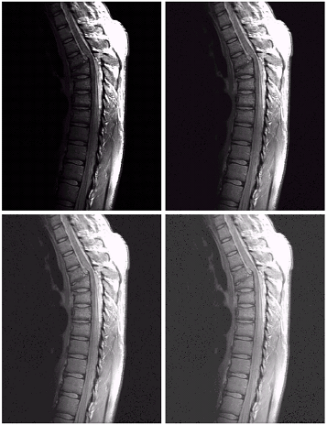
Another example : MRI
a | b
c | d
(a) a magnetic resonance image of an upper thoracic human spine with a fracture dislocation and spinal cord impingement
The picture is predominately dark
An expansion of gray levels are desirable  needs γ < 1
(b) result after power-law
transformation with γ = 0.6, c=1
(c) transformation with γ = 0.4
(best result)
(d) transformation with γ = 0.3
(under acceptable level)

Slide 25
MRI example
% Power-Law Transformation
fname='f308a.jpg';
A=imread(fname);
figure, imshow(A);
title('Original Image');
c=1;
r=0.6;
B=c*power((double(A)),r);
figure, imshow(B,[]);
title('gamma = 0.6');
c=1;
r=0.4;
C=c*power((double(A)),r);
figure, imshow(C,[]);
title('gamma = 0.4');
c=1;
r=0.3;
D=c*power((double(A)),r);
figure, imshow(D,[]);
title('gamma = 0.3');

Slide 26
Effect of decreasing gamma
When the γ is reduced too much, the image begins to reduce contrast to the point where the image started to have very slight “wash-out” look, especially in the background

Slide 27
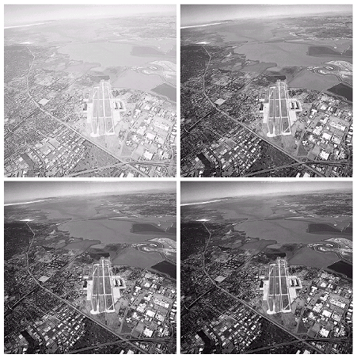
Another example
a | b
c | d
(a) image has a washed-out appearance, it needs a compression of gray levels  needs γ > 1
(b) result after power-law
transformation with γ = 3.0 (suitable)
(c) transformation with γ = 4.0
(suitable)
(d) transformation with γ = 5.0
(high contrast, the image has areas that are too dark, some detail is lost)

Slide 28
% Power-Law Transformation
fname='f309a.jpg';
A=imread(fname);
figure, imshow(A);
title('Original Image');
c=1;
r=3;
B=c*power((double(A)),r);
figure, imshow(B,[]);
title('gamma = 3');
c=1;
r=4;
C=c*power((double(A)),r);
figure, imshow(C,[]);
title('gamma = 4');
c=1;
r=5;
D=c*power((double(A)),r);
figure, imshow(D,[]);
title('gamma = 5');

Slide 29
Piecewise-Linear Transformation Functions
Advantage:
The form of piecewise functions can be arbitrarily complex
Disadvantage:
Their specification requires considerably more user input

Slide 30
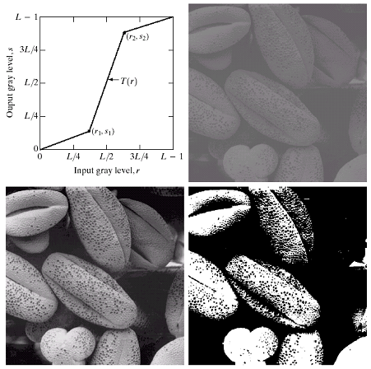
Contrast Stretching
increase the dynamic range of the gray levels in the image
(b) a low-contrast image : result from poor illumination, lack of dynamic range in the imaging sensor, or even wrong setting of a lens aperture of image acquisition
(c) result of contrast stretching: (r₁,s₁) = (r_{min},0) and (r₂,s₂) = (r_{max},L-1)
(d) result of thresholding

Slide 31
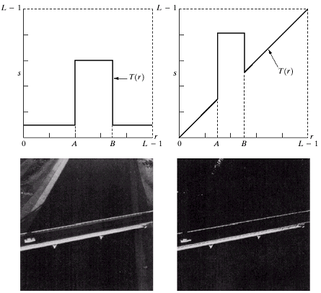
Gray-level slicing
Highlighting a specific range of gray levels in an image
Display a high value of all gray levels in the range of interest and a low value for all other gray levels
(a) transformation highlights range [A,B] of gray level and reduces all others to a constant level
(b) transformation highlights range [A,B] but preserves all other levels

Slide 32
% Constrast stretching
% 1) Read Image
fname = 'f310b.jpg';
A=imread(fname);
info=imfinfo(fname);
rows=info.Height;
cols=info.Width;
figure,imshow(A);
title('Original Image (Image A)');
% 2) Show Histogram
figure,imhist(A);
title('Histogram of A');
% 3) Improve Image using arbitary function
r1=90;
s1=10;
r2=135;
s2=250;
m1=s1/r1;
m2=(s2-s1)/(r2-r1);
m3=(255-s2)/(255-r2);
B=uint8(zeros(size(A)));
for i=1:rows,
for j=1:cols,
temp=double(A(i,j));
if temp < r1,
B(i,j)= m1*temp;
elseif temp < r2,
B(i,j)= m2*(temp-r1)+s1;
else
B(i,j)= m3*(temp-r2)+s2;
end
end
end
figure,imshow(B);
title('Processed Image');

Slide 33
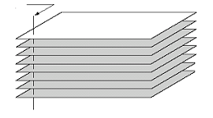
Bit-plane slicing
Highlighting the contribution made to total image appearance by specific bits
Suppose each pixel is represented by 8 bits
Higher-order bits contain the majority of the visually significant data
Useful for analyzing the relative importance played by each bit of the image
One 8-bit byte
Bit-plane 7
(most significant)
Bit-plane 0
(least significant)

Slide 34
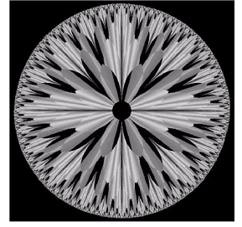
Example
The (binary) image for bit-plane 7 can be obtained by processing the input image with a thresholding gray-level transformation.
Map all levels between 0 and 127 to 0
Map all levels between 129 and 255 to 255
An 8-bit fractal image

Slide 35
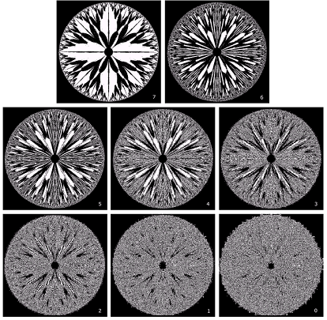
8 bit planes
Bit-plane 7 |  | Bit-plane 6
Bit-plane 5 | Bit-plane 4 |  | Bit-plane 3
Bit-plane 2 | Bit-plane 1 |  | Bit-plane 0

Slide 36
% Bit-Plane Slicing
%%%%%%%%%%%%%%%%%%%%%%%%%%%
% 1) Read Image
%%%%%%%%%%%%%%%%%%%%%%%%%%%
fname = 'Fig3.13.jpg';
A=imread(fname);
info=imfinfo(fname);
rows=info.Height;
cols=info.Width;
figure,imshow(A);
title('Original Image (Image A)');
P7=bitshift(A,-7);
P7=bitand(P7,1);
figure,imshow(P7,[0,1]);
title('Plane 7');
P6=bitand(bitshift(A,-6),1);
figure,imshow(P6,[0,1]);
title('Plane 6');
P5=bitand(bitshift(A,-5),1);
figure,imshow(P5,[0,1]);
title('Plane 5');

