Slide 1


PCA-guided
TTA Findings
Barcelona, Spain. 16/09/2026
Notes:
PCA-guided episodic test-time adaptation results on BabyLand-72 and InfantFace.
[Sources]
- /Users/jocareher/Downloads/tta/weekly_meeting_82.pptx (template and prior BabyLand reporting context)
[/Sources]

Slide 2
Experimental Protocol
Component | Configuration
Source supervision | Synthetic-only training on SynBaby-72
Adapted parameters | External image-normalization network
Frozen parameters | Complete BabyLand-72 landmark detector
TTA signal | PCA shape reconstruction loss only
Adaptation mode | Episodic: normalizer reinitialized for every test image
Learning rate | 1 × 10⁻⁴ and 1 × 10⁻³
TTA updates | BabyLand: 0–1250 at 10⁻⁴; 0–1500 at 10⁻³; InfAnFace: 0 and 1500 at 10⁻³
Evaluation | Predictions on crops are reprojected; ground truth is used only for metrics
All reported natural-image labels remain outside the adaptation loop.
Notes:
The normalizer is the only trainable module at test time. The landmarker and PCA prior remain frozen. The 10⁻⁴ and 10⁻³ sweeps share the same step-0 checkpoint.
[Sources]
- /Users/jocareher/Downloads/tta/resolved_config.json
- /Users/jocareher/Downloads/tta/sweep_orientation_results.csv
- /Users/jocareher/Downloads/tta/sweep_orientation_results_lr-1e-3.csv
- /Users/jocareher/Downloads/tta/infanface_sweep_orientation_results_lr-1e-3.csv
[/Sources]

Slide 3
TTA Restores BabyLand and Improves InfantFace
Dataset | Metric ↓ | Paper baseline | TTA step 0 | TTA 1500 (10⁻³) | Δ vs paper
BabyLand | Mean NME | 10.41% | 12.84% | 10.45% | +0.04 pp
 | Median NME | 6.27% | 6.93% | 5.92% | −0.35 pp
 | Mean HD | 20.43% | 23.07% | 19.87% | −0.56 pp
InfAnFace | Mean NME | 8.56% | 8.61% | 7.95% | −0.61 pp
 | Median NME | 6.79% | 6.75% | 6.41% | −0.38 pp
 | Mean HD | 19.69% | 19.78% | 18.21% | −1.48 pp
At 10⁻³, BabyLand recovers the paper-level mean NME while improving median NME and HD. InfAnFace improves all three aggregate metrics.
Notes:
Paper baseline denotes the previously reported model without TTA. Step 0 denotes the normalizer-based checkpoint before episodic adaptation.
[Sources]
- /Users/jocareher/Downloads/tta/metrics_summary.csv
- /Users/jocareher/Downloads/tta/infanface_metrics_summary.csv
- /Users/jocareher/Downloads/tta/image_summary.csv
- /Users/jocareher/Downloads/tta/infanface_sweep_orientation_results_lr-1e-3.csv
- User-provided paper baseline table in the task context
[/Sources]

Slide 4
A Higher Learning Rate Accelerates BabyLand Adaptation
Mean NME
Mean normalized Hausdorff distance
At 750 updates, lr = 10⁻³ reaches 10.57% NME, already below lr = 10⁻⁴ at 1250 updates (11.04%). The higher rate also lowers HD more quickly.
Notes:
Global values are weighted by the number of samples in each orientation bin. Step 0 is the shared unadapted checkpoint. The 10⁻³ sweep approaches a plateau after 750 updates, whereas 10⁻⁴ remains above it at 1250 updates.
[Sources]
- /Users/jocareher/Downloads/tta/sweep_orientation_results.csv
- /Users/jocareher/Downloads/tta/sweep_orientation_results_lr-1e-3.csv
- /Users/jocareher/Downloads/tta/image_summary.csv
[/Sources]

Slide 5
Central Views Plateau by 750 Steps while Profiles Keep Improving
Profile views
Frontal and three-quarter views
At lr = 10⁻³, 750 steps capture essentially all gains in frontal and three-quarter views. Both profile means continue decreasing through 1500 steps.
Notes:
The central-view curves remain flat or worsen slightly after 750 updates: quarter-left changes from 5.00% to 5.01%, frontal stays at 4.61% at reported precision, and quarter-right changes from 5.19% to 5.20%. Left and right profiles continue improving to 15.03% and 14.77% at 1500 updates. This supports a pose-dependent descriptive interpretation, not an implemented stopping policy.
[Sources]
- /Users/jocareher/Downloads/tta/sweep_orientation_results_lr-1e-3.csv
- /Users/jocareher/Downloads/tta/orientation_tta_summary.csv
[/Sources]

Slide 6
InFanFace: TTA Improves Every Orientation Group
The largest absolute reductions occur in the profile bins, but those estimates have the smallest sample sizes; the three larger central bins also improve consistently.
Notes:
Step-1500 mean NME is below both step 0 and the paper baseline for every orientation group. Profile groups should be interpreted with n=7 and n=13.
[Sources]
- /Users/jocareher/Downloads/tta/infanface_sweep_orientation_results_lr-1e-3.csv
- /Users/jocareher/Downloads/tta/infanface_image_summary.csv
- User-provided InfantFace paper baseline table in the task context
[/Sources]

Slide 7
Aggregate PCA Convergence and Landmark Drift
Median PCA-loss reduction
Mean landmark drift from step 0
By 750 steps, the median PCA loss falls 84.1% and median drift reaches 4.65 px. From 750 to 1500, loss reduction gains only 4.7 pp while drift rises to 4.90 px.
Notes:
aggregate_curves.csv describes the optimization objective and prediction movement across all 622 BabyLand images. It does not contain NME at every step. Therefore these curves show convergence and drift, not localization accuracy. P25 and P75 indicate the wide heterogeneity across images.
[Sources]
- /Users/jocareher/Downloads/tta/aggregate_curves.csv
[/Sources]

Slide 8
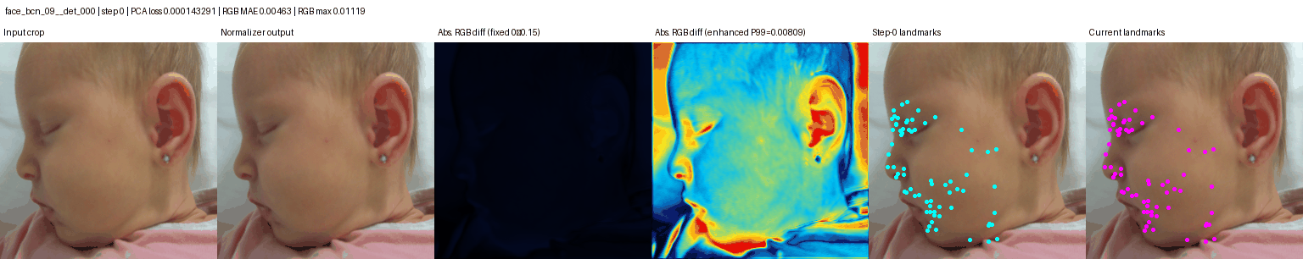
Qualitative Adaptation in a Successful Left-Profile Case
Observed change
Step 0 → step 1500
The magenta landmarks move from a scattered profile prediction toward a coherent eye, nose, mouth, and jaw configuration. The input and normalized image remain visually similar, while the enhanced difference map reveals where the normalizer changes image evidence.
PCA loss: 1.43e-4 → 6.02e-6
NME: 12.31% → 4.75%
Hausdorff: 30.14% → 19.63%
Mean landmark drift: 15.58 px
The GIF plays in slideshow mode. It is a selected successful example, not a representative estimate. Enhanced-difference colors are rescaled per frame and should not be compared as absolute magnitudes.
Notes:
The six panels show input crop, normalizer output, fixed-scale absolute RGB difference, enhanced P99-scaled difference, step-0 landmarks, and current landmarks. The enhanced map makes subtle changes visible but rescales each frame independently. This probe was selected because it clearly illustrates the mechanism and its metrics improve; it should be presented as an illustrative success case. Ground truth is used only for the post-hoc NME and Hausdorff values.
[Sources]
- /Users/jocareher/Downloads/tta/probes/face_bcn_09__det_000/adaptation.gif
- /Users/jocareher/Downloads/tta/image_summary.csv
- /Users/jocareher/Downloads/tta/trajectories.csv
[/Sources]

Slide 9
Notes:
The BabyLand mapping and proposed first test are methodological inferences, not experiments reported in the paper. Two manuscript inconsistencies require verification: the sign of Eq. 8 relative to its prose, and the mixed-shift comparison in Table 3.
[Sources]
- Shamsi et al., Multi-Hypothesis Test-Time Adaptation to Mitigate Underspecification, 2026 manuscript, pp. 9-13.
- /workspace/scratch/5a51b64b8959/upload/multi_hypothesis_tta.pdf
[/Sources]

Slide 10
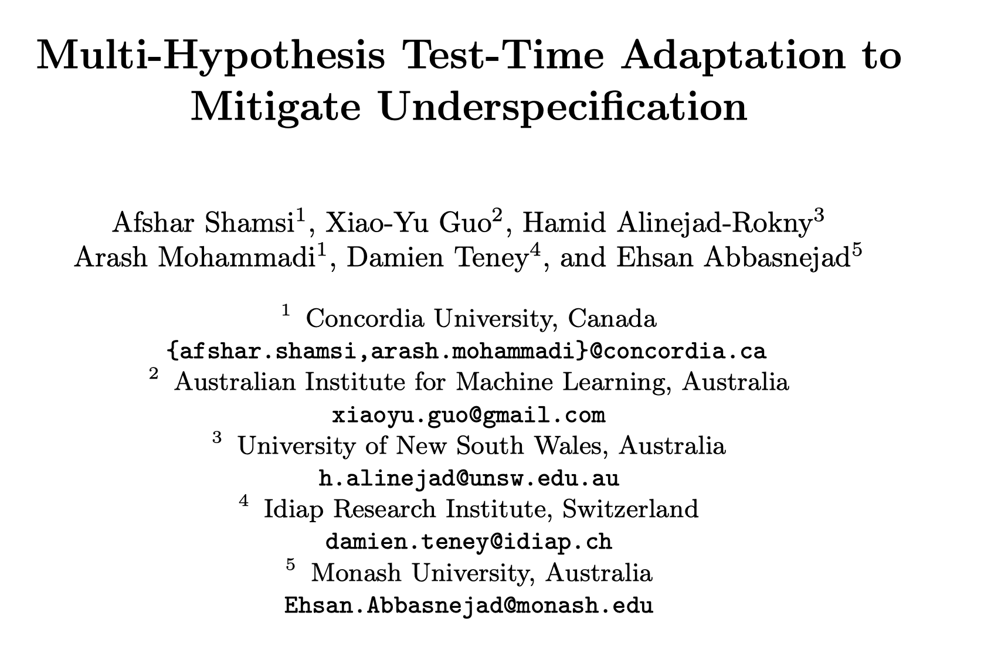
Notes:
The BabyLand mapping and proposed first test are methodological inferences, not experiments reported in the paper. Two manuscript inconsistencies require verification: the sign of Eq. 8 relative to its prose, and the mixed-shift comparison in Table 3.
[Sources]
- Shamsi et al., Multi-Hypothesis Test-Time Adaptation to Mitigate Underspecification, 2026 manuscript, pp. 9-13.
- /workspace/scratch/5a51b64b8959/upload/multi_hypothesis_tta.pdf
[/Sources]

Slide 11
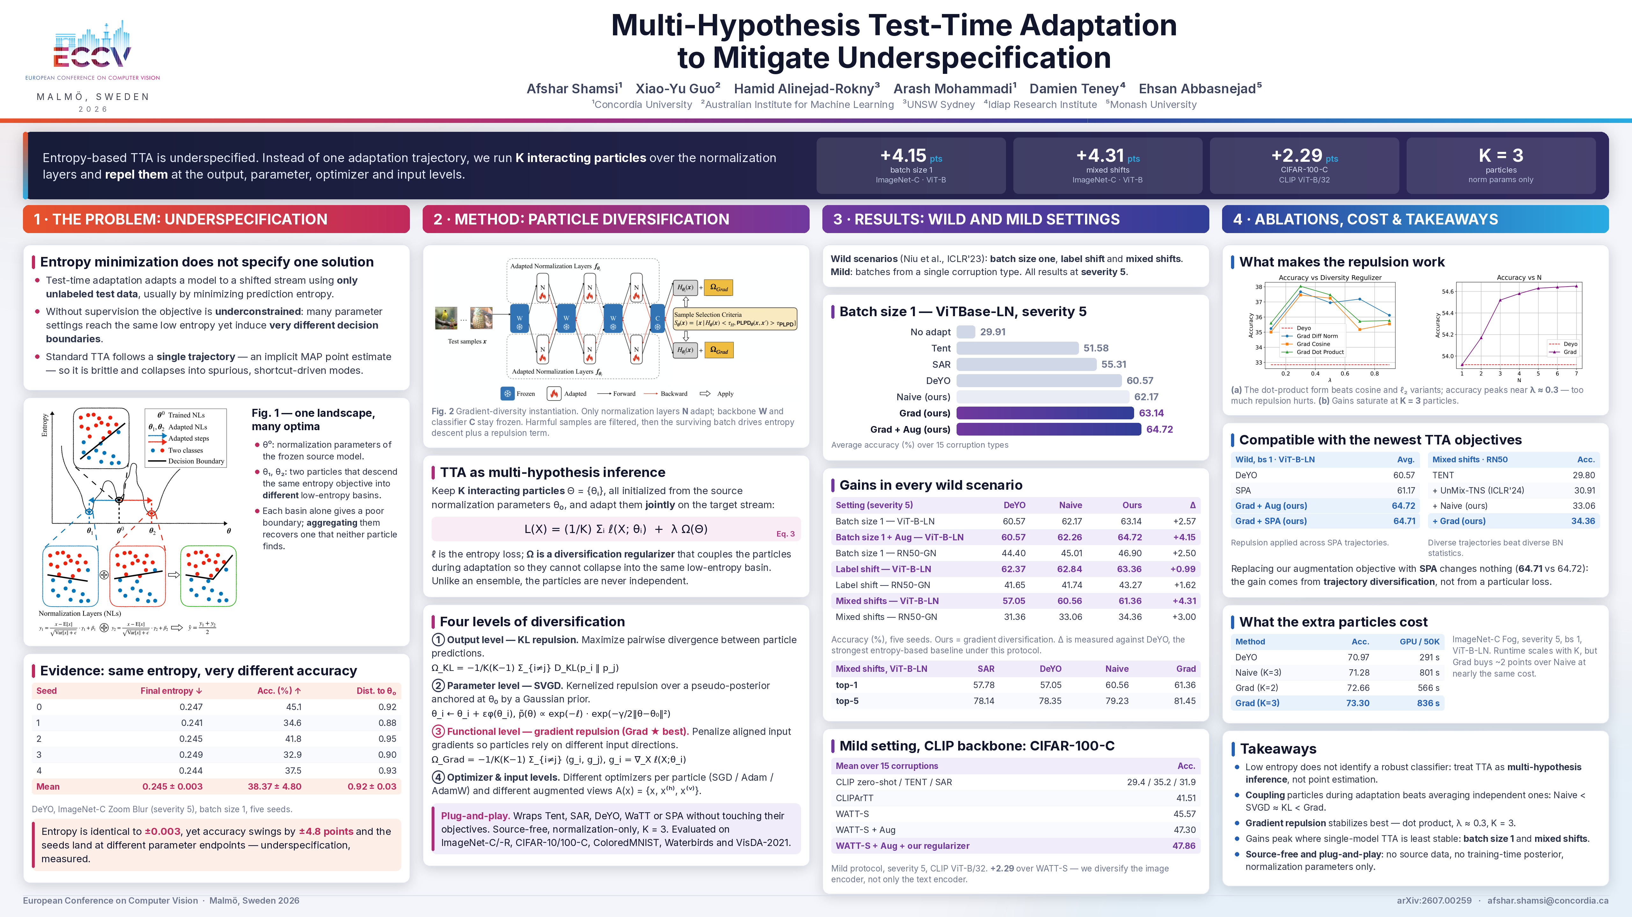
Notes:
The BabyLand mapping and proposed first test are methodological inferences, not experiments reported in the paper. Two manuscript inconsistencies require verification: the sign of Eq. 8 relative to its prose, and the mixed-shift comparison in Table 3.
[Sources]
- Shamsi et al., Multi-Hypothesis Test-Time Adaptation to Mitigate Underspecification, 2026 manuscript, pp. 9-13.
- /workspace/scratch/5a51b64b8959/upload/multi_hypothesis_tta.pdf
[/Sources]

Slide 12
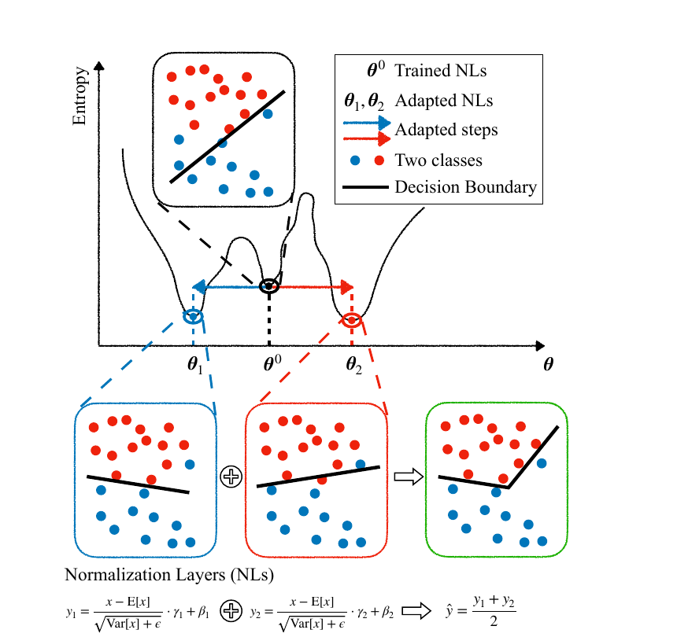
Multi-Hypothesis TTA: Motivation and Core Idea
Problem
Entropy minimization is underconstrained. Several low-entropy solutions can produce different decision boundaries and test performance.
Standard TTA
A single adapted parameter set follows one trajectory and can converge to a spurious solution.
Proposed framework
Maintain K adaptation particles, encourage them to explore different solutions, and average their predictions.
A particle is one copy of the trainable normalization parameters, not a separately trained backbone.
Notes:
The figure is reproduced from the attached manuscript. The summary distinguishes the paper's stated motivation from its empirical evidence.
[Sources]
- Shamsi et al., Multi-Hypothesis Test-Time Adaptation to Mitigate Underspecification, 2026 manuscript, pp. 2-4.
- /workspace/scratch/5a51b64b8959/upload/multi_hypothesis_tta.pdf
[/Sources]

Slide 13
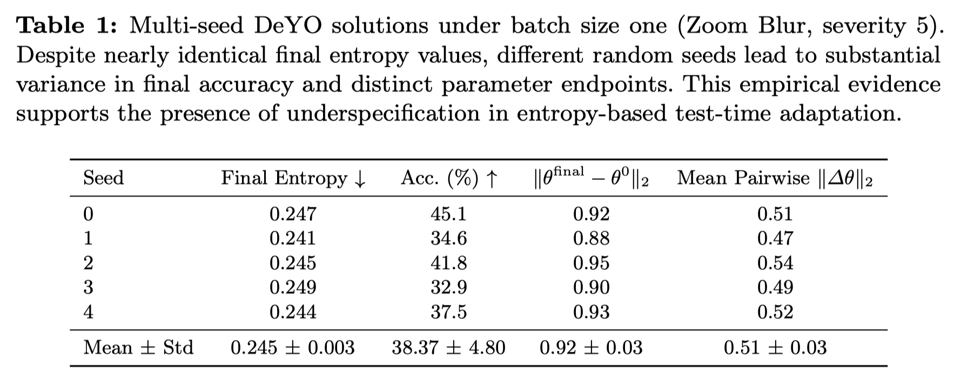
Notes:
The figure is reproduced from the attached manuscript. The summary distinguishes the paper's stated motivation from its empirical evidence.
[Sources]
- Shamsi et al., Multi-Hypothesis Test-Time Adaptation to Mitigate Underspecification, 2026 manuscript, pp. 2-4.
- /workspace/scratch/5a51b64b8959/upload/multi_hypothesis_tta.pdf
[/Sources]

Slide 14
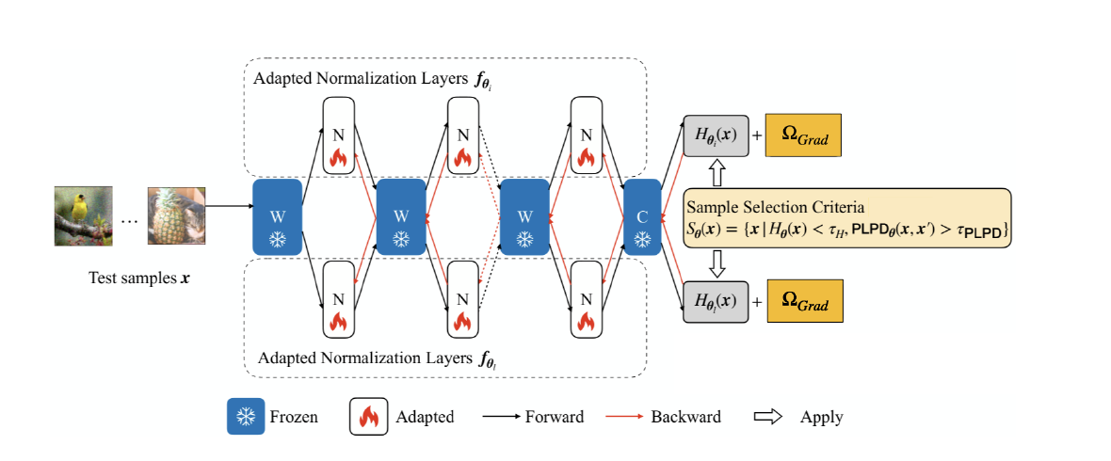
Three Particles Adapt Concurrently
Initialization: θ₁⁽⁰⁾ = θ₂⁽⁰⁾ = θ₃⁽⁰⁾ = θ⁰
L(X) = ⅓ Σᵢ ℓ(X; θᵢ) + λ Ω(Θ)
Only normalization parameters are copied and updated. The remaining layers stay frozen and shared.
Stage | What happens within one TTA run
Target batch | The same batch is evaluated by all three particles.
Joint adaptation | The diversity term compares or couples the particles during the update.
Prediction | The method aggregates the three predictive distributions.
They coexist in one run. Computation may be sequential on the GPU, but all particles persist over the same target stream.
Notes:
The paper uses K = 3 in its experiments. 'Concurrent' describes the algorithmic state, not necessarily hardware-level parallel execution.
[Sources]
- Shamsi et al., Multi-Hypothesis Test-Time Adaptation to Mitigate Underspecification, 2026 manuscript, pp. 3-4, 7, 13.
- /workspace/scratch/5a51b64b8959/upload/multi_hypothesis_tta.pdf
[/Sources]

Slide 15
Diversification Variants Are Separate Experiments
Configuration | Mechanism within a K = 3 run | How to interpret it
Naive | Three particles without explicit repulsion | Ensemble baseline
KL | Encourages disagreement between predictions | Separate run
SVGD | Combines low-entropy attraction with particle repulsion | Separate run
Grad | Uses input-gradient alignment as the diversity signal | Separate run
Optimizer / Aug | Different optimizers or transformed input views | Can be combined with KL, SVGD, or Grad
KL, SVGD, and Grad are not assigned to particles 1, 2, and 3. Each row is a separate run containing three particles.
Notes:
The manuscript evaluates diversification mechanisms as separate configurations. It also reports combinations with optimizer diversity or input augmentation.
[Sources]
- Shamsi et al., Multi-Hypothesis Test-Time Adaptation to Mitigate Underspecification, 2026 manuscript, pp. 8-12.
- /workspace/scratch/5a51b64b8959/upload/multi_hypothesis_tta.pdf
[/Sources]

Slide 16
Evaluation Settings Represent Different Target Streams
Setting | Target stream | What it tests
Mild | One corruption type per batch; shuffled labels | Controlled adaptation under a stable shift
Batch size 1 | One test image per update | Stability without reliable batch statistics
Label distribution shift | Class proportions change and may become highly imbalanced | Collapse toward dominant classes
Mixed corruptions | Several corruption types appear in the same stream | Adaptation under changing and compound shifts
These scenarios are evaluated separately. They are not sequential stages of the method.
The paper reports K = 3 and an inference cost that scales approximately linearly with K, giving roughly 3× overhead.
Notes:
The scenario definitions follow the manuscript. The overhead statement is the authors' approximation and does not replace hardware-specific profiling.
[Sources]
- Shamsi et al., Multi-Hypothesis Test-Time Adaptation to Mitigate Underspecification, 2026 manuscript, pp. 6, 9-13.
- /workspace/scratch/5a51b64b8959/upload/multi_hypothesis_tta.pdf
[/Sources]

