Slide 1

Jocelyn Li
August 2017

Slide 2
Agenda
Pandora Business Metrics
01
02
Performance Metrics
Financial Metrics
Active Listeners
Listener Hours
Paid Subscribers
Penetration Rate
Churn Rate
Revenue
Cost
ROI
LTV
AVPU
Total LPM

Slide 3
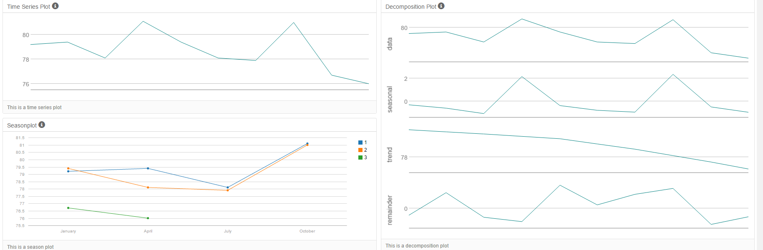
Agenda
Total Active Users
Decomposite the total active users into: trend, seasonality, cyclical and randomness.
Seasonality: higher active users during the fourth quarter of each calendar year, lower active users in the first quarter of each calendar year
Trend: decreasing trend for total active users.

Slide 4
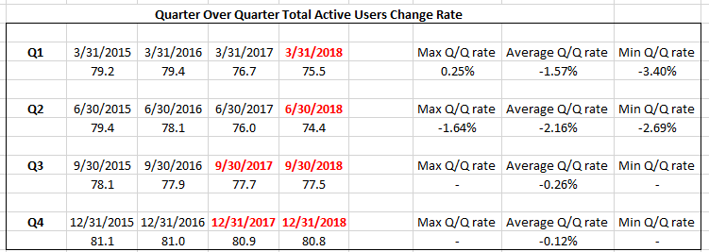
Agenda
Total Active Users Forecasting
Assumptions:
Assume we have three different scenarios by using the best, worst and average Q/Q rate
Forecast the quarterly active users by using the average Q/Q rate and annually trend

Slide 5
Agenda
Factors Affecting Paid Subscribers Forecasting
Past Paid Subscribers Number
Seasonal Fluctuations
Changing User Behavior
Product Innovation
Marketing Efforts
Current Industry Conditions / Competitors
Rate of Inflation

Slide 6
Agenda
Assumptions for Paid Subscribers Forecasting
Assumptions:
We will use the total active user numbers to forecast the number of paid subscribers
Over the past few quarters, the penetration rate increased from 5.15% to 6.39%, we will assume penetration rate increased 0.3% Q/Q.
By the end of 2017Q2, we have 4.47M Pandora Plus subscribers and 0.39M Pandora Premium subscribers
Pandora Plus subscriber takes ~91% of the overall paid subscribers, Pandora Premium subscriber takes ~9% of the overall paid subscribers.
We will assume Pandora premium subscribers rate will increase ~1.5% Q/Q.

Slide 7
Agenda
Forecasting Model
Exponential Smoothing
Moving Average: ARIMA models
Winters smoothing, additive and multiplicative
Trend Projection

Slide 8
Agenda
Total Paid Subscribers

Slide 9
Agenda
Data Pipeline Model
Fleet Management Process
Car Prep Cycle
Vehicle Tracking
KPIs
Dashboard
Dataset Analysis

Slide 10

Thanks!
Jocelyn Li
May 5, 2017

