Slide 1
Proportions of Bacterial Genera in 72 Stool Samples
Jocelyn Sietsma Penington
Bioinformatics Division
Notes:
1. Smile, breath, Good morning
The event invitation said this would be an occasion to go away inspired to move beyond bar charts and box plots.
I'm afraid I am going to give you bar charts and box plots, but with a twist

Slide 2
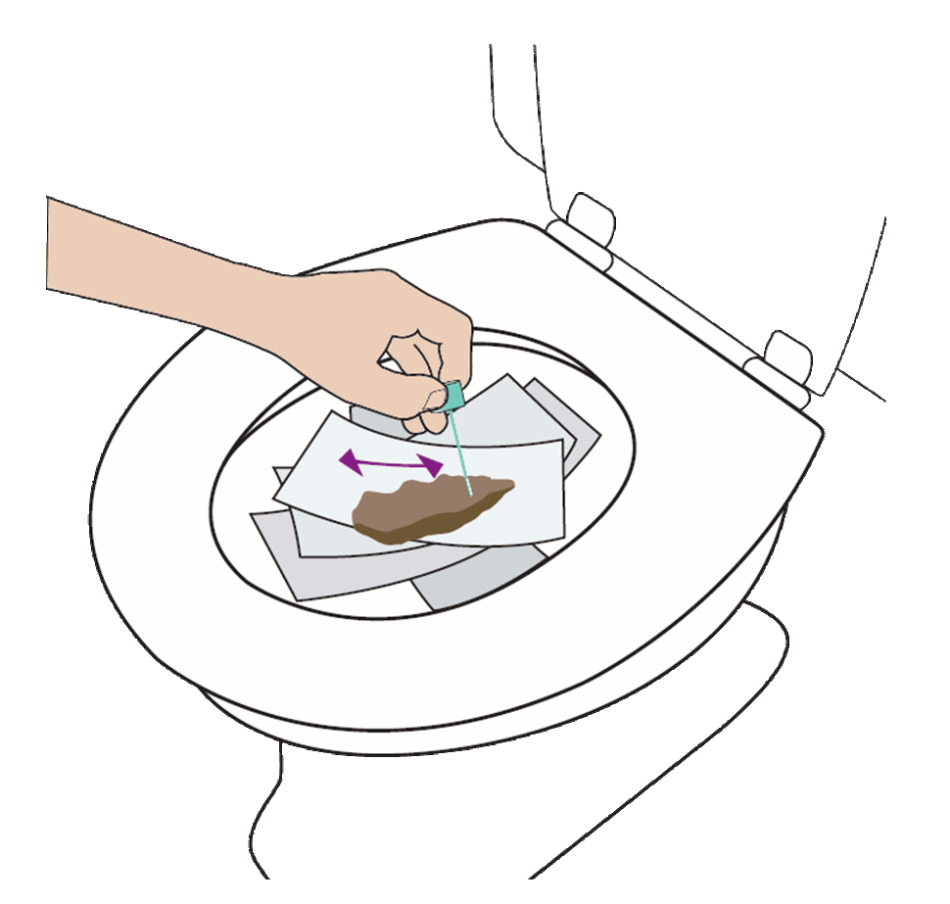
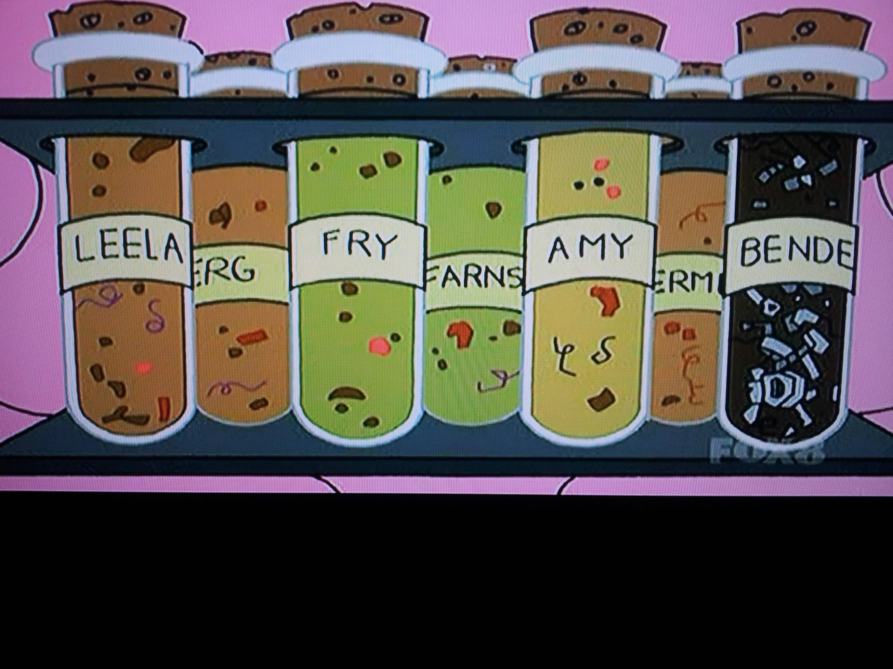


A microbiome study -
Short sequences are compared to a database of bacterial gene sequences.
Data is counts of each unique sequence, tagged with best match taxonomy.
Goal is relative abundance of different microbes in sample.
Human colon estimated to contain 500 - 3000 bacterial species
Notes:
stool sample teeming with microbes, (10^12 per g dry weight) each with their own genome. From each genome a small fragment of a gene not found in humans. Data is a count of how many of each sequence in those small scoops of faeces, and the taxonomy of the bacteria they represent, analysed as proportions of each sample
Estimates of # of species disagree, usually dominated by a few, variation important?

Slide 3
Classification of Living Organisms
Kingdom / Domain
Phylum
Class
Order
Family
Genus
Species
?
Bacteria
Archaea Eucarya
Bacteroidetes
Firmicutes
Proteobacteria Actinobacteria …
Bacilli
Clostridia
Erysipelotrichi
Clostridiales
Clostridiaceae
Lachnospiraceae
Ruminococcaceae …
Domain: Eukaryota
Kingdom: Animalia
Phylum: Chordata
Class: Mammalia
Order: Primates
Family: Hominidae
Genus: Homo
Species: H. sapiens
Blautia
Lachnospira Roseburia …
Notes:
Taxonomy! (More dynamic than you might think)
detected members of approximately 10 phyla, 20 classes, 30 orders, 40 families, or 70 genera
Order is lowest at which almost all are known

Slide 4
Default outputs
Notes:
QIIME
no current standard way to visualise taxonomy in microbiome studies.
These produced for ranks phylum - genus; this is Order
x-axis = 72 samples; y-axis = proportion
Highlight c__Clostridia; Other (animated)
Repeated colours - palette has 29, 31 in key

Slide 5
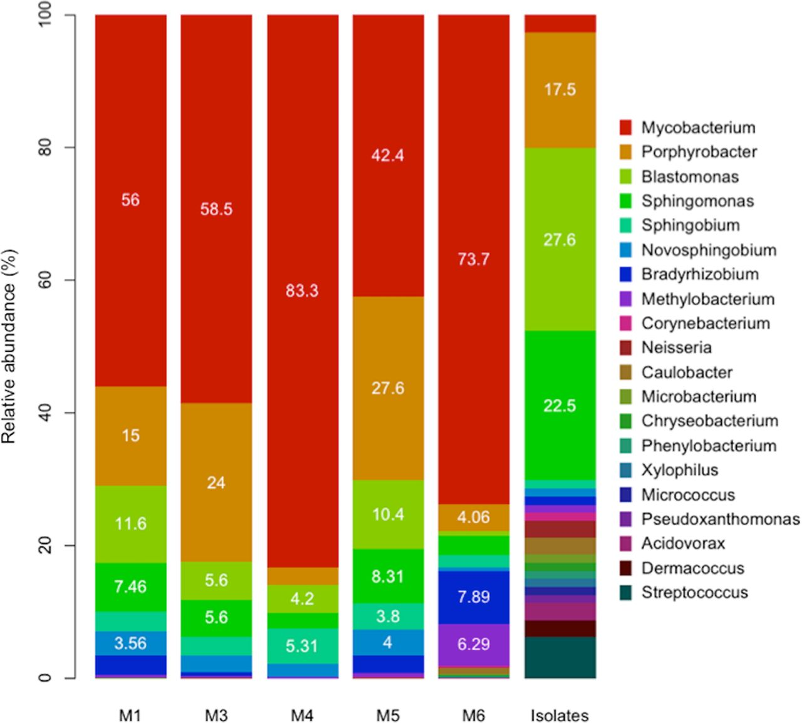
Taxonomic composition of the shower hose biofilms based on 16S rRNA gene fragments recovered from the metagenomes and isolates.
Maria J. Soto-Giron et al. Appl. Environ. Microbiol. 2016;82:2872-2883
Notes:
Recent journal paper
When a visual summary is given, it is common to give a bar or pie chart at a single rank, and to omit incompletely-assigned bacteria
20% of sequences are unknown family; invisible colours; paper discusses Phyla and Orders.
Assigned genera - all bars reach 100% - 20% of sequences are unknown family; invisible colours; paper discusses Phyla and Orders.
Taxonomic composition of the shower hose biofilms based on 16S rRNA gene fragments recovered from the metagenomes and isolates. The relative abundances (y axis) of the 16S rRNA gene-containing reads recovered from the metagenomes (normalized by the total number of classified 16S rRNA gene-containing reads in each metagenome) and the cultured fraction (normalized by the number of isolates; last column) for the major genera present in each sample (x axis) are shown.

Slide 6

Our microbiome study -
6 volunteers collect samples of their stool on each of 3 days.
Each sample is stored using one of 4 methods
- 72 samples, in triplicate, to 2 laboratories
Aims: - characterize the bacteria in each sample: taxonomy, abundance
- determine whether storage methods changed the samples
~100,000 gene sequences per sample, from 500 - 3000 bacterial species
Notes:
Our study
Interested in what bacteria, in what proportion. Counts + taxonomies
Individual characteristics, daily variability, effect of Method

Slide 7
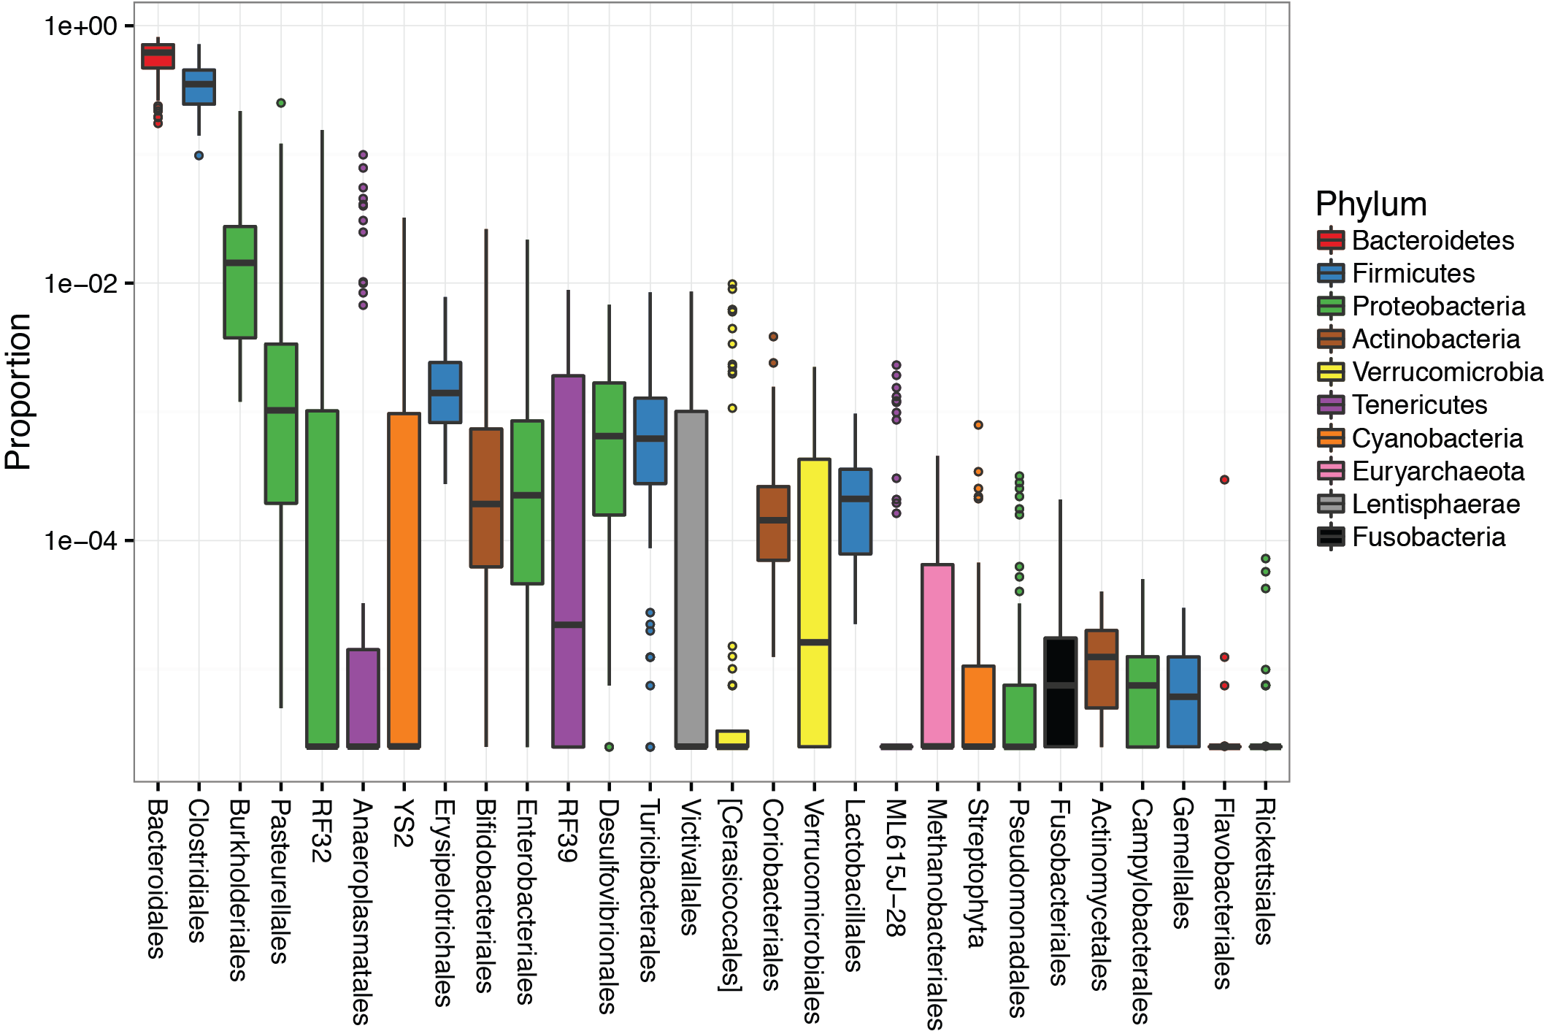
Proportion of bacterial orders
100%
10%
1%
0.1%
0.01%
0.001%
Notes:
Orders A
Summary of all 72 samples, 28 orders. x-axis is name of order, y-axis is log-base-10 of relative abundance, fill-colour is phylum
Log scale allows seeing small divisions
Dominated by 1st 2, Bacteroidales from 25% to 80%
Firmicutes more diverse: 5 orders, dominated by Clostridiales
Diversity of tail. Another 4 orders have outliers up to 10%

Slide 8
Design goals
Aim: communicate a snapshot of each sample at the genus level
not expecting the viewer to remember the taxonomy of each genus
not only showing proportions of known genera
not using 120 genus-categories
not having bars that are 25% ‘other’
AND
visible to colour-deficient colleagues
Notes:
Design goals
As well as common problem of having small categories; i.e. genera present in small proportions; in microbiome analysis many data points are incompletely labelled.
117 genus-level labels, of which 66 define the genus and 51 don’t
five of top 10 L6 have genus un-assigned

Slide 9
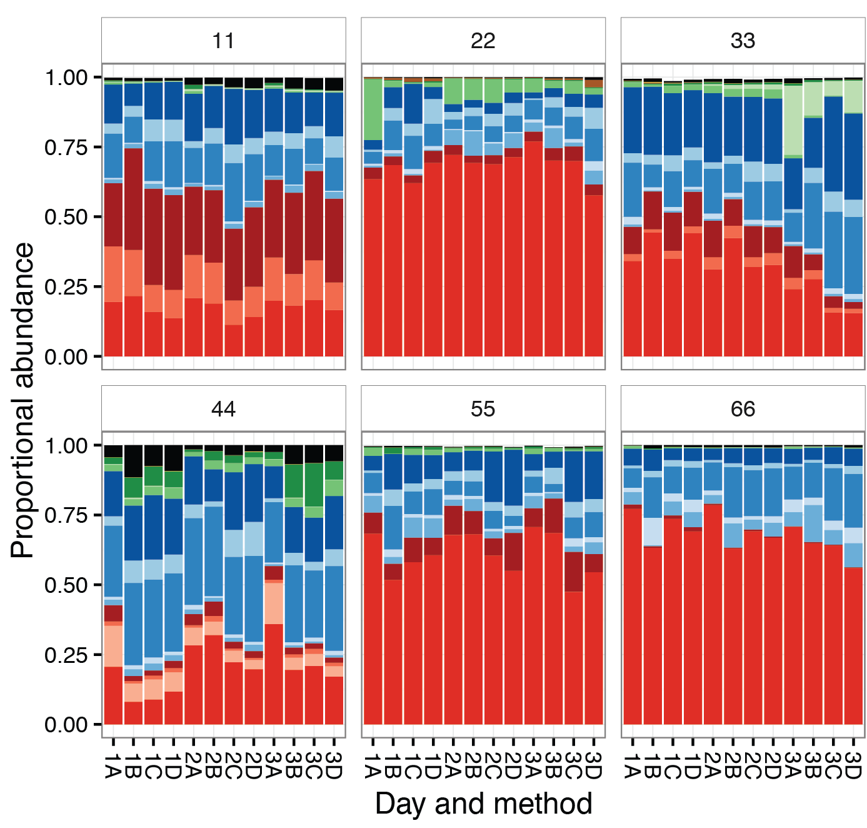
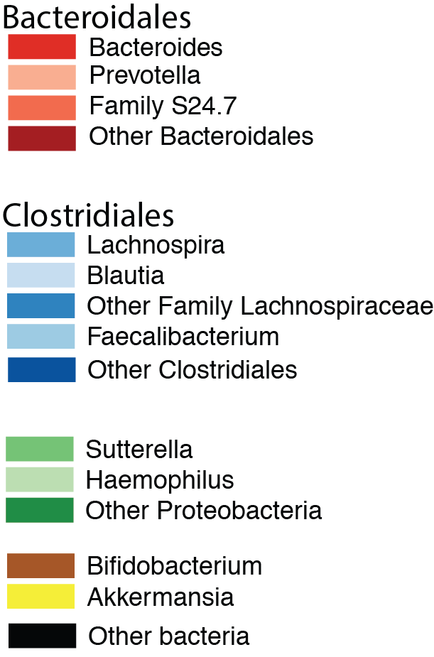
Dominant bacterial genera in each sample
Notes:
Genus bars A
One panel for each person; x-axis are samples, labelled with day and method; y-axis is relative abundance in sample (linear)
Same phyla colours as box-whiskers:
red Bacteroidetes, blue Firmicutes, green Proteobacteria, brown Actinobacteria, yellow Verrucomicrobia
Can see again that bacteroidetes + Firmicutes is 80%+
Clear, stable differences between individuals. Individual structure at genus-level, e.g. person 11 no Prevotella, versus person 44. Some changes from day to day, e.g. 33 day 3 bloom in Haemophilus.
Some difficult decisions between 2 centres - Akkermansia
Effect of method: A increase relative abund of Firmicutes? No
Alternating shades helps discriminate.

Slide 10
Design decisions
colour by phylum, so that similar genera have similar colours
Bacteroidetes (red) and Firmicutes (blue) were each dominated by a single order, so this order is named.
use genera that reached at least 10% in at least 1 sample
include a shade for significant families, where the genera in the family were not given or were multiple and small
Notes:
Decisions
For example in the family Lachnospiracea, our data points included genera at smaller proportions than Blautia, and data points labelled 'family lachnospiraceae, unknown genus'

Slide 11
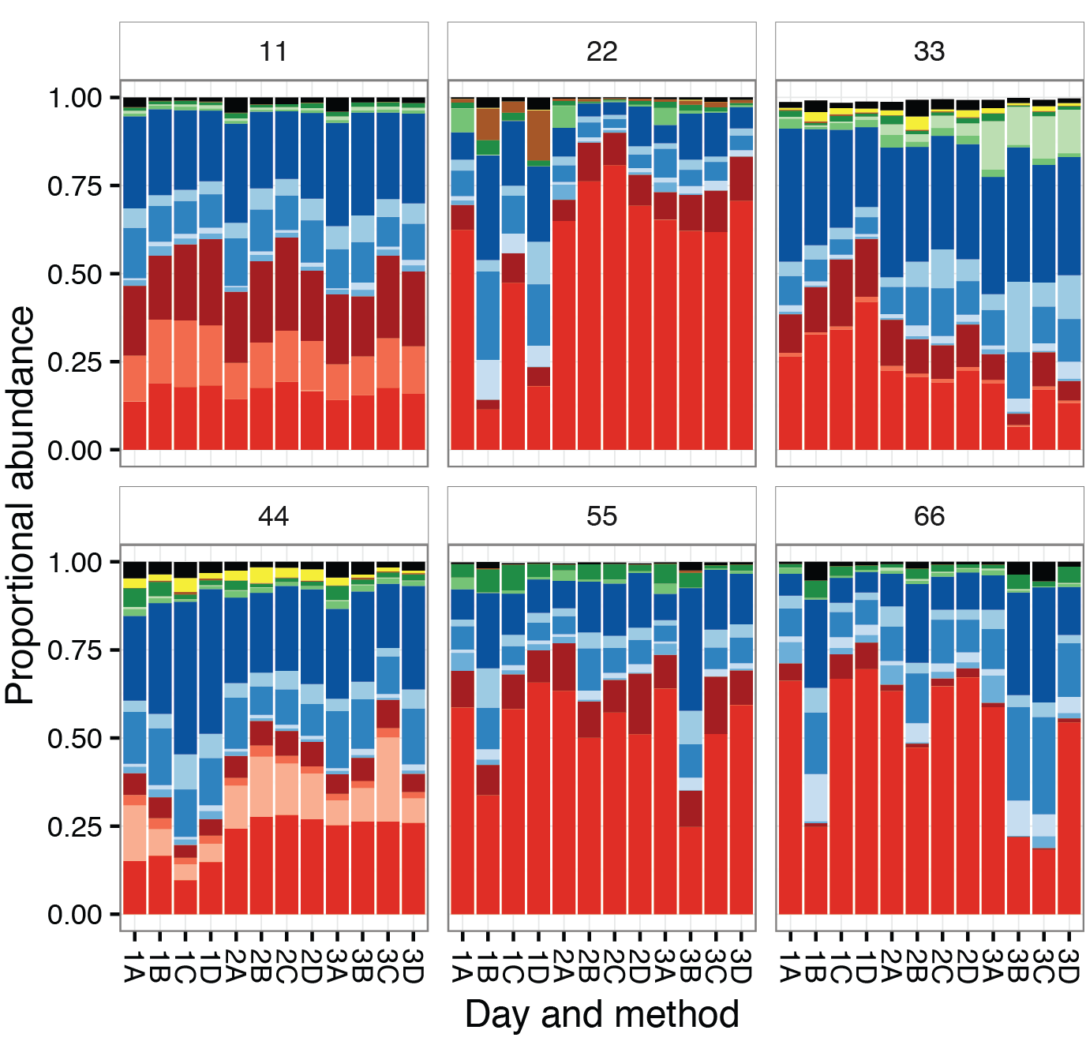
R code
library(ggplot2); library(RColorBrewer)
palette_phylum =
## Consistent colours needed for 2 data sets: hard-coded compromise list of representative genera
palette_genus <- c(brewer.pal(5, "Reds")[c(4, 2, 3, 5)], # 4 x red for Bacteroidetes,
brewer.pal(6, "Blues")[c(4, 2, 5, 3, 6)], # 5 x blue for Firmicutes
brewer.pal(4, "Greens")[c(3, 2, 4)], # 3 shades of green for proteobacteria
palette_phylum[4:5], # brown for actino, yellow for verruco
palette_phylum[10] # black for 'other')
ggplot(longProp, aes(x=DayXMethod, y=propAbund, fill=genuslabel)) +
geom_bar(stat="identity") +
facet_wrap(~personID) +
scale_fill_manual(values = palette_genus)
Notes:
R code
ColorBrewer: Set 1 + black + pastel1.
(Swapped some colours: purple, orange, yellow, brown -> brown, yellow, purple, orange
based on which had good sub-shades and to separate yellow-orange )
brewer.pal gives requested number of shades of named palette. 1st too pale; alternating light and dark

Slide 12
Acknowledgements and thanks
Papenfuss Lab members, for their comments and questions.
Particularly Tony, for confessing he couldn’t see my first attempts
Len Harrison, for repeatedly pushing me to include more, and make it clearer and more interesting.
Environmental Determinants of Islet Autoimmunity (ENDIA) Study, for providing the project and the samples
Funding agencies: The Juvenile Diabetes Research Foundation (JDRF) Australia, the Australian Research Council, 441 Special Research Initiative in Type 1 Juvenile Diabetes, The Helmsley Charitable Trust and the National Health and Medical Research Council (NHMRC) of Australia

