Slide 1
Sekai Recommendation System

Slide 2
Introduction
AI‑powered, multi‑agent recommender for Sekai
Autonomous prompt optimisation → +90 % precision gain
Leveraging Gemini 2.5 Pro, Gemini 2.0 Flash, Claude 3.5 Sonnet

Slide 3
Problem & Solution Overview
Infer tastes from few tags
Recommend 10 best stories among thousands
Self‑improve each cycle with no human in loop
Three‑agent loop: Prompt Optimizer → Recommender → Evaluation

Slide 4
System Architecture
Vector Store: FAISS
Multi‑View Recall → LLM Rerank → Policy Guard
Evaluation ↔ Prompt Optimizer loop

Slide 5
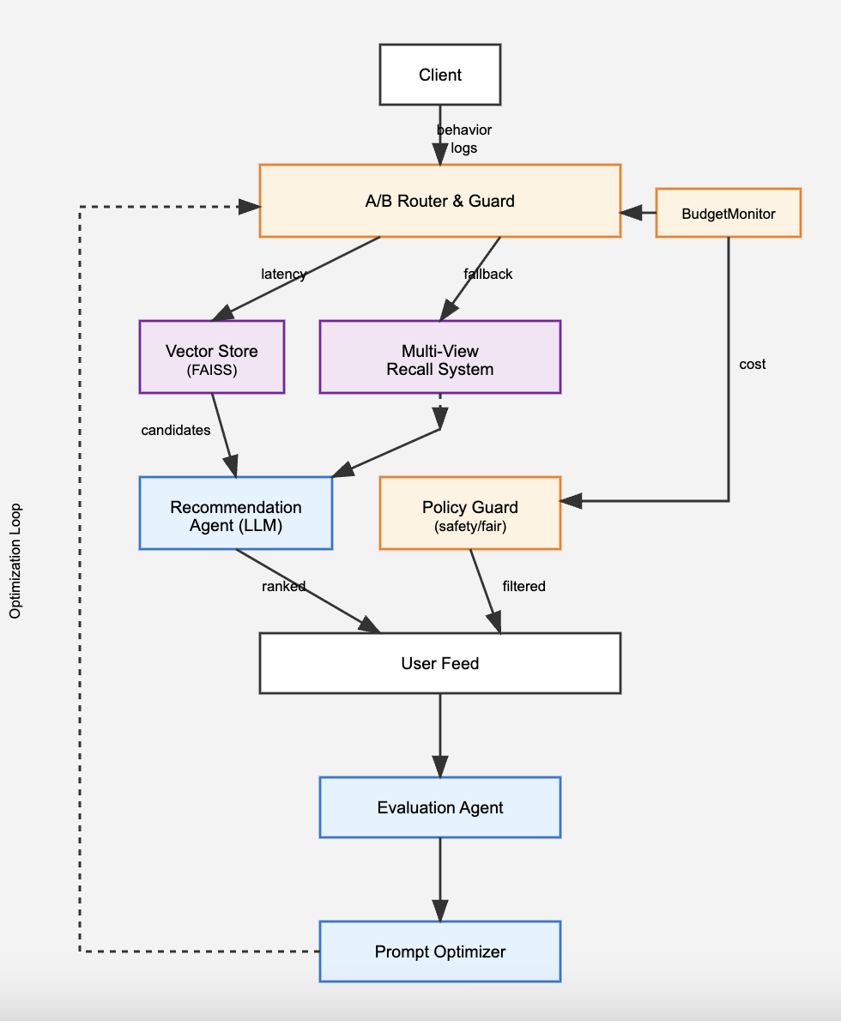

Slide 6
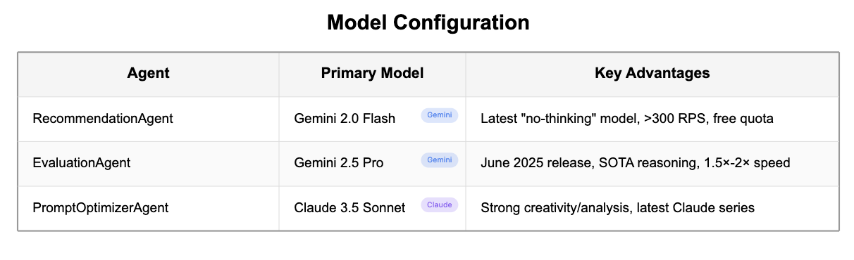
Smart Model Selection

Slide 7
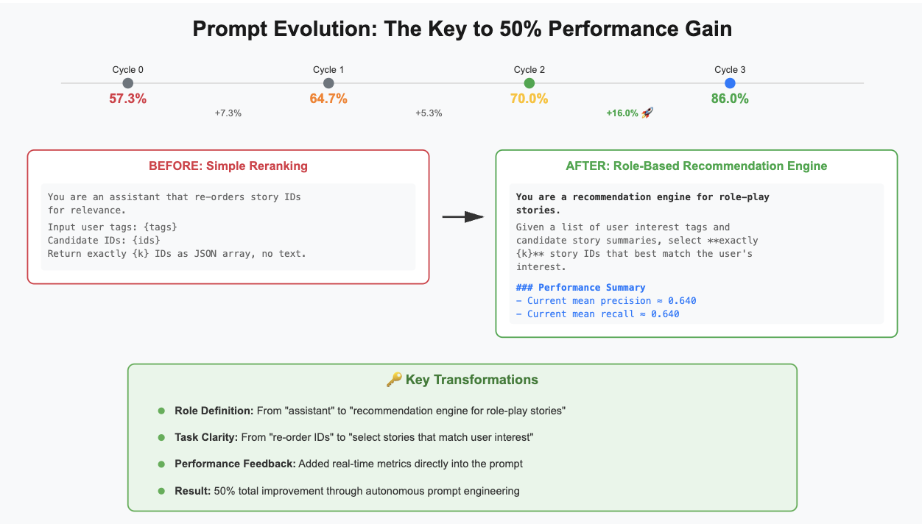
Autonomous Prompt Optimisation

Slide 8
Technical Highlights
Multi-View Recall System
Tag matching + Semantic search + Rule-based + Popularity
~220 diverse candidates per query
- Ensures precision AND diversity
Performance Optimization
FAISS vector index for <100ms latency – Sentence
BERT embeddings (all-MiniLM-L6-v2)
Smart caching reduces API calls
Production Robustness
BudgetMonitor with hard spending limits
Automatic API fallbacks (Gemini → OpenAI → Offline)
Comprehensive logging (JSON format)
Reliability Features
Handles rate limits with exponential backoff
Works offline with vector-only mode
Tested on unseen user profiles

Slide 9
Thanks for Listening !

