Slide 1
In App Billing
Szilágyi István
Jochem Van Hespen

Slide 2
Monetizing
Advertisement
Paid-apps
In-App Purchases

Slide 3

General setup
Google Developer Console Account
Google Merchants Account
Signed APK
Setting up product list
Content rating, Store listing, Pricing and distribution

Slide 4

Type of Products
Managed products
Consumables
Non-consumables
Subscriptions

Slide 5
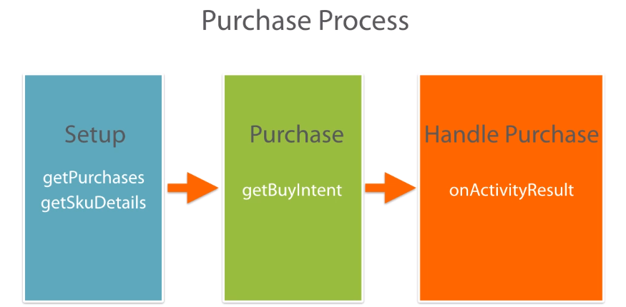

Slide 6
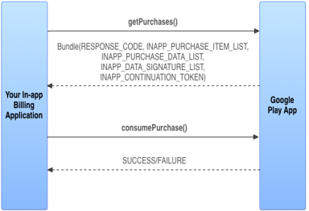
Consuming In-app Products
Querring user purchases
Product state
Owned
Consumed
Unonwed
Consume Request

Slide 7
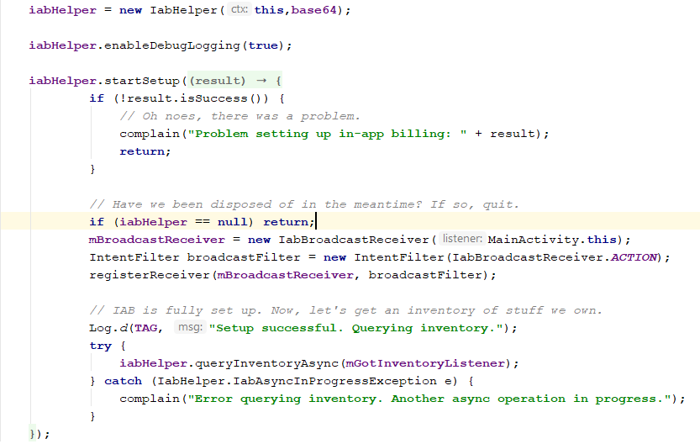

Slide 8
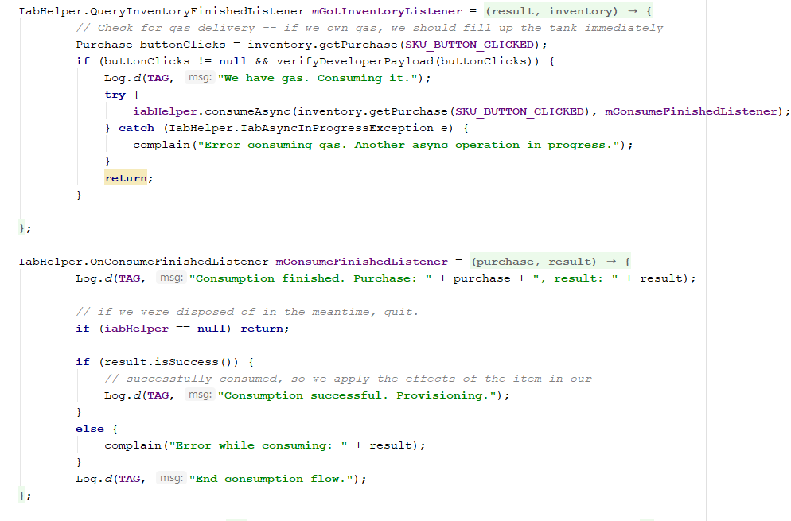

Slide 9
Questions?

Slide 10

Thank you!

