Slide 1
Programming Languages Design and Implementation
Prof. Saleh Abu-Soud
Fall 23/24

Slide 2
Chapter 1
Introduction

Slide 3
Why study programming languages?
To improve your ability to develop effective algorithms
To improve your understanding and use of the language you are using
To increase your vocabulary of useful programming constructs
To allow a better choice of programming languages
To make it easier to learn a new language
To make it easier to design a new language

Slide 4
What make a good language?
Clarity, simplicity, and unity of language concept

Slide 5
What make a good language?
Clarity of program syntax
Readability
Structured programming (top-down)
FORTRAN is widely used but Pascal is favorable over it because it gives more encouragement to elegant program design

Slide 6
What make a good language?
Naturalness for the application
COBOL is suitable for business applications
FORTRAN is suitable for scientific applications

Slide 7
What make a good language?
Support for abstraction
The gap between the abstract data structures and operations of the problem
EXAMPLE: Pascal may be an appropriate language for constructing a program to do class scheduling. But, the abstract data structures of “student”, “class section”, and the abstract operations of “assign a student to a class section” are not provided directly by Pascal.
to be defined and maintained as self-contained abstractions. (can be used without knowing their details)

Slide 8
What make a good language?
Support for abstraction
An important part of the programmer’s task is to design the appropriate abstractions for the problem solution and use the more primitive features of the PL
Ideally the language should allow data structures, types, and operations as self-contained abstractions, so the programmer may use them in other parts of the program knowing only their abstract properties, without concern for the details of their implementations. (subprogram call) ing their details)

Slide 9
What make a good language?
Ease of program verification
Simple semantics and syntax simplify program verification.
Verification may be:
By desk checking informally (reading and checking the text)
By testing it against input data, or
Formally, by a formal verification method

Slide 10
What make a good language?
Programming environment
External support
Special editors for maintaining and modifying a program
Support of multiple versions

Slide 11
What make a good language?
Portability of Programs
A program runs on different SW and HW

Slide 12
What make a good language?
Cost of use
Of program execution (CPU time, space, …
Of program translation (students compile more than execute)
Of program creation, testing, and use.
Of program maintenance (higher cost: errors, change of HW, and enhancements)

Slide 13
Programming languages history
Machine Code
Assembly
3rd GL: FORTRAN, COBOL, BASIC, PL/I, C, ….
4th GL:
Visual Languages, OO PL, C++, ORACLE, .Net, ….
Window-based programmer interface
Easy access to DB
Input forms & elegant output

Slide 14
Programming languages history
Numerically based languages (scientific)
FORTRAN, was designed for IBM 704, FORTRAN II, FORTRAN IV, FORTRAN 66, FORTRAN 77, FORTRAN 90
ALGOL, ALGOL-W, ALGOL 60, ALGOL 68
run on Burrroughs
Close to standard mathematics
Useful for description of algorithms
Compilable to machine language
On several computer architectures
IBM developed PL/I (FORTRAN + COBOL)
BASIC (Numerical for nonscientests)
C ➔ C++

Slide 15
Programming languages history
Business languages
FLOWMATIC (55) for Univac
Englishlike text
COBOL (60), 61, 62, 68, 74, and 84

Slide 16
Programming languages history
AI languages
IPL-V: fairly known, limited (50s)
LISP (58), for IBM 704, LISP 1.5, Common LISP
General purpose
Games
Machine Translation
COMIT: Machine Translation, MIT
SNOBOL: AT&T Bell Labs
Prolog: (80s), based on logic

Slide 17
Programming languages history
System languages
Assembly: efficient
CPL and BCPL: not widely used
C (70s) on UNIX

Slide 18
Programming languages history
<50 Machine code
50 – 55 Assembly, experimental HLL
56 – 60 FORTRAN, ALGOL 58 and ALGOL 60, COBOL, LISP
61 – 65 FORTRAN IV, COBOL 61, ALGOL 60 revised, SNOBOL
66 – 70 PL/I, FORTRAN 66, COBOL 65, ALGOL 68, SNOBOL 4, SIMULA 67, BASIC, ALGOL-W
71 – 75 Pascal, COBOL 74, PL/I(standard), C, Prolog
76 – 80 Ada, FORTRAN 77, Smalltalk, ML
81 – 85 Turbo Pascal, Smalltalk-80, Prolog, Ada 83, Postscript
86 – 90 FORTRAN 90, C++, SML
91 – 95 Ada 95, PERL, HTML
96 – 2000 Java, Java script, XML
01 – now visual PL: VB, .Net
4th GL: ORACLE
OO PL: C++, Java
Python, R

Slide 19
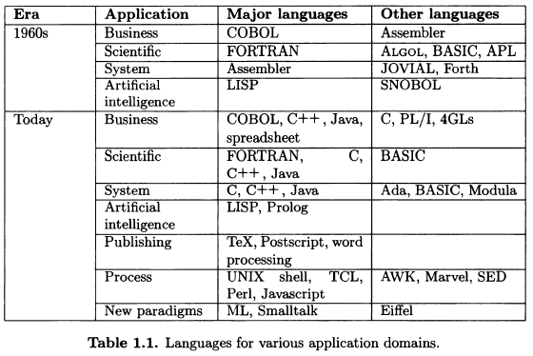
Programming languages history

Slide 20
Programming languages history
ALGOL is replaced by Pascal
Pascal is replaced by C++ and Java
COBOL is replaced by C++
APL, PL/I, and SNOBOL4 (60s) and Pascal (70s) disappeared

Slide 21
Evolution of Software Architectures
Operating Environment: in which the program is designed
Host Environment: in which the program is used

Slide 22
Evolution of Software Architectures
Mainframe Era:
Batch environment: 50-60s,FORTRAN, COBOL, Pascal
Interactive Environments: 70s to mid 80s, timesharing, centralized computing
Minicomputer Era: 70s
PC Era: 70s, by IBM, Apple (78), Windows, graphics PL
Embedded- System Environment: Java, C++
Networking Era: Distributed computing, Internet, HTML, centralized computing, security, performance

Slide 23
What do make a language strong?
Government agencies: COBOL, ORACLE
Strong support of computers manufacturers: FORTRAN, PL/I
Good documentation: SNOBOL4, ORACLE
Theoretical study and actual practical use: Pascal, Java, LISP, Python, C++

Slide 24
What are the influences of PL?
Computer capabilities
Applications: scientific, business, games, …
Programming methods
Implementation methods
Theoretical studies (research)
Standardization

