Slide 1
Math-ek

Slide 2
The purpose of the website
We made this page for elementary school students to give them a way to develop their mathematical skills wherever they are.

Slide 3






used technologies for the website
-javascript
-html
-wampserver
-boorstrap
-mysql
-css
-php
-git, github

Slide 4



Brainstorming and communication
We communicated via google classroom, google meet and facebook.

Slide 5
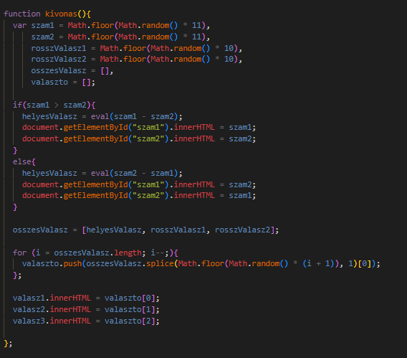
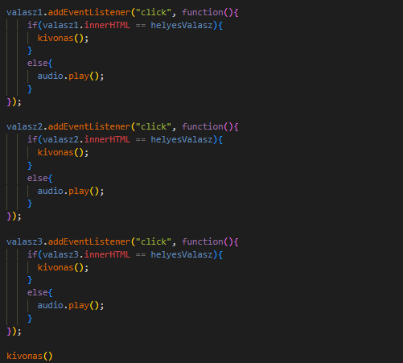
Under the hood
This is the logic behind the subtraction tasks

Slide 6
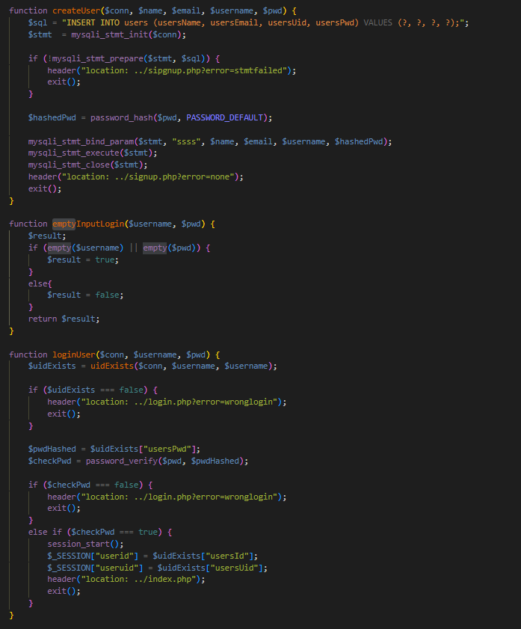
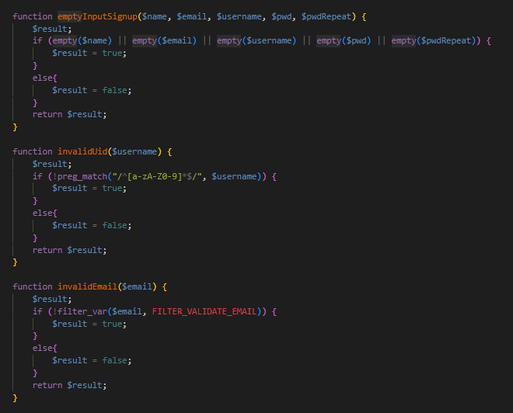
Login/signup functions and checkers

Slide 7
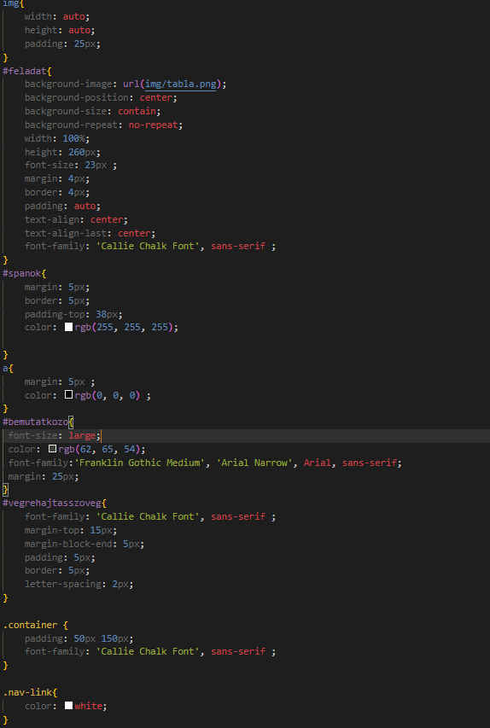
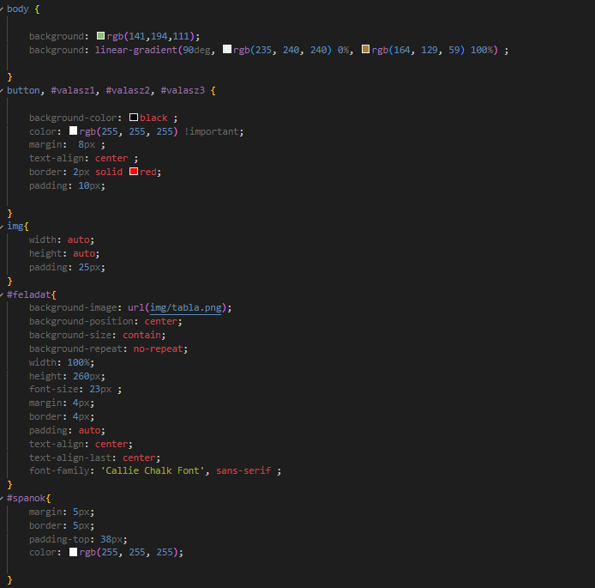
The Style

Slide 8
How to make it work
- save it into the www directory of the wampserver
-make sure wamp service services are running
-type in the browser localhost

Slide 9
Thank you for listening!

