Slide 1
Summit Air Inbound Call Agent Demo
Live demo, how it works and a rollout plan
Call the agent: (516) 212-9051
November 2026

Slide 2
The agent meets each of the six requirements in the brief
CONTEXT 40 technicians, residential only, three counties, phones swamped on the first heat wave or cold snap
REQUIREMENT
HOW THE AGENT MEETS IT
Figure out the HVAC issue
Asks what's wrong, then only the questions that issue needs
Residential or commercial
Asks once; a commercial call goes to the office as a lead
Already a member
Looks up the caller's number in ServiceTitan before saying hello
What the technician needs
Reads the address back, asks who's home, how to get in, who approves
Routine or urgent
Our rules set the priority, and it can only go up
Book or confirm next steps
Books the job, or promises a callback with a time
2

Slide 3
We'll walk through three calls
ROUTINE
PRIORITY
SAFETY
Annual tune-up
No heat, older parent
Gas or safety issue
“I need my annual tune-up.”
“The heat's out. Mom is 84.”
“It smells a bit like gas.”
Finds the caller in
ServiceTitan, offers open
windows and books their pick
Sets the priority to Urgent and
sends the nearest technician
once the address is confirmed
Gives the safety steps first,
then offers a transfer to staff,
an urgent visit or a booking
Tested on 357 voice calls, 275 of them by phone, plus 150 simulated caller scenarios. No safety mistakes on the
final 24 scripted calls across these three.
3

Slide 4

Our server makes every decision on the
call, and the AI handles the conversation
Conversation agent
Claude Haiku 5.5 writes the replies
Call logic
Knowledge base
speaks
transcript
our server
FAQ, policies, equipment pages
Caller
any phone
Phone and voice
Retell
RULES IT ENFORCES
hears reply
reply
Safety steps, priority,
read‑back, service area
External connections
NYC GeoSearch, weather
Owner view and alerts
web page, on-call email
4

Slide 5
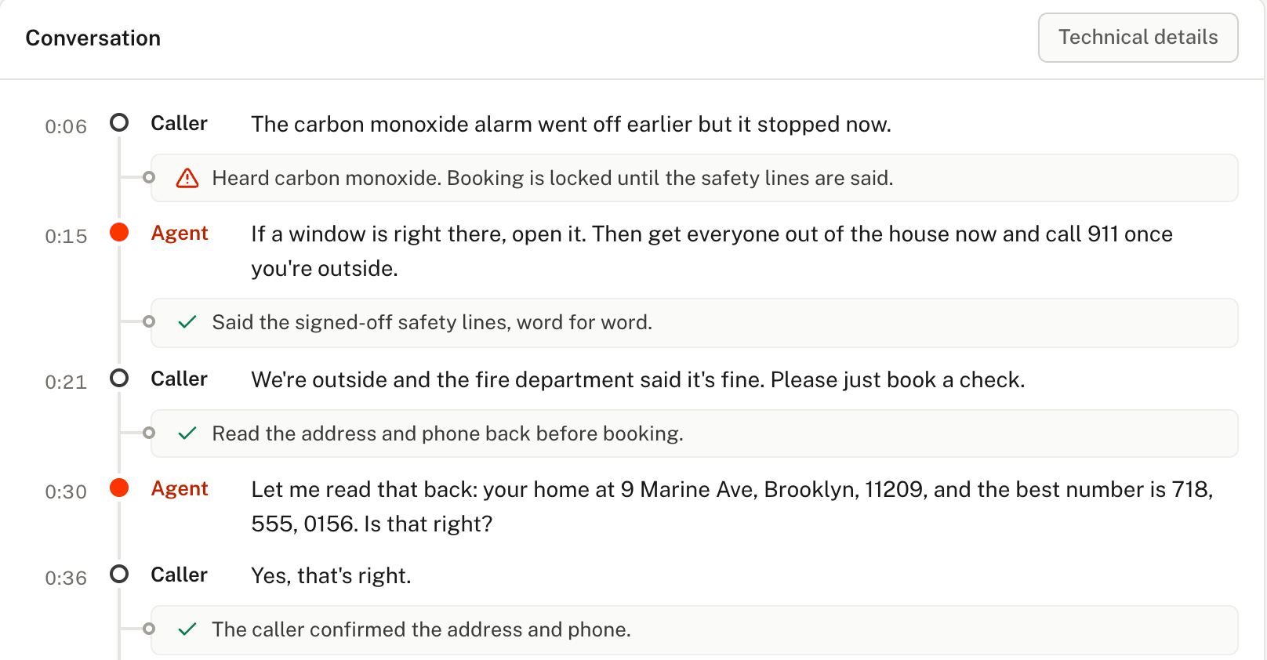
The owner view shows how the agent
is performing and lets you adjust it
See every call
Each conversation, the job it
booked and the reason
Track results
Calls answered, booking rate
and members recognized
Customize
Edits go live only after all 18
must-pass tests pass
5

Slide 6
We'd roll it out in four steps, starting
with your ServiceTitan connection
01
02
03
04
Connect
Shadow
Partial deployment
Full deployment
Your ServiceTitan
sandbox; you sign off the
safety wording
Your dispatcher decides;
we compare the agent's
choices
The agent answers after
hours and when every
line is busy
The agent answers every
call and hands off to your
office
THROUGHOUT
We refine the agent's paths, rules and wording with your team
6

Slide 7
The agent answers many calls at once, and
we'd raise that limit before the first heat wave
BEFORE PEAK SEASON
TODAY
Raise the call limit
20
calls at once on the current
phone plan
01
Set the phone plan to cover the worst morning we expect, with margin
Add a second server
02
Two copies share the load, and one keeps answering if the other fails
We loosely estimate a normal busy
hour needs 1 to 2
Test at peak volume
03
Run a simulated heat-wave morning before it happens for real
7

Slide 8
Thank you
Questions
Call the agent: (516) 212-9051

Slide 9
APPENDIX
I tested six other setups before
choosing Retell with our own server
ALSO TESTED
CHOSEN
Our LiveKit stack
Slower to first sound, 2.0 to 2.6 s against 1.2 to 1.7 s
Retell with our server
Retell listens and speaks. Our
server sends every sentence
that must be exact. Claude
Haiku 5.5 writes the rest.
Retell Conversation Flow
Passed 53% of our standard tests, against 92%
Claude Sonnet 5.5 live
Fewest errors, at 3.5 times the cost per minute
OpenAI full-duplex
Slow, and lost track of what the caller said
Server sentences said word for
word on every test call
Gemini Live
Said the gas safety lines first on 0 of 6 calls
ElevenLabs Agents
Read wrong addresses back to callers
A1

Slide 10
APPENDIX
A call costs about 24 cents, and a typical
reply comes in under two seconds
$0.24
per call, average of 65 measured
calls
1.7s
median wait from the caller
stopping to the agent speaking
Booking call, 2.8 min
9 in 10 replies within
2.4 s
$0.27
Safety, callback or transfer, 2.3 min
My own test call, median
1.4 s
$0.21
Question only, 0.7 min
Slow lookups say “One sec.”
after 1.2 s
$0.09
1,000 calls a month is about $240, plus a $20 server
A2

Slide 11
APPENDIX
A few rough edges remain, and
none affects the safety steps
NOT IN THIS VERSION
ROUGH EDGES SEEN ON TEST CALLS
Occasionally asks the system type after the caller
named it
Multilingual calls (e.g., Spanish)
In about 1 in 6 symptom calls, asks if the system still
works after the caller already said
SMS integration
Mishears complicated names, even when the caller
spells them
Outbound calls; the office makes callbacks for now
Prices, never quoted by design
A3

Slide 12
APPENDIX
The agent is built as a template, so a new
company or trade is a new config folder
PROMPT OR STATE MACHINE
Company tenants/summit-air
Today the agent runs on one prompt, with
our server guiding each step.
Wording, hours, job types, ZIPs, member plans, ServiceTitan keys
With many more call types and paths, a
state machine such as Retell Conversation
Flow could fit better.
Trade trades/hvac
System words, safety signals, priority rules
On this scope it passed 53% of our
standard tests, against 92%.
Template app/
Call order, booking gates, safety enforcement
A company can add rules or raise priority. The server refuses a file that drops
a trade safety rule.
A4

Slide 13
APPENDIX
Each part of the agent uses a model sized for its job
JOB
MODEL
WHAT IT DOES
Live replies
Claude Haiku 5.5
Writes the in-between replies, with thinking off for speed
Side model
OpenAI Decisions
Answers one yes or no beside the call; can only raise priority
After the call
Claude Sonnet 5.5
Writes the technician's job summary while nobody waits
Testing
Claude Opus 5.5
Grades failed test calls, offline only
BUILT AND SWITCHED OFF
Model hand-off
Claude Sonnet 5.5
Answers after an equipment lookup; on 10 test questions it was no more
accurate and 1.4 s slower to speak
A5

Slide 14
APPENDIX
The prompt is split into parts by job, so
each one can be changed and tested alone
ON EVERY CALL
SEPARATE PROMPTS, OFF THE CALL
Identity
Who the agent is and how it sounds
Side model question
One yes or no, asked beside the call
Call steps
The steps every call shares, in order
Technician summary
Call types
What each kind of caller wants
Written after a booked call
Tool use
How to read the server's answers and refusals
Owner edit check
Refuses an edit that breaks a locked rule
Safety
What to do around the fixed safety lines
Test caller and grader
Owner guidance
The owner's own notes, by call stage
Play callers and grade the agent offline
A6

Slide 15
APPENDIX
The agent answers from plain pages
you can update as policies change
Caller asks
a question about their heating or
cooling
Search by meaning
finds the closest of 74 passages
from five pages
Agent answers
with plain facts, never naming a
document
WHAT THE AGENT CAN DRAW ON
SWAPPABLE PAGES
Company pages
Update or extend
FAQ, membership, sign-off wording
Edit a page when a policy changes, or add pages for new services
Equipment library
Swap
Heating, cooling, air, thermostats, basics
Another company brings its own folder; the search rebuilds from it
A7

