Slide 1
EVENTS HANDLING AND USER INTERFACE GROUP NO 09.

Slide 2
❖ Buttons, touch gestures, form inputs
❖ Event listeners (onClick, onTouch,
etc.)
❖ Toasts, Snackbars, and Dialogs
❖ Basic UI/UX best practices

Slide 3
1.Buttons, Touch Gestures, and Form Inputs:

Slide 4
Buttons
Buttons are essential interactive elements in any user interface. They act as the primary way for users to perform actions, such as submitting forms or navigating between screens. They should be clearly labeled and positioned for easy access. A good example would be a "Submit" button that visually changes when clicked, indicating the user’s action has been recognized.

Slide 5
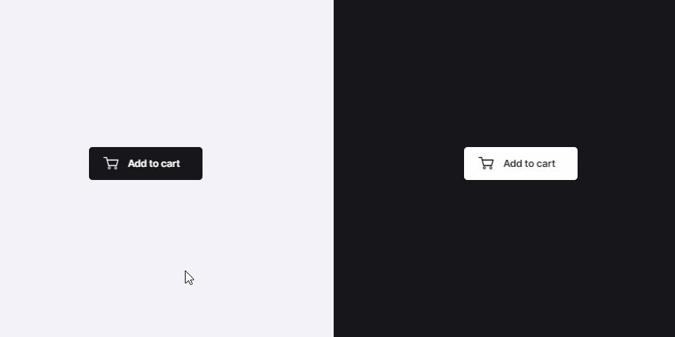
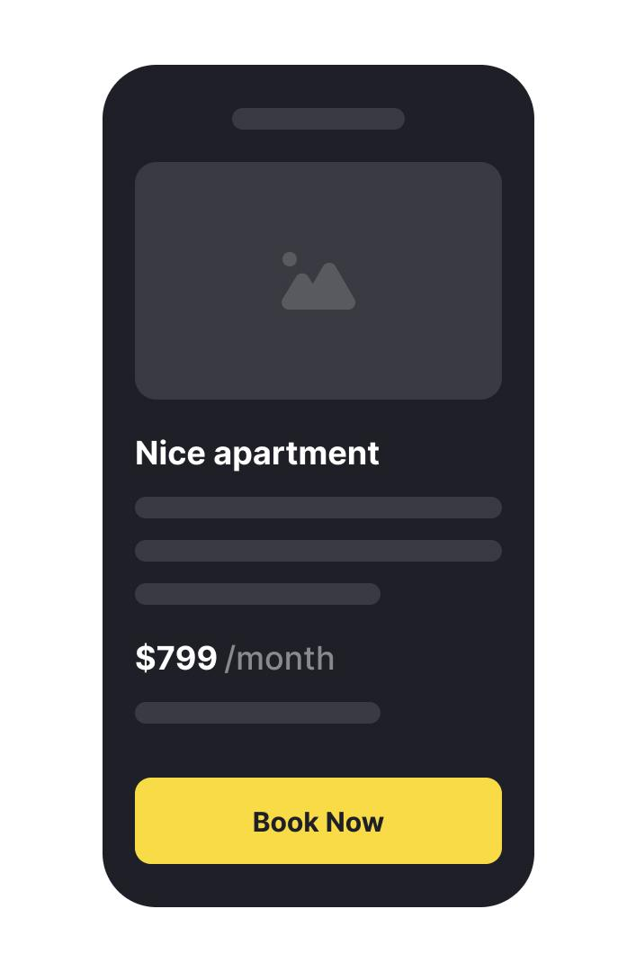
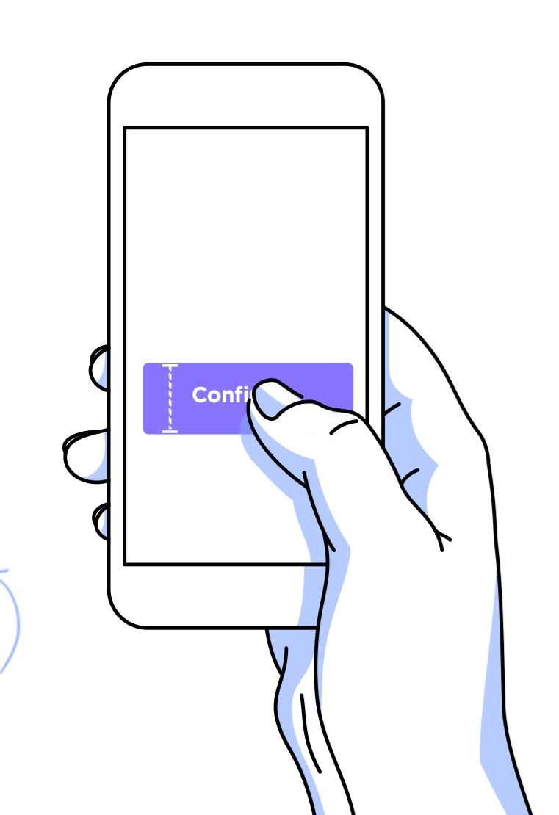
Examples:

Slide 6
Touch Gestures
Touch gestures, such as swiping, pinching, or tapping, enhance navigation in apps and provide intuitive controls. For instance, swiping left to delete an item or pinching to zoom in on an image feels natural and reduces clutter from unnecessary buttons.

Slide 7
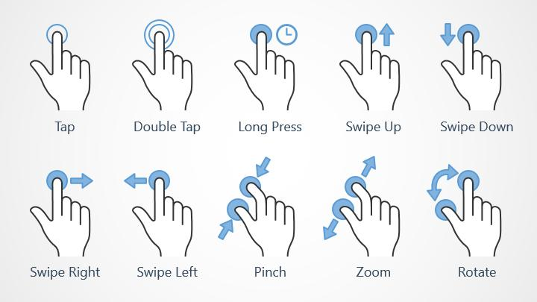
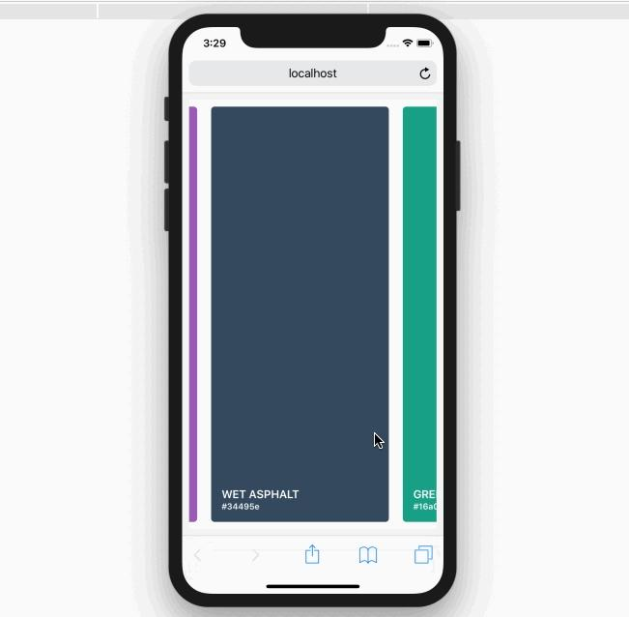
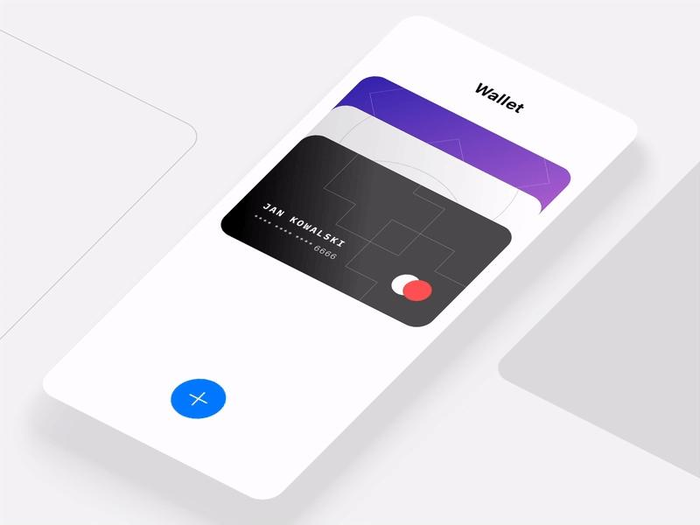
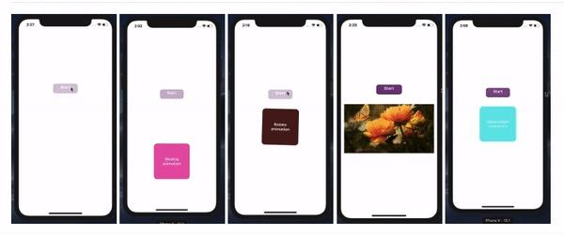
Examples:

Slide 8
Form Inputs
Form inputs allow users to enter and submit data. They should be designed with accessibility in mind, including clear labels and error feedback. For example, a form asking for an email address might highlight the input box red with an error message if the format is incorrect

Slide 9
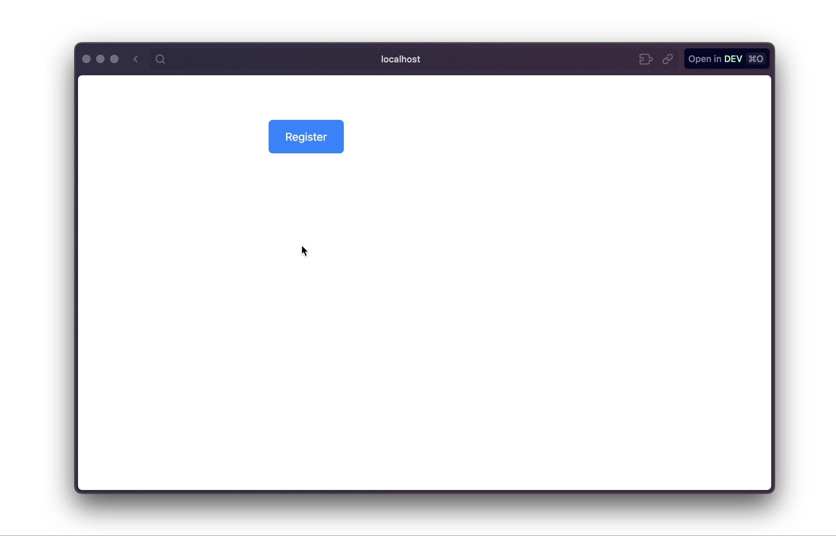
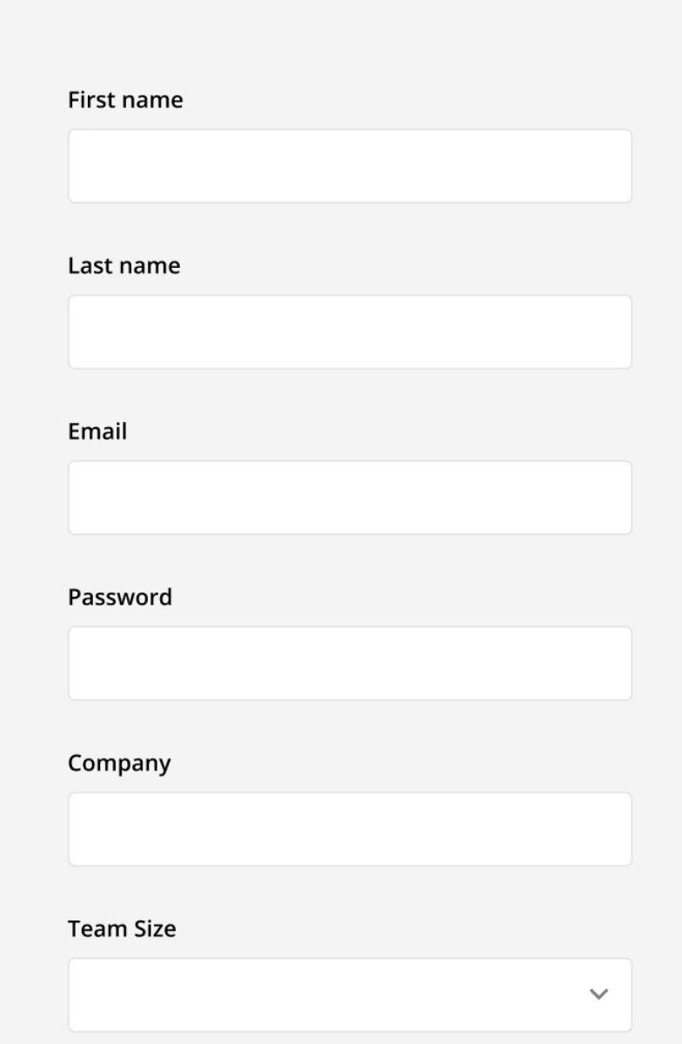
Examples:

Slide 10
2. Event Listeners (onClick, onTouch, etc.)

Slide 11
Event listeners are functions that wait for specific actions or "events" from users, such as a click, touch, or keypress. For example, `onClick()` listens for when a button is clicked and executes the assigned function. Similarly, `onTouch()` detects gestures on touch-sensitive devices, enabling features like swipe-based navigation or drag-and-drop interactions. - A critical aspect of event listeners is their efficiency and proper implementation to avoid performance issues. Using tools like event delegation can ensure better handling of events for dynamic and larger interfaces.

Slide 12
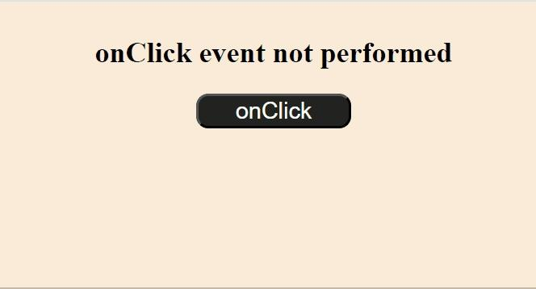
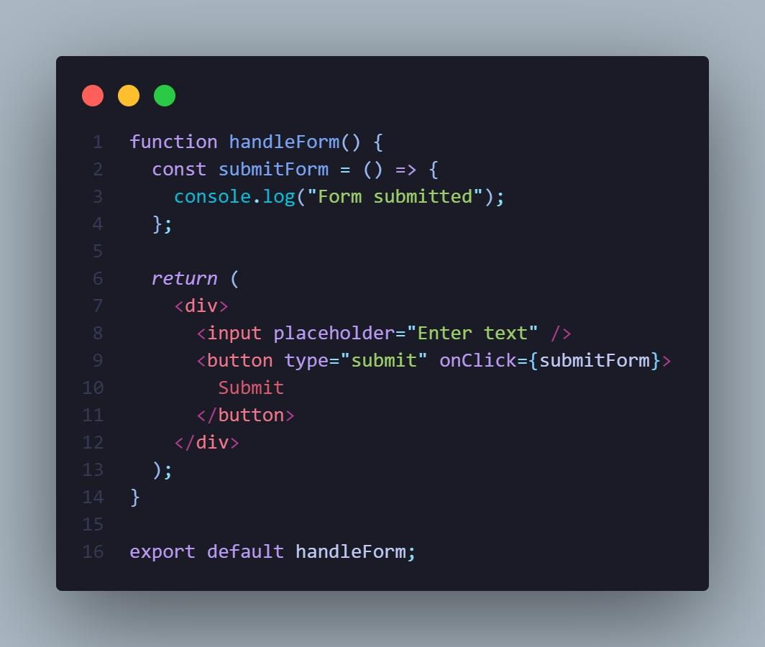
Examples:

Slide 13
3. Toasts, Snackbars, and Dialogs:

Slide 14
Toasts
Toasts are small messages that briefly appear on the screen, often at the bottom or top, and disappear automatically after a short duration. They are ideal for non-intrusive feedback, such as "Message Sent Successfully" after hitting a send button. They don’t require user interaction and are excellent for quick updates.

Slide 15
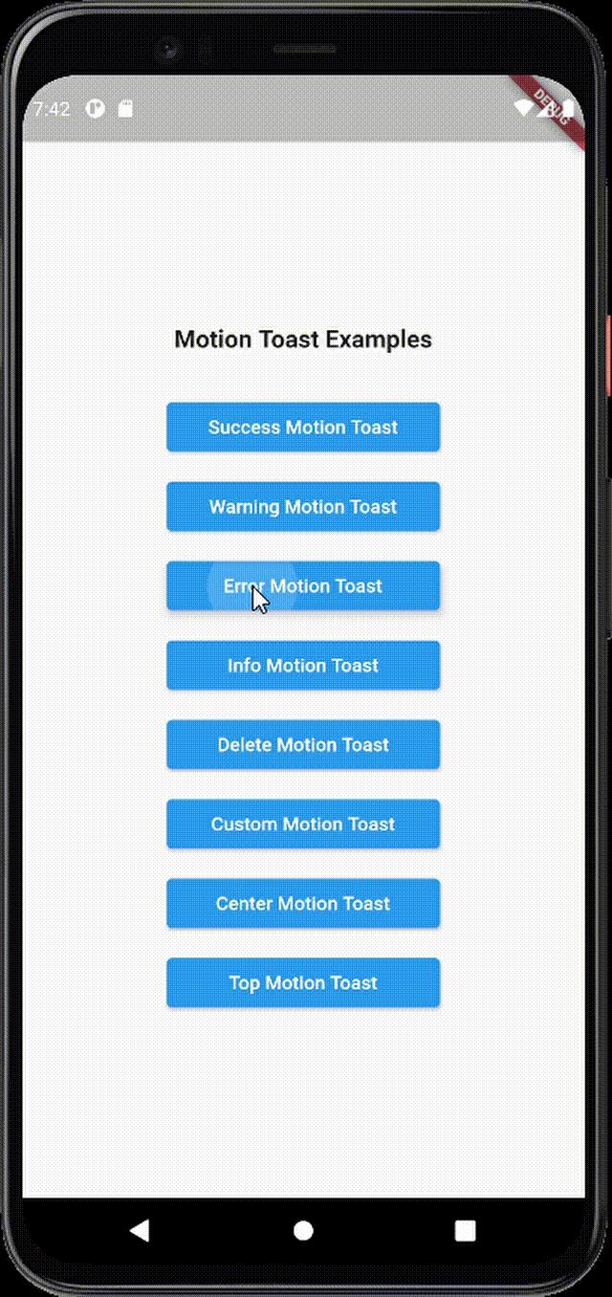
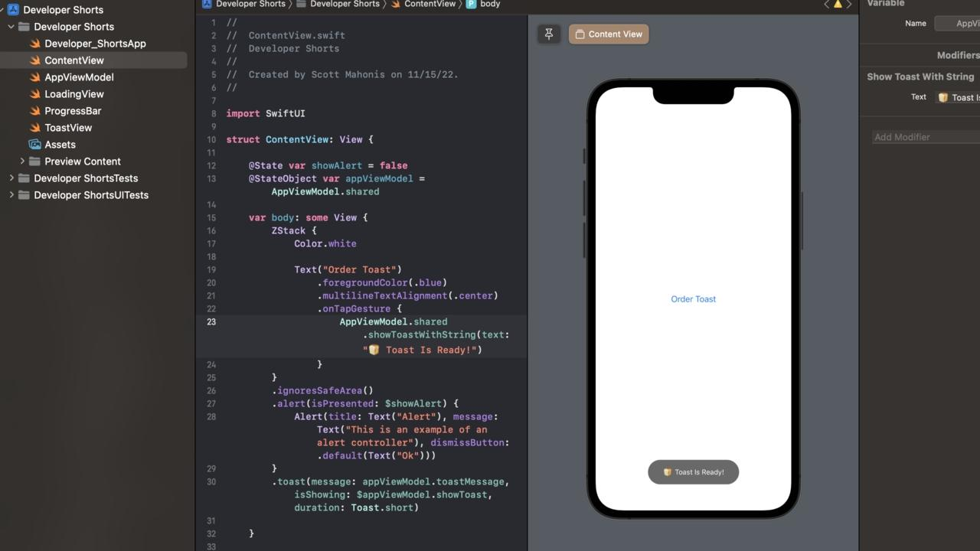
Examples:

Slide 16
Snackbars
Snackbars are similar to Toasts but are slightly more advanced. They allow for user interaction, such as an undo button to reverse an action (e.g., "Email deleted. Undo?"). Snackbars are visible for a short duration but are dismissible.

Slide 17
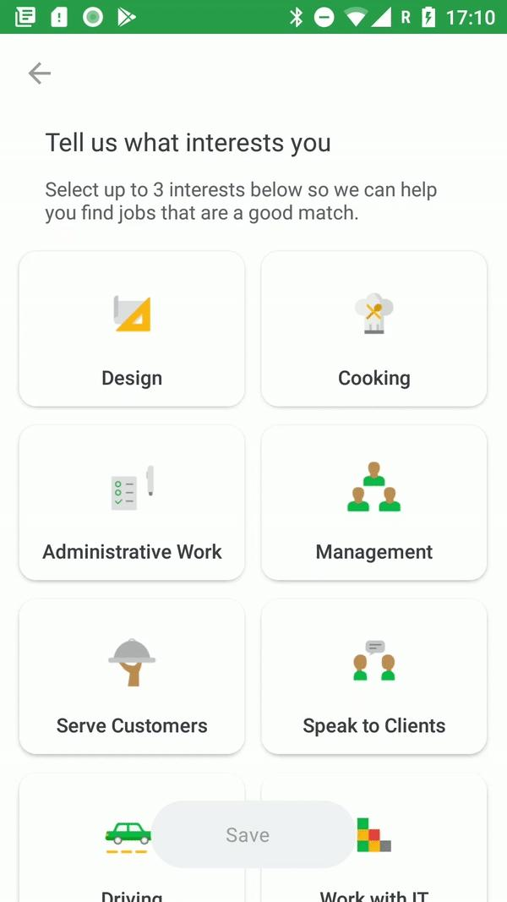
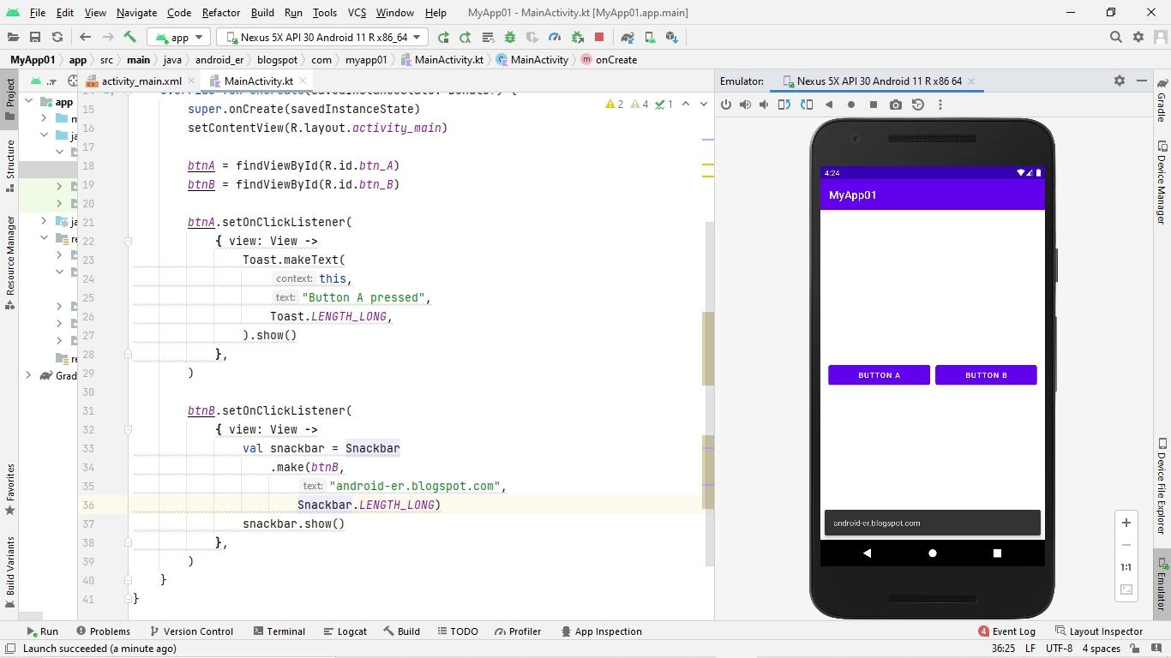
Examples:

Slide 18
Dialogs
Dialogs are pop-up windows used for critical or interactive messages, requiring user input or confirmation. For example, when a user clicks "Delete Account," a dialog might appear saying, "Are you sure you want to delete your account? This action cannot be undone." Dialogs ensure that users don’t accidentally perform irreversible actions.

Slide 19
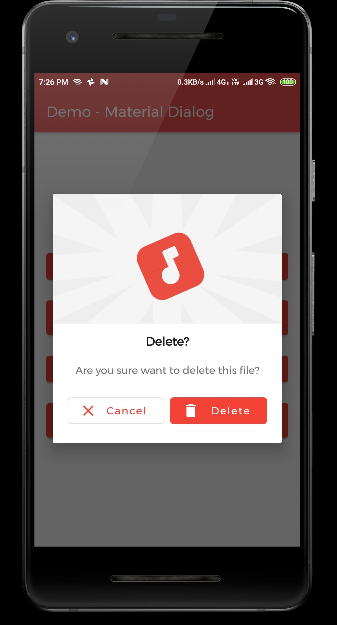
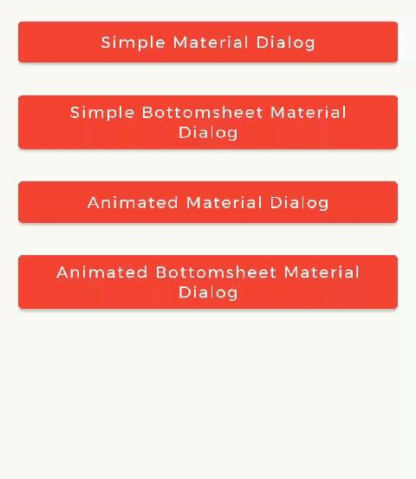
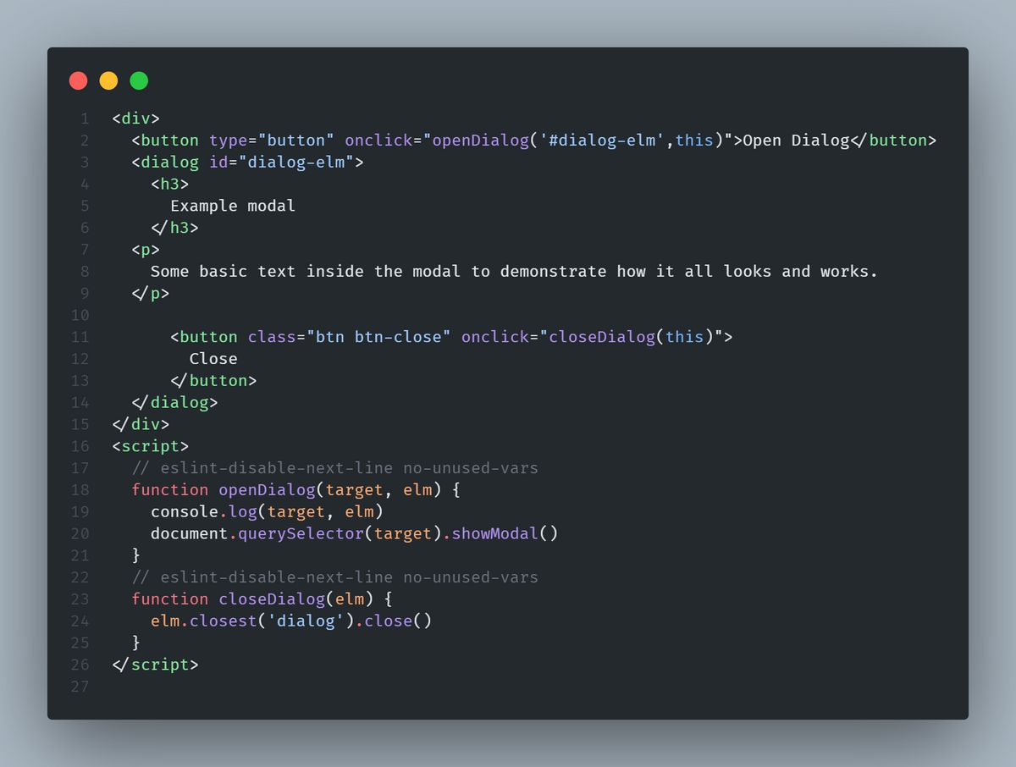
Examples:

Slide 20
4. Basic UI/UX best practices

Slide 21
The user interface (UI)refers to the visual and interactive elements of a system, software, or application that users interact with to perform tasks. It serves as the medium between users and the functionality of a device or program, ensuring ease of use and accessibility.

Slide 22
Key Aspects of a User Interface.
1.Visual Components: - Buttons, icons, menus, sliders, text boxes, and images are examples of visual elements that users see and interact with. - These components should be well-designed, intuitive, and visually appealing to enhance user experience.

Slide 23
2.Interactive Elements: - The UI involves how users interact with the system, such as clicking buttons, typing text, swiping screens, or using gestures. - It includes feedback mechanisms like animations, sounds, and error messages to guide users during interaction.

Slide 24
3. Design Principles: - A good UI should be simple,consistent,responsive, and accessible, ensuring users can navigate efficiently without confusion.

Slide 25
4.Purpose:- The main goal of a user interface is to make interaction seamless and help users accomplish their tasks without frustration.

Slide 26
THANK YOU……

