Slide 1
Build Realtime Application with Node.js
by Eang Lay (a coding lover)
Backend Developer
Front-end Developer
GitHub: Joden-Lay
GitHub: chamnab
Email: joden.lay@gmail.com
Email: choung.chamnab@gmail.com
Facebook: eang.lay.7
Facebook: choung.chamnab
LinkedIn: eanglay
LinkedIn: choungchamnab

Slide 2
Overview
What?
Why?
How?
What is Node.js?
ExpressJS
Socket.IO
Codes
Final Words
Q&A

Slide 3
1. What?
Realtime Application is the application program that user can senses the changes immediately.
Like: chat, online gaming, stock auction.

Slide 4
2. Why?
- To keep user up to date with the informations
- Exchange message right in time
- Media streaming
- Activity tracking
- Online Gaming

Slide 5
3. How?
- Node.js
- Socket.IO
- ExpessJS (optional)

Slide 6
4. What is Node.js
- It’s a platform that allow you to build applications using JavaScript
- Node.js can use for building website, console, service, desktop, maybe mobile app too.
Website: https://nodejs.org/en/

Slide 7
5. ExpressJS
A node.js minimal and flexible web application framework that provide you a set of features to quickly build a web application.
Website: http://expressjs.com/

Slide 8
6. Socket.IO
A node.js WebSocket library that is very simple to use and having client SDK for most of major language and platform. eg: .NET, Java, Web, Objective C, Swift …
Website: http://socket.io/

Slide 9
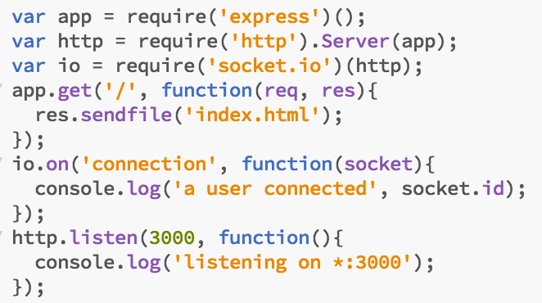
7. Codes
1- Install modules
2- Codes

Slide 10

DEMO TIME !!!

Slide 11
8. Final Words
- Node.js is not the only way to make realtime application. You may want to try something other like Go, Erlang, C++.
- Make a realtime server is very easy but tuning a realtime server is a living hell. 😈

Slide 12

Q&A

