Slide 1




Slide 2
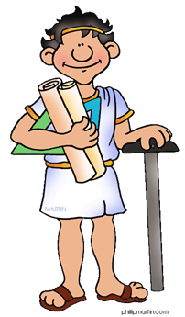


Thomas Billiet
Software Analyst/Architect
Jonas Anseel
Software Engineer
Hayk Avetisyan
Software Bug Tester

Slide 3
Concept
Make it easy to find and share vegan food in a shop.
A UX-friendly app instead of excel.

Slide 4
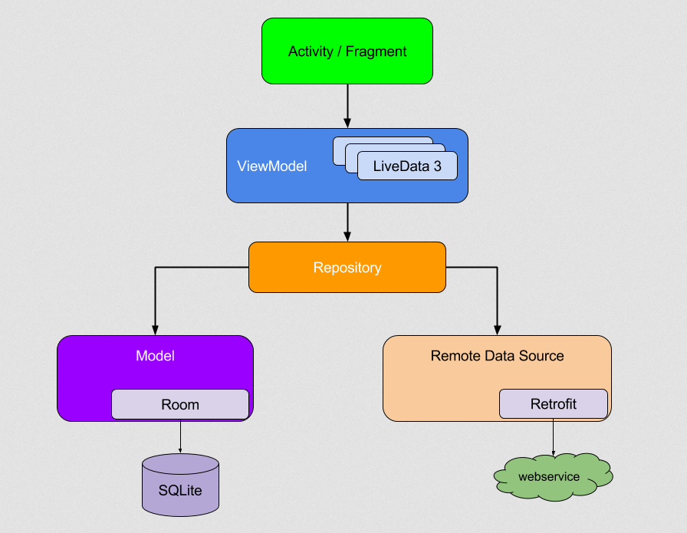
Android Architecture Guidelines

Slide 5


Machine Learning with Google Vision API
Upload a picture of the product
Give label suggestions
Give brand suggestions
Safe Search

Slide 6
Demo

