Slide 1

Vegan food finder
Group: TabTab Studio Group members: Thomas Billiet, Jonas Anseel, Hayk Avetisyan

Slide 2
Concept
Make it easy to find and share vegan food in a shop.
A UX-friendly app instead of excel.

Slide 3
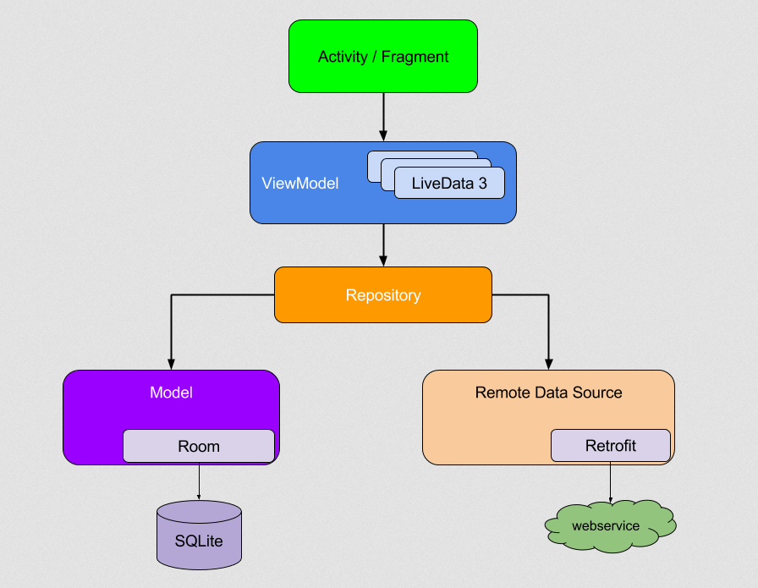
Android Architecture Guidelines

Slide 4


Machine Learning with Google Vision API
Upload a picture of the product
-> Give label suggestions
-> Give brand suggestions
-> Safe Search

Slide 5
Demo

