Slide 1
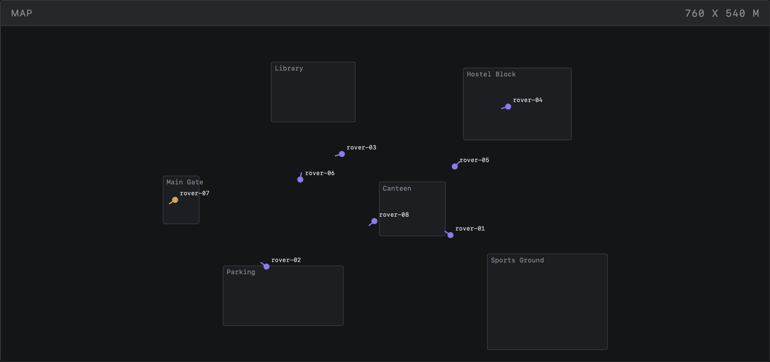
CAPSTONE PROJECT
Campus Patrol
DevOps Capstone
A command center for a fleet of campus patrol rovers, built, shipped, run and observed end to end.
Live map: 8 rovers patrolling campus zones
Joe Daniel
github.com/Joe-Daniel29/campus-patrol
Notes:
Introduce yourself and the project. Campus Patrol is a command-center dashboard for a fleet of quadruped patrol rovers on a college campus, inspired by my robotics project. Over the next slides I will walk through the app, then every DevOps stage: Git, Docker, CI/CD with a security gate, the container registry, Terraform on AWS, Kubernetes with Helm, autoscaling, observability and troubleshooting.

Slide 2
PROBLEM & IDEA
Security staff need one screen for a robot fleet
Quadruped rovers patrol the campus, report their pose and battery, and raise detection events. Staff triage those events as incidents.
WARNING
WARNING
Unrecognised person
Door left open
after hours
outside access hours
No physical robots needed. A simulator posts telemetry and events to the same API real hardware would use.
Privacy by design. Only event metadata is stored, never images or video.
Inspired by my own robotics project.
WARNING
CRITICAL
Vehicle
SOS button
in a restricted area
pressed on a rover
Detection events a rover can raise
Notes:
The problem: a security team running a fleet of patrol rovers needs a single place to see where every rover is, how much battery it has, and what it has detected. Rovers raise four kinds of detection events: unrecognised person after hours, door left open, vehicle in a restricted area, and the SOS button. Staff acknowledge and resolve them as incidents. There are no physical robots in this project; a simulator posts telemetry and events to the exact API real hardware would call. Privacy by design: only metadata is stored, never images or video.

Slide 3
ARCHITECTURE
From git push to a running fleet dashboard
Developer
git push to main
GitHub Actions
tests + image builds
Trivy gate
HIGH / CRITICAL fails
GHCR
tag = full commit SHA
DELIVERY
pull by SHA
AWS ap-south-1 · VPC 10.20.0.0/16 · EKS 1.31 · 3 × t3.medium
Frontend
React · nginx · 2 pods · /
Rover simulator
asyncio · load generator
Browser
Load balancer
AWS ELB
Ingress
ingress-nginx
Backend
FastAPI · HPA 2–6 · /api
PostgreSQL 16
StatefulSet · gp2 EBS
scrapes /metrics
Prometheus
ServiceMonitor · 3 alerts
Grafana
11-panel dashboard
Notes:
Two halves. Top: delivery. A push to main runs GitHub Actions: tests, then three images are built, scanned by Trivy, and pushed to GitHub Container Registry tagged with the full commit SHA. Bottom: runtime on AWS in Mumbai. Terraform builds the VPC and an EKS 1.31 cluster. A browser hits the AWS load balancer, the nginx Ingress routes / to the React frontend and /api to the FastAPI backend, which stores data in PostgreSQL on an EBS volume. The simulator plays the robots. Prometheus scrapes the backend's /metrics and Grafana visualises it.

Slide 4
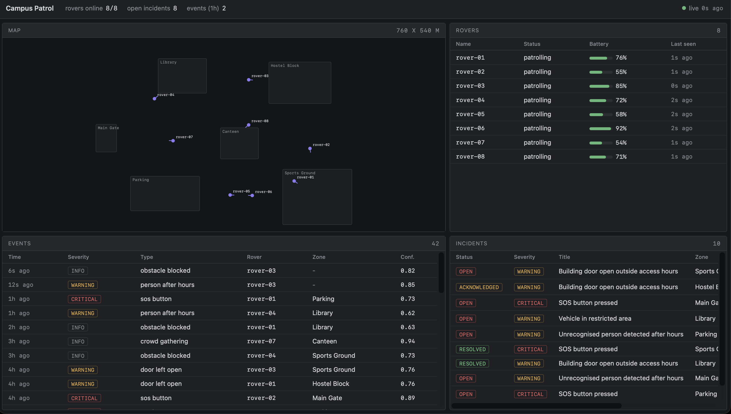
THE APP
A Foxglove-style dashboard for the fleet
Map
Live rover positions across campus zones
Rovers
Status, battery and last-seen per rover
Events
Detections with severity, zone and confidence
Incidents
Open → acknowledged → resolved triage
Running locally with Docker Compose: 8/8 rovers online, 8 open incidents
Notes:
This is the actual dashboard. React plus Vite, dark panel layout inspired by Foxglove. Four panels: the map with live rover positions inside campus zones, the rover table with status and battery, the event stream with severity and model confidence, and incidents that staff move from open to acknowledged to resolved. The header shows rovers online, open incidents and events in the last hour. This screenshot is the local Docker Compose run.

Slide 5
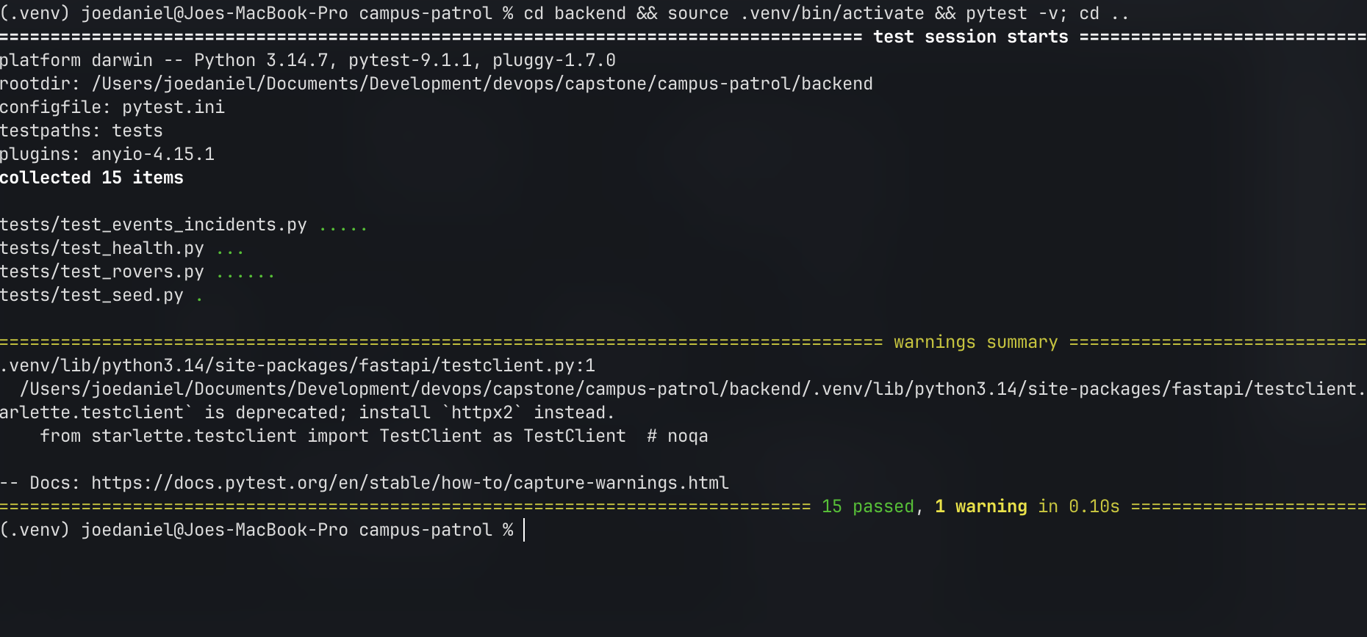
API & TESTS
A FastAPI backend built for Kubernetes
REST endpoints
/api/rovers
CRUD
/api/telemetry
pose + battery
/api/zones
campus zones
/api/events
detections
/api/incidents
CRUD
pytest -v: 15 passed in 0.10 s
/api/stats
header counters
/health
liveness
15 pytest tests covering rovers, events, incidents, health and seed data
In-memory SQLite, so tests need no running Postgres
Settings pinned in conftest, so exported env vars cannot change results
Stack: FastAPI · SQLAlchemy · Alembic migrations · PostgreSQL 16
/ready
checks the DB
/metrics
Prometheus
Notes:
The backend is FastAPI with SQLAlchemy and Alembic migrations on PostgreSQL 16. Endpoints cover rovers, telemetry, zones, events, incidents and summary stats. Three operational endpoints matter for Kubernetes: /health for liveness, /ready which actually checks the database, and /metrics for Prometheus. The test suite is 15 pytest tests on in-memory SQLite, isolated from the environment by pinning settings in conftest. They run in about a tenth of a second and gate every CI run.

Slide 6
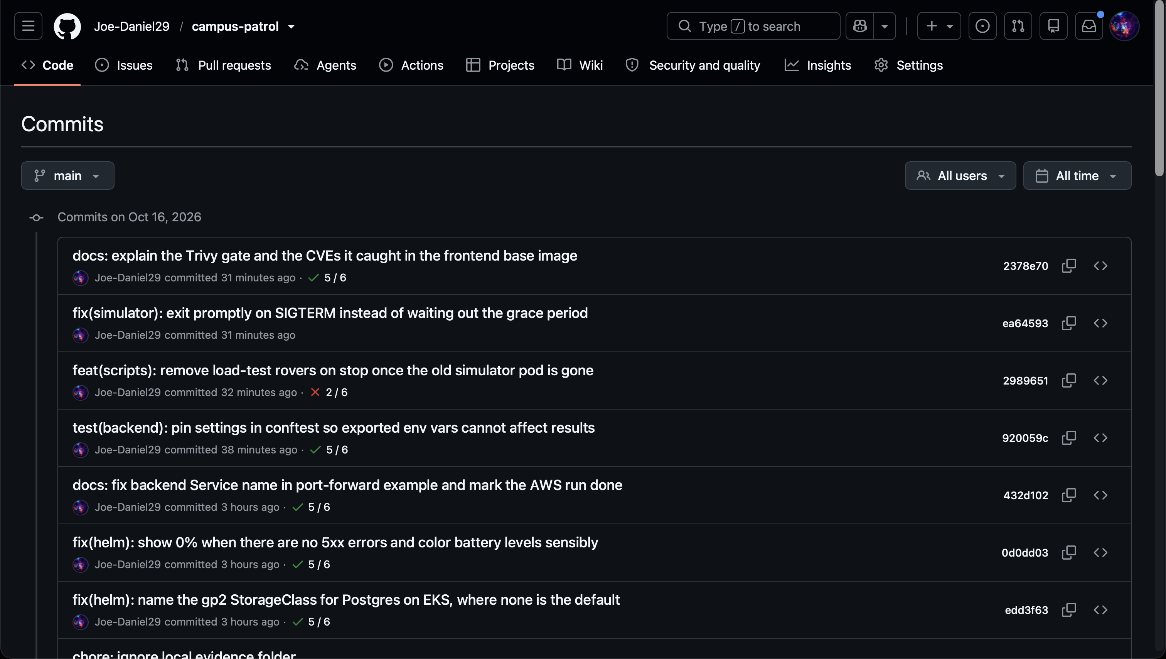
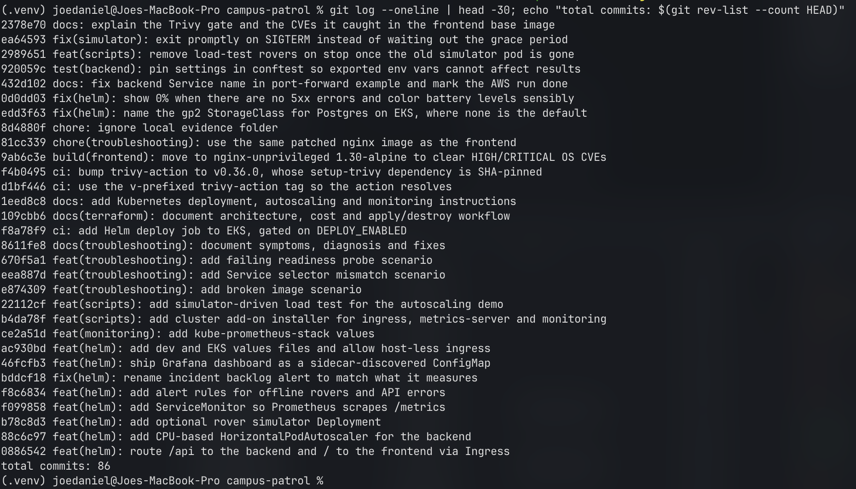
VERSION CONTROL
86 small commits, each one through CI
git log --oneline: Conventional Commits, 86 in total
Conventional Commits: feat, fix, ci, docs, test, build, chore
One change per commit, so history explains why, not just what
Every push runs CI: a red X on a commit means a check failed
GitHub commit list: each commit shows its CI check result
Notes:
All work is in one GitHub repo with 86 commits. I used Conventional Commit prefixes so the history reads like a changelog: feat for features, fix for bugs, ci for pipeline changes and so on. On the left is the GitHub view; each commit shows its check status, and you can see one with a red X where a pipeline step failed, which I then fixed in the next commit.

Slide 7
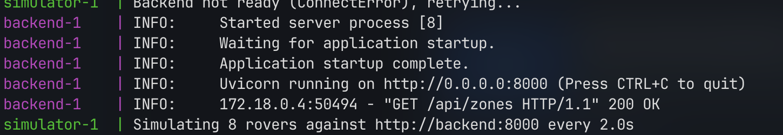
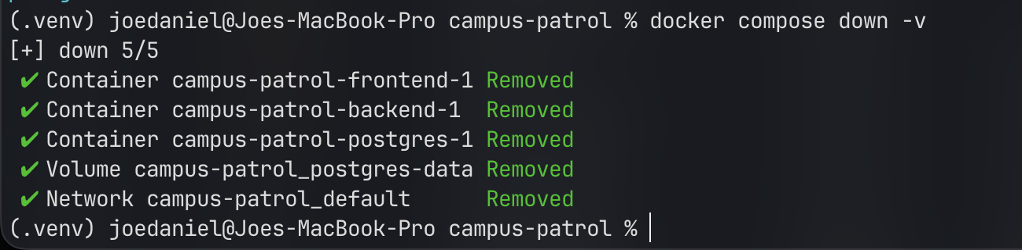
CONTAINERS
Non-root images and a one-command local stack
Backend uid 10001 · frontend nginx uid 101 · multi-stage build · Compose: postgres, backend, frontend, simulator
docker compose ps: all four services up, Postgres healthy
Logs: backend starts, simulator begins posting for 8 rovers
docker compose down -v: clean teardown, volume removed
Verified on EKS: kubectl exec … id shows both containers run as non-root users.
Notes:
Every image runs as a non-root user: the backend as uid 10001 and the frontend on the unprivileged nginx image as uid 101. The frontend uses a multi-stage build, so Node and the build tools never ship. Docker Compose brings up the whole stack locally with one command: Postgres with a health check, the backend which runs migrations before starting, the frontend and the simulator. The bottom strip proves the same images run as non-root inside the cluster.

Slide 8
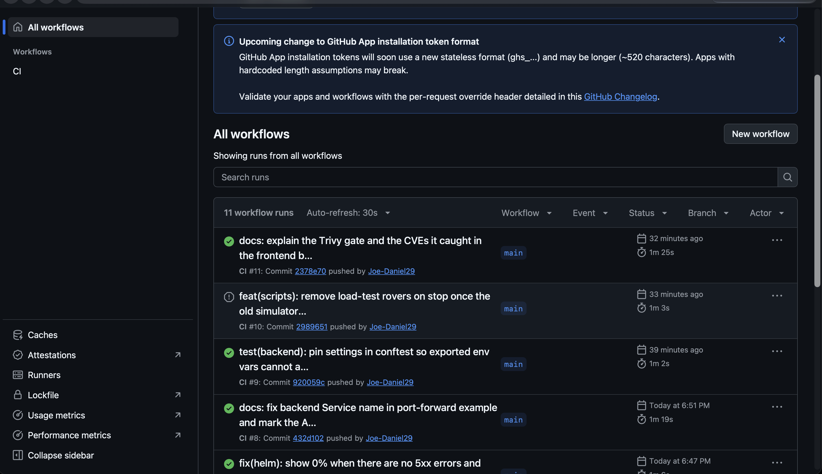
CI/CD
GitHub Actions: test, build, scan, publish
1
Test
15 pytest tests + Vite frontend build
2
Matrix of 3 images
backend · frontend · simulator
3
Build
docker build per image
4
Trivy scan
HIGH/CRITICAL, fixable only → fail job
5
Push to GHCR
tagged with the full commit SHA
Actions run history: 11 workflow runs on main
Deploy
6
Helm to EKS, gated off: no cloud secrets
Notes:
One workflow, ci.yml, triggered on push. Backend tests and the frontend build run first. If they pass, a matrix job builds the three images in parallel, scans each one with Trivy, and only then pushes to GitHub Container Registry, tagged with the full git commit SHA so every running image traces back to an exact commit. The deploy job to EKS exists in the workflow but is gated off with a flag, because I chose not to store cloud credentials in GitHub; I deployed with Helm from my machine.

Slide 9
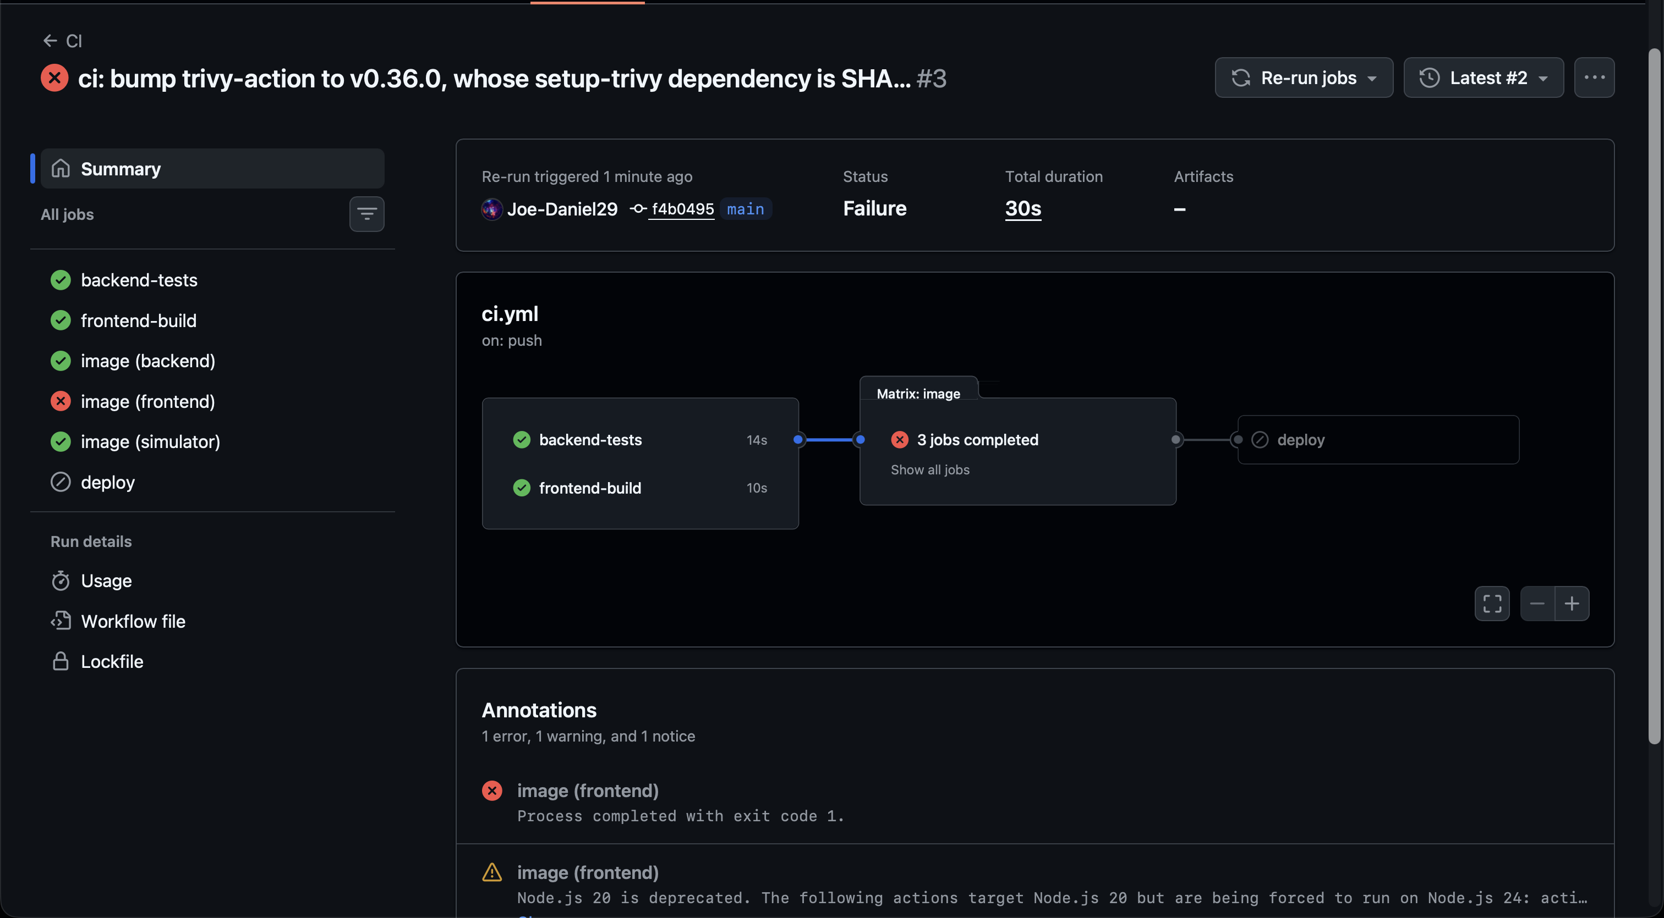
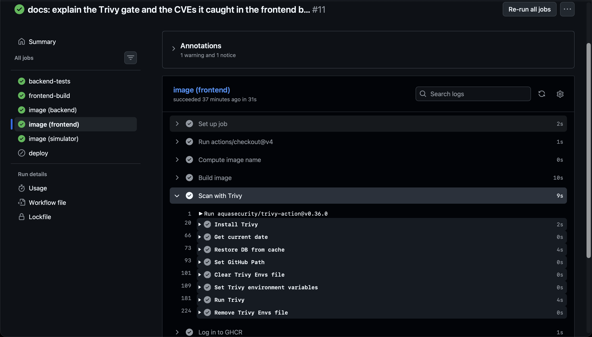
DEVSECOPS
The Trivy gate blocked 41 vulnerabilities
41
39 + 2
0
found by the first frontend scan
HIGH + CRITICAL
after the 1.30-alpine base image
BLOCKED
1.27-alpine base: frontend image blocked
PASSED
1.30-alpine base: scan passes, pushed
Run #3: image (frontend) failed at the scan; deploy skipped
Run #11: Scan with Trivy succeeds, then Log in to GHCR
Notes:
This is the security gate doing its job. The first scan of the frontend image found 41 vulnerabilities, 39 HIGH and 2 CRITICAL, all in the old nginx-unprivileged 1.27-alpine base image. One example is CVE-2026-31789, a heap buffer overflow in OpenSSL libcrypto3 3.3.3, fixed in 3.3.7; it is only exploitable on 32-bit systems, but the gate fails on any fixable HIGH or CRITICAL, so the push was blocked. Left: the failed run, image (frontend) red and deploy skipped. The fix was to move to nginx-unprivileged 1.30-alpine, which cleared all 41. Right: the same scan step now passing.

Slide 10
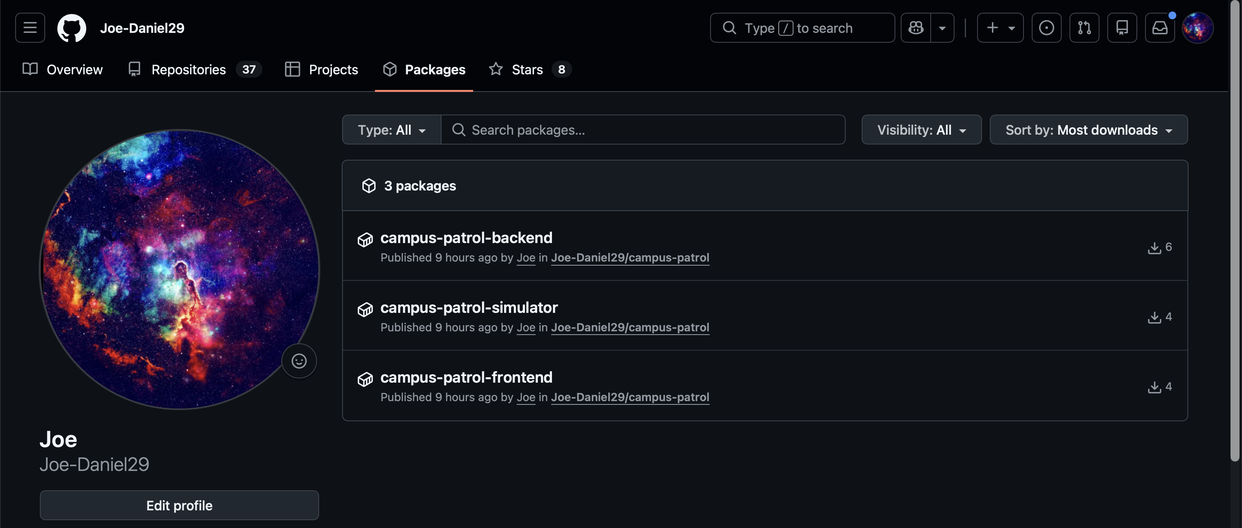
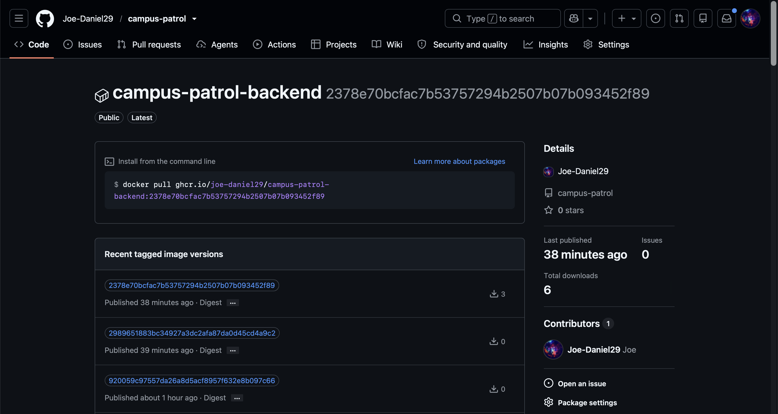
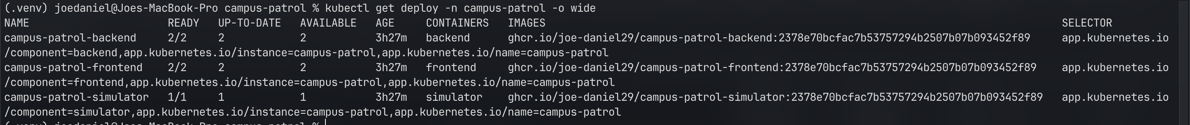
REGISTRY & TRACEABILITY
Every image is tagged with its commit SHA
GHCR: three packages published from the repo
Backend versions, each tag a full commit SHA
kubectl get deploy -o wide: the cluster runs ghcr.io/joe-daniel29/campus-patrol-*:2378e70…, the latest main commit
Notes:
Images go to GitHub Container Registry: backend, frontend and simulator. Instead of a mutable latest tag, each image is tagged with the full commit SHA. The bottom screenshot closes the loop: kubectl shows all three Deployments in the cluster running images tagged 2378e70, which is exactly the latest commit on main from the Git slide. So for any running pod I can say precisely which code it is.

Slide 11
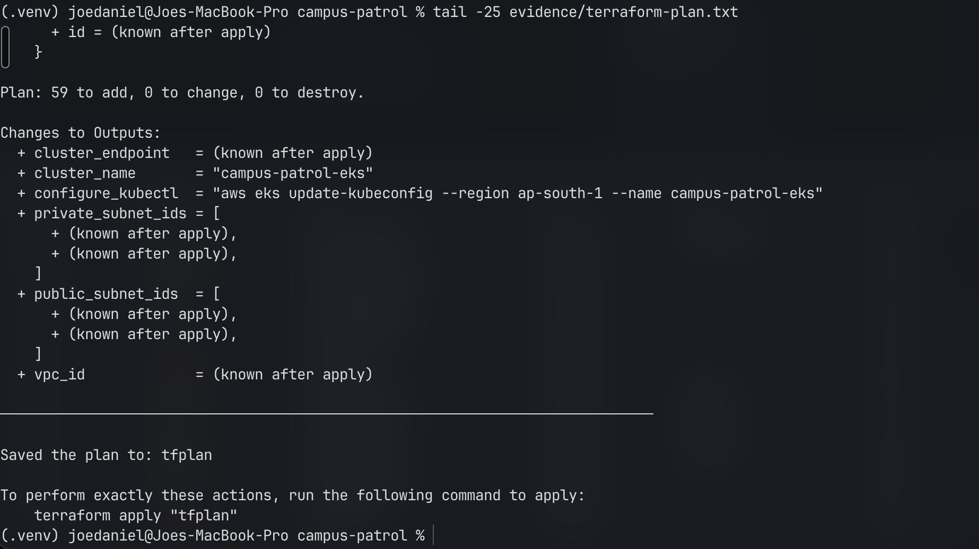
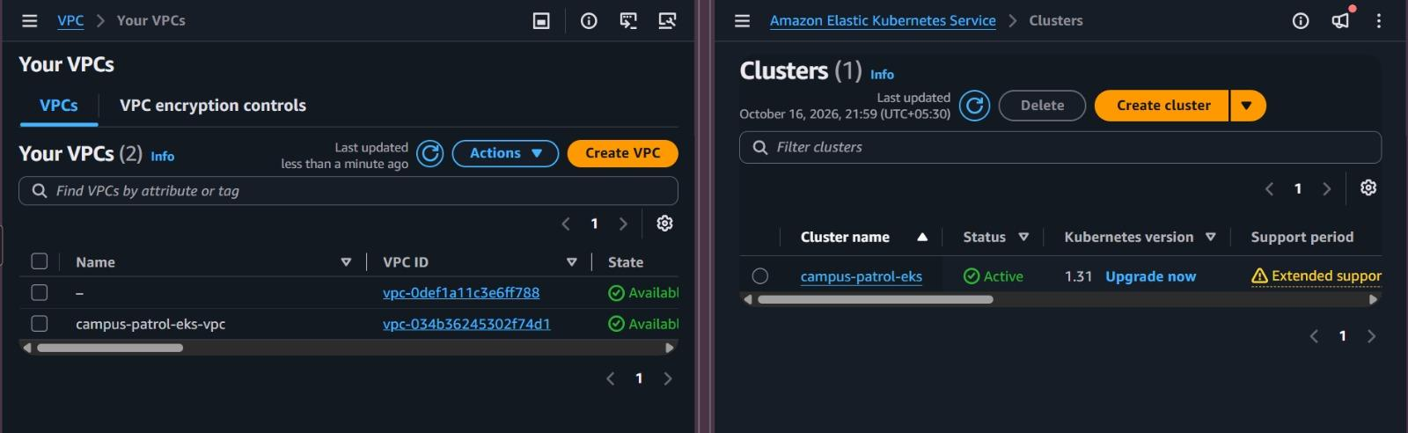
INFRASTRUCTURE AS CODE
Terraform builds the VPC and EKS cluster on AWS
Region: ap-south-1 (Mumbai)
VPC 10.20.0.0/16: 2 public + 2 private subnets across 2 AZs, single NAT gateway
EKS 1.31: managed node group, 3 × t3.medium (min 3, max 5)
Add-ons: coredns, kube-proxy, vpc-cni, aws-ebs-csi-driver
terraform plan: 59 to add, 0 to change, 0 to destroy
AWS console: the VPC and EKS cluster, Active on 1.31
Notes:
All AWS infrastructure is Terraform. In Mumbai: a VPC on 10.20.0.0/16 with two public and two private subnets across two availability zones and a single NAT gateway to keep cost down. On top, an EKS 1.31 cluster with a managed node group of three t3.medium nodes that can grow to five, plus the core add-ons including the EBS CSI driver for persistent volumes. The plan is 59 resources to add. The console screenshot shows the result: the VPC and the cluster Active.

Slide 12
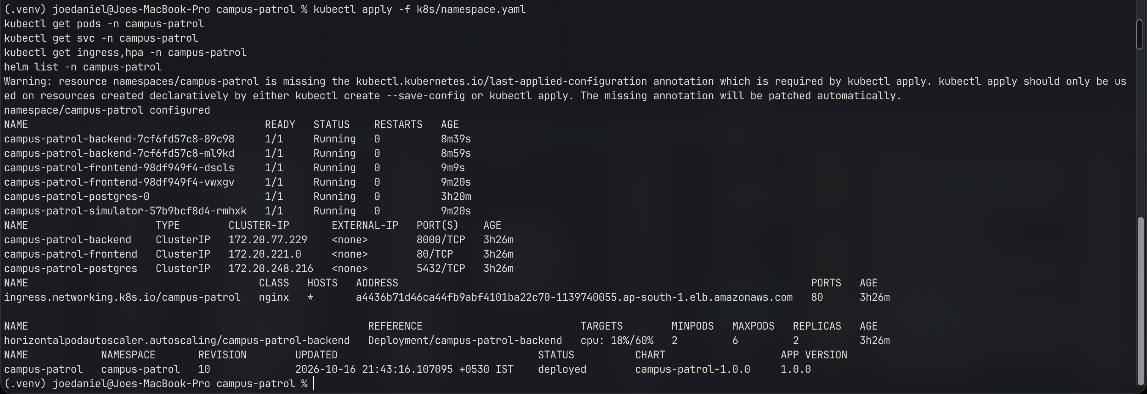
KUBERNETES & HELM
One Helm chart deploys the whole application
Chart contents
Backend Deployment + HPA
Frontend Deployment
PostgreSQL StatefulSet + generated password Secret
ClusterIP Services
nginx Ingress: /api and /
ServiceMonitor + alert rules
Grafana dashboard ConfigMap
Optional simulator Deployment
kubectl: pods Running, ClusterIP Services, Ingress on the ELB, HPA 18%/60%, Helm rev 10
2 – 6
2
1
10
backend replicas (HPA at 60% CPU)
frontend replicas
Postgres StatefulSet on gp2 EBS
Helm revisions deployed
Notes:
Everything in the cluster comes from one Helm chart. The backend Deployment has a HorizontalPodAutoscaler from 2 to 6 replicas at 60 percent CPU; the frontend runs 2 replicas. PostgreSQL is a StatefulSet on an EBS gp2 volume with a generated password Secret. Services are ClusterIP only; the only public entry is the nginx Ingress behind an AWS load balancer. The chart also ships the monitoring pieces: ServiceMonitor, alert rules and the Grafana dashboard. The screenshot shows everything Running and Helm at revision 10.

Slide 13
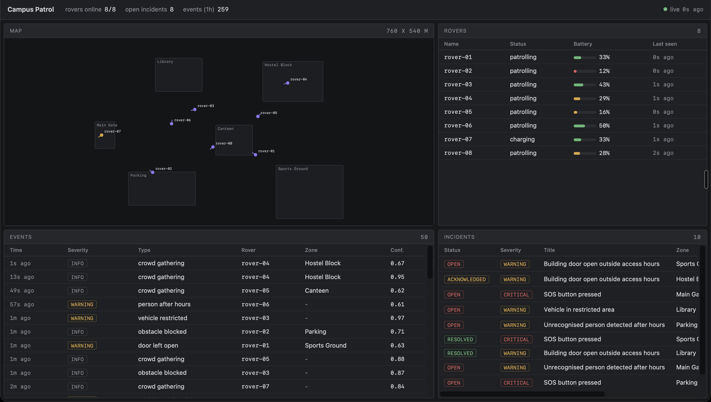
LIVE ON AWS
Served through the Ingress and load balancer
Ingress routes
/
→ frontend (nginx)
/api
→ backend (FastAPI)
One AWS load balancer in front of ingress-nginx
Services stay ClusterIP, nothing else is exposed
Images pulled from GHCR by commit SHA
Dashboard on EKS via the ELB hostname: 8/8 rovers online, 259 events in the last hour
Notes:
This is the same dashboard, now served from EKS through the AWS load balancer and the nginx Ingress. The Ingress sends /api to the backend and everything else to the frontend, so the browser talks to one hostname. Backend and frontend Services stay ClusterIP; nothing else is exposed to the internet. The simulator in the cluster is driving 8 rovers and you can see 259 events in the last hour.

Slide 14
AUTOSCALING
200 rovers of load, zero errors
200
2 → 6
0
≈335 ms
simulated rovers in the load test
backend replicas, scaled by the HPA
HTTP 5xx errors during the test
p95 request latency
Simulator
200 rovers posting telemetry
Backend CPU
rises above the 60% target
metrics-server → HPA
adds replicas, max 6
6 backend pods
share the load, 0 errors
The simulator doubles as the load generator, so the test exercises the real API paths that rovers use.
Notes:
To prove autoscaling I reused the simulator as a load generator with 200 rovers. Backend CPU climbed past the 60 percent target, and the HorizontalPodAutoscaler, using metrics-server, scaled the backend from 2 to its maximum of 6 replicas. Throughout the test there were zero 5xx errors and p95 latency stayed around 335 milliseconds. The load-test script also removes its extra rovers when it stops.

Slide 15
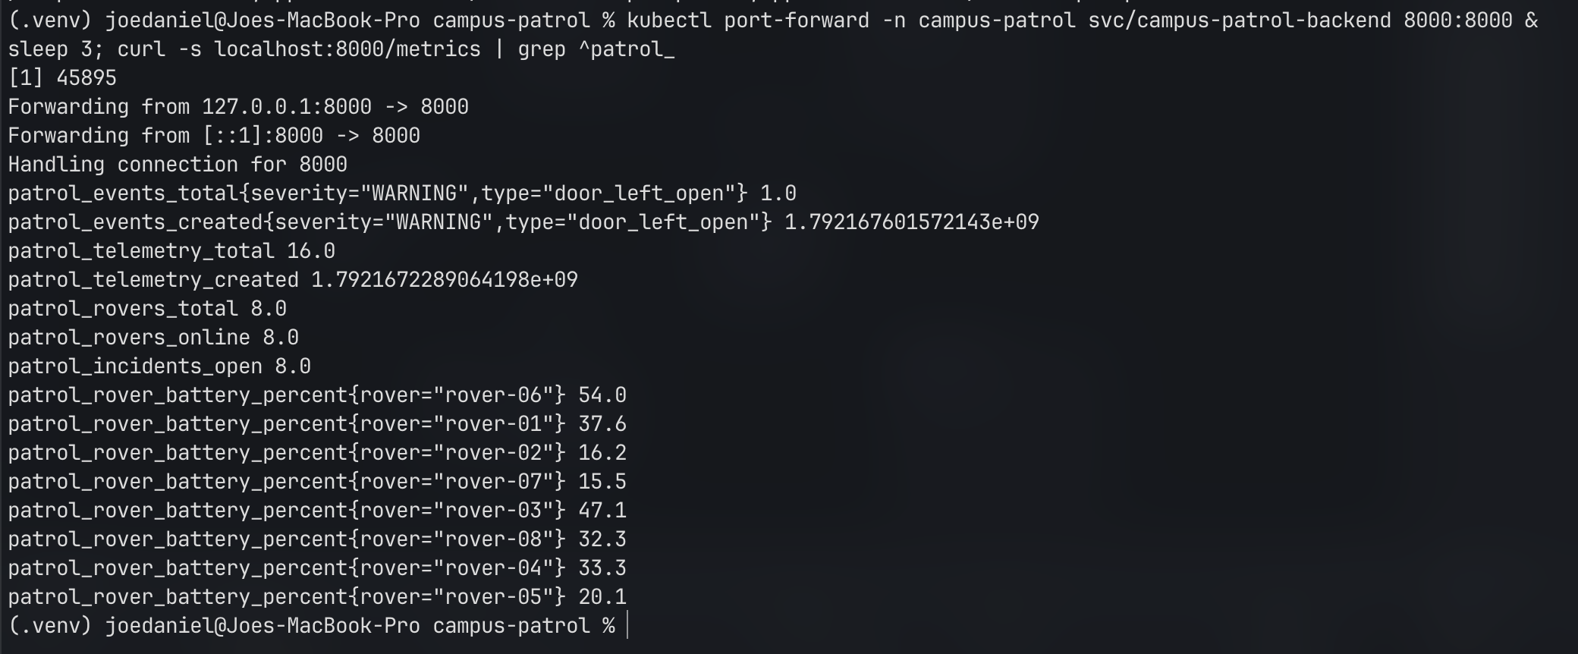
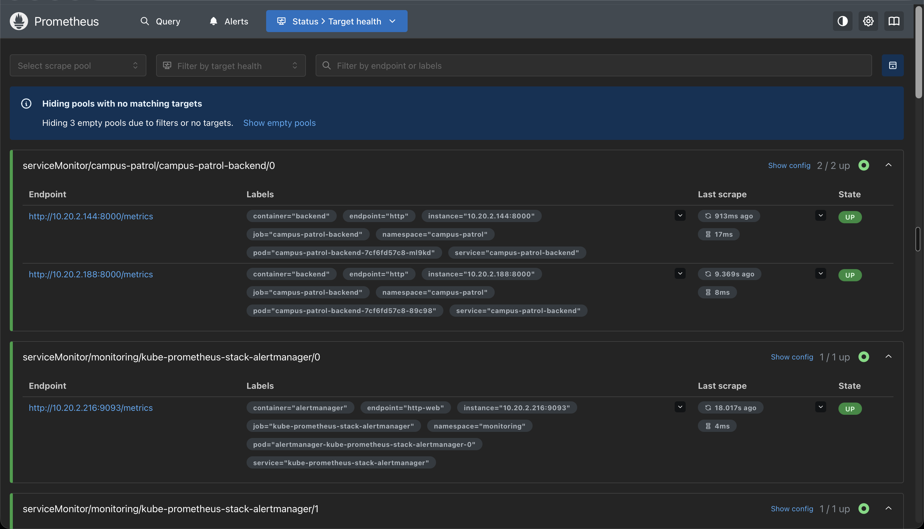
OBSERVABILITY
Custom metrics scraped by Prometheus
Backend /metrics: custom patrol_* metrics
Alert rules shipped in the chart
RoverOffline
a rover stops reporting
Prometheus targets: campus-patrol-backend 2/2 UP via ServiceMonitor
BackendHighErrorRate
too many 5xx responses
IncidentBacklog
open incidents pile up
Notes:
The backend exposes standard HTTP metrics plus domain metrics: patrol_rovers_online, patrol_events_total by type and severity, patrol_telemetry_total, open incidents, and battery per rover. A ServiceMonitor in the Helm chart tells the kube-prometheus-stack to scrape them; Prometheus shows both backend pods UP. Three alert rules ship with the chart: RoverOffline, BackendHighErrorRate and IncidentBacklog.

Slide 16
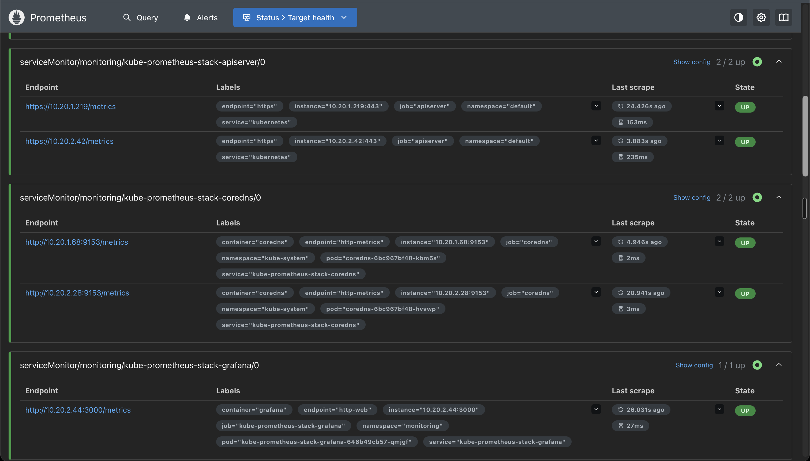
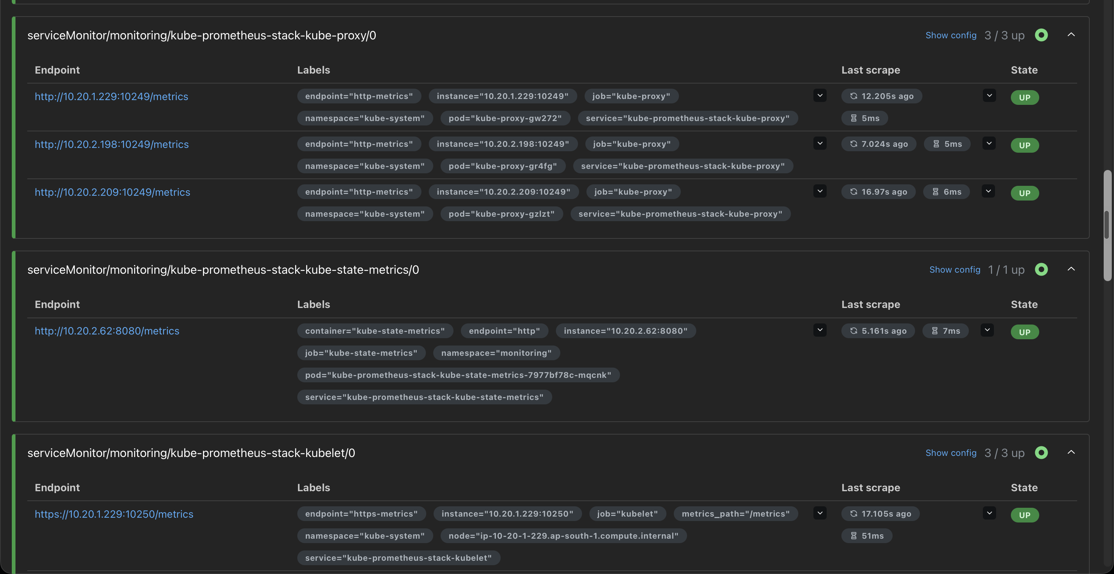
OBSERVABILITY
Every scrape target in the cluster is UP
kube-prometheus-stack also scrapes the control plane and nodes, so app and platform health live in one place.
kube-proxy 3/3 (one per node), kube-state-metrics 1/1, kubelet 3/3 UP
apiserver 2/2, coredns 2/2, grafana 1/1 UP
Notes:
Scrolling further down the Prometheus target page: the API server, CoreDNS, Grafana, kube-proxy on all three nodes, kube-state-metrics and the kubelets are all UP. This means the same Prometheus covers both my application and the platform it runs on.

Slide 17
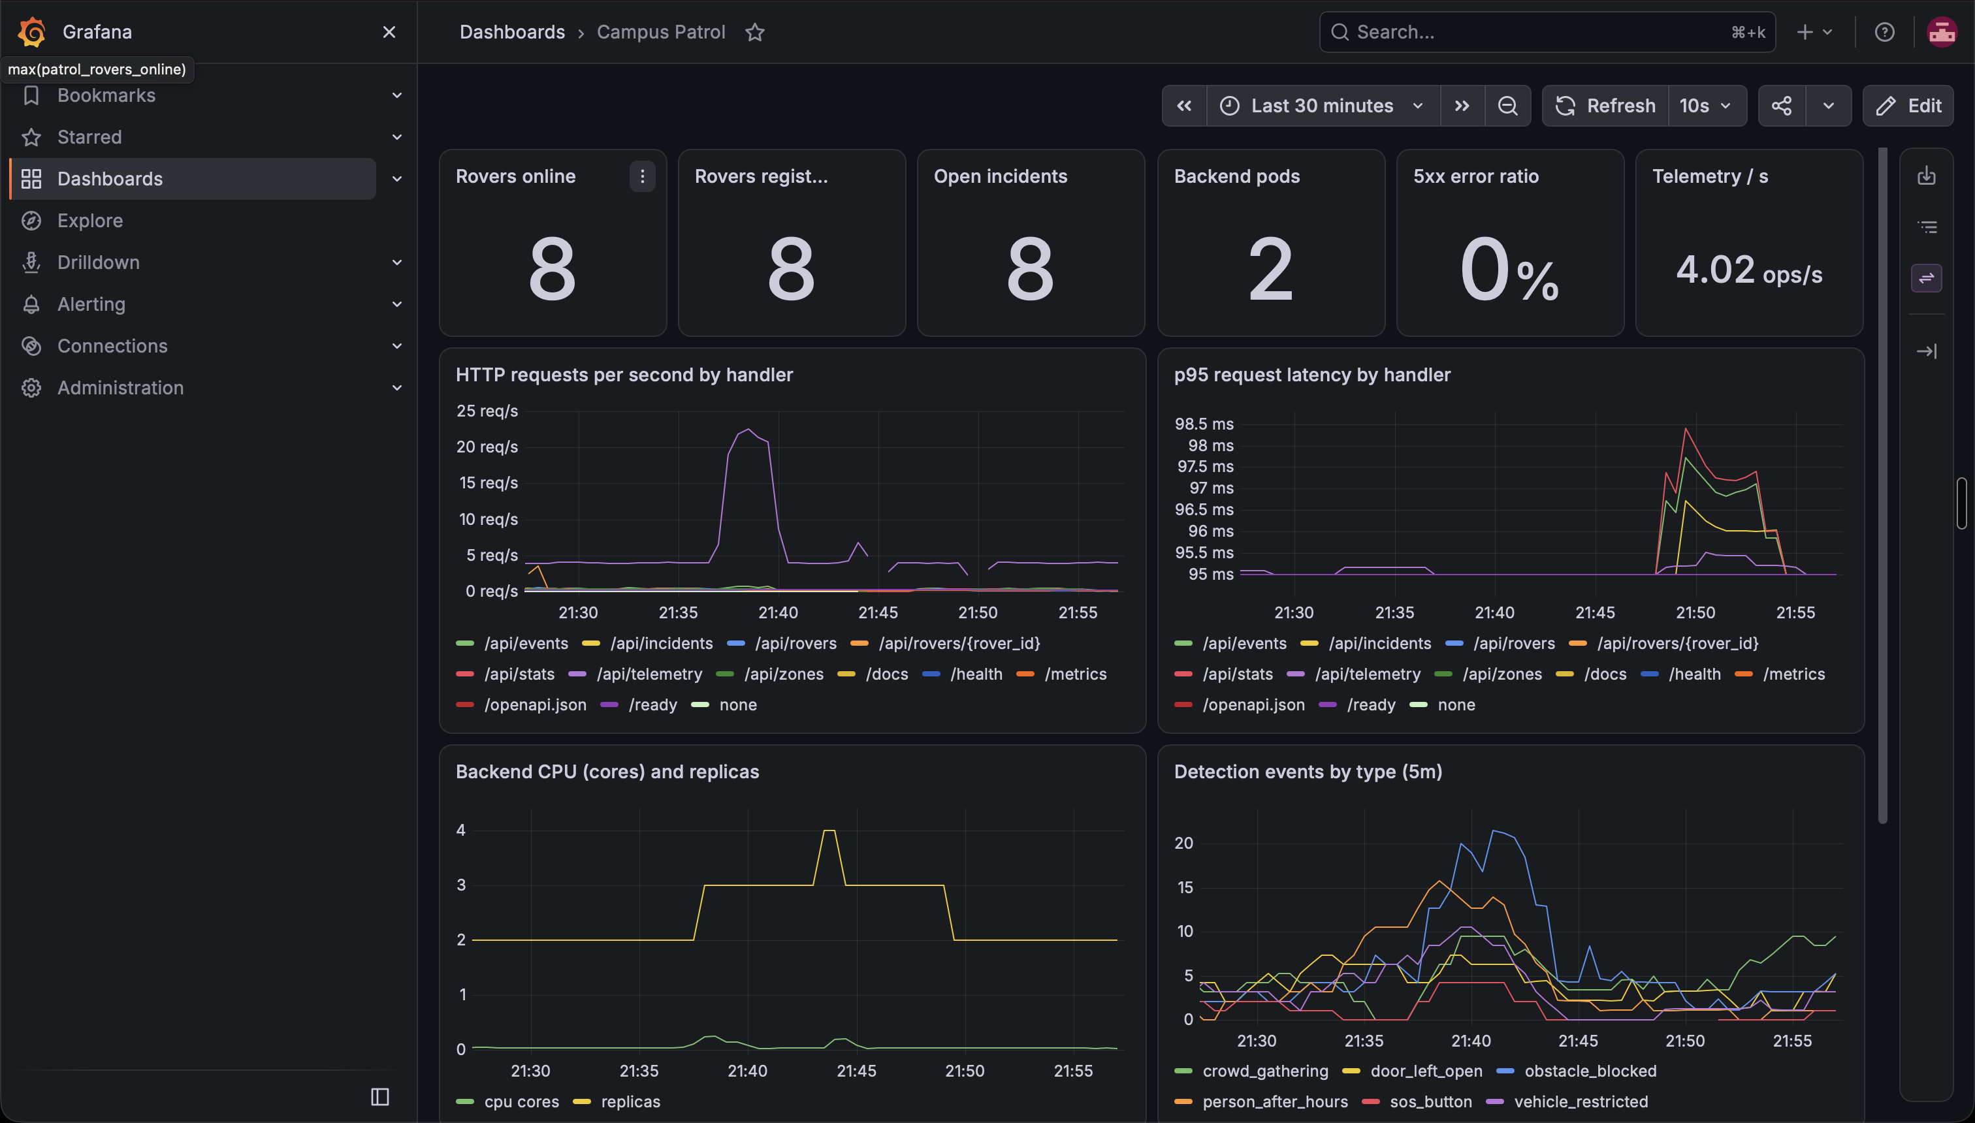
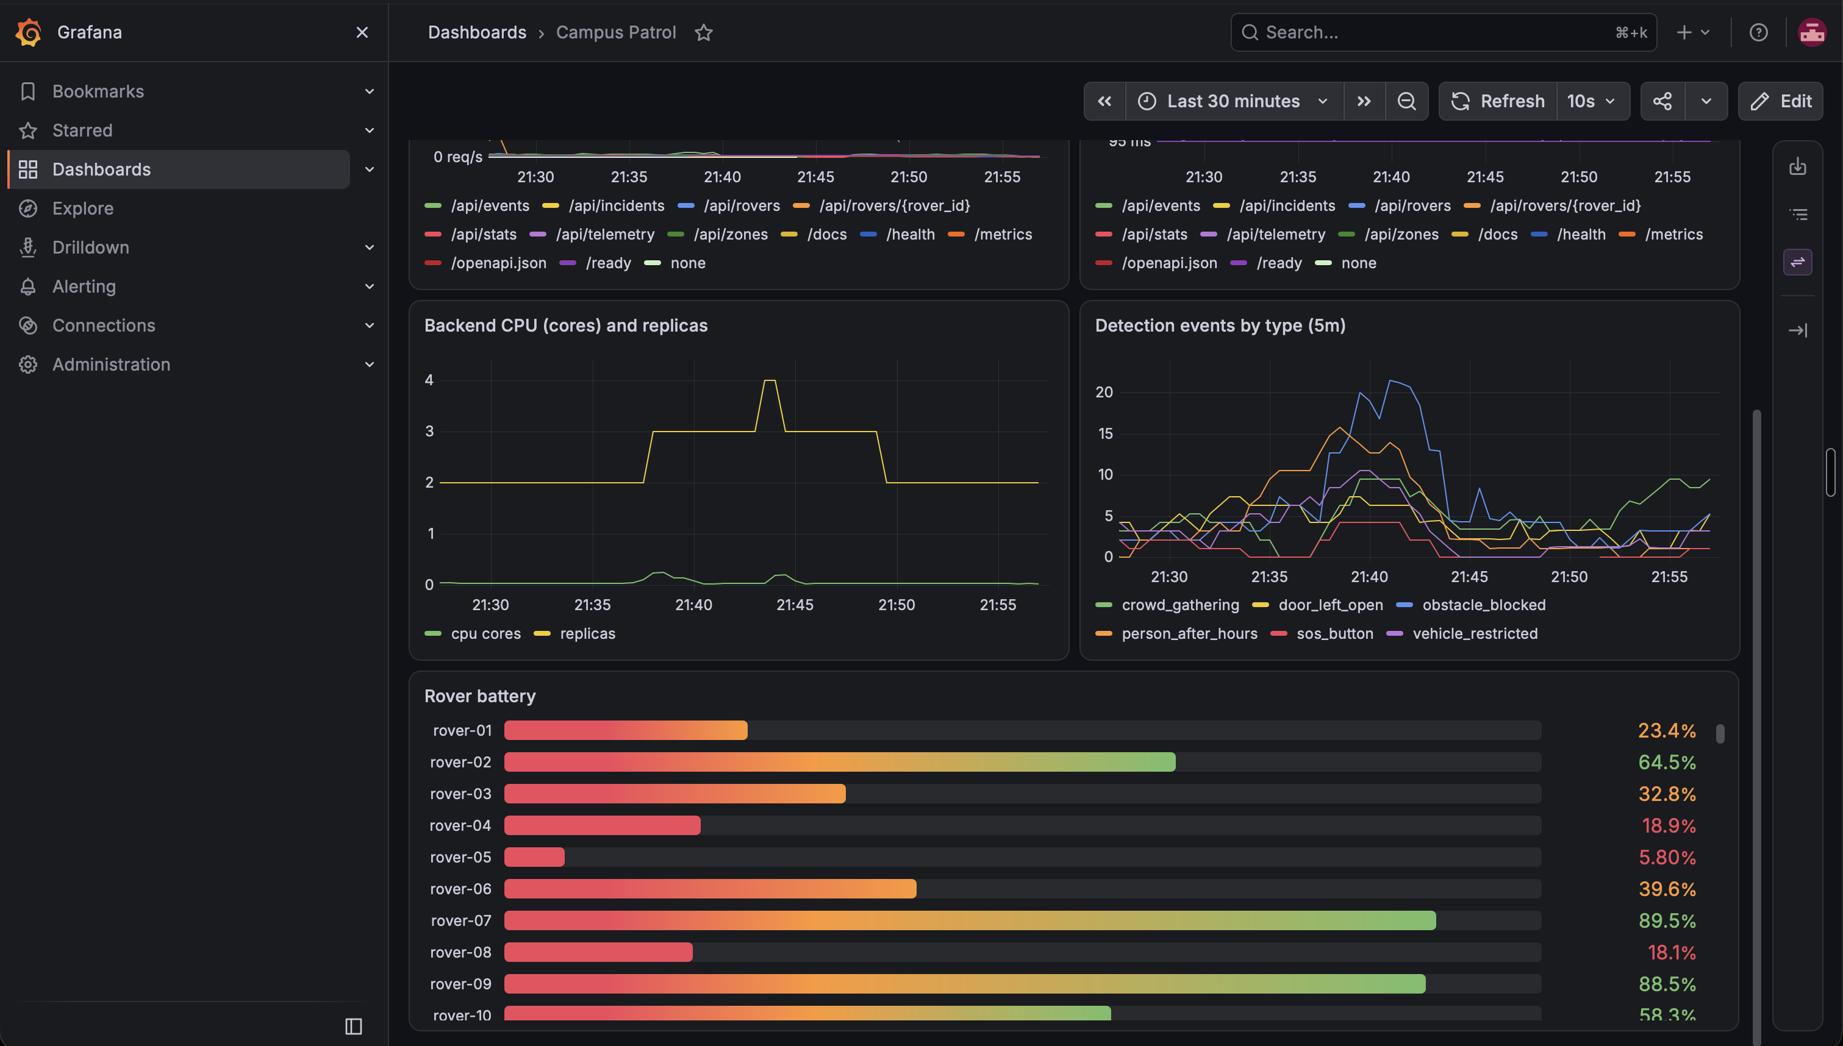
OBSERVABILITY
Grafana dashboard, shipped as code
11 panels in a ConfigMap, auto-loaded by Grafana's sidecar, so the dashboard is versioned with the chart.
Stat row, request rate, p95 latency, CPU vs replicas, events by type
Scrolled down: per-rover battery gauge
Notes:
The Grafana dashboard has 11 panels and is not hand-built in the UI: it is JSON inside a ConfigMap in the Helm chart, picked up by Grafana's sidecar, so it is version-controlled. Top row: rovers online, rovers registered, open incidents, backend pods, 5xx error ratio and telemetry rate. Below: request rate and p95 latency per endpoint, backend CPU against replica count, detection events by type, and battery per rover.

Slide 18
TROUBLESHOOTING LAB
Three broken deployments, fixed live
01
02
03
ImagePullBackOff
Selector mismatch
Failing readiness probe
SYMPTOM
SYMPTOM
SYMPTOM
Pod never starts
Service has no endpoints, requests fail
Pod Running but 0/1 Ready
DIAGNOSIS
DIAGNOSIS
DIAGNOSIS
kubectl describe pod: the image tag does not exist in the registry
kubectl get endpoints is empty: the Service selector does not match the pod labels
kubectl describe pod: readiness probe failures in Events
FIX
FIX
FIX
Point the Deployment at a real tag
Make the selector match the labels
Correct the probe so it targets a healthy endpoint
Notes:
For the troubleshooting module I deliberately broke the deployment three ways and fixed each live. One: a bad image tag gives ImagePullBackOff; describe pod shows the pull error, fix the tag. Two: a Service selector that does not match the pod labels; the pods are fine but the Service has no endpoints, so traffic goes nowhere. Three: a failing readiness probe; the pod is Running but shows 0 of 1 Ready, so it gets no traffic. The scenarios and fixes are documented in the repo.

Slide 19
CHALLENGES & LESSONS
Real problems hit along the way
Trivy action would not resolve
41 CVEs in the base image
Node group create timed out (409)
Tag not found, then a removed transitive dependency. Pinned trivy-action v0.36.0.
The gate blocked the push. Moved to nginx-unprivileged:1.30-alpine.
terraform import, then re-apply. Zero drift afterwards.
Postgres volume stuck Pending
Replicas racing to run migrations
Simulator ignored SIGTERM as PID 1
EKS has no default StorageClass. Named gp2 explicitly.
Wrapped migrations in a Postgres advisory lock.
Added a signal handler so pods stop promptly.
Notes:
These are the real problems I hit. The Trivy GitHub Action first failed to resolve because of a tag format issue and then a removed transitive dependency; pinning v0.36.0 fixed it. The scan then caught 41 CVEs, fixed by the base image bump. Terraform's node group creation timed out with a 409 conflict even though AWS had created it; I imported it into state and re-applied with zero drift. The Postgres volume sat Pending because EKS has no default StorageClass, so the chart now names gp2. Multiple backend replicas raced to run migrations; a Postgres advisory lock serialises them. And the simulator ran as PID 1 and ignored SIGTERM, so pods took the full grace period to stop; a signal handler fixed that. Lesson: most of DevOps is reading the error carefully.

Slide 20
SUMMARY
Thank you
Questions?
App & REST API
15 pytest tests
Git workflow
Non-root Docker
CI/CD pipeline
Trivy security gate
Terraform on AWS
Kubernetes + Helm
HPA autoscaling
Prometheus + Grafana
Joe Daniel · github.com/Joe-Daniel29/campus-patrol
Notes:
To sum up: a working app with a tested API, built into non-root containers, delivered by a CI pipeline with a security gate that actually caught real vulnerabilities, published to a registry with commit-SHA tags, running on an EKS cluster built with Terraform, deployed with one Helm chart, autoscaling under load, and fully observable with Prometheus and Grafana. Thank you, happy to take questions.

