Slide 1
So You Want To Enter the NHC?

Slide 2
Step One: Hone Your Recipe
LIBME Feedback Table. Talk to experienced judges NOT your buddies.
Local Competitions (LIBME NOV. 21st/NYCHG January).
What you intended to brew DOES NOT have to be the category you enter.
Brew, Brew, and Brew again.

Slide 3
Step Two: When to Brew
Must be a current AHA member
First round: Queens, late March/Early April.
Second Round: June 8th, Baltimore
Malty high ABV beers can be brewed early
Hop forward beers as close to possible to entry deadline.
Some styles are best brewed twice, once for each round. (i.e.Weizen, IPA, etc)

Slide 4
Step Three: Entering & Shipping
Potential entrants are part of lottery to submit entries. Registration is typically in early Feb. But can edit entries up until March.
Request as many spots as possible.
Use brown bottles with no identifying marks
Rubber band your entry identification to bottle. NO TAPE!
Use containers specifically for bottles. Don’t be cheap! Do it right.

Slide 5
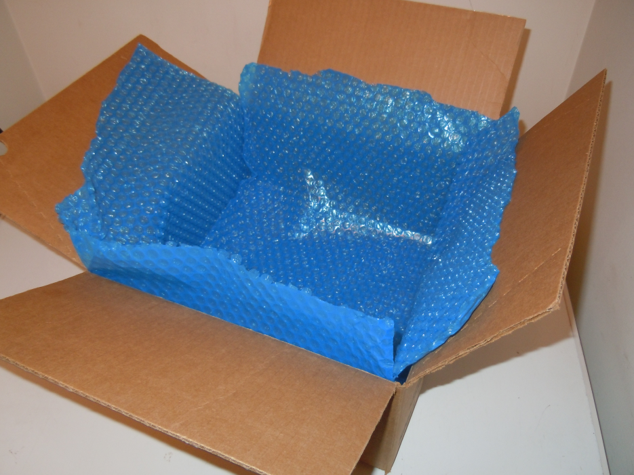
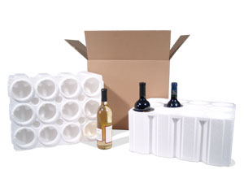
Step Three: Entering & Shipping
PLAN ACCORDINGLY
-Do Not use USPS
-Your box WILL NOT be handled carefully
-Trucks are HOT in late May

