Slide 1
6 Years of Grad School in 30 Minutes
Joe Hilgard

Slide 2
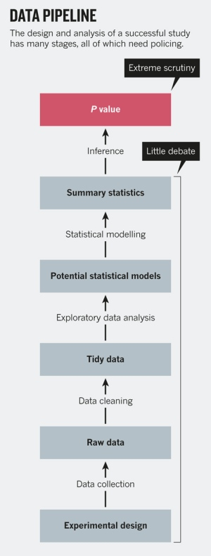
P-value is just the tip of the iceberg. Be confident of every step.

Slide 3
ABC: Always Be Coding

Slide 4
Always Be Coding
There is a clever way and a not-so-clever way to do every task.
The clever way requires more investment but pays dividends.
The not-so-clever way works now, but you’ll pay for it later.
Do things the clever way. Write code.

Slide 5
Practice Good Code and Data Hygiene

Slide 6
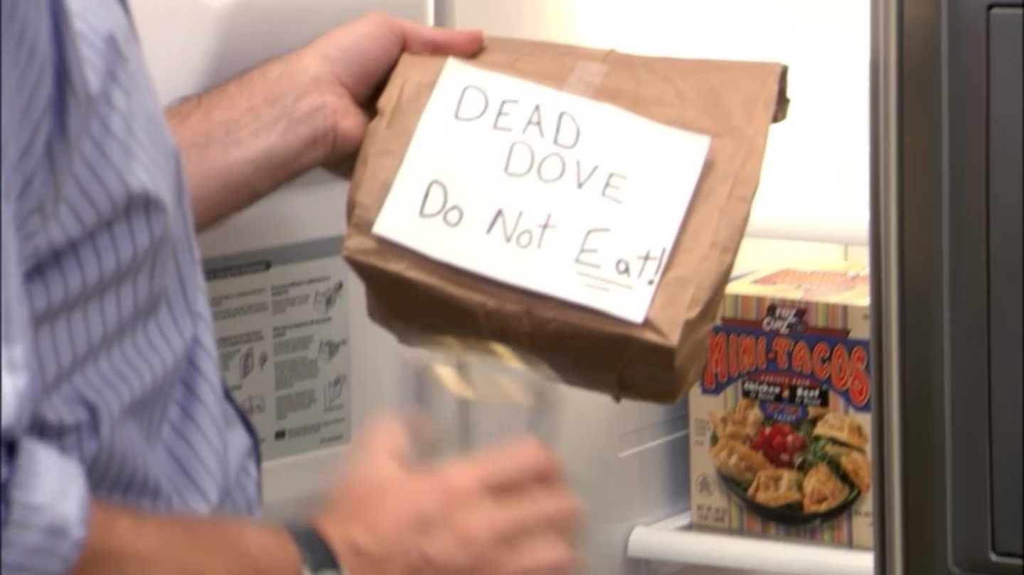
Data Hygiene
Make a copy of your raw data
Archive it
Online
DO NOT MESS WITH THE RAW DATA.
RAW DATA

Slide 7
Data Hygiene
Keep a codebook file that explains what every column of your dataset is.

Slide 8
Data Hygiene
Preserve your data for future generations by putting it on OSF
Other people are going to want to look at your data, either to check it or to explore other hypotheses.
Meta-analysts are going to need statistics that maybe you didn’t report.
If you work matters, people are going to try to build on it. Make sure the data is somewhere close at hand.

Slide 9
Code Hygiene
Version control
Use Git
Dropbox and OSF also have an amount of version control built in.
Use version control instead of having files with names like
“firstYearProject_outliersDropped_Winsorized_aggregatedZScore_final_new_reallyfinal.sav”

Slide 10
Code Hygiene
Make scripts that run from top to bottom.
Have a master script that calls the subscripts with source()
Make sure the script runs from top to bottom before the commit.
Don’t use the command prompt.
I call this “barebacking” – it’s about as dangerous and about as smart.

Slide 11
Code Hygiene
Don’t Repeat Yourself (DRY)
If you’re copy-pasting a brick of code over and over, consider turning it into a function instead.
You will make fewer typos this way and the code will be easier to fix.

Slide 12
Code Hygiene
Comment your code!
Comments help other people and collaborators understand your code.
You’re going to have to come back to your code in six months after your peer review. Good luck remembering what you did!

Slide 13
Code Hygiene
Learn to debug
Use print() or cat() to check on your variables.
Use stopifnot() to catch errors.

Slide 14
Code Hygiene
Factors in R
Factors are mean and weird and cranky. Just be careful with them.

Slide 15
General Hygiene
Pick a naming convention and stick to it.
ant.format (might work poorly with file extensions)
gooseneck_format
camelBackFormat (be consistent about leading capital)
Do NOT use spaces in column names, file names, folder names.

Slide 16
General Hygiene
Make sure columns have the same names across (and especially within!) studies.
Make each column describe only one attribute.

Slide 17
General Hygiene
When working with collaborators, give them all the columns they could possibly need.
Let them select() the ones they want, or give them a script that does select() for them.
It sucks to go back and try to add columns.

Slide 18
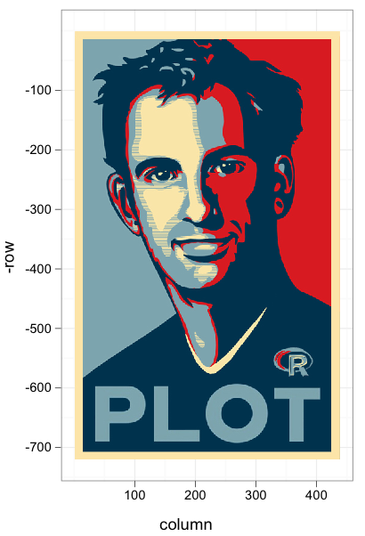
Master the Hadleyverse

Slide 19

Master the Hadleyverse
tidyr, dplyr, and ggplot2 are the Deathly Hallows of Data Analysis
If you master all three, you will be an incredible data wizard.

Slide 20
Master the Hadleyverse
tidyr: The Philosopher’s Stone. Columns into rows.
dplyr: The Wand of Death. Kill bad rows, mutate cols.
ggplot2: The Cloak of (In)visibility. See your data.

Slide 21
Use Social Media

Slide 22
Use Social Media
GitHub
Shows everyone you know how to code
Twitter
Keeps you up to date on the literature much faster than the journals
StackExchange
Your question has already been answered.
If not, experts are dying to answer your questions for meaningless internet points.
You can earn meaningless internet points by asking good questions.

Slide 23
Be Honest with Yourself

Slide 24
Being Honest
Be careful with language
Don’t say “reliable” when you mean “statistically significant.”
Know the definition of p-value and of confidence interval.

Slide 25
Being Honest
If you have to transform the data 80 ways to find evidence, do you really have evidence?
If it only holds in a very specific subgroup or complex interaction, do you think that will replicate?
You can get honest and interesting null results published.

Slide 26
Being Honest
There’s a lot of crap going on out there.
HARKing
Moderator munging
Optional stopping
One-tailed tests (even F-tests!)
Preregister your hypotheses and how you will test them. You will save yourself a lot of time in the long run, feel better about your research, and your null results will mean something.

Slide 27
P-value Isn’t Everything

Slide 28
P-Value Isn’t Everything
There are many ways to talk about evidence.
AIC
BIC
Bayes Factor
Effect Size and Confidence Interval
Sometimes you run a great experiment and but you get only a little evidence. You need to be able to argue that.

