Slide 1
Learn and Help 3.0
Developer Manual
Team Alligators
Mekdes Gebrechristos, Hamdi Kelil, Jet Lao, Pong Lee, Daniel Kolles

Slide 2
Overview
Welcome / Introduction
Team Alligators
Mekdes Gebrechristos
Hamdi Kelil
Pong Shoua Lee
Jet Lao
Daniel Kolles
Learn and Help 2.0 https://learnandhelp.jasthi.com/
Presentation Scope
Developer Manual
Q & A

Slide 3
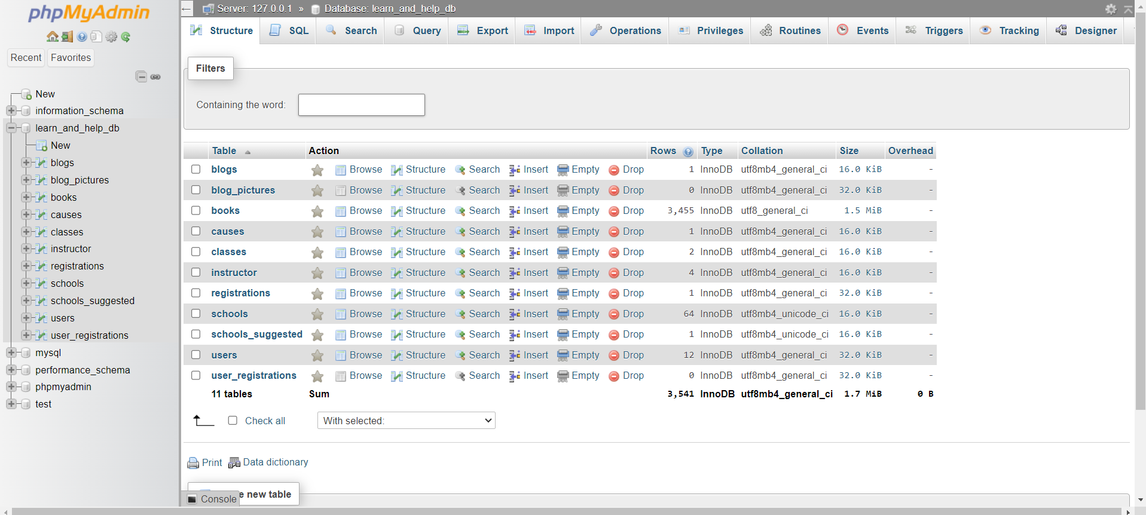
phpMyAdmin
MySQL Database Tables

Slide 4
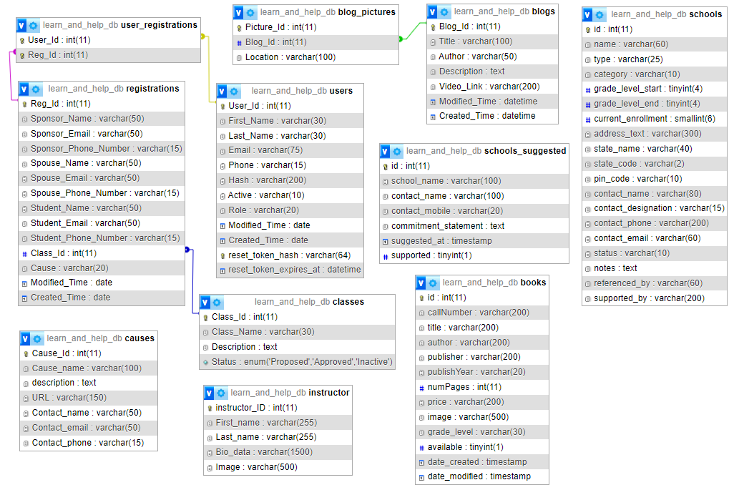
Database Schema
Relationship between tables

Slide 5
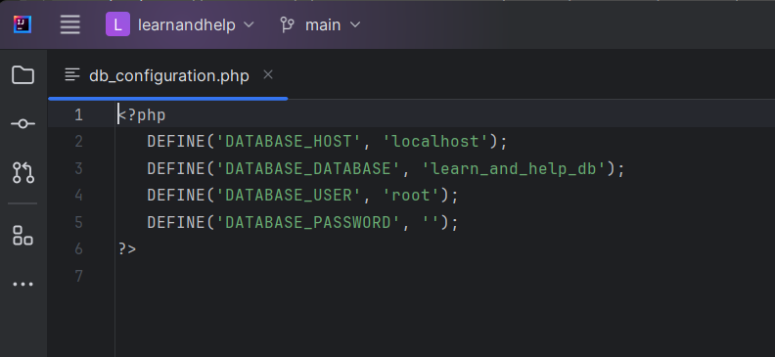
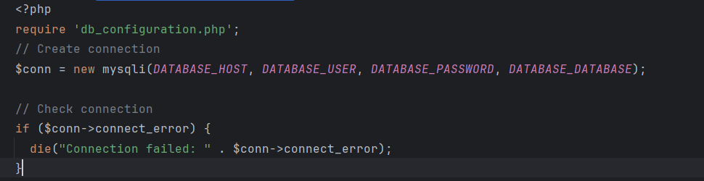
db_configuration
Connection to database to access table contents
db_configuration.php

Slide 6
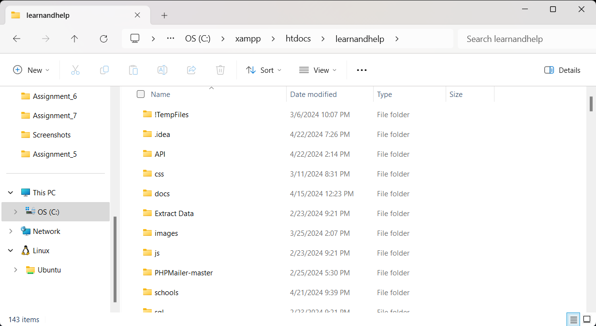
Directory Structure
C:\xampp\htdocs\learnandhelp
Copied project to XAMPP in htdocs folder

Slide 7
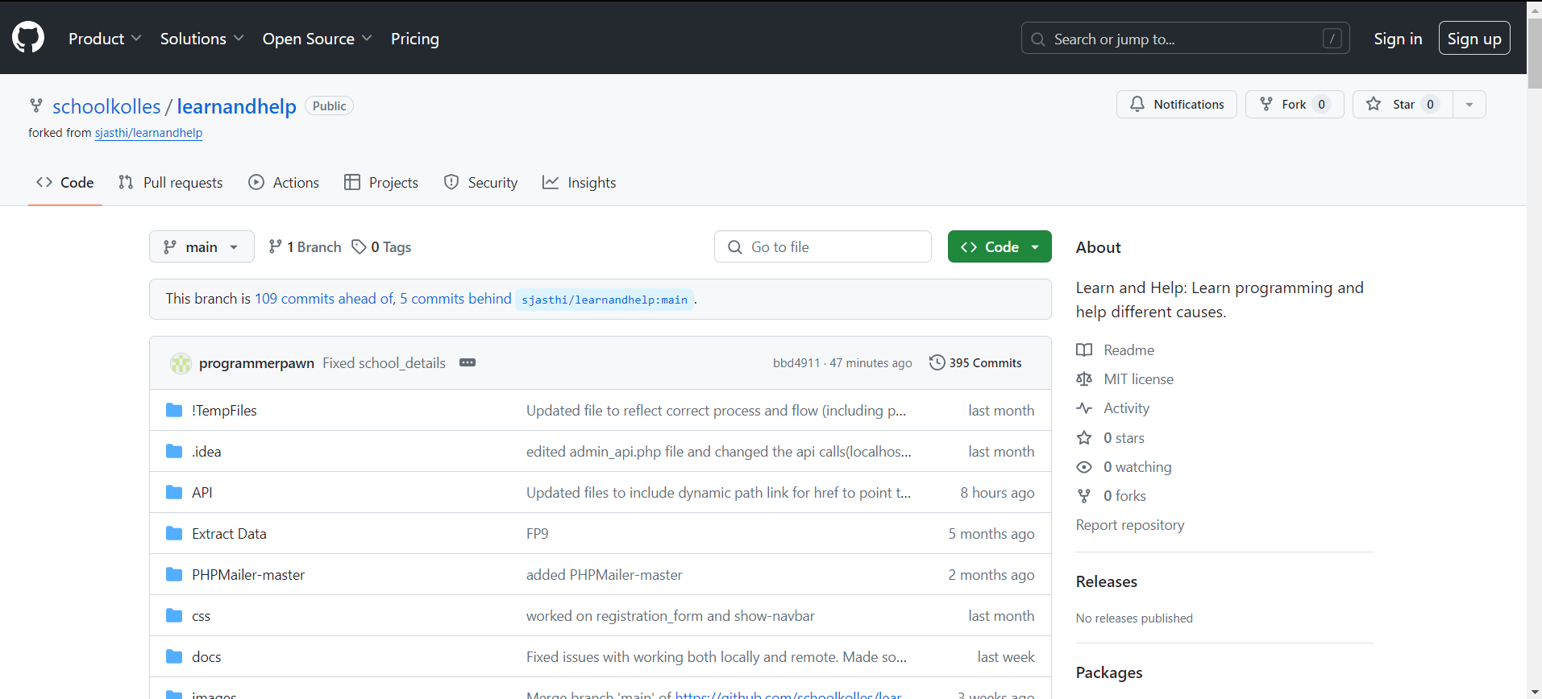
GitHub Repo
Team leader forked the original project
Other team members

Slide 8
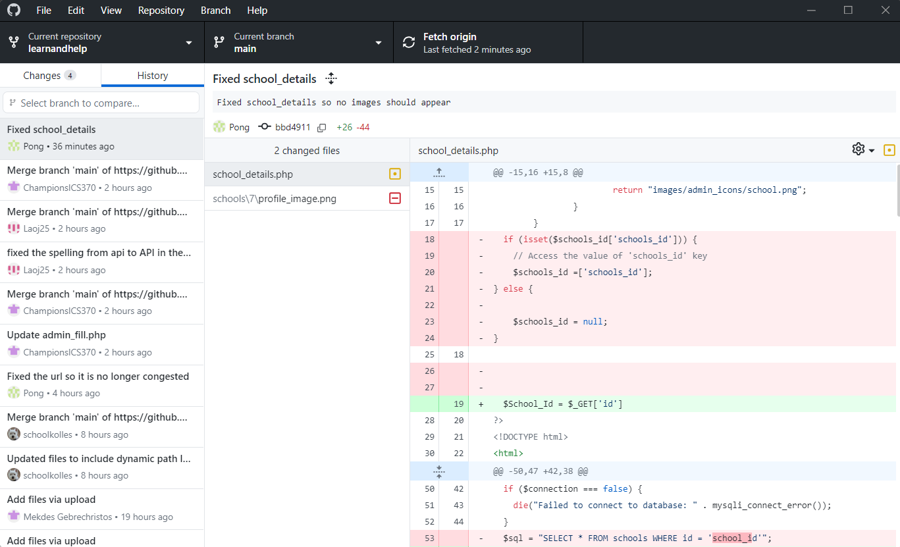
GitHub Desktop
Tool used by team members
Pull (fetch)
Commit
Push

Slide 9

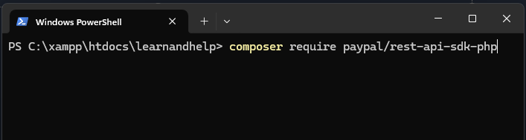
PayPal Integration Setup
Install Composer PHP Dependency manager
https://getcomposer.org/
Install PayPal SDK
C:\xampp\htdocs\learnandhelp> composer require paypal/rest-api-sdk-php

Slide 10
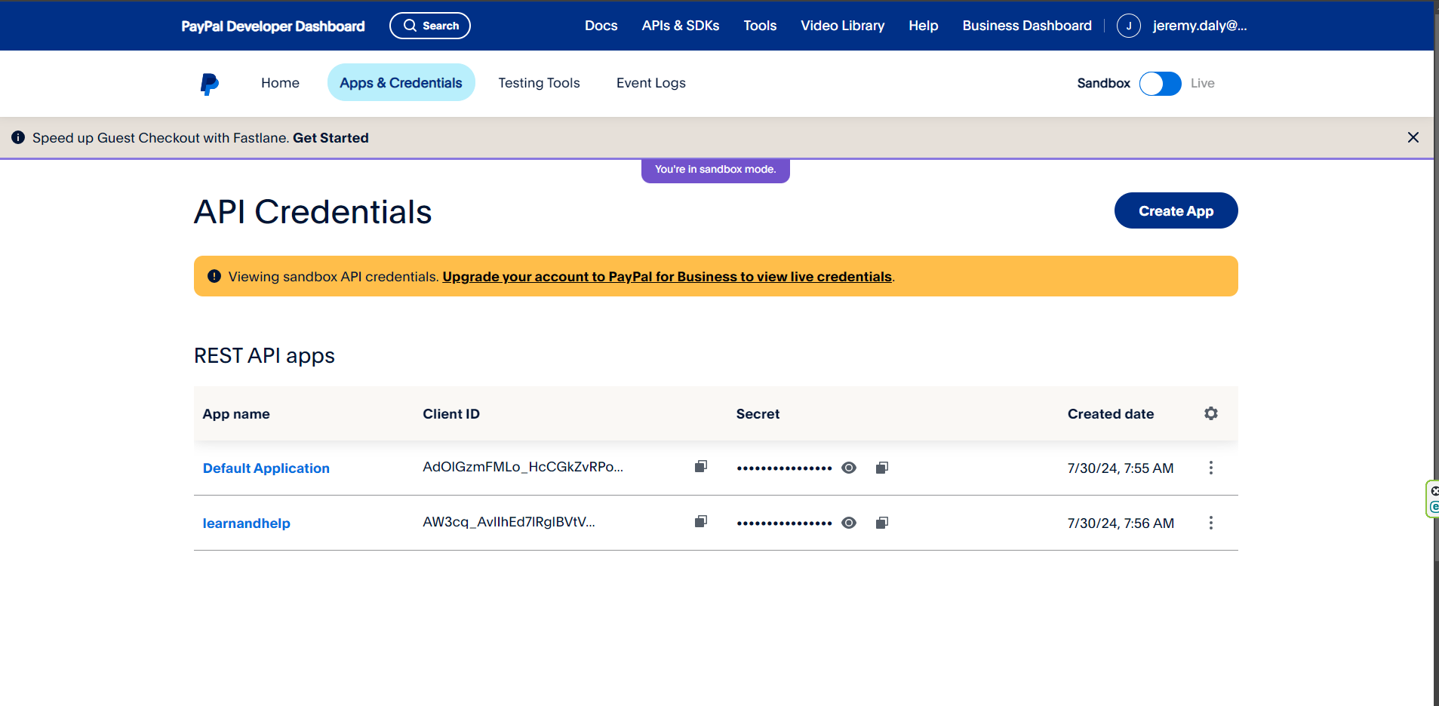
PayPal Integration Setup
1
Create PayPal Developer Account
Go to Developer Dashboard
Go to Apps & Credentials
Create a new App
Select newly created App
2
3

Slide 11
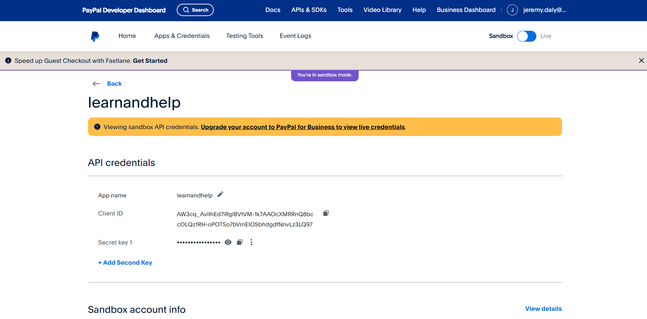
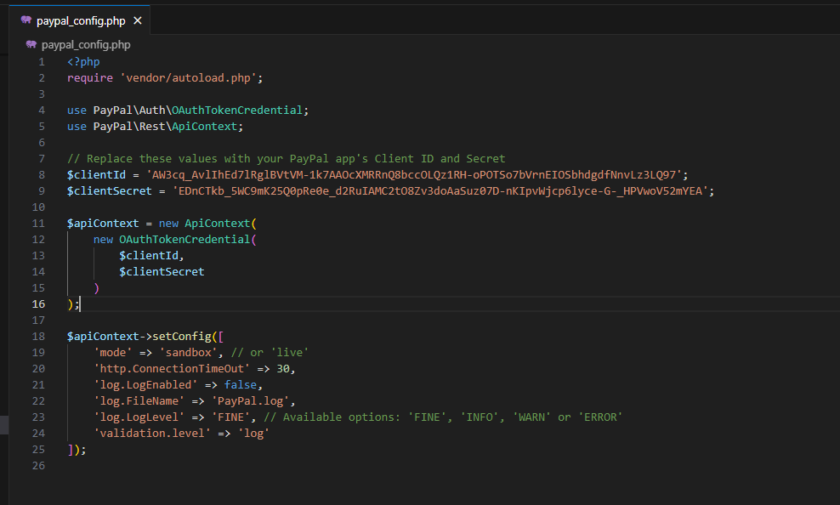
PayPal Integration Setup
1
From Application configuration menu
Select Client ID and Client secret
Paste these values into corresponding paypal_config.php variables.
Adjust for dev/sandbox mode or live
2
3

Slide 12
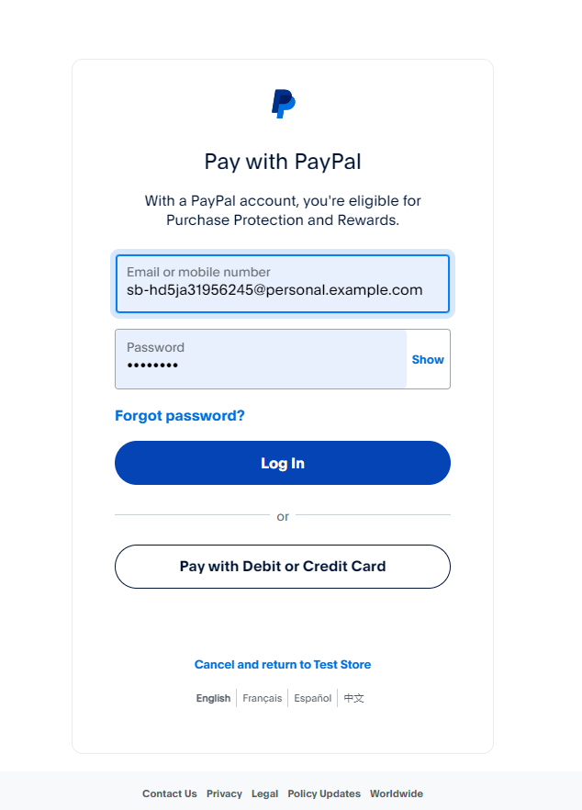
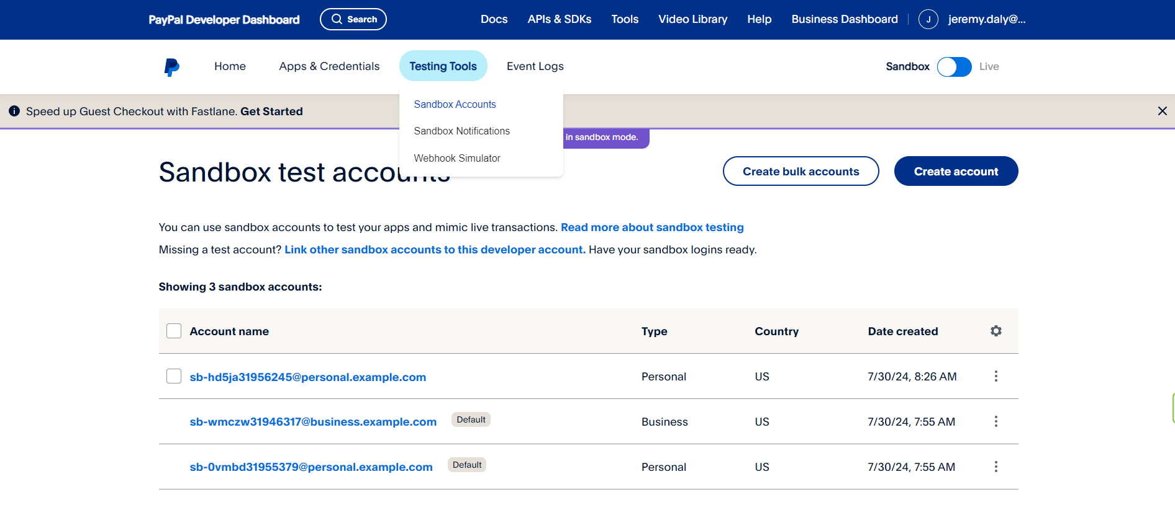
PayPal Integration Testing
2
Test with sandbox accounts
Under Testing Tools > Sandbox Accounts you can create sandbox credentials to test.
Use created credentials to pay for services within sandbox
1

Slide 13
Q & A
Thank you !
Mekdes Gebrechristos
Hamdi Kelil
Pong Shoua Lee
Jet Lao
Daniel Kolles
Dr. Siva Jasthi

