Slide 1
Learn and Help 3.0
Developer Manual
Team Alligators
Mekdes Gebrechristos, Hamdi Kelil, Jet Lao, Pong Lee, Daniel Kolles

Slide 2
Overview
Welcome / Introduction
Team Alligators
Mekdes Gebrechristos
Hamdi Kelil
Pong Shoua Lee
Jet Lao
Daniel Kolles
Learn and Help 2.0 https://learnandhelp.jasthi.com/
Presentation Scope
Developer Manual
Q & A

Slide 3
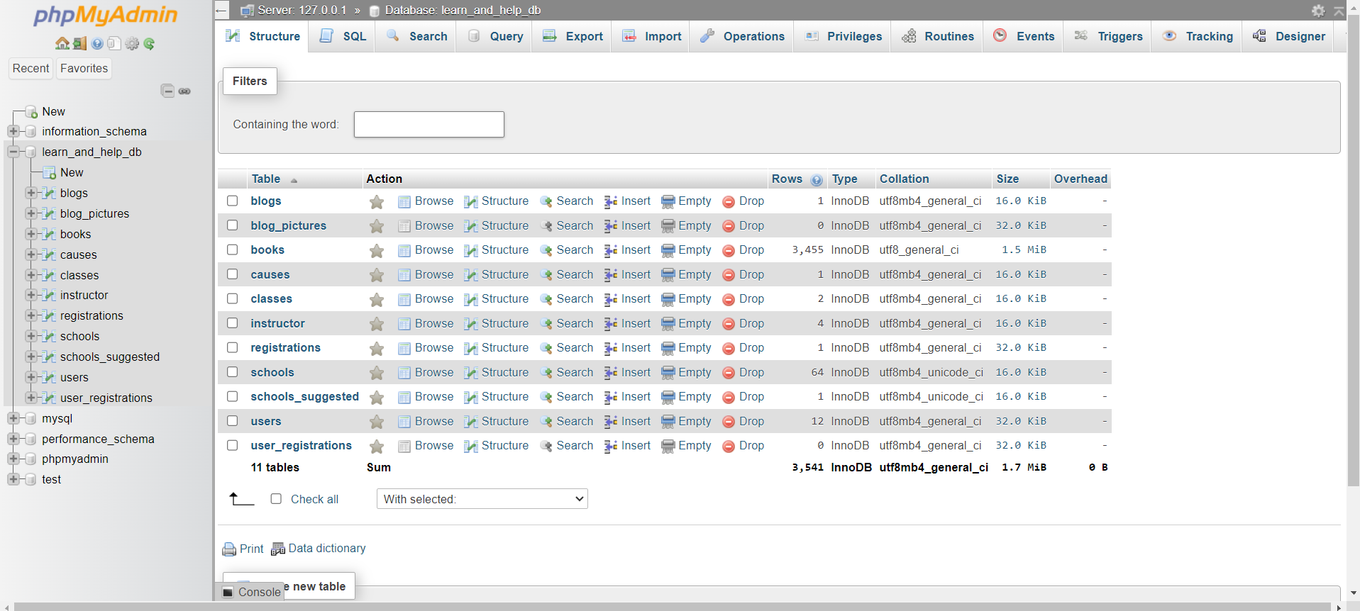
phpMyAdmin
MySQL Database Tables

Slide 4
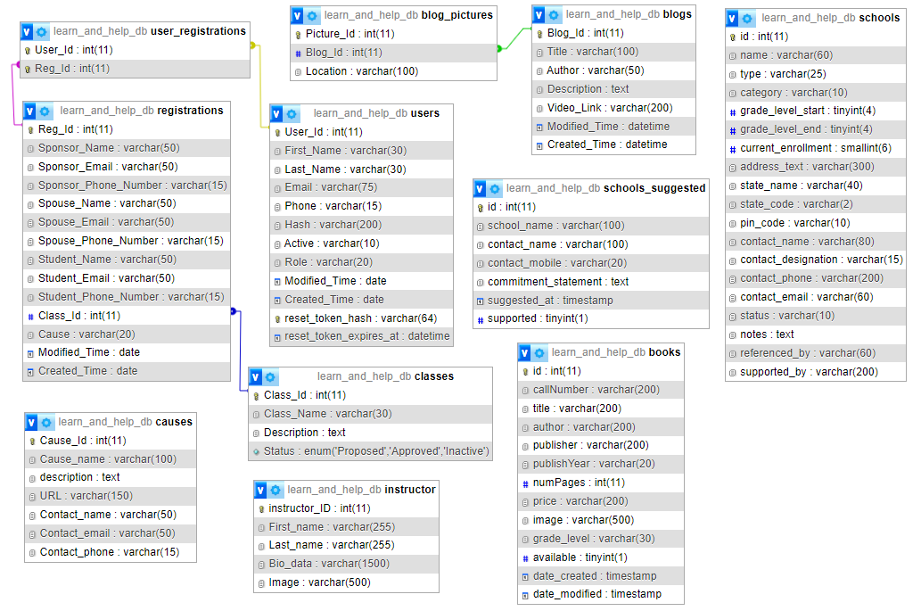
Database Schema
Relationship between tables

Slide 5
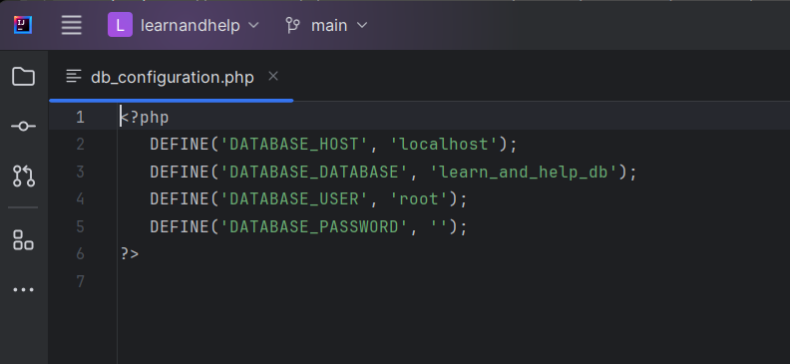
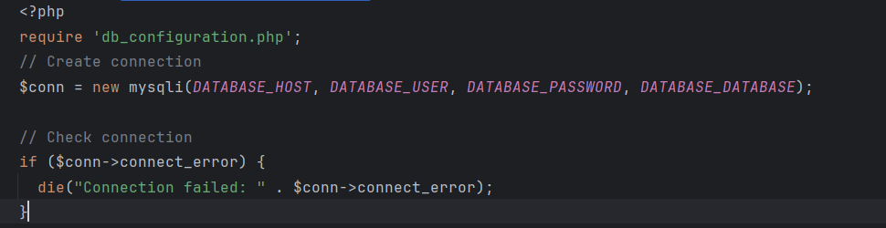
db_configuration
Connection to database to access table contents
db_configuration.php

Slide 6
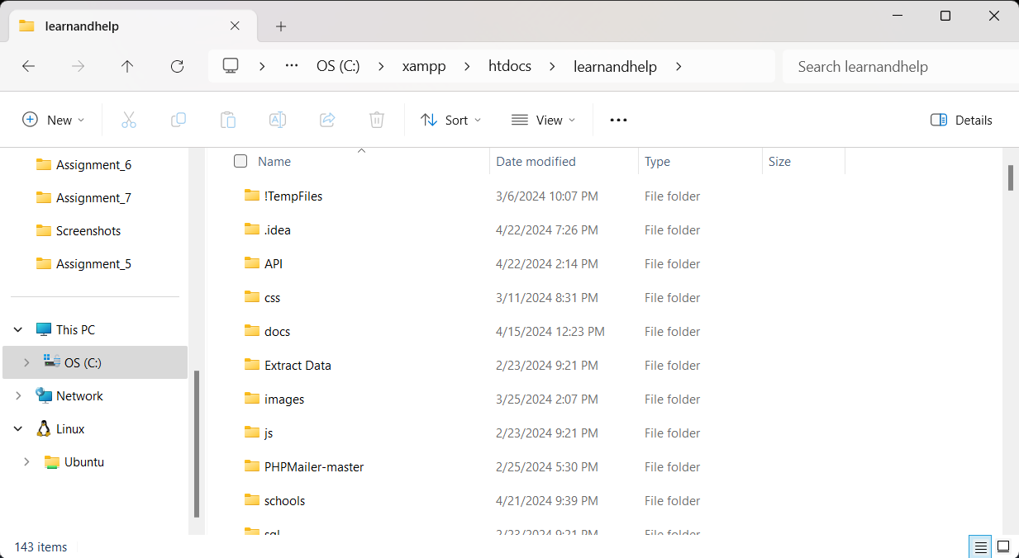
Directory Structure
C:\xampp\htdocs\learnandhelp
Copied project to XAMPP in htdocs folder

Slide 7
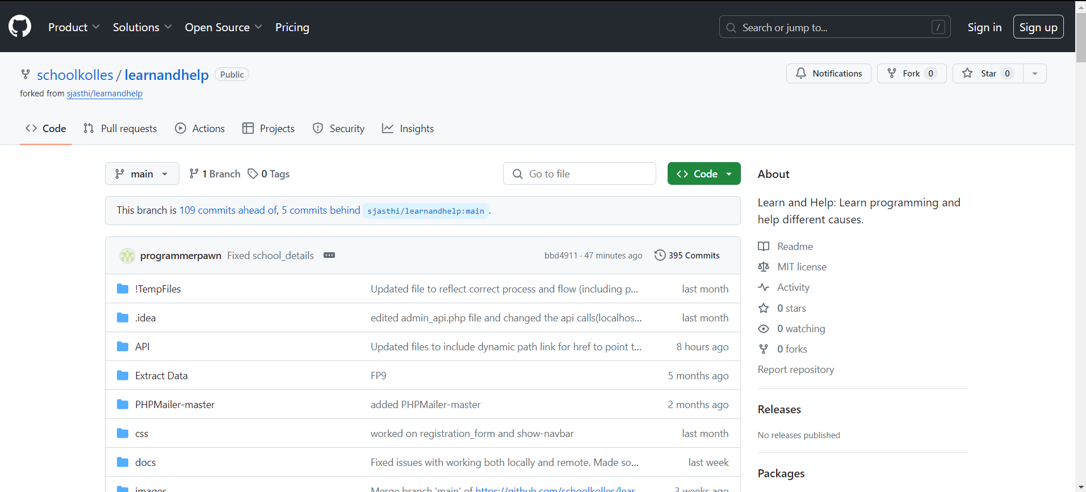
GitHub Repo
Team leader forked the original project
Other team members

Slide 8
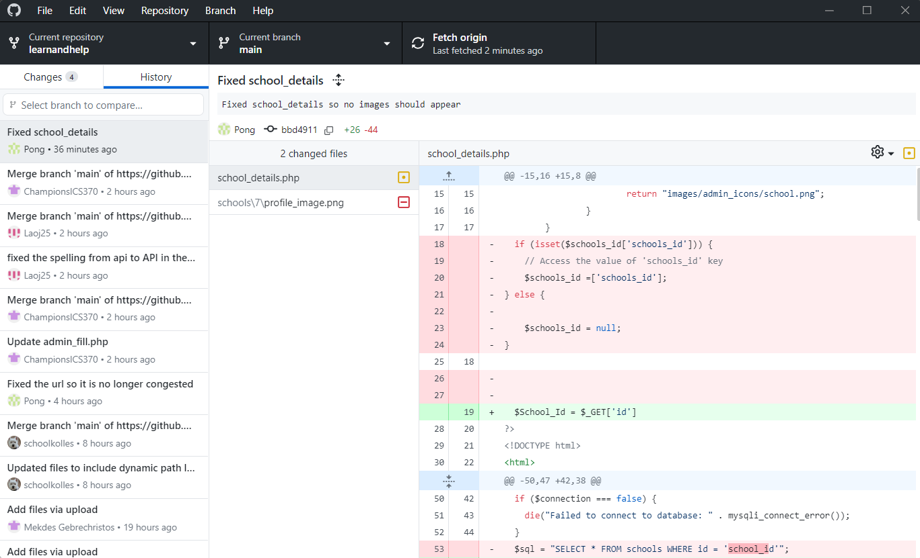
GitHub Desktop
Tool used by team members
Pull (fetch)
Commit
Push

Slide 9
Q & A
Thank you !
Mekdes Gebrechristos
Hamdi Kelil
Pong Shoua Lee
Jet Lao
Daniel Kolles
Dr. Siva Jasthi

