Slide 1
Smart Parking Assistant
Project Presentation
by
Joe Payyappilly (2347227)
Project Guide
Dr. Sreedevi
Department of Computer Science
CHRIST(Deemed to be University), Bengaluru-29

Slide 2
AGENDA
Introduction
Alignment with SDG Goals
Existing Systems
Proposed System
Modules
Feasibility Analysis
Benefits of Proposed
Anticipated Outcomes
References

Slide 3
Introduction
Smart Parking Assistant is a mobile app that helps users find available parking slots and guides them while parking.
A camera on top of the parking lot detects empty slots and assists users with alignment and obstacle avoidance.

Slide 4

Why this project?

Slide 5
Difficulty in finding vacant slots
Inefficient use of space
Poor alignment reducing capacity
Increased risk of minor accidents

Slide 6

AI Based

Slide 7

Alignment with SDG Goals
SDG 9: Industry, Innovation, and Infrastructure
Promotes smart infrastructure by integrating AI and IoT into parking management.
Enhances urban mobility and smart city initiatives.

Slide 8
Existing Systems
Manual Parking: Time-consuming, inefficient
Sensor-based Systems: Expensive hardware installation
CCTV Surveillance: Used for security, not real-time slot detection

Slide 9
Proposed System
Camera-Based Parking Slot Detection using AI
Real-time updates to mobile app
AI-powered Parking Guidance
Warns about misalignment & obstacles

Slide 10
Modules
Parking Slot Detection Module
User Navigation Module
AI-based Parking Assistance Module

Slide 11
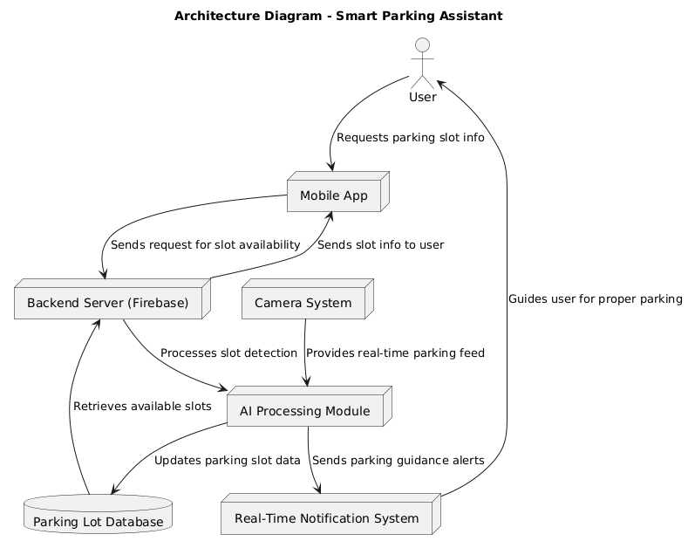

Slide 12
Feasibility Analysis
Minimize costs.
Strategic planning and mitigation strategies.
Prioritizing essential project components and leveraging available learning resources.

Slide 13

Benefits of Proposed
Time-Saving: Quickly finds vacant slots
Efficient Space Utilization: Improves capacity
Accident Prevention: Alerts users of obstacles
Smart City Integration: Future IoT-based expansion

Slide 14

Anticipated Outcomes
AI-based real-time parking slot detection
Seamless user experience via mobile app
Reduction in parking congestion & misalignment

Slide 15
References
M. Waqas et al., “Smart Vehicle Parking Management System using Image Processing,” IJCSNS, vol. 21, no. 8, p. 161, Aug. 2021.
V. Zadachyn and O. Dorokhov, “Calculation of Optimal Path for Parallel Car Parking,” Kharkiv Natl. Univ. Econ., Kharkiv, Ukraine.
Z. Deng and D. Wang, “Research on Parking Path Planning Based on A-Star Algorithm,” J. New Media, vol. 5, no. 1, pp. 55–64, Jun. 2023

