Slide 1
Al-STJ Considerations for v2
2023-09-11
Spencer Fretwell + Joseph Templet
Release #

Slide 2
Background
Process and Tolerances
Trilayer is patterned across entire device then selectively etched (SAEP: Selective Al Etch Process)
Wires are 10 µm wide with a 15 µm pitch
Sequential layers are given 2 µm buffer per side for alignment error
Bond Pads
Bond pads are trilayer Al with added Au (thin Ti underlayer for adhesion)
Bond pads are at minimum 200 µm² with a pitch of 250 µm
Pixels
Rotation to 45° as DC Josephson suppression is improved in this configuration
Sidewalls are passivated by anodization after patterning trilayer and protecting top electrodes with photoresist.
Notes:
Overview
Outline of talk to come

Slide 3
V1 Changes
Wafer is 200 µm thick for backside etch and reduced gamma substrate interactions
Quasiparticle diffusion limited by Nb plugs on Al base electrode wires
Nb wiring for top electrode connection
Au fills “field areas” (unused area) contiguously to provide heat sinking and a phonon “trap” layer
Requires adhesion layer (Ti or Al) underneath. Thermalizes high-energy phonons from interactions in the Si substrate
Bond Pads
Bond pads are trilayer Al with added Au (thin Ti underlayer for adhesion)
Bond pads are at minimum 200 µm² with a pitch of 250 µm
Pixels
Sizes are 70 µm, 130 µm, and 200 µm per side (active areas of 66, 126, and 196 µm² with 2 µm per layer per side) buffer
Notes:
Overview
Outline of talk to come

Slide 4
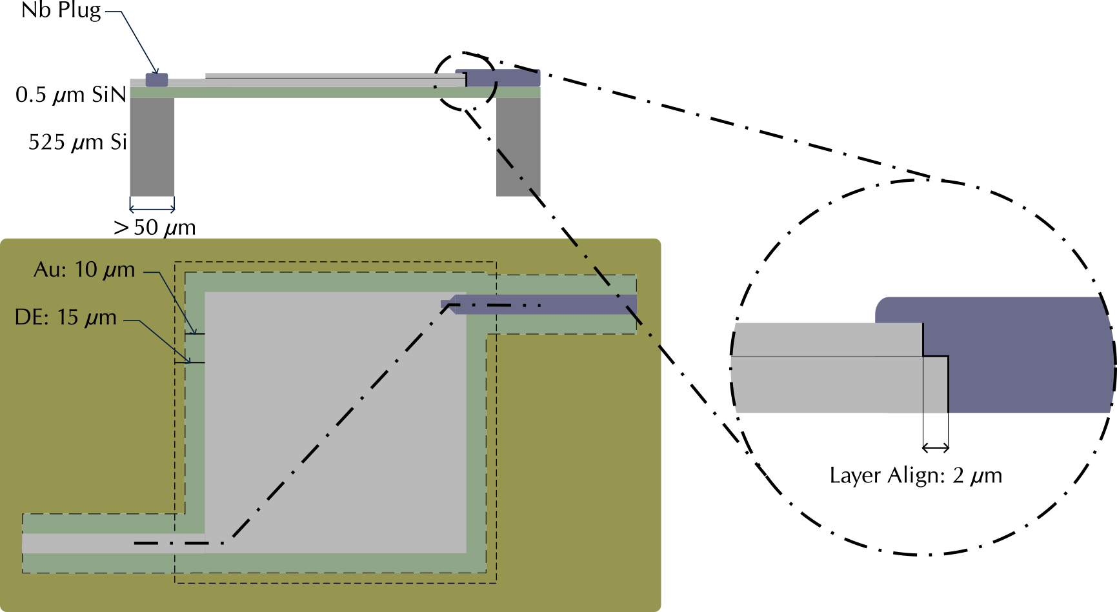
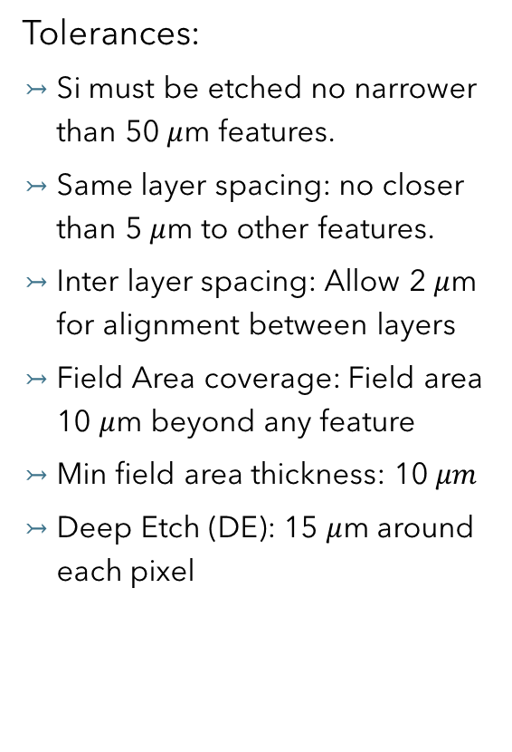
Tolerance Details
Tolerances:
Si must be etched no narrower than 50 $μ$m features.
Same layer spacing: no closer than 5 $μ$m to other features.
Inter layer spacing: Allow 2 $μ$m for alignment between layers
Field Area coverage: Field area 10 $μ$m beyond any feature
Min field area thickness: 10$μm$
Deep Etch (DE): 15 $μ$m around each pixel

Slide 5
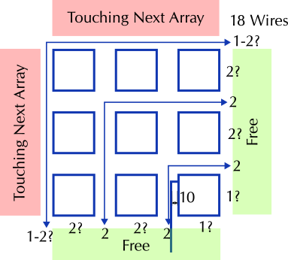

8x1 Quadrant Modules
8 pixels to a quadrant. Same wiring pattern, duplicated x4 for 32 pixel chips.
Trace to pixel clearance of 10 $μ$m
Can probes be on adjacent sides (to ground wires)?
18 wires to route. Best seems to be 2 between quadrant pixels and 4 between quadrants with the “cardinal” pixel (outermost) having probe on adjacent side to ground wire.
Notes:
EE: QE: Peter Aean

Slide 6
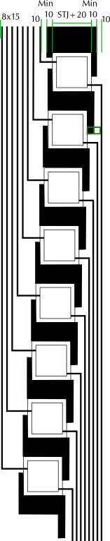
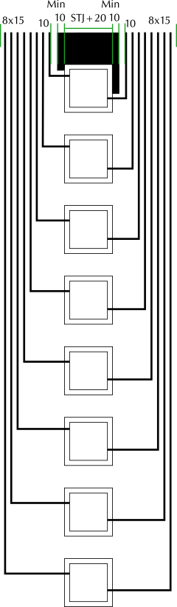
8x1 Linear Modules
Al
Al
STJ
60 µm
STJ
Al
SiN
10µm
15µm
Si bar
STJ + 30µm
50 µm
8 pixels = 16 wires | 32 = 64 | 128 = 256. 78-pin loom and connector reads 39 pixels
Pixel spacing of (STJ+80 µm) within 8 x 1 array module is set by 50 µm min width of Si and 2 x 15 µm space between Si bar and STJ.
Straight Module spacing of (STJ width + 295 µm) is set by 16x15 – 5 µm wiring pitch, plus (40+20) µm field clearance (from STJ and wires) and min thickness. Therefore, 70 (130, 200) µm pixels will have 365 (425, 495) µm pitch.
Offset Module spacing of (STJ width + 175 µm) is set by only 8x15 - 5 µm wiring pitch, saving horizontal space at the cost of having to route wires above and below each module. 70, 130, 200 µm pixels will have 260, 320, 390 µm pitch.
Notes:
We cannot have ground and wire on opposite sides since we want them adjacent at the pads. So, wires will now come out of the same side and travel back in pairs to their respective pads.
! Leave space between pairs for cross-talk mitigation. Keep pairs close for flux induction minimization.

Slide 7

Bond Pads
Currently, 36x250 $μm=9 mm$ of bond pads per side
Need 16 mm for the 64 bond pads per side (256 total)
Shrink Pads? Would need 90x300 $μm$ pads to fit in 9mm
Expand Pad Square? Do we need 0.5mm around edge?
Bigger Chips? What bond pad size can we get away with?
Routing 256 wires may need extra space, too

Slide 8
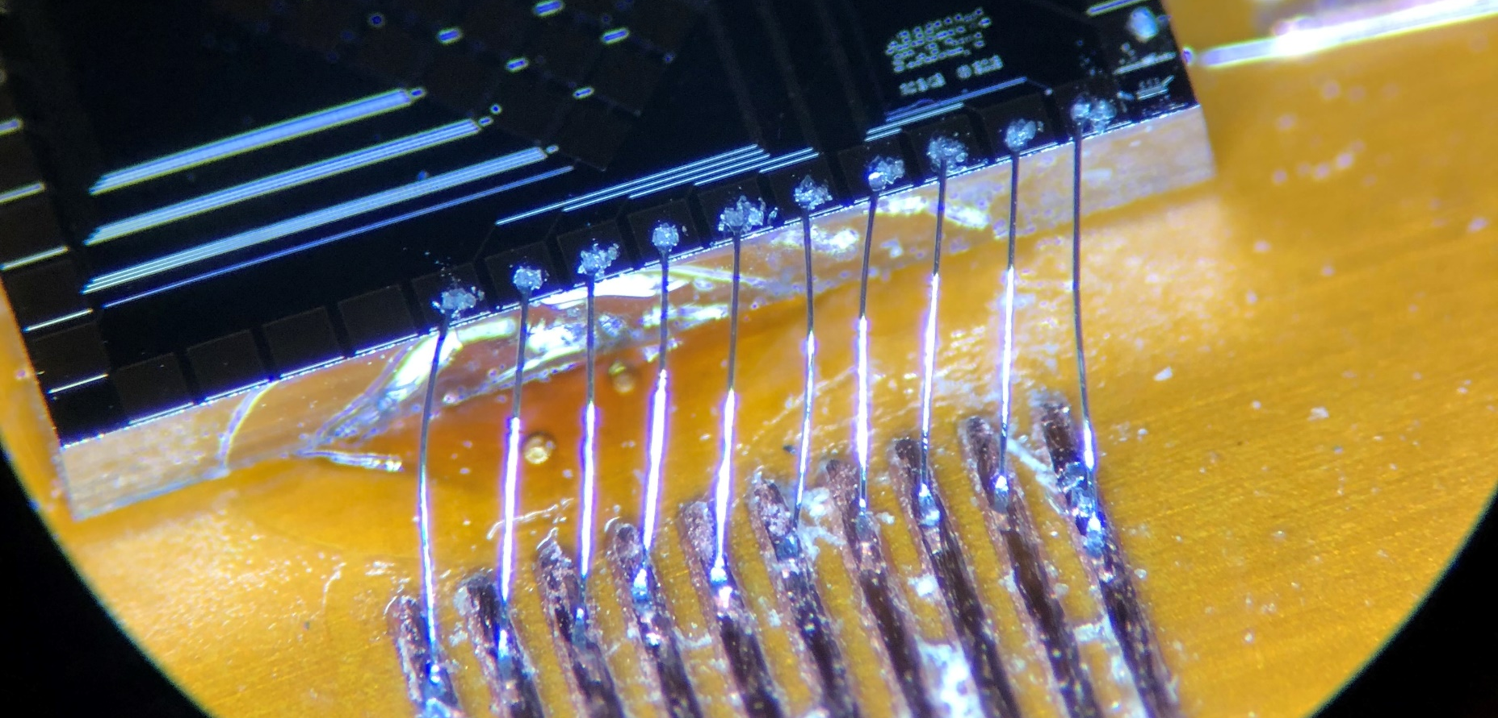
Bond Pads
Going to two-deep pads
Pads need to be offset
Can wirebonding even be done with tighter pitch? The hardest part was making sure wire bonds didn’t touch, and making them that much closer would be painful…
Pitch limitation (JLPCB) on carrier plates is 254 um, which essentially matches current pad pitch. Vias are 500 clearance (let alone hole size) so we would need a complex tree shape under the chip area to make it work.
250 µm
500 µm

Slide 9

Layout and Collimators
Existing layout and collimators may need adjusting.
If chips must be larger (32-200 and 128 specifically) then fewer devices will fit
Pixel modules will change spacing of collimator holes. No change in hole geometries
Laser: extents within bond pad geometry, holes 20 $μm$ smaller than smallest pixel’s active area side length on chip
Implant: extents beyond chip geometry (arb. ~50 $μm$), holes 20 $μ$m smaller than respective pixel’s active area side length
In other words: laser = (uniform, don’t hit wirebonds), implant=(max dose, no wirebonds), both=cover inactive areas

