Slide 1
Database System Concepts
Chapter 17-Transactions
B2 Xu Haoran (Jo) 72344187

Slide 2
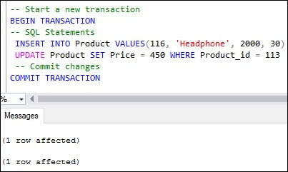
Transactions
Concept: a unit of program execution that accesses and possibly updates various data items.
Statements: A transaction is delimited by statements (or function calls) of the form begin transaction and end transaction.

Slide 3
ACID Property of Transactions
Atomicity: Either all operations of the transaction are reflected properly in the database, or none are.
Consistency: Any database transaction that modifies data must satisfy defined rules. 从一个正确的状态到一个正确的状态
Isolation.(4 levels) Even though multiple transactions may execute concurrently, the system guarantees that, for every pair of transactions Ti and Tj, it appears to Ti that either Tj finished execution before Ti started or Tj started execution after Ti finished. 从外界观察为serial

Slide 4
ACID Property of Transactions
Thus, each transaction is unaware of other transactions executing concurrently in the system.
Durability: After a transaction completes successfully, the changes it has made to the database persist, even if there are system failures.

Slide 5
ACID Property of Transactions
Atomicity, Isolation, and Durability make transactions an ideal way of structuring interaction with a database. AID为数据库feature, 和程序员一起保障应用层C
This leads us to impose a requirement on transactions themselves. A transaction must preserve database consistency: if a transaction is run atomically in isolation starting from a consistent database, the database must again be consistent at the end of the transaction.
How this is done is the responsibility of the programmer who codes a transaction. This property is referred to as consistency.

Slide 6
ACID Property of Transactions
Complete isolation
--> huge adverse effect on system performance.
For this reason, some applications compromise on the isolation property.

Slide 7
A Simple Transaction Model
Ti: read(A);
A := A − 50;
write(A);
read(B);
B := B + 50;
write(B)
Let Ti be a transaction that transfers $50 from account A to account B.
Consistency: The consistency requirement here is that the sum of A and B be unchanged by the execution of the transaction. 和不变
Atomicity: Suppose that the failure happened after the write(A)
operation but before the write(B) operation. The system destroyed $50 as a result of this failure. The sum A + B is no longer preserved.
Failure will cause inconsistent state. Such inconsistencies can’t be visible in a database system.
However, the system must at some point be in an inconsistent state.
Atomicity property ensues that all actions of the transaction are reflected in the database, or none are.

Slide 8
A Simple Transaction Model
Ti: read(A);
A := A − 50;
write(A);
read(B);
B := B + 50;
write(B)
Atomicity: logs -> restore old values 回滚
(C.19 recovery system)
Durability: Transaction completes successfully, there must be no system failure can result in a loss of data.
1. data written to disk
2. update info reconstructable
Isolation: If several transactions are executed concurrently, their operations may interleave in some undesirable way, resulting in an inconsistent state.
Serial excution? Performance loss
--> concurrency control system

Slide 9
Storage Structure
Volatile storage: won’t survive system crashes but fast 拔电源就没
-->main memory and cache memory
Non-volatile storage: survives system crashes, slow,
-->disks
Stable storage: survives everything including zombie apocalypse or nucular war
--> technically doesn’t exist
Stable storage can be closely approximated by replicating the information in several non-volatile storage media (usually disk) with independent failure modes (or use paper)

Slide 10
Transaction Atomicity and Durability
Aborted: Transactions failing to complete
Rolled back: Undoing changes caused by an aborted transaction
--> log is needed
Committed: State of successful execution
A committed transaction that has performed updates transforms the database into a new consistent state, which must persist even if there is a system failure.
The only way to undo the effects of a committed transaction is to execute a compensating transaction. (not always possible)
e.g. +100$ <=> -100$

Slide 11
Transaction Atomicity and Durability: 5 States
Active: The initial state; the transaction stays in this state while it is executing.
Partially committed: After the final statement has been executed.
Failed: After the discovery that normal execution can no longer proceed.
Aborted: After the transaction has been rolled back and the database has been restored to its state prior to the start of the transaction.
Committed: After successful completion
A transaction is said to have terminated if it has either committed or aborted.
a partially committed state appears to occur when all components of a database transaction have finished, and the RDBMS has logically committed to persisting those changes to the database, but has not yet actually persisted them. I use the word "logically" here because it is possible that after the work of a transaction has finished a failure could still occur. To take this possibility into account, the RDBMS writes out enough information to disk to guarantee that, even if a failure were to occur, the result from the transaction could be recreated and the database could be updated appropriately.
So from a logical point of view, a partially committed state and a committed state are identical. But they differ in that in the former the database itself may not actually reflect the results of the transaction.

Slide 12
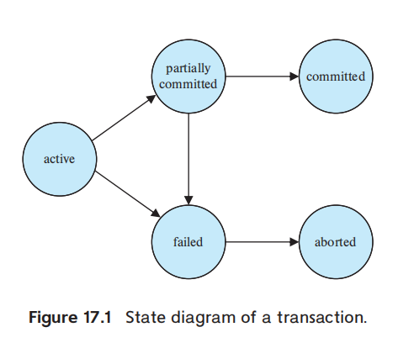
Transaction Atomicity and Durability: 5 States
Aborted State - OS will:
Restart the transaction:
external problem (HW, SW)外部问题
Kill the transaction:
internal logical error 数据未找到
Observable External Writes:
after committed
active display -> bad atomicity
Overwrite to the disk
“commit”
error
DB restored

Slide 13
Transaction Isolation
concurrently
->complications on consistency
serially (Each starting only after the previous one has completed)
-> Indeed easier
2 Reasons of concurrency:
・Improved throughput and resource utilization
Reduced waiting time
concurrency in DB sys == multiprogramming in OS
concurrency-control schemes keep the consistency - InnoDB MVCC s

Slide 14
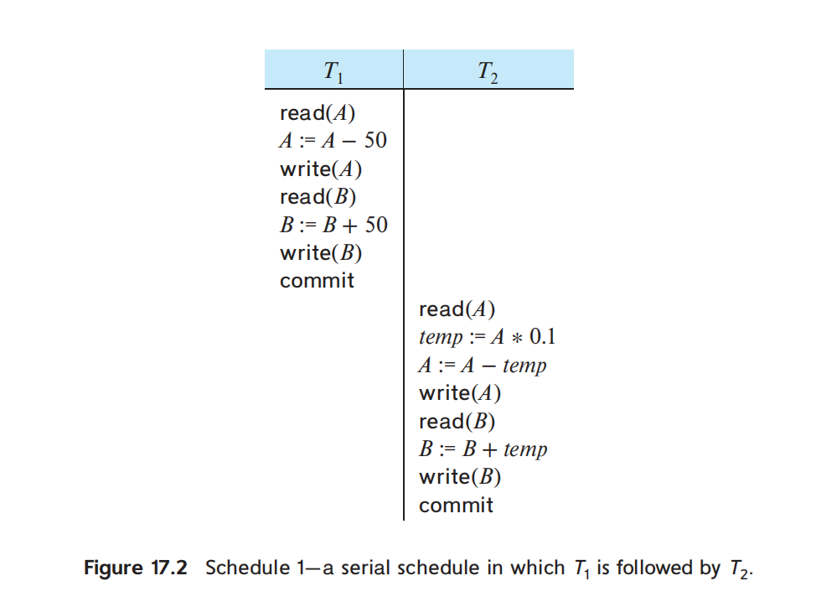
Transaction Isolation
T1: $50 A -> B
T2: 10% A -> B
T1 -> T2: A $855 B $2145
T2 -> T1: A $850 B $2150
execution sequences: schedule
A schedule for transactions:
All instructions of transactions and the instructions orders in each transaction.

Slide 15
Transaction Isolation
T1: $50 A -> B
T2: 10% A -> B
Schedule 1: T1 -> T2: A $855 B $2145
Schedule 2: T2 -> T1: A $850 B $2150
S1 and S2 are serial（串行的，区别于可串行化） :
instructions belonging to one single transaction appear together
Combinatorics formula:
A set of n transactions have (n!) different valid serial schedules -> 2 ! = 2*1 = 2

Slide 16
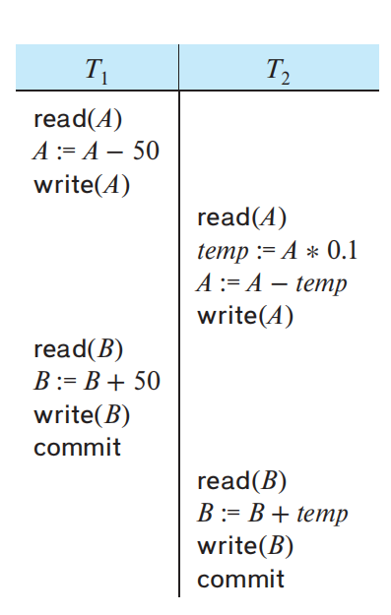
Transaction Isolation
A concurrent schedule equivalent
to serial T1 -> T2
Schedule 3: A $855 B $2145 ✓
serial T1 -> T2: A $855 B $2145
The sum A + B is preserved.
Schedule 3 -> serializable
(可串行化调度)
The schedule which is equivalent to a serial schedule is called a serializable schedule
(can be changed into a serial form) 可以转化为一组串行调度的调度 -> 可串行化调度

Slide 17
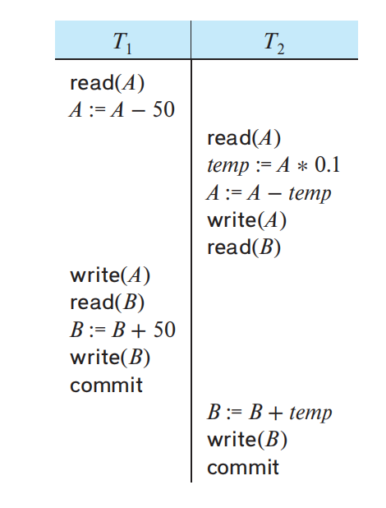
Transaction Isolation
A concurrent schedule resulting in
an inconsistent state
schedule 4: A $950 B $2100 x
serial T1 -> T2: A $855 B $2145
The sum A + B is not preserved.
sum A+B -> +$50
The concurrency-control（并发控制） component of the database system ensure that any schedule that is executed will leave the database in a consistent state.

Slide 18
Serializability
Operations to be focused:
READ and WRITE
The only significant operations of a transaction, from a
scheduling point of view, are its read and write instructions. 正しい値を読み取ること、正しい値を書き換えること
A particular form schedule equivalence （调度等价的一个形式）
-> conflict serializability （冲突可串行化）

Slide 19
Serializability
Schedule S has 2 consecutive instructions I and J, of transactions Ti and Tj respectively 执行顺序改变受不受影响
Referring the same data Q
I = read(Q), J = read(Q): I -> J == J -> I O
I = read(Q), J = write(Q): I -> J != J -> I X
I = write(Q), J = read(Q): I -> J != J -> I X
I = write(Q), J = write(Q):
both write -> Ti or Tj is not affcted
the following read(Q) is affcted
If there is no other write(Q) instruction after I and J in S, then the order of I and J
directly affects the final value of Q in the database state that results from S
Ops from different transaction on a same data, more than 1 of these instructions is write:
-> They are CONFLICT

Slide 20
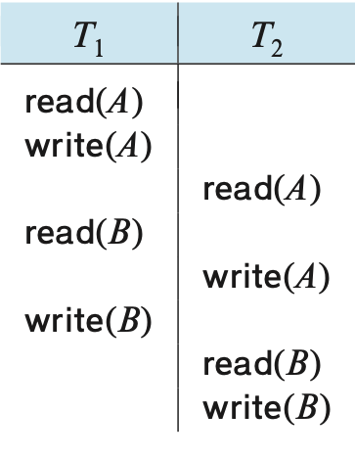
Serializability-An Example
Swap nonconflicting instructions:
T1 read(B) ⇄ T2 read(A)
T1 write(B) ⇄ T2 write(A)
T1 write(B) ⇄ T2 read(A)
S5 -> S6
1. S5 & S6 are conflict equivalent
2. S6 is a serial schedule
-> S5 is conflict serializable
S5
S6
如果调度与一串行调度冲突等价，我们称其是冲突可串行化的（conflict serializable）

Slide 21
Serializability-Precedence Graph
Usage: Determining the conflict serializability of a schedule 直观判断是否可串行化
G = (V, E)
顶点集V: vertices (all the transactions in the schedule)
边集E: all edges Ti → Tj for which one of three conditions holds:
1. Ti write(Q) → Tj read(Q) WR
2. Ti read(Q) → Tj write(Q) RW
3. Ti write(Q) → Tj write(Q) WW
If an edge Ti → Tj exists in the precedence graph,
in any serial schedule S’ equivalent to S, Ti must appear before Tj

Slide 22
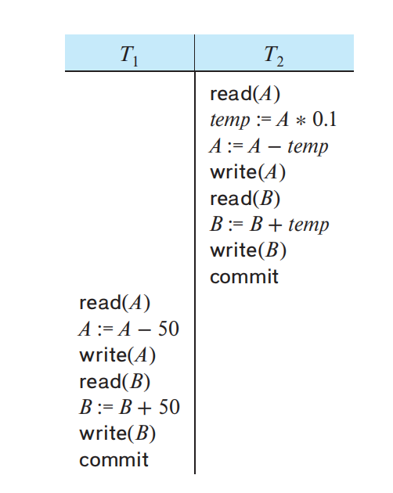
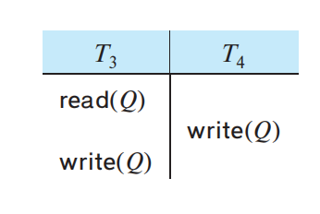
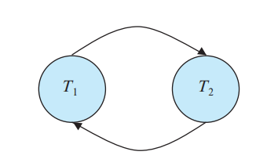

Precedence Graph-Example
If the precedence graph for S has a cycle, then schedule S is not conflict serializable.
If the graph contains no cycles, then the schedule S is conflict serializable.

Slide 23
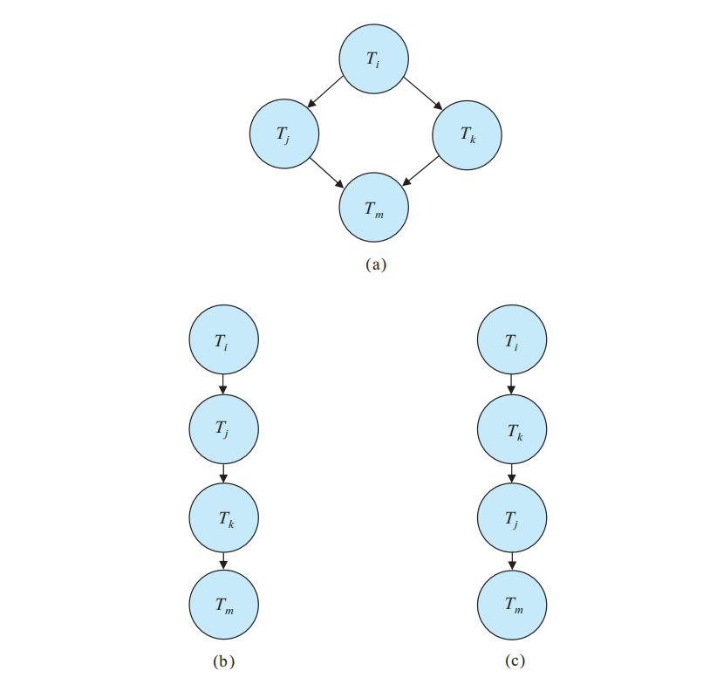
Serializability-Topological Sorting
Topological sorting: Finding a linear order
consistent with the partial order(偏序)of
the precedence graph. 找到一个可能的执行顺序
several possible linear orders that
can be obtained through a topological
Sort 可能有一个以上可能线性排序
A serializability order (串行化顺序) of the
transactions can be obtained by
topological sorting(拓扑排序)

Slide 24
Serializability Checking
1. constructing the precedence graph
2. invoking a cycle-detection algorithm (exp: depth first)
Cycle-detection algorithms require on the order of n^2 operations, where n is the number of vertices in the graph.
(NPC problem)
The precedence graph for this schedule contains a cycle, indicating that this schedule is not conflict serializable.
Notes:
——

Slide 25
Isolation & Atomicity
Facing transaction failures
If a transaction Ti fails, for whatever reason, we need to undo the effect of this transaction to ensure the atomicity property of the transaction. 失败事务消除影响
In a system that allows concurrent execution, the atomicity property requires that any transaction Tj that is dependent on Ti (i.e., Tj has read data written by Ti) is also aborted. 被影响事务也需要退出
To achieve this, we need to place restrictions on the types of schedules permitted in the system. 需要制约
What schedules are acceptable from the viewpoint of recovery from transaction failure?

Slide 26
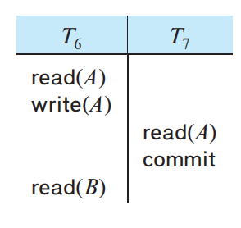
Recoverable Schedules
Partial Schedules: parts of transactions without commit or abort
Dependent: T7 depends on T6
Now suppose that T6 fails before it commits.
T7 has read the value of data item A written by T6.
Because of this, we must abort T7 to ensure atomicity.消除6影响
However, T7 has already committed.
Thus, we have a situation where it is impossible to recover correctly from the failure of T6.
A nonrecoverable schedule

Slide 27
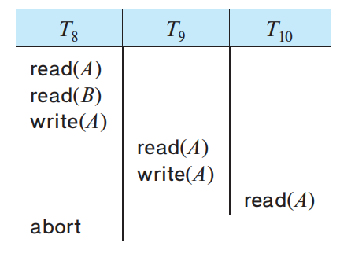
Cascadeless Schedules无级联调度
Cascading Rollback级联回滚:
A single transaction failure leads to a series of transaction rollbacks.
Cascadeless schedule无级联调度:
If Tj read a data item previously written by Ti, the commit of Ti appears before the read operation of Tj.
T8 fails.
T8 must be rolled back.
Since T9 is dependent on T8, T9 must be rolled back.
Since T10 is dependent on T9, T10 must be rolled back.
cascadeless schedules => recoverable
A Cascading Rollback

Slide 28
Isolation Levels
Serializability → too little concurrency → other levels
• Serializable
• Repeatable read – phantom read
• Read committed – non repeatable read
• Read uncommitted – dirty read
SQL provides such features for the benefit of long transactions whose results do not need to be precise. If these transactions were to execute in a serializable fashion, they could interfere with other transactions, causing the others’execution to be delayed.

Slide 29
Read uncommitted
读未提交，就是一个事务可以读取另一个未提交事务的数据。
事例：老板要给程序员发工资，程序员的工资是3.6万/月。但是发工资时老板不小心按错了数字，按成3.9万/月，该钱已经打到程序员的户口，但是事务还没有提交，就在这时，程序员去查看自己这个月的工资，发现比往常多了3千元，以为涨工资了非常高兴。但是老板及时发现了不对，马上回滚差点就提交了的事务，将数字改成3.6万再提交。
分析：实际程序员这个月的工资还是3.6万，但是程序员看到的是3.9万。他看到的是老板还没提交事务时的数据。这就是脏读。
那怎么解决脏读呢？Read committed！读提交，能解决脏读问题。

Slide 30
Read committed
读提交，就是一个事务要等另一个事务提交后才能读取数据。
事例：程序员拿着信用卡去享受生活（卡里当然是只有3.6万），当他埋单时（程序员事务开启），收费系统事先检测到他的卡里有3.6万，就在这个时候！！程序员的妻子要把钱全部转出充当家用，并提交。当收费系统准备扣款时，再检测卡里的金额，发现已经没钱了（第二次检测金额当然要等待妻子转出金额事务提交完)
分析：这就是读提交，若有事务对数据进行更新（UPDATE）操作时，读操作事务要等待这个更新操作事务提交后才能读取数据，可以解决脏读问题。但在这个事例中，出现了一个事务范围内两个相同的查询却返回了不同数据，这就是不可重复读(一个事务范围内两个相同的查询却返回了不同数据)。
那怎么解决可能的不可重复读问题？Repeatable read ！

Slide 31
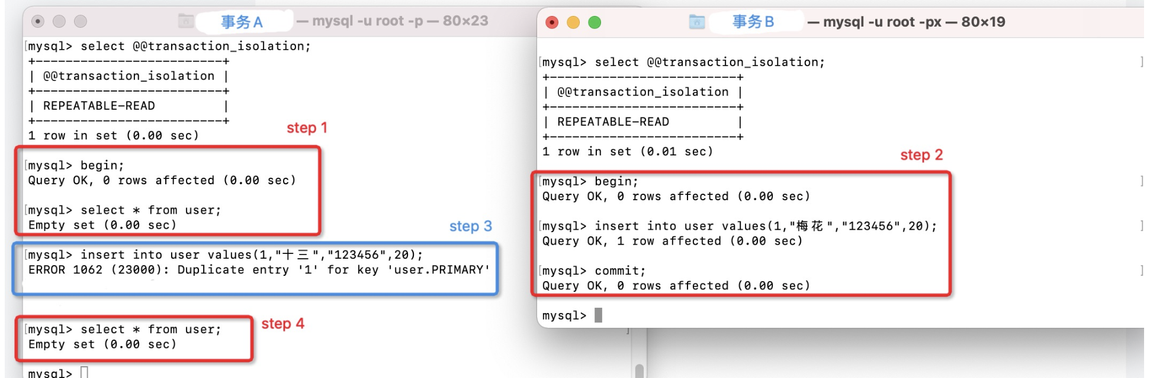
Repeatable read (InnoDB diff)
重复读，就是在开始读取数据（事务开启）时，不再允许修改操作
事例：程序员拿着信用卡去享受生活（卡里当然是只有3.6万），当他埋单时（事务开启，不允许其他事务的UPDATE修改操作），收费系统事先检测到他的卡里有3.6万。这个时候他的妻子不能转出金额了。接下来收费系统就可以扣款了。
分析：重复读可以解决不可重复读问题。写到这里，应该明白的一点就是，不可重复读对应的是修改，即UPDATE操作。但是可能还会有幻读问题。因为幻读问题对应的是插入INSERT操作，而不是UPDATE操作。

Slide 32
Phantom read
事例：程序员某一天去消费，花了2千元，然后他的妻子去查看他今天的消费记录（全表扫描FTS，妻子事务开启），看到确实是花了2千元，就在这个时候，程序员花了1万买了一部电脑，即新增INSERT了一条消费记录，并提交。当妻子打印程序员的消费记录清单时（妻子事务提交），发现花了1.2万元，似乎出现了幻觉，这就是幻读。
(例如第一个事务对一个表中的数据进行了修改，这种修改涉及到表中的全部数据行。同时，第二个事务也修改这个表中的数据，这种修改是向表中插入一行新数据。那么，以后就会发生操作第一个事务的用户发现表中还有没有修改的数据行，就好象发生了幻觉一样)
那怎么解决幻读问题？Serializable！

Slide 33
Serializable
Serializable 是最高的事务隔离级别，在该级别下，事务串行化顺序执行，可以避免脏读、不可重复读与幻读。但是这种事务隔离级别效率低下，比较耗数据库性能，一般不使用。
值得一提的是：大多数数据库默认的事务隔离级别是Read committed，比如Sql Server , Oracle。Mysql的默认隔离级别是Repeatable read。

Slide 34
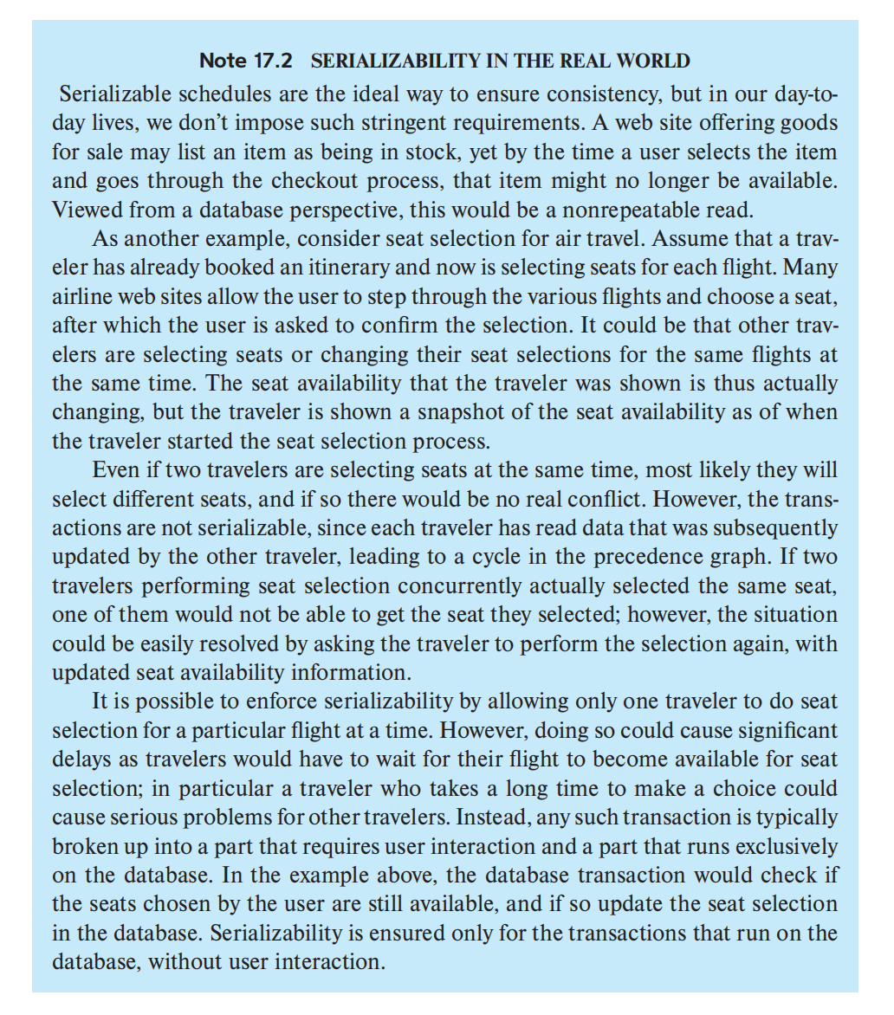
Serializability in the real world

Slide 35
Implementation of Isolation Levels
Concurrency control scheme (并发控制机制)
Only acceptable schedules are generated, regardless of how the operating system time-shares resources (such as CPU time) among the transactions.
A trivial example - Lock
While a transaction holds a lock, no other transaction is allowed to execute.
Only one transaction can execute at a time -> only serial schedules are generated. Recoverable and cascadeless
Zero concurrency, poor performance

Slide 36
Locking
two-phase locking
shared and exclusive lock

Slide 37
Timestamps
For each data item, the system keeps two timestamps.
The read timestamp of a data item holds the largest (that is, the most recent) timestamp of those transactions that read the data item.
The write timestamp of a data item holds the timestamp of the transaction that wrote the current value of the data item.
Timestamps are used to ensure that transactions access each data item in order of the transactions’ timestamps if their accesses conflict.
When this is not possible, offending transactions are aborted and restarted with a new timestamp.

Slide 38
Multiple Versions and Snapshot Isolation
By maintaining more than one version of a data item, it is possible to allow a transaction to read an old version of a data item rather than a newer version written by an uncommitted transaction or by a transaction that should come later in the serialization order.
There are a variety of multiversion concurrency-control techniques. One in particular, called snapshot isolation, is widely used in practice.
too much isolation -> inconsistent database state

Slide 39
Transactions as SQL Statements
End

