Slide 1
Database System Concepts
Chapter 18-Concurrency Control
B2 Xu Haoran (Jo) 72344187

Slide 2
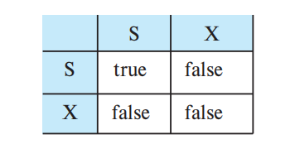
Lock-Based Protocols
One way to ensure isolation is to require that data items be accessed in a mutually exclusive manner（相互排他的）
The most common method used to implement this requirement is to allow a transaction to access a data item only if it is currently holding a lock on that item.
锁是针对事务的概念
锁的对象是数据
Two types of lock
Shared lock S
Exclusive lock X
compatible matrix

Slide 3
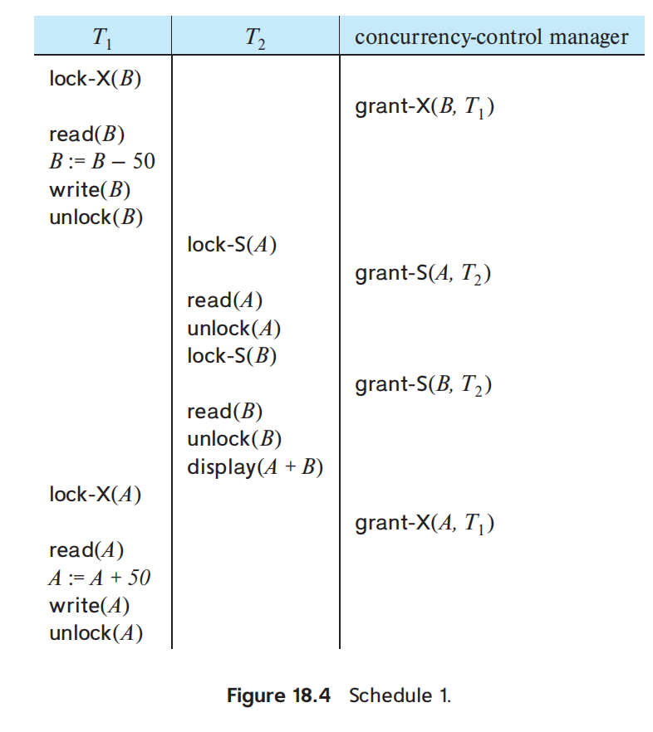
An undesired situation
T1: B-50 A+50 (A:150, B:150)
T2: Display A, B
T1, T2 are excuted concurrently
T1 unlocked data item B too early
T2 display(A + B) = 250 != 300
--> Inconsistent State

Slide 4
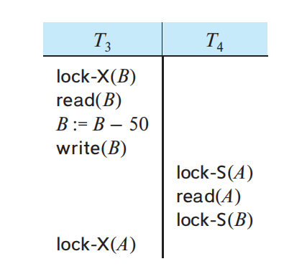
Solution & Another Undesired Situation
Delay unlockings to the end of the transactions
--> Inconsistency got resolved
Another problem: Deadlock
T3 holds the lock of B (til the end of T3)
T4 holds the lock of A (til the end of T3)
T4 waits for the unlock of A
T3 waits for the unlock of A
T3 and T4 got each other locked up --> Deadlock
Unlockings
can’t be too early
neither too late
We’ll need a
locking protocol
Deadlocks are “nessary evil”, at least more favorable than inconsistent states!

Slide 5
A Few Terminology
Let {T0, T1, …, Tn} be a set of transactions participating in a schedule S.
Ti precedes Tj in S, written Ti → Tj
If there exists a data item Q such that Ti has held lock mode A on Q
Tj has held lock mode B on Q later
comp(A, B) = false.
If Ti → Tj, then that precedence implies that in any equivalent serial schedule, Ti must appear before Tj
*Similar to the precedence graph of conflict serializability
*Conflicts between instructions <=> noncompatibility of lock modes.

Slide 6
Conclusion
We say that a schedule S is legal under a given locking protocol if S is a possible schedule for a set of transactions that follows the rules of the locking protocol.
We say that a locking protocol ensures conflict serializability if and only if all legal schedules are conflict serializable.
In other words, for all legal schedules
the associated “→” relation is acyclic (无环)

Slide 7
Granting of the Locks & Deadlock
The lock can be granted
when a transaction requests a lock on a data item in a particular mode
no other transaction has a lock on the same data item in a conflicting mode
T1 has a shared-lock on A
T2 requests a exclusive-lock on A uncompatible
T3 request a shared-lock on A compatible
T4 request a shared-lock on A compatible
T5 request a shared-lock on A compatible
...
T10000 request a shared-lock on A compatible
->T2 has to wait until T10000 is finished, T2 is starved

Slide 8
To Avoid Starvation
When a transaction Ti requests a lock on a data item Q in a particular mode M, the concurrency-control manager grants the lock provided that:
1. There is no other transaction holding a lock on Q in a mode that conflicts with M
2. There is no other transaction that is waiting for a lock on Q and that made its lock request before Ti

Slide 9
The Two-Phase Locking Protocol
Growing Phase: A transaction may obtain locks, but may not release any lock.
Shrinking Phase: A transaction may release locks, but may not obtain any new locks.
Lock Point: the end of its growing phase
The two-phase locking protocol ensures conflict serializability
Transactions can be ordered according to their lock points
--a serializability ordering
两段锁协议确保冲突可串行性

Slide 10
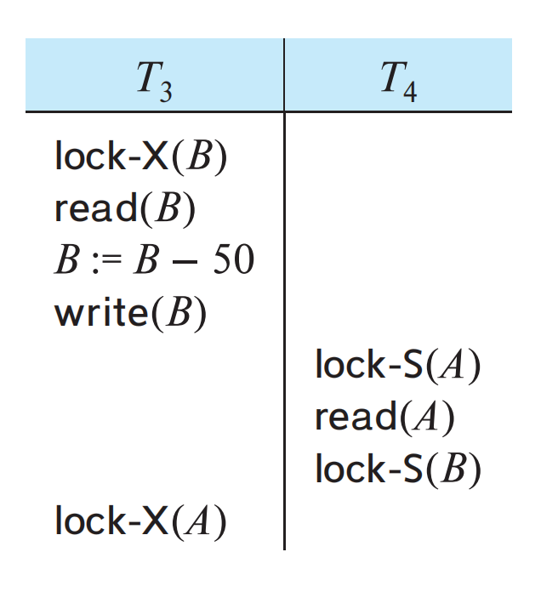
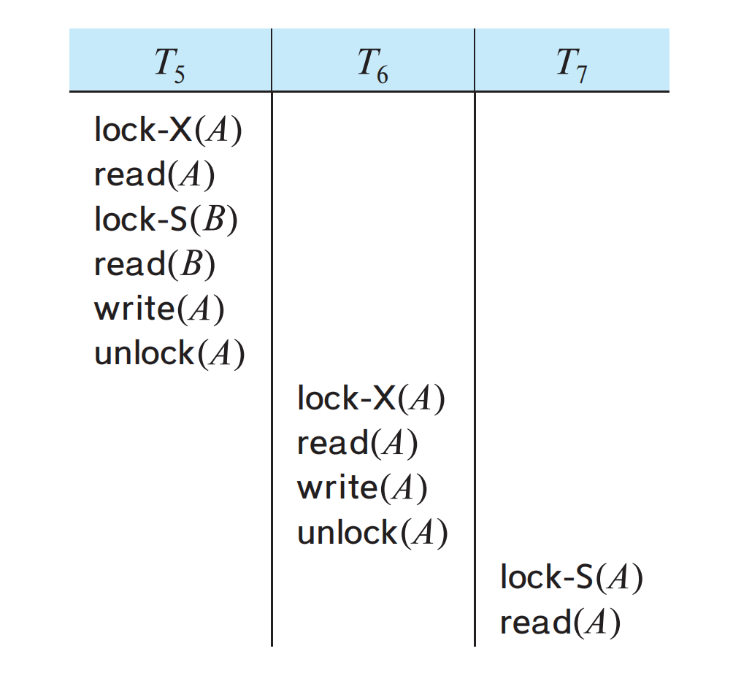
The Two-Phase Locking Protocol
Two-phase locking does not ensure freedom from deadlock (1PL can)
Cascading rollback 17-P27 may occur under two-phase locking.

Slide 11
Strict & Rigorous 2-Phase Locking
・Strict Two-Phase Locking protocol:
All exclusive-mode locks taken by a transaction be held until that transaction commits
--> Cascading rollbacks can be avoided
・Rigorous two-phase locking protocol:
All locks be held until the transaction commits
--> transactions can be serialized in the order of commit
Lock Conversion: Upgrade/Downgrade

Slide 12
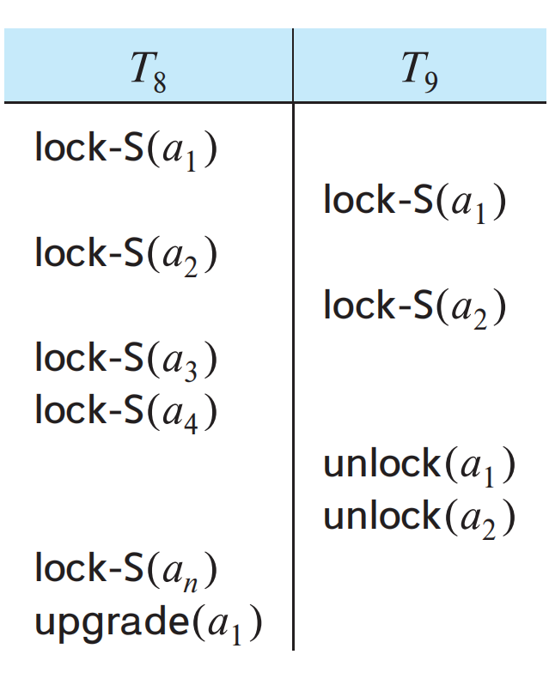
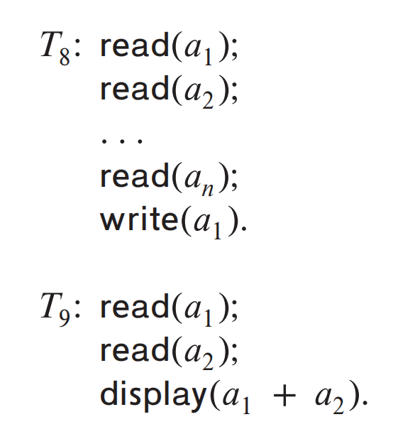
Lock Conversion
Two-phase locking protocol
-> T8 must lock a1 in exclusive mode
Any concurrent execution == Serial execution
T8 needs an exclusive lock on a1 only at the end when it writes a1.
Thus, if T8 could initially lock a1 in shared mode, and then could later change the lock to exclusive mode
->T8 and T9 could access a1 and a2 simultaneously. More concurrency

Slide 13
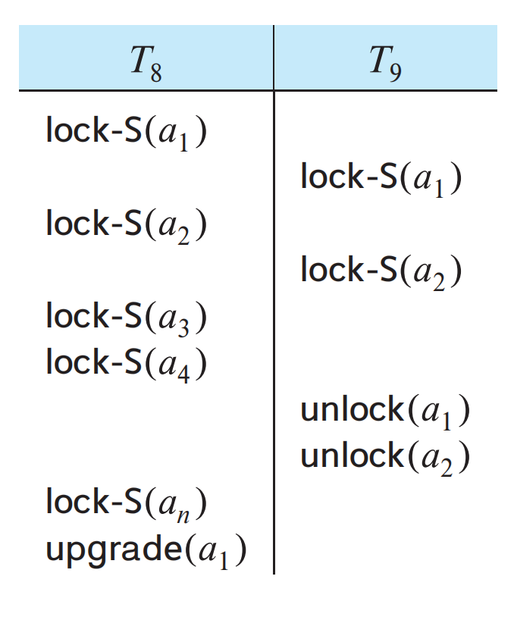
Lock Conversion
Upgrade: shared lock -> exclusive lock
Downgrade: exclusive lock -> shared lock
Upgrading can take place in only the growing phase
Downgrading can take place in only the shrinking phase

Slide 14
A widely used scheme
When a transaction Ti issues a read(Q) operation, the system issues a lock-S(Q) instruction followed by the read(Q) instruction.
When Ti issues a write(Q) operation, the system checks to see whether Ti already holds a shared lock on Q. If it does, then the system issues an upgrade(Q) instruction, followed by the write(Q) instruction. Otherwise, the system issues a lock-X(Q) instruction, followed by the write(Q) instruction.
All locks obtained by a transaction are unlocked after that transaction commits or aborts.
Read(Q) -> Lock-S(Q)
Write(Q) -> Lock-S(Q)? -Yes-> Upgrade(Q)
L No-> Lock-X(Q)

Slide 15
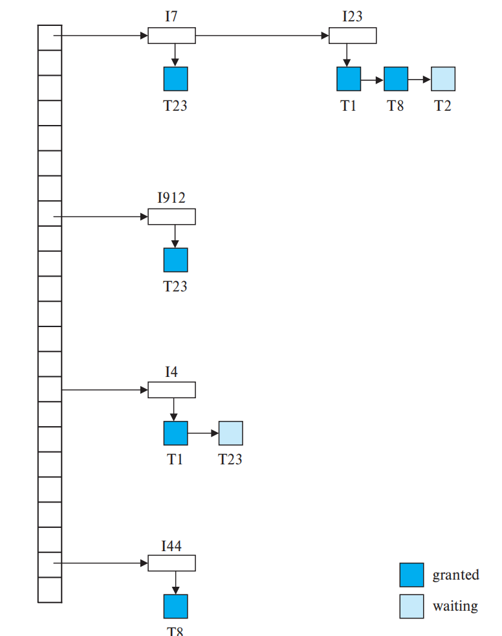
Implementation of Locking
A process: Lock Manager
Data structure of LM:
Linked-lists in a hash table (哈希性质)
1. A linked list of records for each currently-locked data item
(in arriving order)
2. A hash table indexed on the name of a data item
A Lock Table

Slide 16
Requests Processing of LM
1. A lock request message arrives [if linked list exist?]
N -> A record to the end of the linked list for the data
Y -> Creates a new linked list with the request
2. [if lock is currently held?]
N ->Grants a lock request on a data item.
Y -> 3. [if compatible and earlier requests granted?]
N -> wait
Y -> grants the lock
4. Receiving an unlock message from a transaction -> deletes the record, tests following records 123 Y -> grants that request and so on
A transaction aborts -> deletes any waiting request made by the transaction.
(DB system has taken appropriate actions to undo the transaction -> LM releases all locks held by the aborted transaction.)

Slide 17
Graph Based Protocols
*Prior knowledge: the order in which the database items will be accessed (重要前提)
Partial Ordering → directed acyclic graph (有向无环)
set{d1, d2, …, dh} di → dj: Any T accessing di and dj must access di before dj
A lock-X only Tree Protocol (Serializability & Avoid Dead Lock)
1. The first lock by Ti may be on any data item.
2. Subsequently, a data item Q can be locked by Ti only if Ti currently locks the parent of Q.
3. Data items may be unlocked at any time.
4. A data item that has been locked and unlocked by Ti cannot subsequently be relocked by Ti.

Slide 18
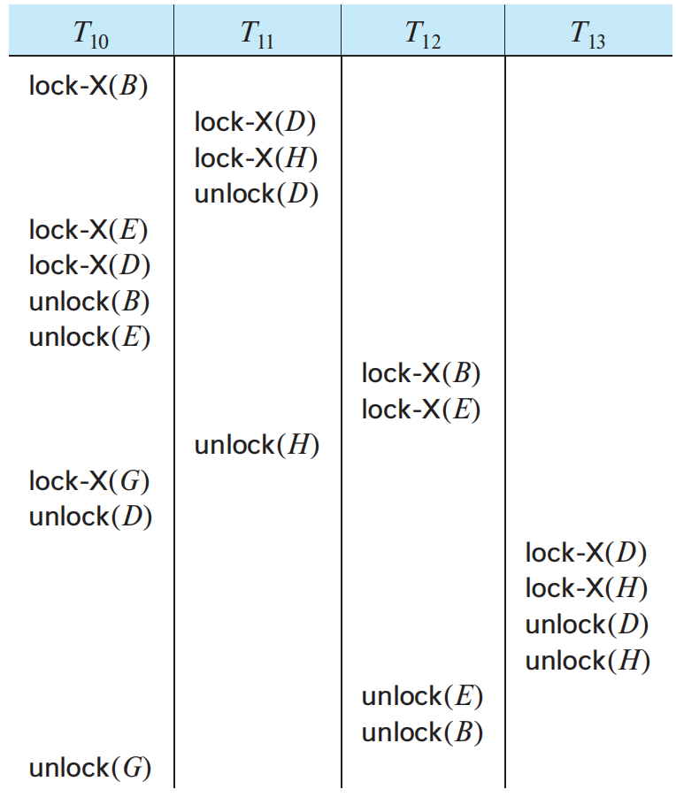
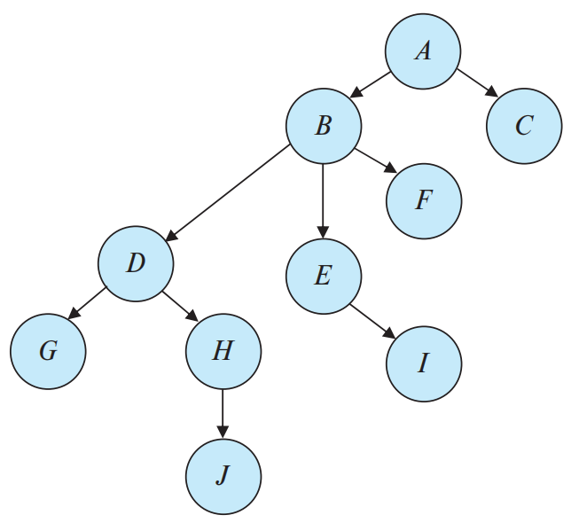
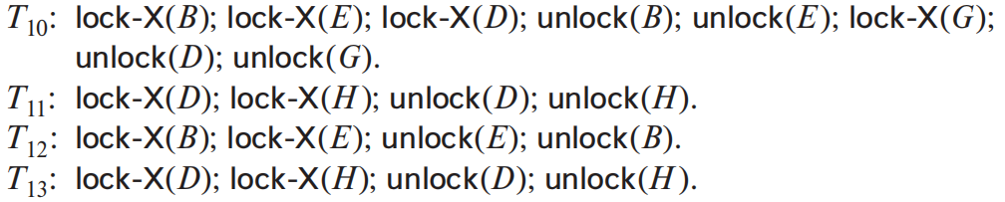
An Example
4 Transaction under tree protocol
Serializable Scheduling ! ( = T11->T13->T12->T10)

Slide 19
About Tree Protocol
Ensures conflict serializability & freedom from deadlock (no cycle)
Does not ensure recoverability and cascadelessness (无级联)
-> not permit release of X locks until the end of the transaction
(bad concurrency)
-> An alternative method only ensuring recoverability (good concurrency)
T0 uncommitted write data item A -> record last write transaction on A
Ti read this uncommitted A-> record a Commit Dependency of Ti on T0 (在T0上记Ti-CD)
Ti is then not permitted to commit until all transactions with a CD of Ti commit. (所有Ti-CD事务提交 例T0)
If any of these transactions aborts, Ti must also be aborted

Slide 20
Advantages & Disadvantages
Advantages over the 2PL protocol:
Deadlock-free -> no rollbacks are required
ealier unlocking, shorter waiting-> increase in concurrency
Disadvantages:
A transaction may have to lock data that it doesn’t access
(its “parent nodes”) -> potential decrease in concurrency 锁父节点
The root of the tree will be locked without prior knowledge

Slide 21
Deadlock Handling
Definition of Deadlock:
a set of transactions
every transaction is waiting for another transaction
{T0, T1, …, Tn} -> T0 wait for a data T1 holds, T1 wait T2, T2...
Remedy:
Rollback (partial部分的) to a point
where T obtained a lock whose release resolves the deadlock
2 Principle Methods:
Deadlock prevention: ensure that the system will never enter a deadlock state
Detection & Recovery: allow entering a deadlock state -> try to recover
Prevention: High deadlock probability sys / Detection & recovery: Low probability

Slide 22
Deadlock Prevention
2 Approaches
1. ordering lock requests / acquire all locks together
-> ensuring no cyclic waits
2. perform rollback instead of waiting for potential deadlock
(closer to deadlock recovery)

Slide 23
Deadlock Prevention: Lock all / Ordering
Method1 Simplist scheme (全锁-效率低)
Require each transaction to lock all data before execution
Lock all / Lock none
2 Disadvantages:
hard to predict what data items need to be locked
locked but unused -> data item utilization may be low
Method2 (数据项排序-难以实现)
Impose an ordering of all data items -> lock data items by order
(Exp. Tree protocol)

Slide 24
Deadlock Prevention: Preemption
Preemption & Rollback: 2 Methods by timestamp
1. Wait-Die (nonpreemptive 不剥夺，但只有老的有资格等待)
Ti requests a Tj hold data -> Ti is older than Tj? (smaller timestamp)
Y. Ti wait
N. Ti is rolled back (dies)
2. Wound-Wait (preemptive 老的直接被干掉，新的才去等待)
Ti requests a Tj data -> Ti is older than Tj?
Y. Tj is rolled back (wounded by Ti)
N. Ti wait
Problem:
Unnecessary Rollbacks
Either old/new transactions get excuted -> one direction -> prevent cyclic structure

Slide 25
Deadlock Prevention: Lock Timeout
A transaction that has requested a lock waits for at most a specified amount of time.
If the lock has not been granted within that time, the transaction is said to time out, and it rolls itself back and restarts.
If there was in fact a deadlock, one or more transactions involved in the deadlock will time out and roll back, allowing the others to proceed.
Adv: Easy to implement
Dis: Hard to decide timeout length, Starvation possibility

Slide 26
Deadlock Detection and Recovery (已发生)
Using deadlock possible protocol
-> a detection and recovery scheme must be used
An algorithm (invoked periodically) examine the sys state
if deadlock occur -> recovery
System must:
1. Maintain info about: current allocation of data items, outstanding(未解决) data item requests.
2. Provide an algorithm that uses this info to determine whether is a deadlock state.
3. Recover from the deadlock when the detection algorithm determines that a deadlock exists.

Slide 27
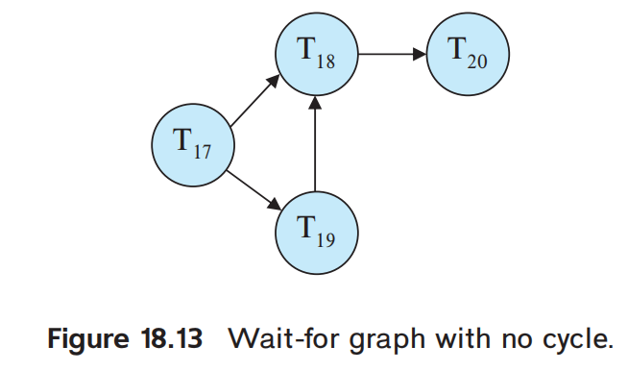
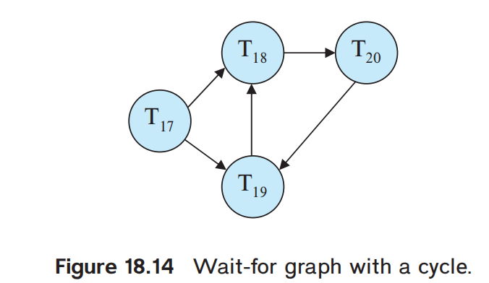
Deadlock Detection
Wait-for graph (directed graph)
Ti requests a data item currently being held by Tj: Ti → Tj
A deadlock exists in the system if and only if the wait-for graph contains a cycle

Slide 28
*Recovery from Deadlock
The logic
A deadlock exists -> recover
1. Selection of a victim: (minimum cost)
decide which transaction (or transactions) to roll back
a. How long the transaction has computed, and how much longer it will compute.
b. How many data items the transaction has used.
c. How many more data items the transaction needs for it to complete.
d. How many transactions will be involved in the rollback
2.Rollback
determine how far this transaction should be rolled back
a. total rollback: abort & restart
b. partial rollback:
1. record sequence of lock requests/grants & updates
2. decide which locks need to be release to break the deadlock.
3. roll back to the first of these locks/undo all actions after that point.
3. Starvation
select victims base on cost factors -> same transaction always be a victim -> starvation
(Include the number of rollbacks in the cost factor)

Slide 29
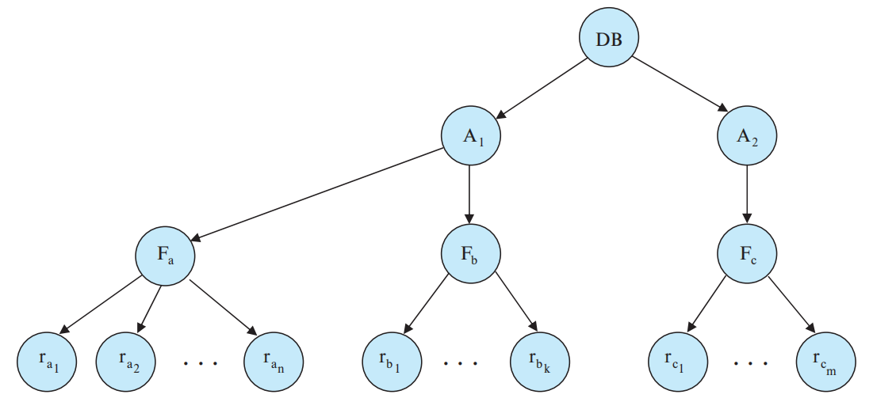
Multiple Granularity (多粒度)
Individual data item as the unit (单元执行多个数据)
-> group data items as one individual synchronization unit
-> Exp. a single lock request to lock the entire relation
Granularity
-> data be various sizes & hierarchy of granularities
Area type
Highest level: entire database.
Nodes of type area: what the database consists of
Nodes of type file : what area contains.
(No file is in more than one area)
Nodes of type records: what each file consists of
File type

Slide 30
Multiple Granularity: Exp1
Each node in the tree can be locked individually
Shared and eXclusive lock modes
Explicitly(显式) locks a node in S / X mode
-> all the descendants are implicitly(隐式) locked in the same mode
Tj wants to lock rb6 of Fb.
Ti has locked Fb explicitly -> rb6 is locked (implicitly).
Tj issues a explicit X lock request for rb6 , rb6 is not explicitly locked
System needs to determine whether Tj can lock rb6.
Tj traverse the tree from the root to rb6
If any node in that path is locked in an incompatible mode, then Tj is delayed.

Slide 31
Multiple Granularity: Exp2
Tk wishes to lock the entire DB, Ti has the lock of Fb
Tk locks the root of the hierarchy -> not succeed
System determine if the root node can be locked?
search the entire tree? multiple-granularity will be meaningless
A more efficient way
Introducing a new class of lock modes, called intention lock modes.
If a node is locked in an intention mode, explicit locking is done at a lower level of the tree(that is, at a finer更小 granularity).
Intention locks are put on all the ancestors before explicitly locked node
-> Transaction won’t need to search the entire tree to determine whether can lock.
A transaction wishing to lock a node must traverse a path in the tree from the root to target.
While traversing the tree, the transaction locks all nodes in an intention mode.

Slide 32
Intention lock modes
Intention-shared (IS)共享意向 mode:
Explicit locking is being done at a lower level of the tree, but with only shared-mode locks. (下级节点中显式共享锁)
Intention-exclusive (IX)排他意向 mode:
Then explicit locking is being done at a lower level, with exclusive-mode or shared-mode locks. (显式排他/共享锁)
Shared & intention-exclusive共享排他意向 (SIX) mode:
The subtree rooted by that node is locked explicitly in shared mode, and that explicit locking is being done at a lower level with exclusive-mode locks.子树共享，更低层排他

Slide 33
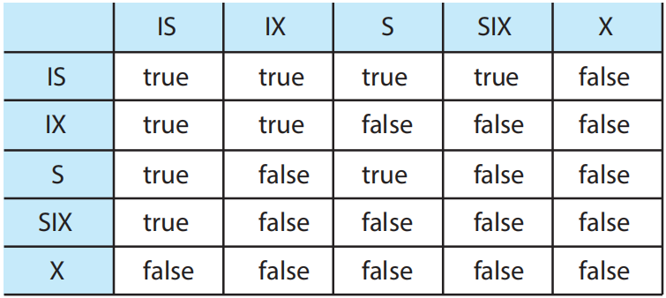
Multiple-Granularity Locking Protocol
Transaction Ti, Node Q
Ti must observe the lock-compatibility function
Ti must lock the root of the tree first (any mode)
Ti can lock Q in S/IS mode only if Ti has the IX/IS lock of its parent
Ti can lock Q in SIX/IX mode only if Ti has the IX/SIX of its parent
Ti can lock Q only if Ti has not previously unlocked any node (2PL)
Ti can unlock Q only if Ti currently has none of Q’s cildren locked
1. Lock acquire: top-down order (root-to-leaf)
2. Lock release: bottom-up order (leaf-to-root)
3. Deadlock is possible

Slide 34
Multiple-Granularity Locking Examples
T21 reads ra2 in Fa:
Lock the DB -> A1 -> Fa in IS mode;
Then lock ra2 in S mode
T22 modifies ra9 Fa.
Lock the DB -> A1-> Fa in IX mode;
Then lock ra9 in X mode
T23 reads all records in Fa
Lock the DB -> A1 in IS mode;
Then lock Fa in S mode
T24 reads the DB
Lock the DB in S mode
T21, T23, T24 can access the DB concurrently
T22 and T21 can excute concurrently
T22 and T23 / T24 cannot
concurrency+ and lock overhead(锁开销)-
It is particularly useful when:
1. Short transactions, accessing few data items. 短事务多访问
2. Long transactions that produce reports from an entire file or set of files.

Slide 35
Insert/Delete Operations & Predicate Reads
2 new operations:
delete(Q): deletes data item Q from the DB
insert(Q): inserts a new data item into the DB and assigns an initial value
Ti read(Q)after delete(Q) -> logical error in Ti 删除后读x
Ti read(Q) before insert(Q) -> logical error in Ti 插入前读x
delete a nonexistent data -> logical error

Slide 36
Deletion
Ti: Ii = delete(Q); Tj: Ij
schedule S: consecutive order
consider several instructions Ij
Ij = read(Q).
Ii - Ij conflict. If Ii -> Ij, Tj logical error.
If Ij -> Ii, Tj read(Q) success
Ij = write(Q).
Ii - Ij conflict. If Ii -> Ij, Tj logical error.
If Ij -> Ii, Tj write(Q) success
Ij = delete(Q).
Ii - Ij conflict. If Ii -> Ij, Tj logical error.
If Ij -> Ii, Ti logical error.
Ij = insert(Q).
Ii - Ij conflict. Q did not exist prior to Ii&Ij
if Ii-> Ij, Ti delete(Q) logical error
Conclusion:
For 2PL: X lock is required before deletion
*For Timestamp-ordering:
A test similar to that for a write (类似给write上的锁) -> delete(Q)
1. If TS(Ti) < R-timestamp(Q) 未来读？
TS(Tj) > TS(Ti) Order: Ti delete(Q) -> Tj read(Q)
delete operation rejected -> Ti is rolled back.
2. If TS(Ti) < W-timestamp(Q)
TS(Tj) > TS(Ti) Order: Ti delete(Q) -> Tj write(Q)
delete operation rejected -> Ti is rolled back
3. Otherwise, the delete is executed
If Ij -> Ii, then no logical error results.
if Q existed prior to Ii&Ij
if Ij -> Ii error
if Ii -> Ij success

Slide 37
Insertion
Insert(Q) conflict with read(Q), write(Q), delete(Q)
No ops can be performed before a data item exists
Insert(Q): assigns a value to Q
-> treated similarly to write for concurrency-control purposes
2PL: Ti insert(Q) need Ti Lock-X(Q) 对于新建的Q加锁
TS-ordering:
Ti insert(Q) operation, R-timestamp(Q) & W-timestamp(Q) = TS(Ti)

Slide 38
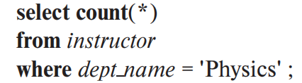

Predicate查询条件 Reads & The Phantom Phenomenon
T30:
T31:
S: A schedule involving T30 and T31
1. If T30 uses the tuple newly inserted by T31 in computing count(*), then T30 reads a value written by T31. Thus, in a serial schedule equivalent to S, must T31 -> T30
2. If T30 does not use T31’s insertion in count(*), then in a serial schedule == S, must T30 -> T31
T30 requires access to all tuples of the instructor relation pertaining to有关 the Physics department.
case 2: T30 and T31 do not access any tuple in common, yet they conflict with each other!
In effect, T30 and T31 conflict on a phantom tuple (tuple: 数据库中的一行).
If concurrency control is performed at the tuple granularity, this conflict would go undetected.
As a result, the system could fail to prevent a nonserializable schedule.
This problem is an instance of the phantom phenomenon

Slide 39
Predicate Reads & The Phantom Phenomenon
Phantom Phenomenon: inserts & updates
Ti and Tj have not accessed any tuples in common yet conflict with each other
phantom phenomenon is rooted in predicate reads (查询条件读取) that conflict with insert/update that result in new/updated tuples that satisfy the predicate *(insert/update使tuple变得可以满足predicate条件)
Solution: Allowing T30 to prevent other transactions from creating new tuples and from updating an existing instructor tuple
To find all instructor tuples with dept_name = “Physics”, T30 must search either the whole instructor relation, or at least an index on the relation. 要么找整个，要么找索引
Up to now, we have assumed implicitly that the only data items accessed by a transaction are tuples. However, T30 reads information about what tuples are in a relation, and T31 updates that info
Not just lock the tuples accessed, the info used to find the tuples that are accessed by the transaction must also be locked.

Slide 40
Solution: Create conflict on a new data item
To lock tuples-finding info:
associating a data item with the relation 关系起来数据项(relation信息)和relation
data item here: tuples-finding info (what tuples are in the relation)
T30 reads the info (what tuples are in the relation)
-> S-lock this data item corresponding to the relation
T31 updates the info
-> X-lock the data item
Thus, T30 and T31 would conflict on a real data item, rather than on a phantom.
Similarly, transactions that use an index to retrieve(搜索) tuples must lock the index itself.

Slide 41
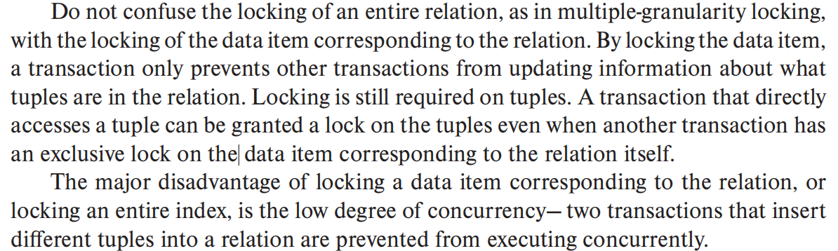
Problems

Slide 42
A Better Solution
Index-locking
Every relation must have at least one index.
A transaction Ti can access tuples of a relation only after first finding them through one or more of the indices on the relation. For the purpose of the index-locking protocol, a relation scan is treated as a scan through all the leaves of one of the indices. 先找索引才能access tuple
A transaction Ti that performs a lookup (whether a range lookup or a point lookup) must acquire a shared lock on all the index leaf nodes that it accesses. 共享锁 锁索引
A transaction Ti may not insert, delete, or update a tuple ti in a relation r without updating all indices on r.
The transaction must obtain X-locks on all index leaf nodes that are affected by the insertion, deletion, or update.
For insertion and deletion, the leaf nodes affected are those that contain (after insertion) or contained (before deletion) the search-key value of the tuple.
For updates, the leaf nodes affected are those that (before the modification) contained the old value of the search key, and nodes that (after the modification) contain the new value of the search key.
Locks are obtained on tuples as usual.
The rules of the two-phase locking protocol must be observed.

Slide 43
Timestamp-Based Protocol
TS(Ti)：事务进入时间
进入后先开始排序
然后统一执行
Ordering TXs in advance: timestamp-ordering scheme
Timestamp: Ti->Tj: TS(Ti)<TS(Tj)两种实现方法
1.System clock: TS(Ti) = value of the clock
2. Logical counter: increment after a new timestamp has been assigned
Timestamps of the TXs determine the serializability order
TS(Ti) < TS(Tj) -> serial Ti -> Tj
Each data item Q two timestamp values:
W-timestamp(Q) denotes the largest timestamp of any TX that executed write(Q)最晚写事务
R-timestamp(Q): read(Q)
R/W be excuted -> update W-TS / R-TS

Slide 44
The Timestamp-Ordering Protocol
Any conflicting R/W ops are executed in timestamp order
Ti read(Q): 不能小于w
If TS(Ti) < W-timestamp(Q), then Ti needs to read a value of Q that was already overwritten. Hence, the read operation is rejected, and Ti is rolled back. (Ti 进入时间早于最晚写 -不能读新数据滚回去)
If TS(Ti) ≥ W-timestamp(Q), then the read operation is executed, and R-timestamp(Q) is set to the maximum of R-timestamp(Q) and TS(Ti)
Ti write(Q): 不能小于r/w
If TS(Ti) < R-timestamp(Q), then the value of Q that Ti is producing was needed previously, and the system assumed that that value would never be produced. Hence, the system rejects the write operation and rolls Ti back. (Ti进入时间早于最晚读 已经有更晚事务读过了，不能被更早的事务改变)
If TS(Ti) < W-timestamp(Q), then Ti is attempting to write an obsolete value of Q. Hence, the system rejects this write operation and rolls Ti back.
Otherwise, the system executes the write operation and sets W-timestamp(Q) to TS(Ti)
If Ti is rolled back as result of a R/W op, the system assigns it a new TS and restarts it

Slide 45
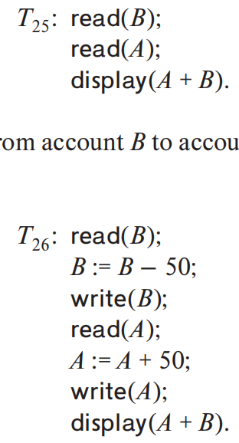
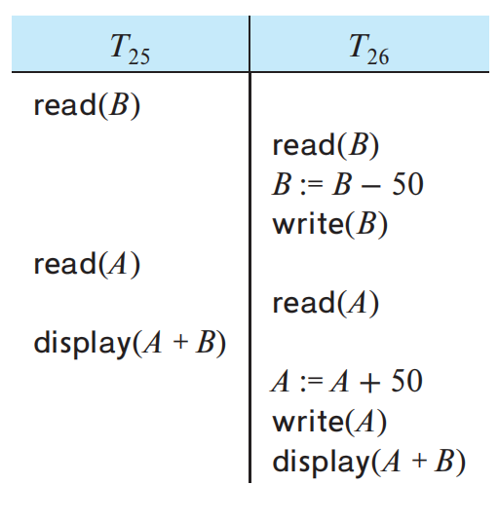
The Timestamp-Ordering Protocol
TS(T25) < TS(T26)
the schedule is possible under the timestamp protocol
(also possible under 2PL but not always, vice versa)
conflicting operations -> in timestamp order
TS ensures conflict serializability
No deadlock
a sequence of conflicting short transactions-> repeated restarting -> starvation
TS(T25), TS(T26) 两个时间戳值
W-timestamp(Q), R-timestamp(Q)对于数据，接收时间戳值
数据Q每次R/W后更新W/R-timestamp(Q)为TS(Ti)的值
TS(25) < TS(26)
R-timestamp(B) = TS(25)
R(B) = TS(26) update
W(B) = TS(26) > 25 conflict->OK
R(A) = TS(25)
R(A) = TS(26) update
W(A) = TS(26) >= 26 conflict->OK
conflict serializibility T25->T26

Slide 46
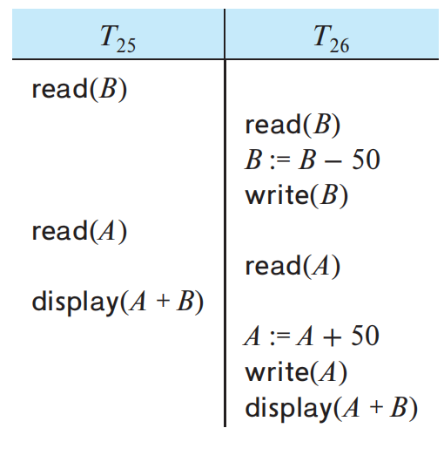
To Make schedules under TS recoverable
Recoverability (and cascadelessness):
1. performing all writes together at the end of the transaction. Writes: atomic, no TX is permitted to access any of the written data while writing
2. using limited form of locking -- reads of uncommitted items are postponed until the TX that updated the item commits
3. Tracking uncommitted writes and allowing a Ti to commit only after the commit of any TX that wrote a value that Ti read.

Slide 47
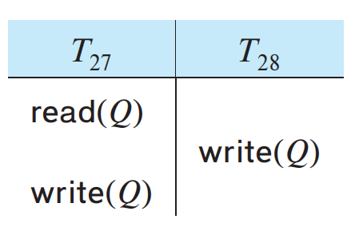
Thomas’ Write Rule
A modification to TS
Apply TS to schedule T27 -> T28
TS(T27)<T(T28)
R(Q) = TS(T27)
W(Q) = TS(T28) > R(Q) conflict OK
W(Q) = T(T27) < W(Q) conflict X
T27 rolls back
Any Ti with TS(Ti) < TS(T28) attempts a read(Q) will be rolled back, since TS(Ti) < W-timestamp(Q).
早于W(Q)=T28开始的事务 根据协议要读全部回滚->不会读T27想写的
Any Tj with TS(Tj) > TS(T28) must read the value of Q written by T28, rather than the value that T27 is attempting to write.
晚于T28开始的事务只会读T28写的数据
rolling back T27 is unnecessary 没必要回滚T27 滚不滚没影响
Unnecessary rollbacks: A waste of resource

Slide 48
Thomas’ Write Rule
ignored certain obsolete(过时的) write operation
read unchanged
Assuming Ti issues write(Q)
If TS(Ti) < R-timestamp(Q), then the value of Q that Ti is producing was previously needed, and it had been assumed that the value would never be produced.
Hence, the system rejects the write operation and rolls Ti back.
If TS(Ti) < W-timestamp(Q), then Ti is attempting to write an obsolete value of Q. Hence, this write operation can be ignored.
Otherwise, the system executes the write operation and sets W-timestamp(Q) to TS(Ti).
TS(Ti) < 最新R-timestamp(Q) 那就是写一个已读过Q 回滚Ti
TS(Ti) < 最新W-timestamp(Q) 那就是想写一个过期值(已写过Q) 无视此操作
否则正常写 更新W-stamp(Q)到TS(Ti)

Slide 49
Differences
When Ti issues write(Q)
The timestamp-ordering protocol:
TS(Ti) < W-timestamp(Q) Ti be rolled back
Thomas’ write:
TS(Ti) < W-timestamp(Q) and TS(Ti) ≥ R-timestamp(Q) ignore the write 無視
Thomas’ write allow not conflict serializable but correct schedules
允许非冲突可串行化（完全等价串行调度） 但结果正确的调度
Thomas’ write T27 T28 view equivalent 视图等价 to the serial schedule <T27, T28>.

Slide 50
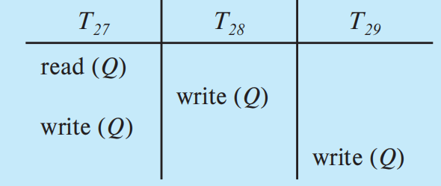
VIEW SERIALIZABILITY 视图可串行化
针对调度的概念 调度S, S’ prime
1. For each data item Q, if transaction Ti reads the initial value of Q in schedule S, then transaction Ti must, in schedule S′, also read the initial value of Q.
调度S中Ti读了Q初始值，S’中Ti就也得读
2. For each data item Q, if transaction Ti executes read(Q) in schedule S, and if that value was produced by a write(Q) operation executed by transaction Tj, then the read(Q) operation of transaction Ti must, in schedule S′, also read the value of Q that was produced by the same write(Q) operation of transaction Tj
S中Ti读了Tj写的Q，S’中Ti就也得读同一个Tj写操作的Q
3. For each data item Q, the transaction (if any) that performs the final write(Q) operation in schedule S must perform the final write(Q) in schedule S′
调度S如最后写了Q 那S’最后也得一样写Q
-> All TX read the same value
-> S&S’ result the same
S5 is not conflict serializable 每两个连续指令都冲突 没法换 -> 非冲突可串行化 但是
-> View equivalent to serial schedule <T27, T28, T29>
(less stringent than conflict equivalence)
T28, T29 write without read -> blind writes 不读直接写
appear in view-serializable but not conflict serializable schedule
S5

Slide 51
Validation-Based Protocols
A conflict monitoring scheme
Each TX executes in 2 or 3 different phases in its lifetime, depending on it’s read-only / update
1. Read phase.
During this phase, the system executes transaction Ti.
It reads the values of the various data items and stores them in variables local to Ti.
Performing all write operations on temporary local variables, without updates of the actual DB 本地储存不更新DB
2. Validation phase.
The validation test is applied to Ti .
Determining whether Ti is allowed to proceed to the write phase or a violating the serializability.
If fails -> aborts Ti
3. Write phase.
If validation test succeeds for Ti.
Temporary local variables that hold the results of Ti’s write are copied to the DB.
If read-only -> omit this step (只读事务跳过)

Slide 52
Validation-Based Protocols
Associating 3 different timestamps with Ti
1. StartTS(Ti), the time when Ti started its execution
2. ValidationTS(Ti), finished read phase, started validation phase
3. FinishTS(Ti), finished its write phase.
Using the value of the timestamp Validation TS(Ti) to determine the serializability order by the timestamp-ordering technique.
Thus, the value TS(Ti) = ValidationTS(Ti) and, if TS(Tj) < TS(Tk), then any produced schedule must be equivalent to a serial schedule in which Tj appears before Tk
用Validation TS当作TS(Ti)来排序，TS(Tj)<TS(Tk)的话产生的调度需等价于某个Tj->Tk的串行调度

Slide 53
validation test
TS(Tk) < TS(Ti), one of the following two conditions must hold: 一个就行
1. FinishTS(Tk) < StartTS(Ti).
Tk completes before Ti started -> serializability order maintained
2. Data items written by Tk does not intersect with Data read by Ti, and Tk completes its write phase before Ti starts its validation phase (FinishTS(Tk) < ValidationTS(Ti)) Ti检查前Tk结束
writes of Tk and Ti do not overlap 写不重叠
Tk writes do not affect the Ti reads Tk写不影响Ti读
Ti never affect the read of Tk -> serializability maintained.

Slide 54
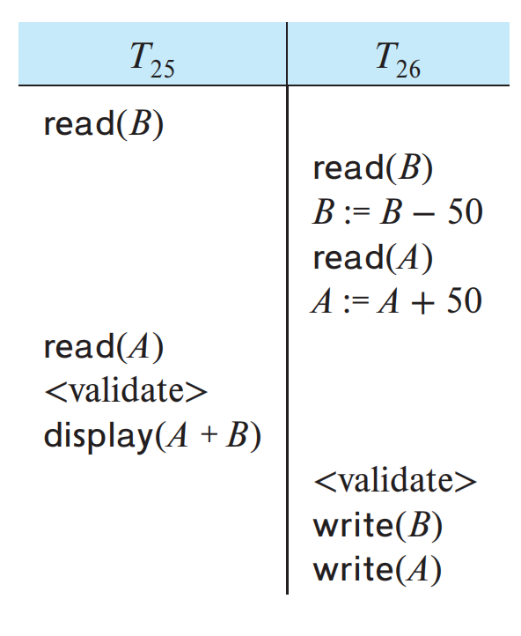
Validation-Based ProtocolsP868 typo
T25 write set: nothing
T26 read set: B, A
No overlap
StartTS(T25) < FinishTS(T25) < ValidationTS(T26)
26检查前25结束
equivalent to <T25, T26>
startTS25
Automatically guards against cascading rollbacks 写事务提交后才真写
Possibility of starvation: 长事务不断重启
optimistic concurrency-control
assuming TXs are able to finish execution
locking & timestamp ordering are pessimistic
FinishTS25
ValidateTS25

Slide 55
Multiversion Schemes
each write(Q) operation creates a new version of Q
A TX issues a read(Q)
-> Concurrency control manager selects a version of Q to be read
Multiversion Timestamp Ordering
associate each Ti a static TS, denoted by TS(Ti)
associate each Q a sequence of versions <Q1, Q2, …, Qm>
Each version Qk contains 3 data fields数据字段:
1. Content is the value of version Qk
2. W-timestamp(Qk) is the timestamp of the TX that created Qk 写Qk版本的事务TS
3. R-timestamp(Qk) is the largest timestamp of any TX successfully read Qk 读Qk的最晚事务TS
W-timestamp(Qk), R-timestamp(Qk)初始值均为执行write的事务TS，有read了就更新R

Slide 56
Multiversion timestamp-ordering scheme
(The same)
Ti issues a read(Q) / write(Q)
Let Qk denote the version of Q whose write TS is the largest write timestamp <= TS(Ti)
1. If Ti issues read(Q) value returned is the content of Qk 读 返回Qk
2. If Ti issues write(Q),
TS(Ti) < R-timestamp(Qk) Sys rolls back Ti 写事务早于最新读 回滚写
TS(Ti) = W-timestamp(Qk) Sys overwrites the contents of Qk 写事务等于最新写(同tx) 覆盖
TS(Ti)> R-timestamp(Qk)) Sys creates a new version of Q 写事务晚于最新读 新建版本
W-timestamp of Qj & Qk is less than the TS of the oldest TX in the system -> Delete older one from Qj, Qk
rule 1 A TX reads the most recent version
rule 2 forces Ti to abort if Ti attempts to rewrite a version that other TX would have read

Slide 57
Multiversion timestamp-ordering scheme
Disirable: Read request never fails and is never made to wait 优点读得快不用等
-> frequent read in typical DB Sys
Undisirable:
reading updates of the R-timestamp field 读TS要更新
-> potential disk accesses
conflicts are resolved through rollbacks rather than waits 失败回滚
-> expensive
Does not ensure recoverability and cascadelessness

Slide 58
Multiversion Two-Phase Locking
rigorous two-phase locking: hold all locks til commit
TXs can be serialized according to their commit order
Each ver of data item has a timestamp base on a counter (increments during commit processing) called ts-counter
只有一个TS
DB Sys assigns a read-only TX current value of ts-counter as its TS before TX starts 只读事务TS初始化为当前counter值
read-only Ti read(Q) -> return contents of the version with the largest timestamp <=TS(Ti) 返回最新版本Q
update TX read(Q) -> obtain S-Lock & read the latest ver 对于update类型事务: 共享锁; 读最新TS
update TX write(Q) -> obtain X-Lock & create a new ver, TS = inf 互斥锁; 写新ver; TS(Q)初始化无穷大-谁都读不成
when update TX finishes: 1. all new ver’s TS = ts-counter+1 结束时 所有新Ver TS(Q)=当前counter值+1
2. ts-counter += 1 counter值+=1
only 1 update TX is allowed to perform commit processing at a time

Slide 59
Multiversion Two-Phase Locking
Tx, Ti, Ty, ts-counter = a
Tx read only, TS(Tx) = ts-counter = a
Ti update, ts-counter += 1 = a+1
Ty read-only, TS(Ty) = ts-counter = a+1
Tx can only read contents of version Q where TS(Q) = a
Ty can only read updated value TS(Q) = a+1
read-only transactions never need to wait for locks
recoverable and cascadeless

Slide 60
Snapshot Isolation
A concurrency-control scheme widely used in many DB Sys
Giving a TX a “snapshot” of the DB when begin excution
Data values in the snapshot consist only of values written by committed TXs
Ideal for read-only: never wait/abort
When T is allowed to commit
1. the transition of T to the committed state
2. the writing of all updates made by T to the DB
must be atomic -> any snapshot for another TX either includes all updates of T or none 别的快照含有全部的更新修改，不能中途那种

Slide 61
Multiversioning in Snapshot Isolation
TS(Qk)=1
StartTS(Ti)=1
read(Q) TS(Qk)=1
write(Q)
CommitTS(Ti)=2
ver.Qi TS(Qi)=2
Each TX 2 TS
StartTS(Ti) & CommitTS(T): the time when TX requested validation.
TS: wall clock time(真实时间)/usually counter (+=1 when TX enter validation phase)
Snapshot isolation is based on multiversioning
Ti update: creates a new version Qk, Qk has only 1 TS(Qk) = CommitTS(Ti) 版本TS为提交时间戳
Ti read -> largest TS(Qk) ≤ StartTS(Ti) is returned to Ti 读 事务开始前最大版本
Thus, Ti does not see the updates of any TXs that committed after Ti started, 因此事务开始后中Ti看不到任何更新
while it does see the updates of all TXs that commit before it started 开始时能看到最新所有update值
As a result, Ti effectively sees a snapshot of the DB as of the time it started Ti可以得到高效获得数据库快照

Slide 62
Validation Steps for Update Transactions
Concurrent TX only R/W their own snapshot
2 TX Both update Q & pass valid test
overwrite -> lost update
2 variants to prevent:
1. first committer wins 先提交算数
2. first updater wins 先更新算数
Tj is said to be concurrent with Ti if it was active or partially committed at any point from the start of Ti to validation of Ti started
因为事务都只能操作自己的快照
2事务写入同一数据&检测有效
晚事务覆盖新 更新丢失
Tj与Ti并发定义：Ti开始到有效test开始之间，Tj为active/部分提交

Slide 63
Validation Steps for Update Transactions
First committer wins
the following actions are performed as a part of validation after CommitTS 验证阶段的一部分
(For simplicity assume only 1TX performs validation at a time, real implementations support concurrent validation.)
1. Test if concurrent TX has written an update to DB for data items T intends to write
(by checking whether there is a version TS is between StartTS(Ti) and CommitTS(Ti) for all datas Ti write)
(查看Ti写的数据中，有无StartTS(Ti)<TS<CommitTS(Ti), 即执行过程中被更新的版本)
2. If any such data item is found, then Ti aborts. 有的话abort
3. if not found, then Ti commits and its updates are written to the database.
if transactions conflict, the first one to be tested succeeds in writing its update

Slide 64
Validation Steps for Update Transactions
first updater wins
using locking mechanism that applies only to updates (在更新时使用锁)
TX attempt to update Q -> requests a write lock on Q
1. if lock free:
if Q has been updated by concurrent TX: Ti aborts
已被并发事务(因为一堆事务等一个)更新过 -> abort 重新进
else Ti may proceed (including possibly committing)
2. else lock is obtained by Tj: Ti waits until Tj aborts / commits: 别人拿了的话就等 看情况
if Tj aborts -> lock released -> obtain, back to 1
if Tj commits -> Ti aborts
the first one to obtain the lock is permitted to commit and perform its update

Slide 65
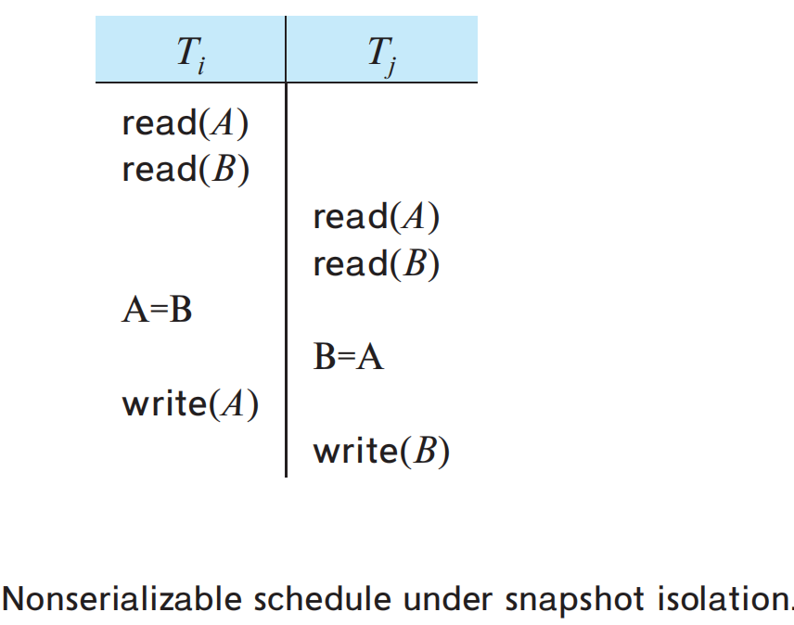
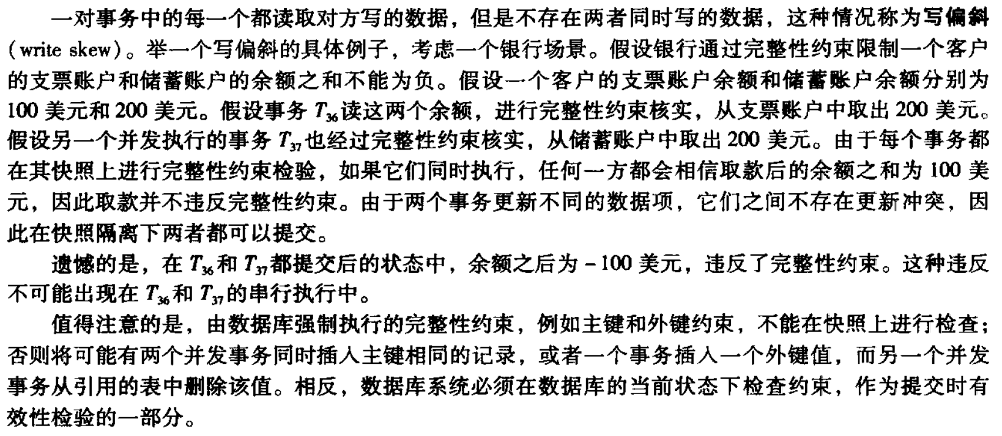
Serializability Issues and SolutionsP876 typo
Snapshot isolation does not ensure serializability!
Ti, Tj concurrent 并发事务
can only see their own snapshot 只能看到自己快照
write different data item -> both can commit
写不同数据的话就都可以提交
However
Ti read(B) -> Tj write(B)
Tj read(A) -> Ti write(A) -> not acyclic!
A nonserializable schedule！ 非可串行化事务
each of a pair of TXs has read a data item that is written by the other, but the set of data items written by the two transactions do not have any data item in common, is referred to as write skew
读对面写的但是没有写相同数据项: 写偏斜
这里有环

Slide 66
Serializability Issues and Solutions
在这个协议下生成了非可串行化调度
Tk快照中没有Tj更新的A
Tk读Tj未更新值 Tk->Tj
CYCLE!
Remember why serializability is needed?
-> keep consistency in concurrency
Potential non serializability is acceptable sometimes
不影响consistency情况下有时可以接受部分不可串行化
It depend on If update order in Tk is important
University DB -> A,B are register num Fine
Financial DB -> A,B are balance Unacceptable
Thus, checking integrity constraints when commit but not on snapshot is helpful in avoiding inconsistency(完整性约束)
Ti Tj Tk
read(B)
read(A)
write(A)
read(B)
write(B)
commit read(A)
read(B)
Xxxx(Q)
Ti commited
->Snapshot Tk has Ti’s update but no Tj’s
Tk read(A) -> Tj write(A)

Slide 67
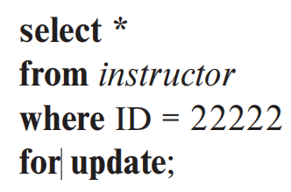
Serializability Issues and Solutions
Guard against certain snapshot anomalies异常 by “for update”
Causes the system to treat data that are read as if they had been updated
for update clause子句 were appended to the select queries that read the values of A and B, only one of the two concurrent TXs would be allowed to commit since it appears that both TXs have updated both A and B 在两事务都读AB的情况下 将读行为升级为好像和update一样 这样就会收到机制约束 只能提交一个
SQLserver: Serializable Isolation(真正的串行执行) / Snapshot Isolation

Slide 68
Weak Levels of Consistency in Practice
Isolation levels specified by the SQL standard:
serializable
repeatable read
read committed
read uncommitted
Some older terminology relating to consistency levels weaker than serializability & Concurrency control that involve user interaction

Slide 69
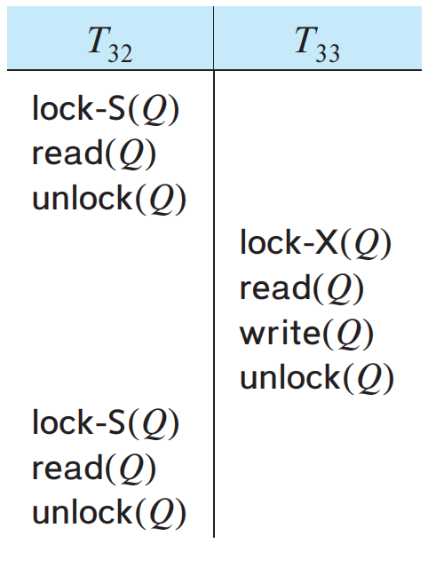
Degree-Two Consistency
古いやつ
二级一致性
Purpose: avoid cascading aborts without necessarily ensuring serializability
(不需要可串行性前提下避免级联中止)
S-Lock & X-Lock
A TX must hold the appropriate lock mode when it accesses a data item
S-locks may be released / acquired at any time.
X-locks cannot be released until the TX commits / aborts.
Serializability is not ensured
different values
Reads are non repeatable, but since exclusive locks are held until commit, no TX can read an uncommitted value. Thus, degree-two consistency is
one particular implementation of the read-committed isolation level
不可重复读但是一直有排他锁，没人能真正读到读未提交值 - 读提交级别的实装

Slide 70
Cursor Stability游标稳定性
古いやつ
A form of degree-two consistency
Designed for programs that iterate over tuples of a relation by using cursors 为使用游标遍历元祖的程序设计
The tuple that is currently being processed by the iteration is S-locked. Once the tuple is processed, the lock can be released.
Any modified tuples are X-locked until TX commits.
Serializability is not guaranteed
Used on heavily accessed relations
When supported by the database, snapshot isolation is a better alternative to degree-two consistency as well as cursor stability

Slide 71
*Concurrency Control Across User Interactions
Selecting seat 飞机选座
2PL: Nobody is allowed to select until I finish -- BAD
(read: S-Lock; write: X-Lock)
Timestamp / Validation: user A will be aborted if user B has updated even if B’s choice does not conflict with A’s -- BAD
(Ta read(Q) Tb write(Q); TS(Ta) < W-timestamp(Q)=TS(Tb))
Snapshot isolation: won’t abort anyone as long as they are not selecting the same seat
However, problematic for long-duration transactions

Slide 72
Concurrency Control Across User Interactions
Another option
Split a TX that involves user interaction into two or more
no TX spans a user interaction.
Exp:
1st transaction read the seat availability,
2nd transaction complete the allocation of the selected seat.
2nd could resulting in lost-update
(assign the selected seat to the user without checking if the seat was meanwhile assigned to some other user)
To avoid the problem 2nd TX should perform the seat allocation only if the seat was not meanwhile assigned to some other user

Slide 73
Optimistic concurrency control without read validation
Adding an extra version number attribute, which is initialized to 0 when the tuple is created.
When a transaction reads (for the first time) a tuple that it intends to update, it remembers the version number of that tuple.
The read is performed as a stand-alone TX on the DB, and hence any locks that may be obtained are released immediately. 读编号操作为单独事务瞬间结束
Updates are done locally and copied to the DB as part of commit processing

Slide 74
Optimistic concurrency control without read validation
TX checks if the current version number is the same as the version number of the tuple when it was first read by the TX.
1. If the version numbers match -> update is performed in DB,
version number+=1.
2. If not match -> TX aborts, rolling back all the updates
If the version number check succeeds for all updated tuples, the TX commits.
TS could be used instead of the version number
exp: Q版本号为0，Ti首次读记录0，Tj首次读记录0，Tj更新时检查，还为0于是更新；版本号+1，Ti更新时检查版本好不为0(已被更新，再更新会lost update)，Ti回滚

Slide 75
Optimistic concurrency control without read validation
optimistic concurrency control without read validation
similar to snapshot isolation
version number check implements the first-committer-wins rule used in snapshot isolation 类似快照隔离 先提交的算数
unlike snapshot isolation, the reads may not correspond to a snapshot
unlike the validation-based protocol, reads are not validated
weak level of serializability
can be implemented easily on top of a DB system

Slide 76
Advanced Topics in Concurrency Control
Online Index Creation:
allows relation updates to occur even as the index is being created
Concurrency in Index Structures:
Crabbing protocol, B-link Tree
Concurrency Control in Main-Memory Databases:
latch-free data structure/lock-free data structure
Long-Duration Transactions
Concurrency Control with Operations
Real-Time Transaction Systems

Slide 77
Summary
When several TXs execute concurrently in DB, the consistency of data may no longer be preserved.
It is necessary for the system to control the interaction among the concurrent TXs, and this control is achieved through one of a variety of mechanisms called concurrency-control schemes.
Various concurrency-control schemes are used to ensure serializability
All of them delay an operation / abort the TX
The most common ones: locking protocols, timestamp-ordering schemes, validation techniques, and multiversion schemes.

Slide 78
Summary
A locking protocol is a set of rules that state when a TX may lock and unlock each of the data items in the DB.
2PL protocol allows a TX to lock a new data item only if that TX has not yet unlocked any data item.
The protocol ensures serializability, but not deadlock freedom. In the absence of information concerning the manner in which data items are accessed, the two-phase locking protocol is both necessary and sufficient for ensuring serializability.
The strict 2PL permits release of X-locks only at the end of TX, in order to ensure recoverability and cascadelessness of the resulting schedules. The rigorous two-phase locking protocol releases all locks only at the end of the transaction.

Slide 79
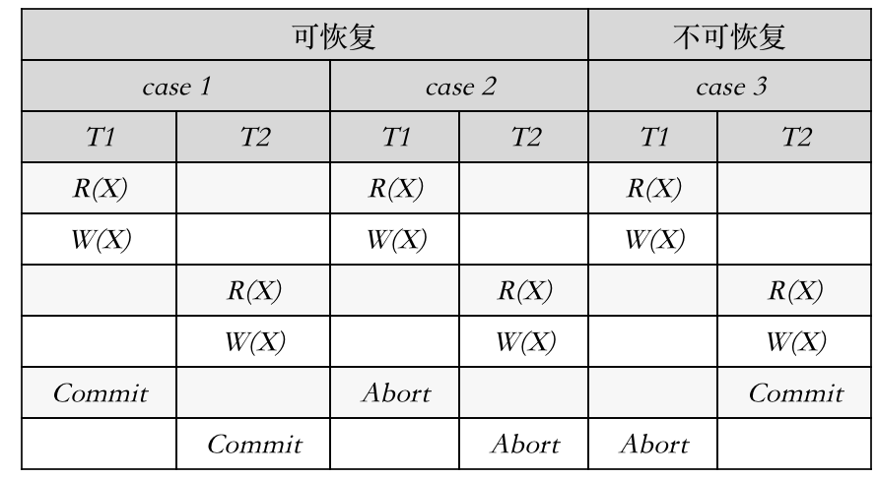
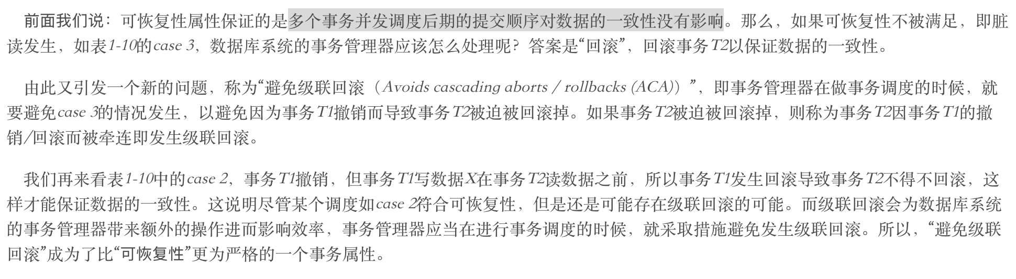
可恢复性与级联回滚
可恢复性：已经提交的事务没有读过被撤销的事务的写数据。
如果这样的事情发生了，则已经提交的事务读过被撤销的事务的写数据，则脏读异常发生，导致数据不一致。所以可恢复性属性保证的是多个事务并发调度后期的提交顺序对数据的一致性没有影响。
如表1-10，case 1的事务T2读数据X发生在事务T1写数据X之后，两个事务都提交，没有违反“可恢复性”的定义；case 2 的事务T2读数据X发生在事务T1写数据X之后，事务T1和T2都撤销，没有违反“可恢复性”的定义；所以case 1和case 2这两种调度方式都具有“可恢复性”。而case 3发生了脏读，所以不满足“可恢复性”。
脏读：一个事务读取了另一个未提交事务中的数据

Slide 80
Summary
Various locking protocols do not guard against deadlocks.
prevent deadlock by using an ordering of data items and to request locks in a sequence consistent with the ordering.
Another way to prevent deadlock is to use preemption抢占 and TX rollbacks. P24
Timestamp -> control the preemption. The system uses these TSs to decide whether a TX should wait / roll back. The wound–wait scheme is a preemptive scheme.
If deadlocks are not prevented, the system must deal with them by using a deadlock detection and recovery scheme. To do so, the system constructs a wait-for graph. A system is in a deadlock state if and only if the wait-for graph contains a cycle.
When the deadlock detection algorithm determines that a deadlock exists, the system rolls back one or more TXs to break the deadlock.

Slide 81
Summary
There are circumstances where it would be advantageous to group several data items and to treat them as one aggregate data item for purposes of working, resulting in multiple levels of granularity. We allow data items of various sizes, and we define a hierarchy of data items where the small items are nested within larger ones.
Such a hierarchy can be represented graphically as a tree. In such multigranularity locking protocols , locks are acquired in root-to-leaf order; they are released in leaf-to-root order. Intention lock modes are used at higher levels to get better concurrency, without affecting serializability

Slide 82
Summary
A timestamp-ordering scheme ensures serializability by selecting an ordering in advance between every pair of transactions. A unique fixed timestamp is associated with each transaction in the system. The timestamps determine the serializability order. Thus, if the TS(Ti) < TS(Tj), then the scheme ensures that the produced schedule is equivalent to a serial schedule in which Ti -> Tj . It does so by rolling back a transaction whenever such an order is violated.
A validation scheme is an appropriate concurrency-control method in cases where a majority of TXs are read-only, and thus the rate of conflicts among these transactions is low. A unique fixed timestamp is associated with each transaction in the system. The serializability order is determined by the timestamp of the transaction. A transaction in this scheme is never delayed. It must, however, pass a validation test to complete. If it does not pass the validation test, the system rolls it back to its initial state.

Slide 83
Summary
A multiversion concurrency-control scheme is based on the creation of a new version of a data item for each transaction that writes that item. When a read is issued, the system selects one of the versions to be read. The concurrency_x0002_control scheme ensures that the version to be read is selected in a manner that ensures serializability by using timestamps. A read operation always succeeds.
In multiversion TS ordering, a write operation may result in the rollback of the transaction.
In multiversion 2PL locking, write operations may result in a lock wait or, possibly, in deadlock.
Snapshot isolation is a multiversion concurrency-control protocol based on validation, which, unlike multiversion 2PL, does not require TXs to be declared as read-only / update. Snapshot isolation does not guarantee serializability but is nevertheless supported by many DB systems.
Serializable snapshot isolation is an extension of snapshot isolation which guarantees serializability.

Slide 84
Summary
A delete operation may be performed only if the TX has an X-lock on the tuple.
TX that inserts a new tuple into the DB is given an X-lock on the tuple.
Insertions can lead to the phantom phenomenon, in which an insertion logically conflicts with a query even though the two transactions may access no tuple in common. Such conflict cannot be detected if locking is done only on tuples accessed by the transactions. Locking is required on the data used to find the tuples in the relation. The index-locking technique solves this problem by requiring locks on certain index nodes. These locks ensure that all conflicting TXs conflict on a real data item, rather than on a phantom.

Slide 85
Summary
Weak levels of consistency are used in some applications where consistency of query results is not critical, and using serializability would result in queries adversely affecting TX processing. Degree-two consistency is one of it; cursor stability is a widely used special case of degree-two consistency.
Concurrency control is a challenging task for TXs that span user interactions. Applications often implement a scheme based on validation of writes using version numbers stored in tuples; this scheme provides a weak level of serializability and can be implemented at the application level without modifications to the DB.
Special concurrency-control techniques can be developed for special data structures. Often, special techniques are applied in B+trees to allow greater concurrency. These techniques allow nonserializable access to the B+-tree, but they ensure that the B+tree structure is correct, and they ensure that accesses to the DB itself are serializable. Latch-free data structures are used to implement high-performance indices and other data structures in main-memory databases.

Slide 86
kappa201 2.30 1.8

