Slide 1
Reliable Facility Location Problem
——Wenxing Lan

Slide 2
Outline:
Introduction to RFLP
EA with Memorable Local Search (EAMLS)
Reproduction Result of EAMLS
Some Ideas
Conclusion

Slide 3

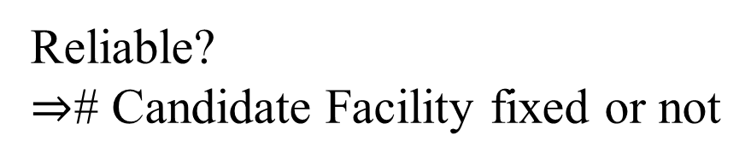
Introduction to RFLP:
Reliable?
$⇒$# Candidate Facility fixed or not
# Candidate Facility
Position of Candidate Facility

Slide 4
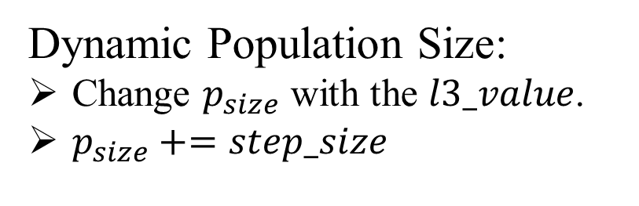
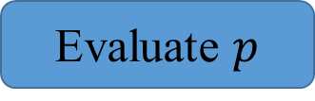
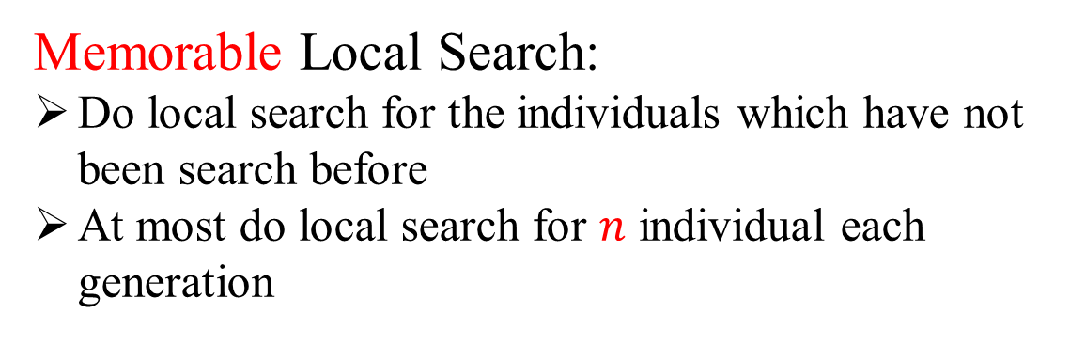
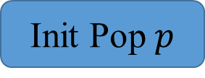
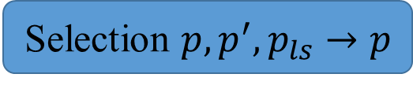
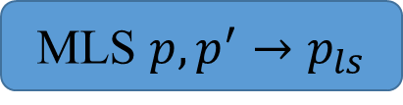
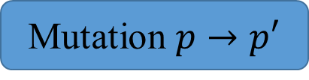
EAMLS:
Initialization Method:
Stochastic initialization
Binary Representation
Every gene of an individual takes 0 or 1 with equal probability
Init Pop $p$
Evaluate $p$
Memorable Local Search:
Do local search for the individuals which have not been search before
At most do local search for $n$ individual each generation
Mutation $p→p′$
# Generation < G
MLS $p,p^{′}→p_{ls}$
Selection $p,p^{′},p_{ls}→p$
Dynamic Population Size:
Change $p_{size}$ with the $l3_value$.
$p_{size}+=step_size$
Output Best Solution
[1] H. Zhang, J. Liu, and X. Yao, “A hybrid evolutionary algorithm for reliable facility location problem,” in Parallel Problem Solving from Nature – PPSN XVI, T. B¨ack, M. Preuss, A. Deutz, H. Wang, C. Doerr, M. Emmerich, and H. Trautmann, Eds. Cham: Springer International Publishing, 2020, pp. 454–467.

Slide 5
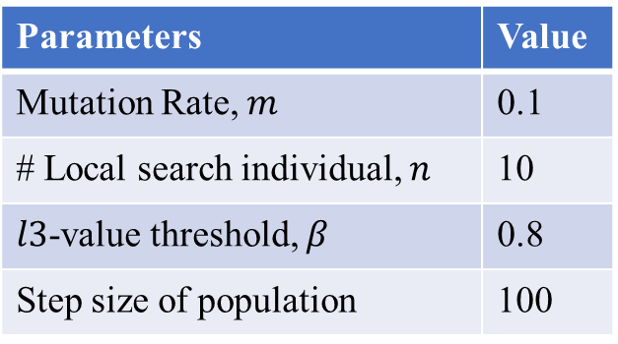
Reproduction Result of EAMLS:
Runtime Environment:
All programs have been written in C++ 11 and executed on an Intel(R) Core(TM) i5-10400F CPU working at 2.90 GHz on Windows 10 20H2, using a single thread.
Parameters Setting (Same as ones in [1]):
Parameters | Value
Mutation Rate, $m$ | 0.1
# Local search individual, $n$ | 10
$l3$-value threshold, $β$ | 0.8
Step size of population | 100
Instance Scale (# nodes) | # Generation | Population Size
10 | 10 | 20
50 | 20 | 20
100 | 50 | 100
Wilcox Sign Rank test is done with the level of significance 0.05.
[1] H. Zhang, J. Liu, and X. Yao, “A hybrid evolutionary algorithm for reliable facility location problem,” in Parallel Problem Solving from Nature – PPSN XVI, T. B¨ack, M. Preuss, A. Deutz, H. Wang, C. Doerr, M. Emmerich, and H. Trautmann, Eds. Cham: Springer International Publishing, 2020, pp. 454–467.

Slide 6
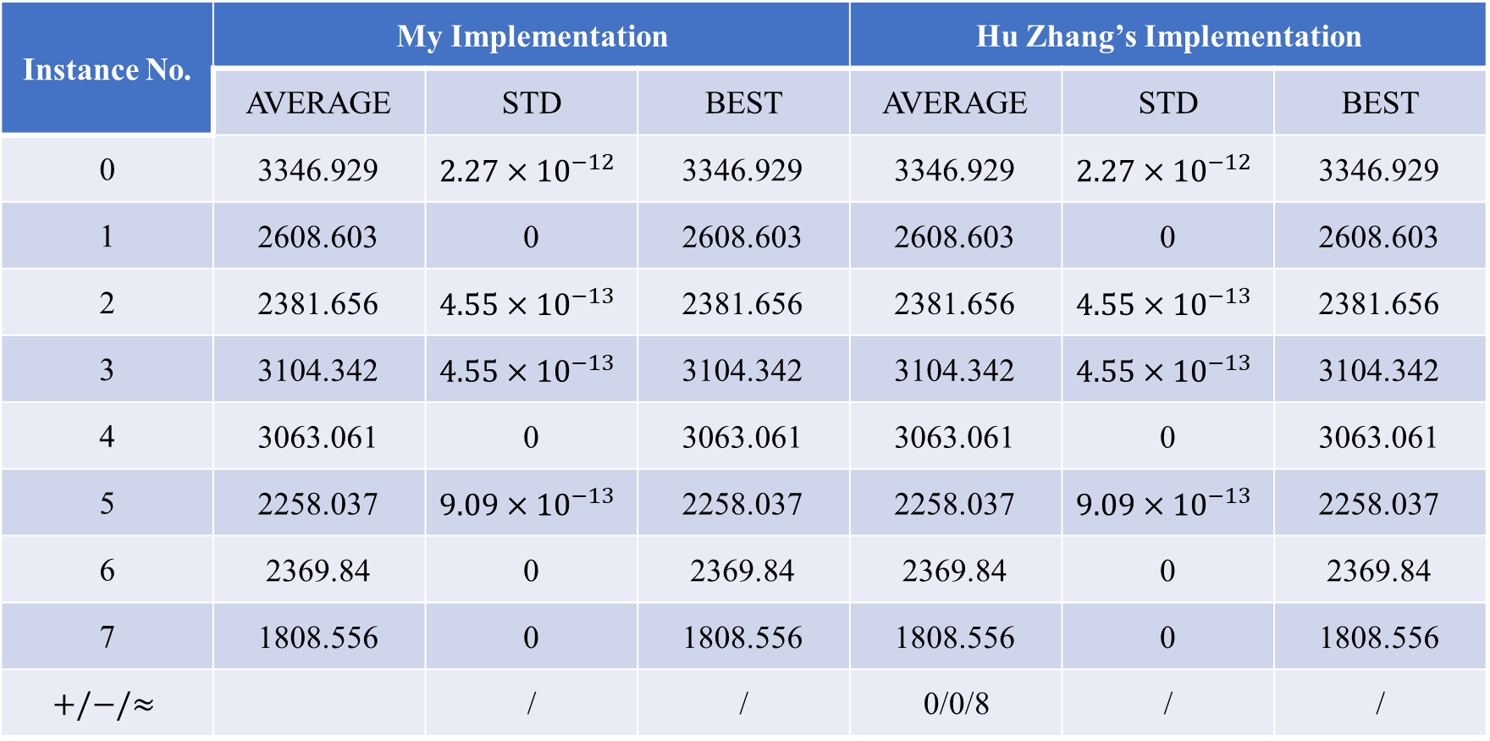
Reproduction Result of EAMLS:
10 nodes instances:
Instance No. | My Implementation |  |  | Hu Zhang’s Implementation
 | AVERAGE | STD | BEST | AVERAGE | STD | BEST
0 | 3346.929 | $$2.27×{10}^{−12}$$ | 3346.929 | 3346.929 | $$2.27×{10}^{−12}$$ | 3346.929
1 | 2608.603 | 0 | 2608.603 | 2608.603 | 0 | 2608.603
2 | 2381.656 | $$4.55×{10}^{−13}$$ | 2381.656 | 2381.656 | $$4.55×{10}^{−13}$$ | 2381.656
3 | 3104.342 | $$4.55×{10}^{−13}$$ | 3104.342 | 3104.342 | $$4.55×{10}^{−13}$$ | 3104.342
4 | 3063.061 | 0 | 3063.061 | 3063.061 | 0 | 3063.061
5 | 2258.037 | $$9.09×{10}^{−13}$$ | 2258.037 | 2258.037 | $$9.09×{10}^{−13}$$ | 2258.037
6 | 2369.84 | 0 | 2369.84 | 2369.84 | 0 | 2369.84
7 | 1808.556 | 0 | 1808.556 | 1808.556 | 0 | 1808.556
$$+/−/≈$$ |  | / | / | 0/0/8 | / | /

Slide 7
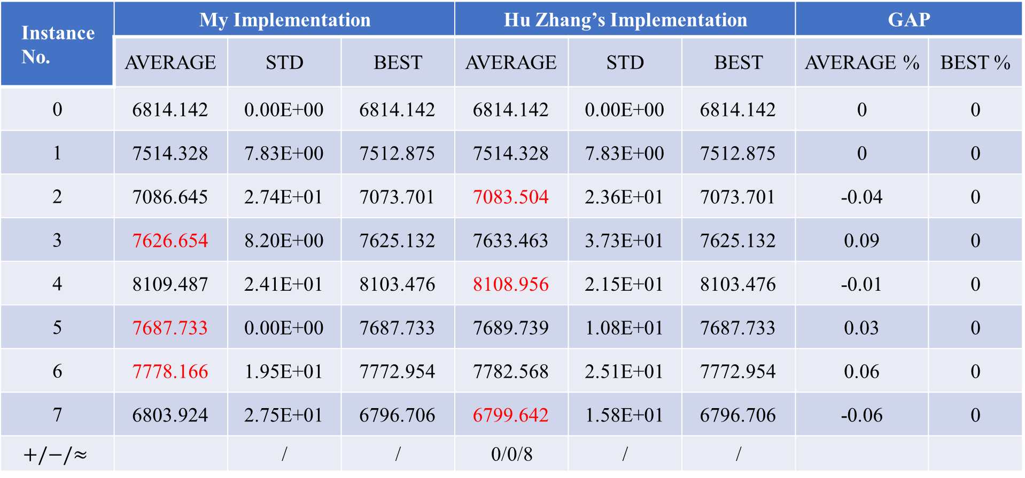
Reproduction Result of EAMLS:
50 nodes instances:
Instance No. | My Implementation |  |  | Hu Zhang’s Implementation |  |  | GAP
 | AVERAGE | STD | BEST | AVERAGE | STD | BEST | AVERAGE % | BEST %
0 | 6814.142 | 0.00E+00 | 6814.142 | 6814.142 | 0.00E+00 | 6814.142 | 0 | 0
1 | 7514.328 | 7.83E+00 | 7512.875 | 7514.328 | 7.83E+00 | 7512.875 | 0 | 0
2 | 7086.645 | 2.74E+01 | 7073.701 | 7083.504 | 2.36E+01 | 7073.701 | -0.04 | 0
3 | 7626.654 | 8.20E+00 | 7625.132 | 7633.463 | 3.73E+01 | 7625.132 | 0.09 | 0
4 | 8109.487 | 2.41E+01 | 8103.476 | 8108.956 | 2.15E+01 | 8103.476 | -0.01 | 0
5 | 7687.733 | 0.00E+00 | 7687.733 | 7689.739 | 1.08E+01 | 7687.733 | 0.03 | 0
6 | 7778.166 | 1.95E+01 | 7772.954 | 7782.568 | 2.51E+01 | 7772.954 | 0.06 | 0
7 | 6803.924 | 2.75E+01 | 6796.706 | 6799.642 | 1.58E+01 | 6796.706 | -0.06 | 0
$$+/−/≈$$ |  | / | / | 0/0/8 | / | /

Slide 8

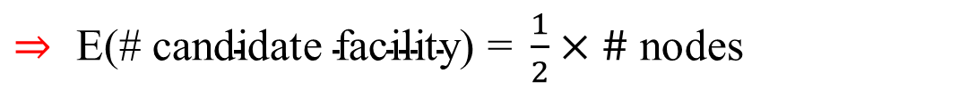


Idea 1: Change Initialization
Initialization Method in [1]:
Stochastic initialization
Binary Representation
Every gene of an individual takes 0 or 1 with equal probability
$⇒ \text{E}\text{(\# }\text{candidate} \text{facility}\text{) = }\frac{1}{2}×\#$ nodes
# Candidate Facility
Position of Candidate Facility
Change:
Make # candidate facility more diversity
# nodes $≤μ$
按照$m∈\{2,3,…,\# node\}$生成facility位置随机的个体, 剩余部分的个体$按照m=uniform[2, \#node]$生成facility位置随机的个体
$μ<$# nodes $<2μ$
按照$m∈\{2,4,…,2⌊\frac{\#node}{2}⌋\}$生成facility位置随机的个体, 剩余部分的个体$按照m=uniform[2, \#node]$生成facility位置随机的个体
# nodes $≥2μ$
$a=\left\lfloor \frac{\#node}{μ}\right\rfloor ,$按照$m∈\{2,2+a,2+2a,…\}(m≤\#node)$生成facility位置随机的个体, 剩余部分的个体$按照m=uniform[2, \#node]$生成facility位置随机的个体

Slide 9
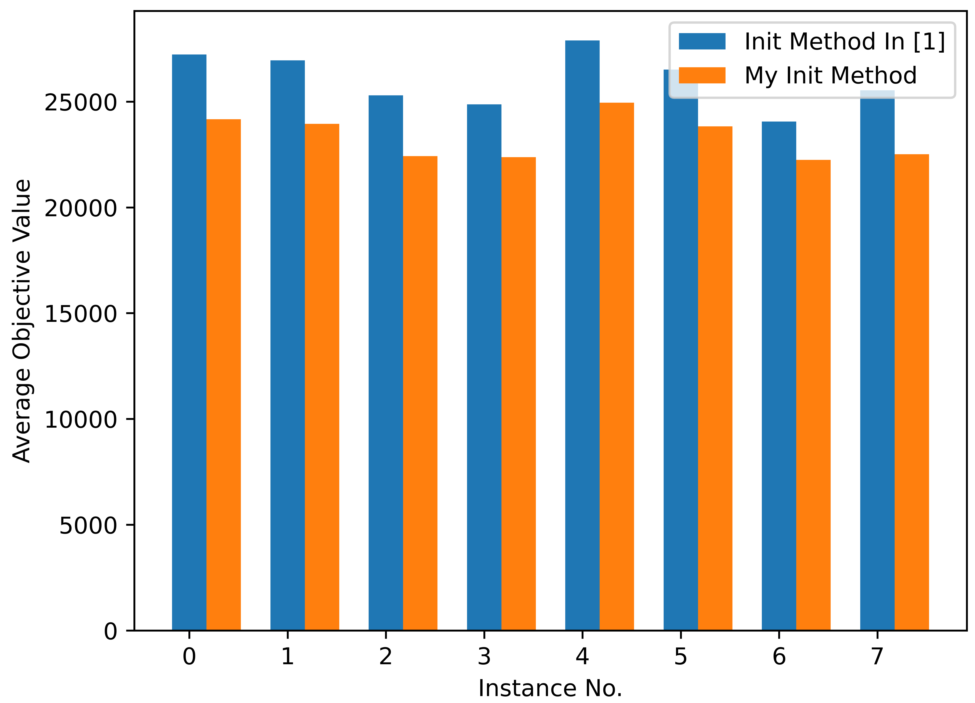
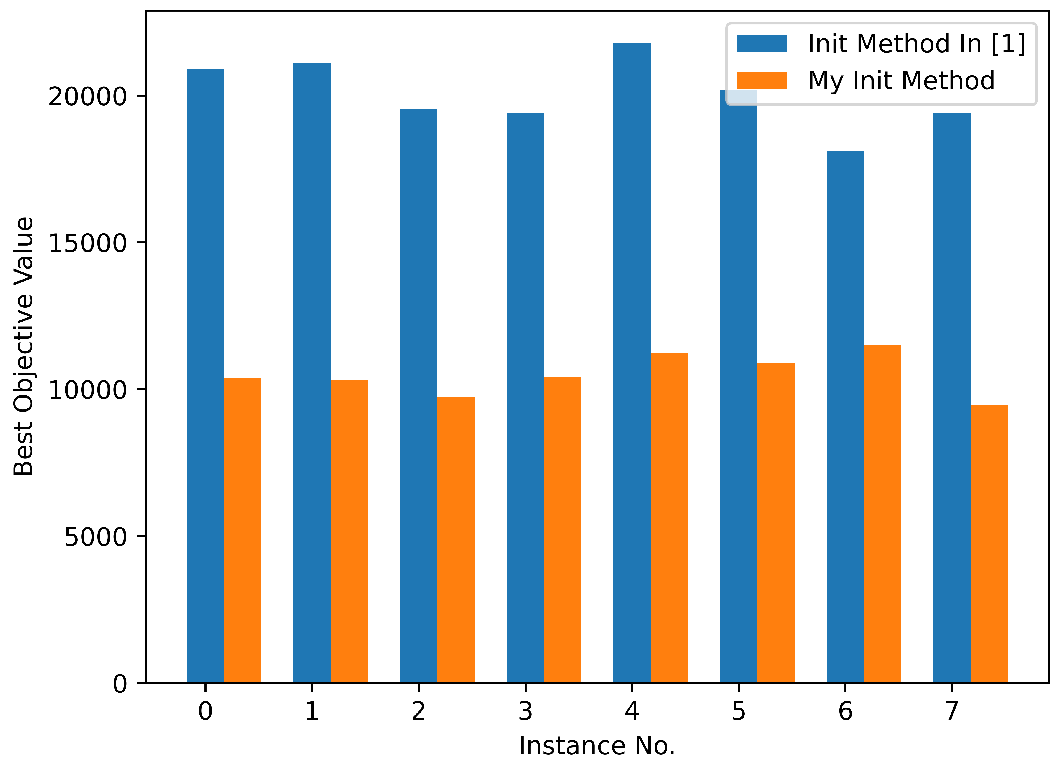
Experimental Result:
50 node instances:
[1] H. Zhang, J. Liu, and X. Yao, “A hybrid evolutionary algorithm for reliable facility location problem,” in Parallel Problem Solving from Nature – PPSN XVI, T. B¨ack, M. Preuss, A. Deutz, H. Wang, C. Doerr, M. Emmerich, and H. Trautmann, Eds. Cham: Springer International Publishing, 2020, pp. 454–467.

Slide 10
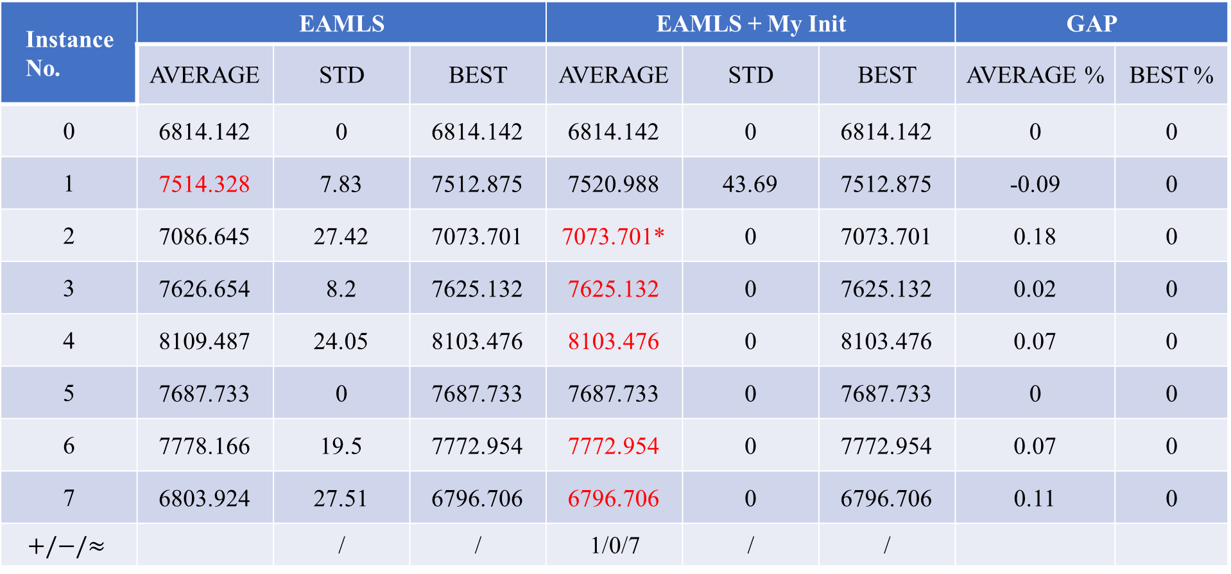
Experimental Result:
50 nodes instances:
Instance No. | EAMLS |  |  | EAMLS + My Init |  |  | GAP
 | AVERAGE | STD | BEST | AVERAGE | STD | BEST | AVERAGE % | BEST %
0 | 6814.142 | 0 | 6814.142 | 6814.142 | 0 | 6814.142 | 0 | 0
1 | 7514.328 | 7.83 | 7512.875 | 7520.988 | 43.69 | 7512.875 | -0.09 | 0
2 | 7086.645 | 27.42 | 7073.701 | 7073.701* | 0 | 7073.701 | 0.18 | 0
3 | 7626.654 | 8.2 | 7625.132 | 7625.132 | 0 | 7625.132 | 0.02 | 0
4 | 8109.487 | 24.05 | 8103.476 | 8103.476 | 0 | 8103.476 | 0.07 | 0
5 | 7687.733 | 0 | 7687.733 | 7687.733 | 0 | 7687.733 | 0 | 0
6 | 7778.166 | 19.5 | 7772.954 | 7772.954 | 0 | 7772.954 | 0.07 | 0
7 | 6803.924 | 27.51 | 6796.706 | 6796.706 | 0 | 6796.706 | 0.11 | 0
$$+/−/≈$$ |  | / | / | 1/0/7 | / | /

Slide 11
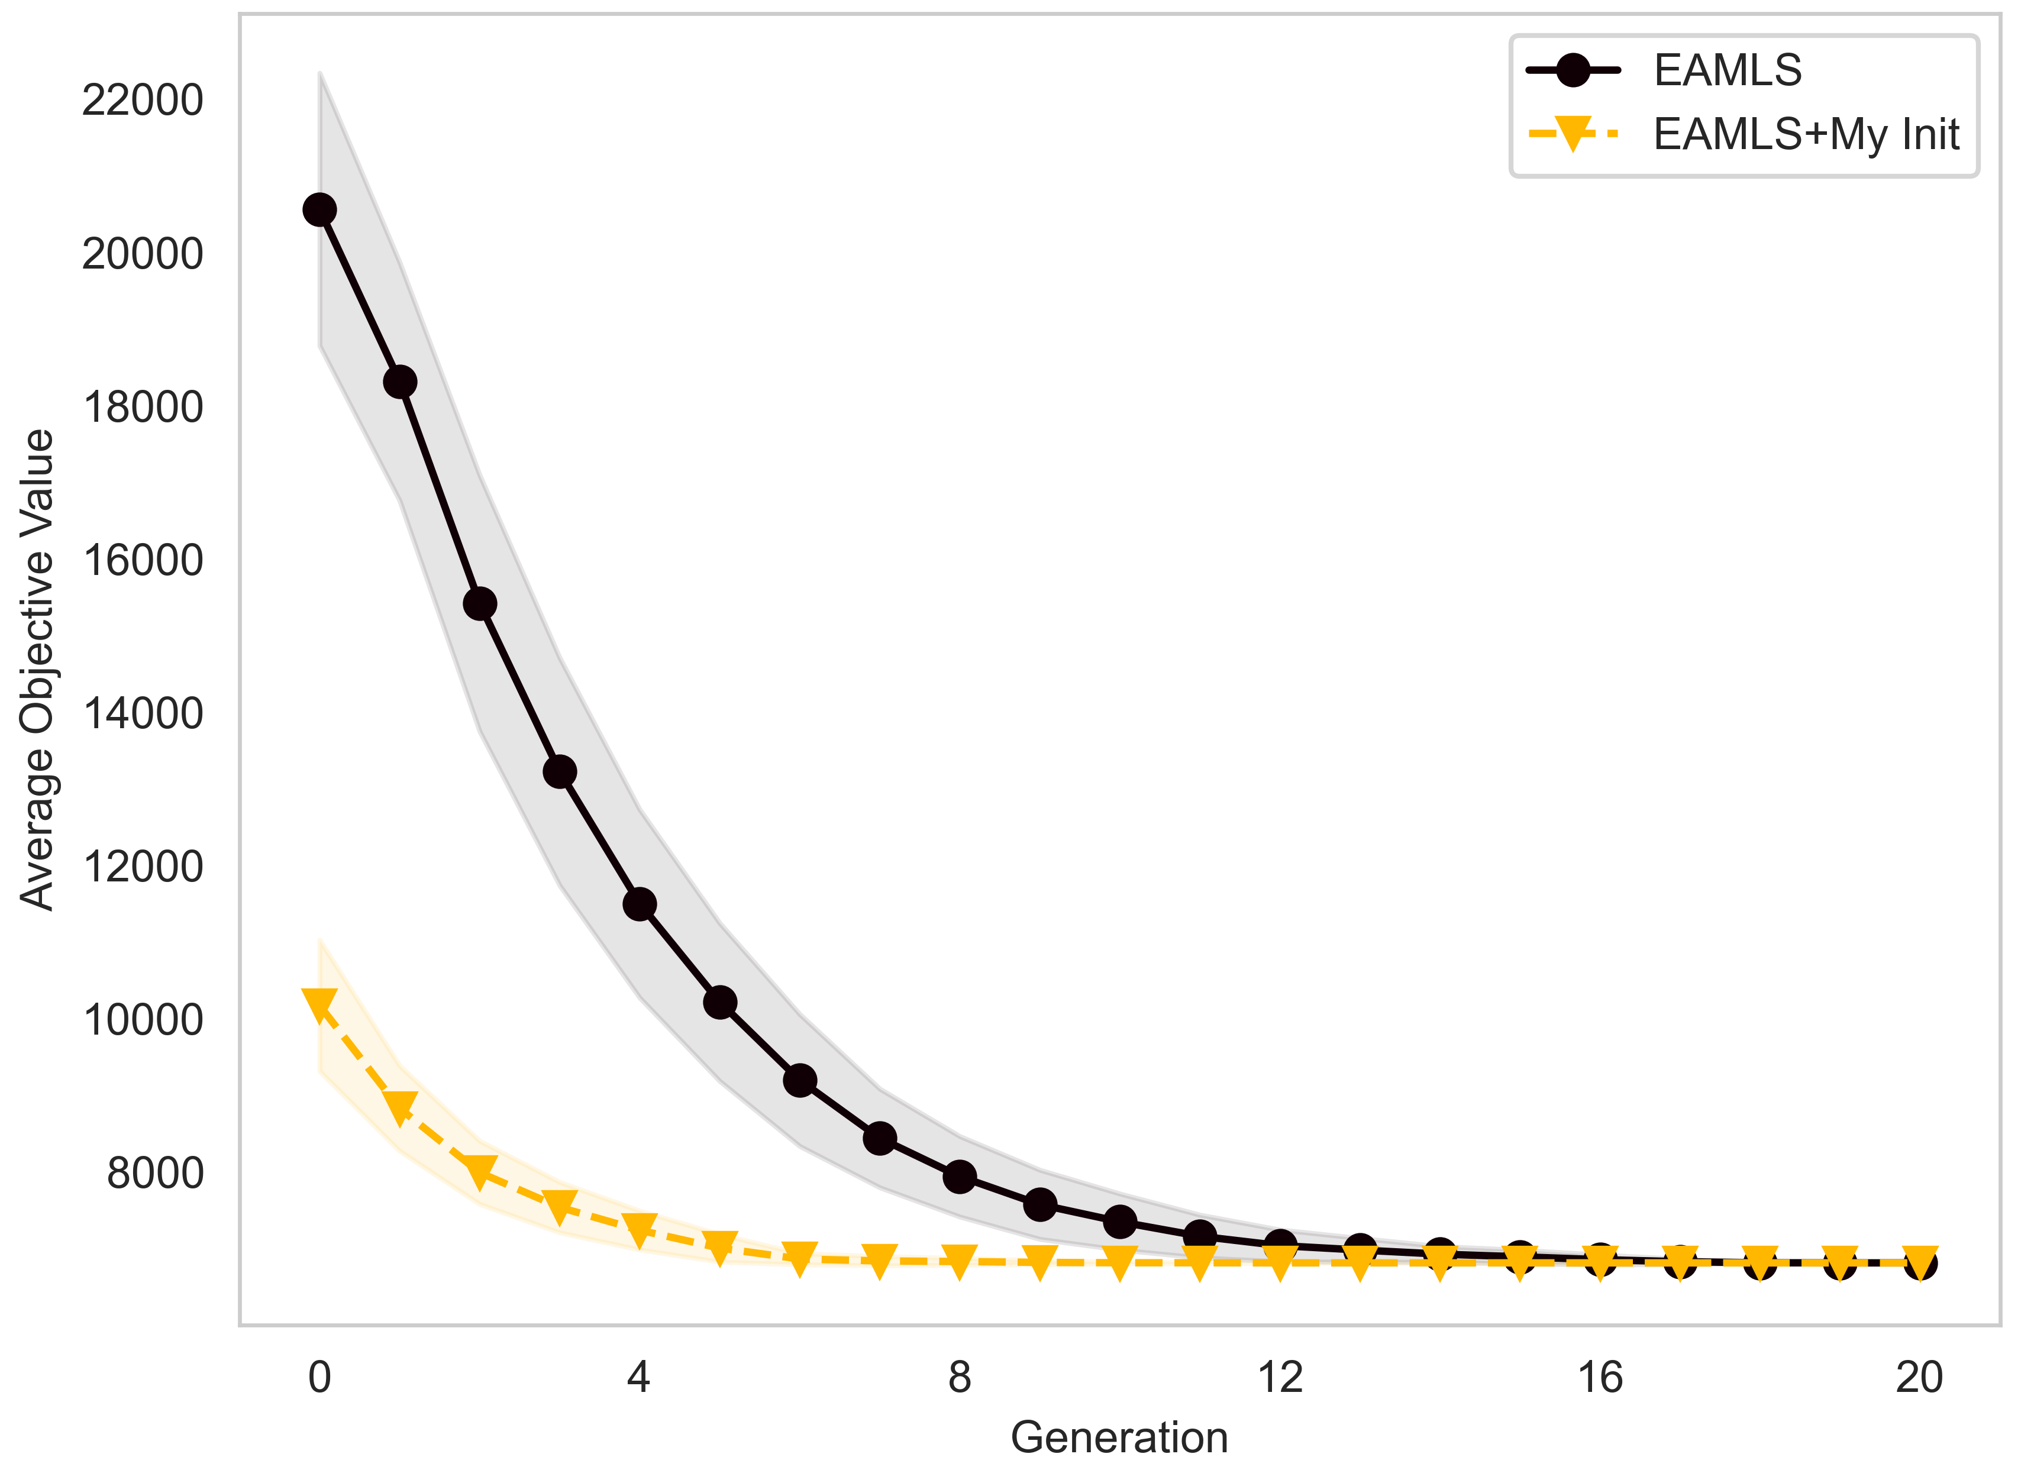
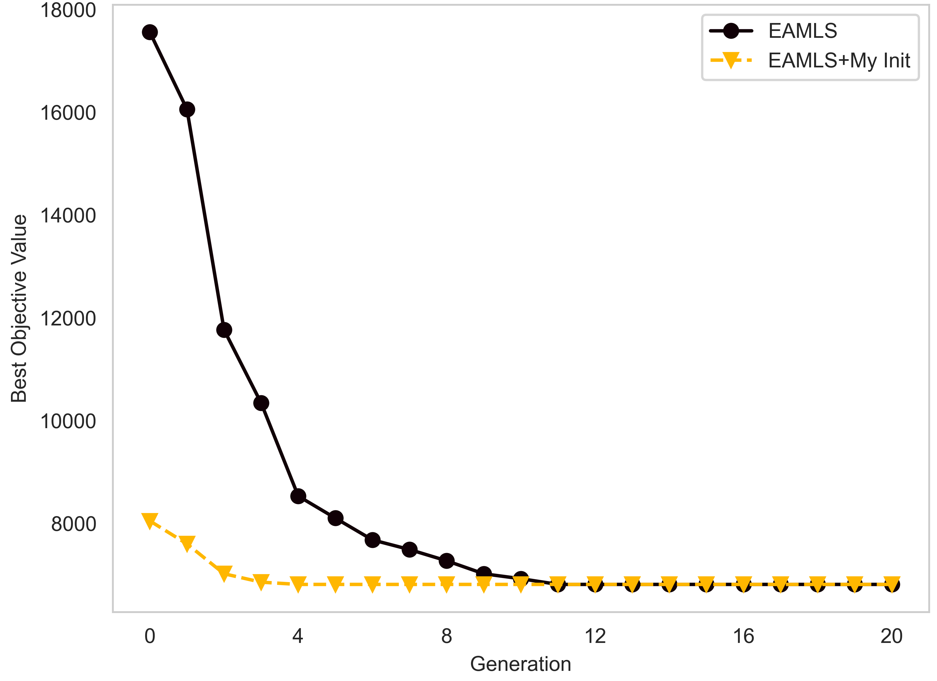
Experimental Result:
50_0 instance:

Slide 12
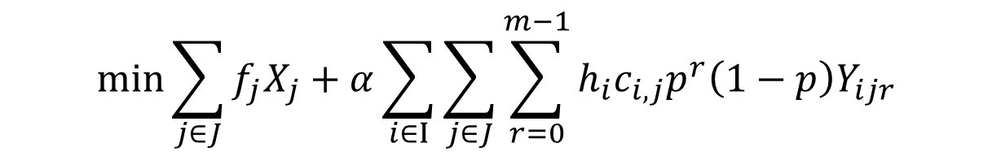
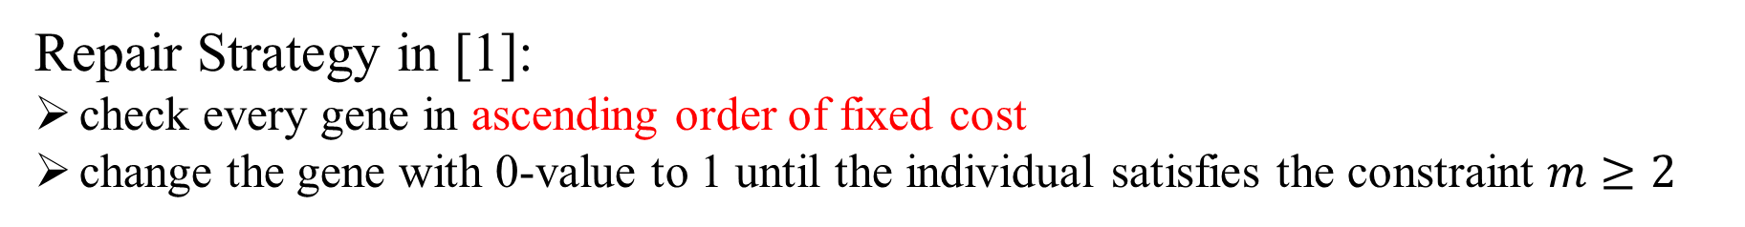
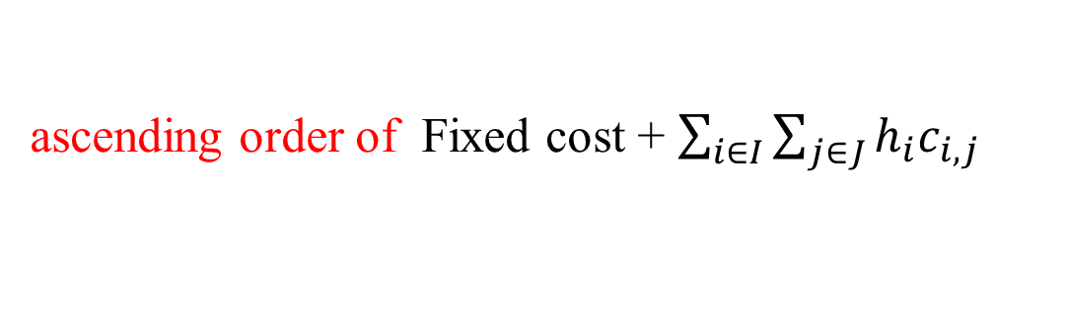
Idea 2: Change Repair Strategy
Repair Strategy in [1]:
check every gene in ascending order of fixed cost
change the gene with 0-value to 1 until the individual satisfies the constraint $m≥2$
$$\min{\sum_{j∈J}{f_{j}X_{j}}+α\sum_{i∈I}{\sum_{j∈J}{\sum_{r=0}^{m−1}{h_{i}c_{i,j}p^{r}\left(1−p\right)Y_{ijr}}}}}$$
Change:
ascending order of Fixed cost + $\sum_{i∈I}{\sum_{j∈J}{h_{i}c_{i,j}}}$

Slide 13
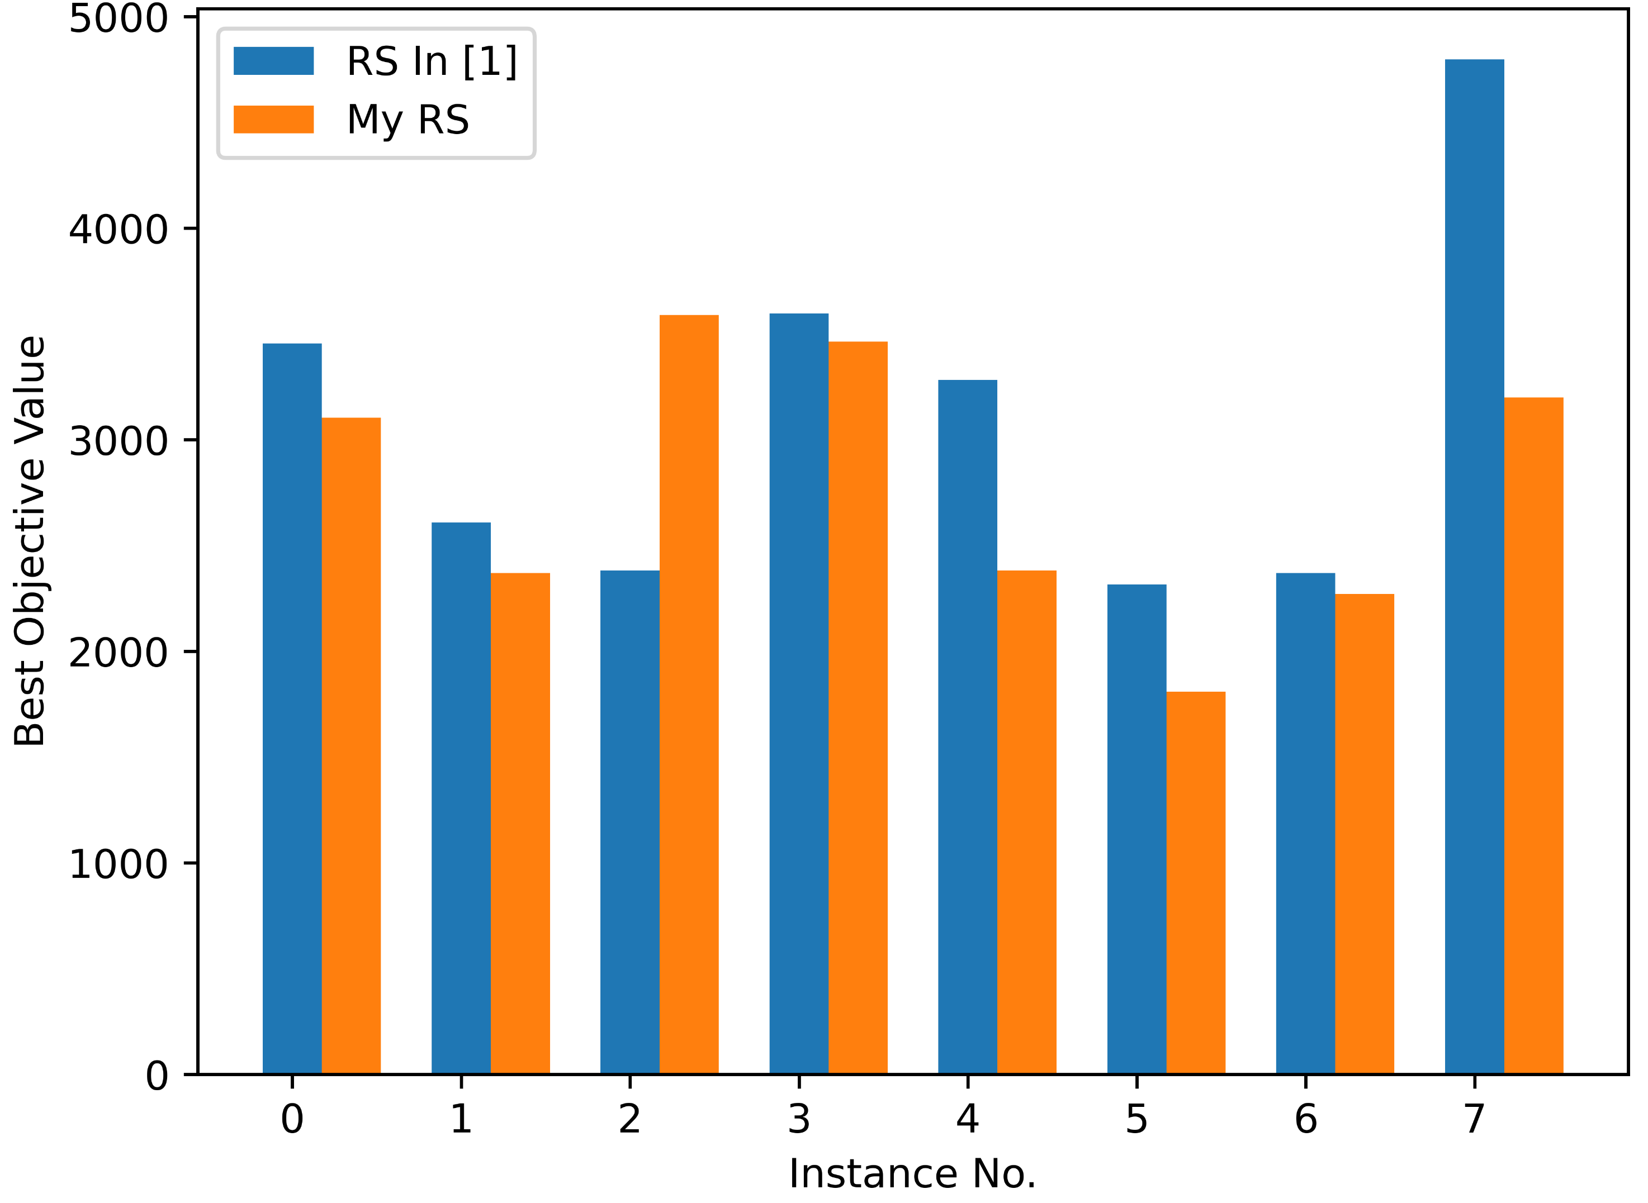
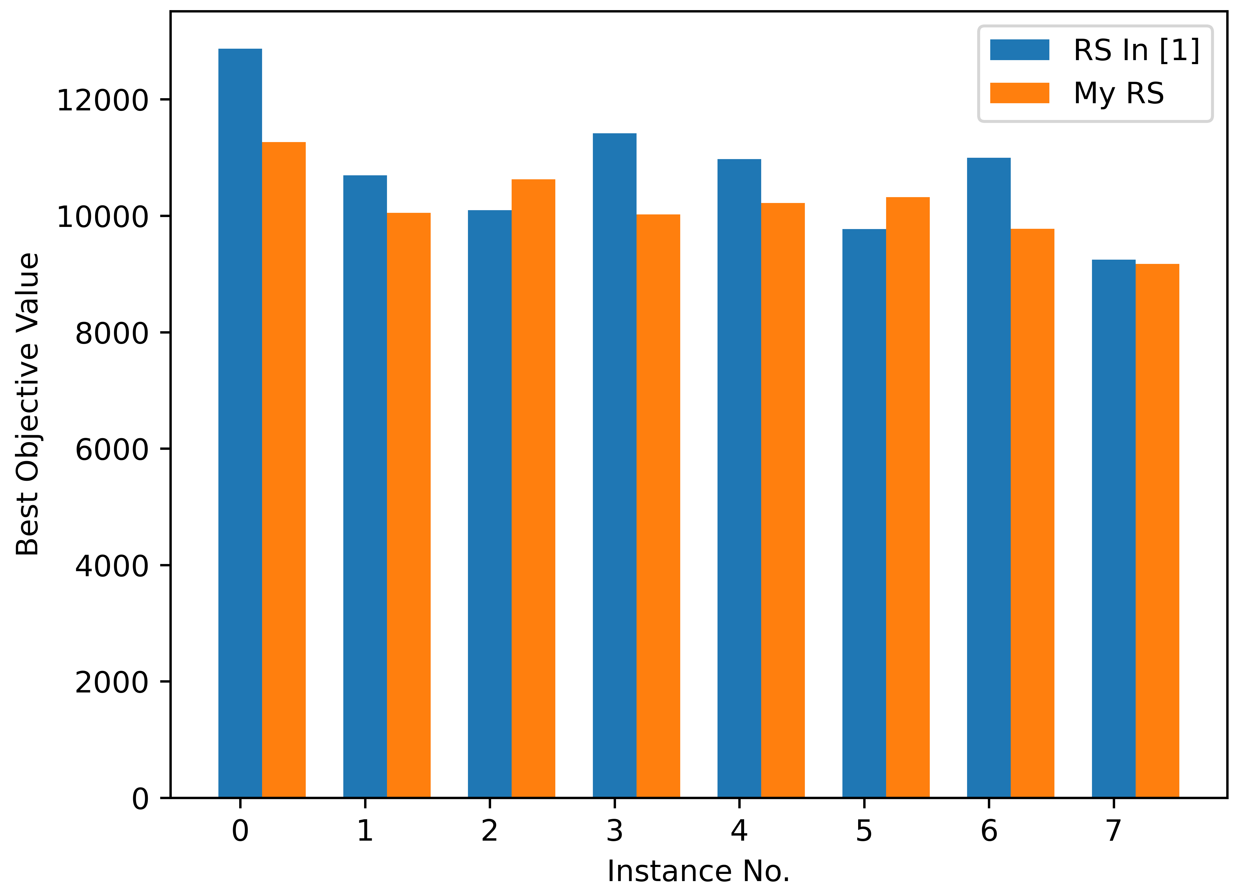
Experimental Result:
All zero solution
10 nodes instances
50 nodes instances
1:7
2:6

Slide 14
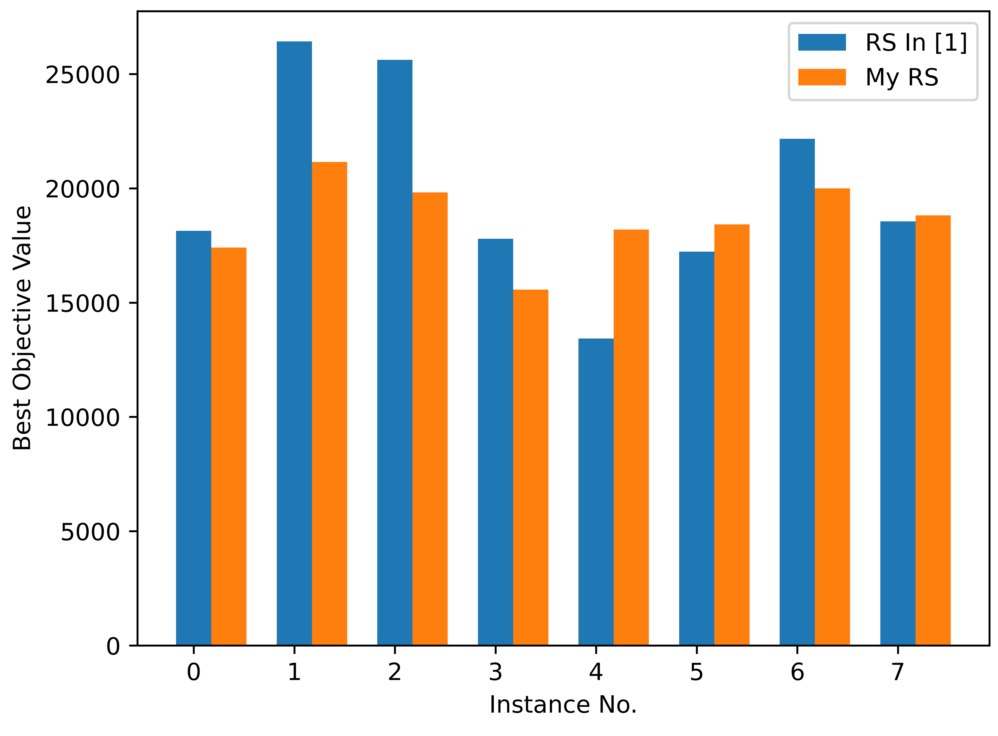
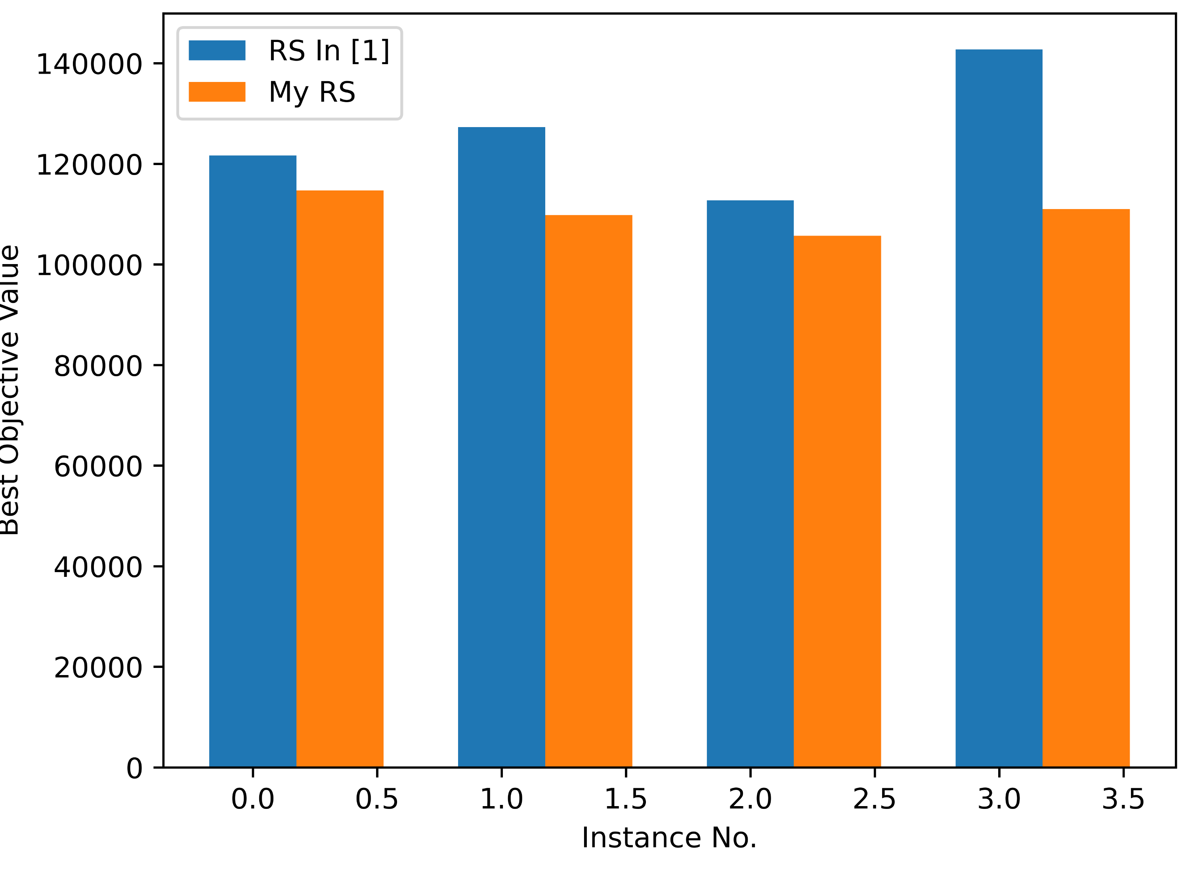
Experimental Result:
All zero solution
100 nodes instances
600 nodes instances:
3:5
0:4

Slide 15
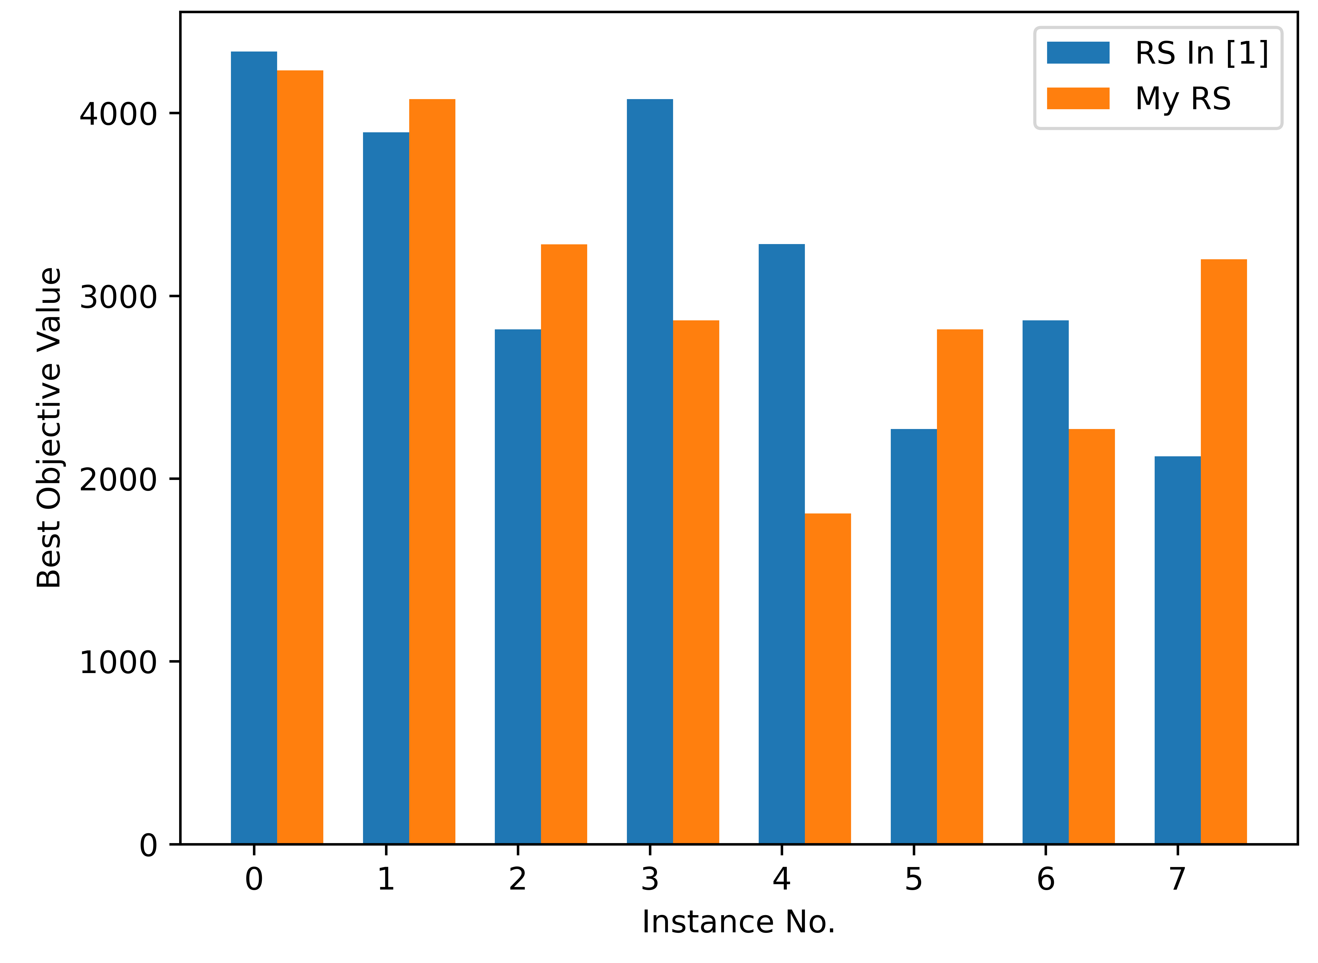
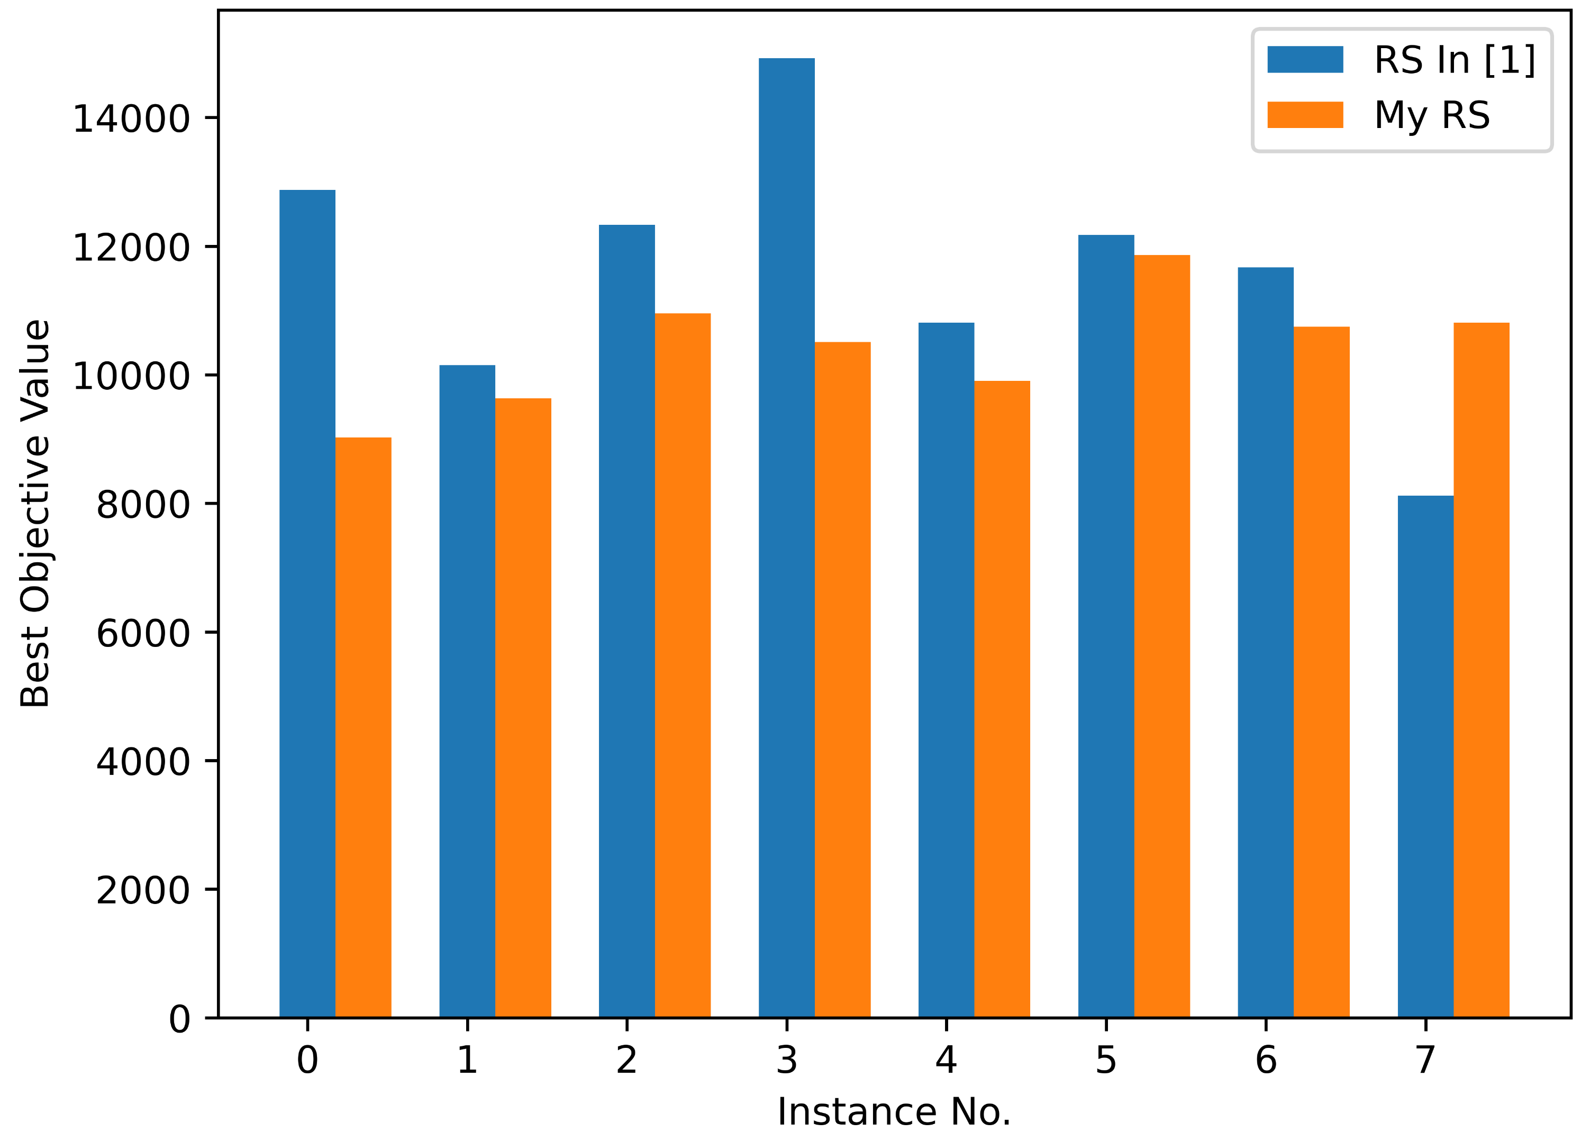
Experimental Result:
One bit solution
10 nodes instances
50 nodes instances
4:4
1:7

Slide 16
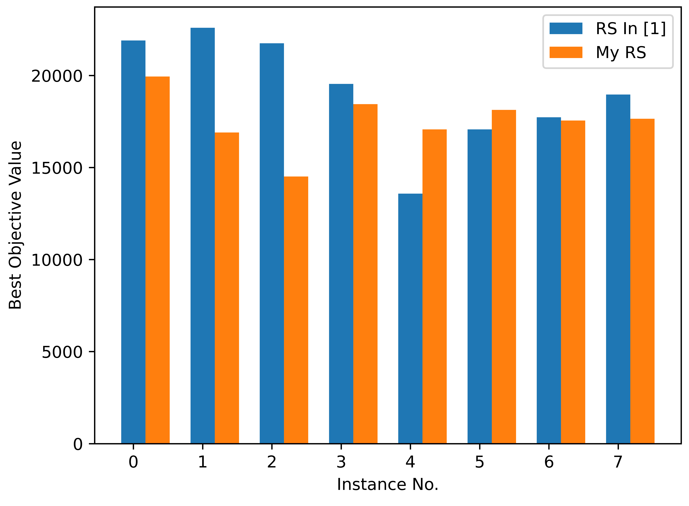
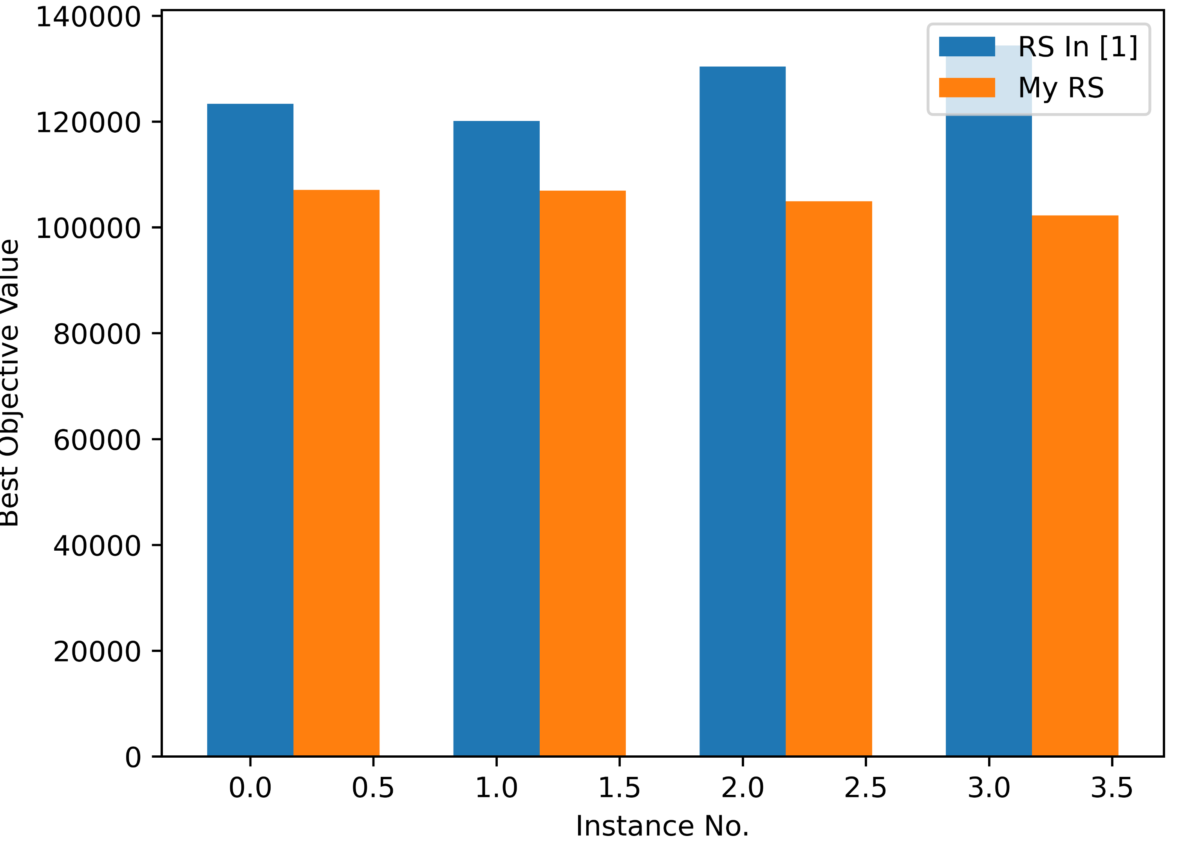
Experimental Result:
One bit solution
100 nodes instances
600 nodes instances
2:6
0:4

Slide 17
Experimental Result:
10 nodes instances:
50 nodes instances:
Instance No. | Avg # Repair
0 | 199
1 | 179
2 | 161
3 | 157
4 | 189
5 | 165
6 | 221
7 | 185
Instance No. | Avg # Repair
0 | 0
1 | 0
2 | 0
3 | 0
4 | 0
5 | 0
6 | 0
7 | 0

Slide 18










Idea 3: Change Local Search
Neighborhood in [1]:
The set of individuals whose Hamming distance is 1 from that individual
$$1,0,0,1,1,0,1$$
$$⇒$$
$$0,0,0,1,1,0,1$$
$$1,1,0,1,1,0,1$$
$$……$$
Add:
Same $m$ value, but different position
$$1,0,0,1,1,0,1$$
$$⇒$$
$$0,1,0,1,1,0,1$$
$$0,0,1,1,1,0,1$$
$$……$$

Slide 19
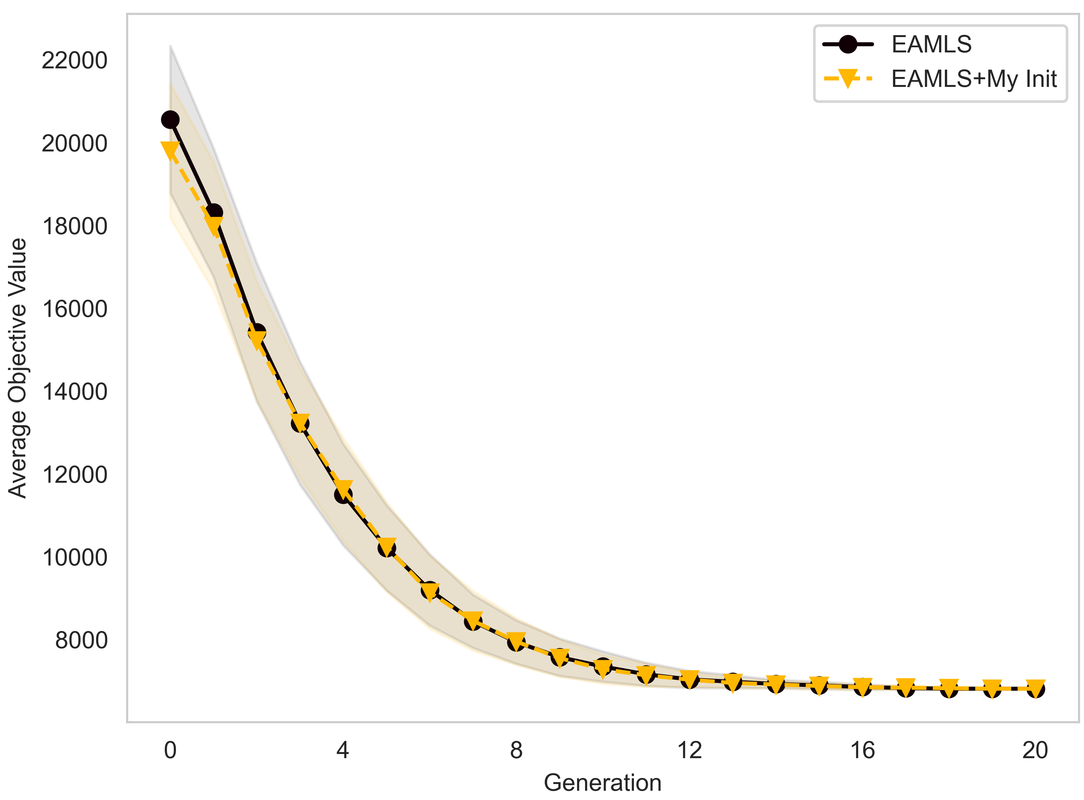
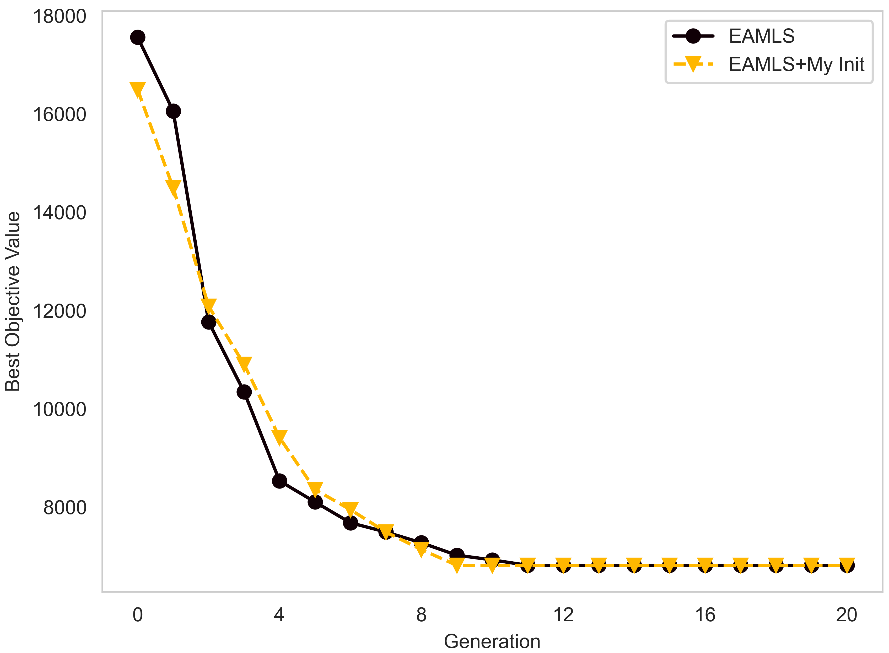
Experimental Result:
50_0 instance:

Slide 20
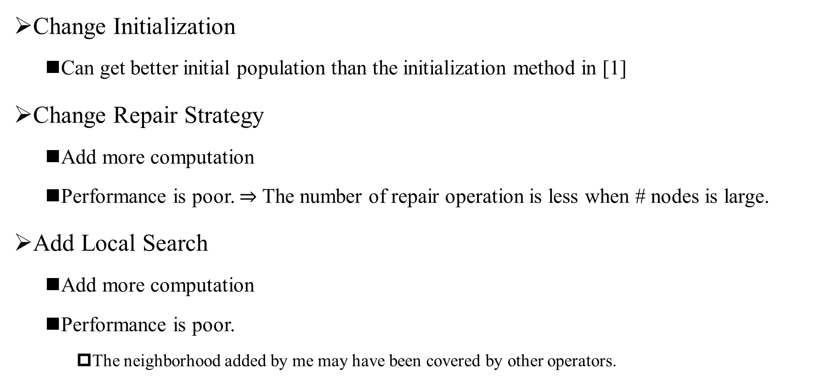
Conclusion:
Change Initialization
Can get better initial population than the initialization method in [1]
Change Repair Strategy
Add more computation
Performance is poor. $⇒$ The number of repair operation is less when # nodes is large.
Add Local Search
Add more computation
Performance is poor.
The neighborhood added by me may have been covered by other operators.

