Slide 1
Reliable Facility Location Problem
——Wenxing Lan

Slide 2
Outline:
Introduction to RFLP
EA with Memorable Local Search (EAMLS)
Reproduction Result of EAMLS
Some Ideas
Conclusion

Slide 3

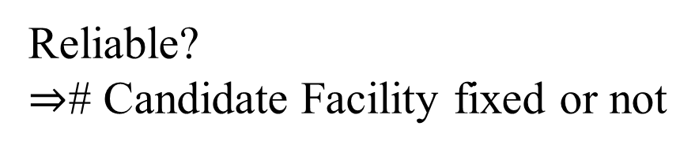
Introduction to RFLP:
Reliable?
$⇒$# Candidate Facility fixed or not
# Candidate Facility
Position of Candidate Facility

Slide 4
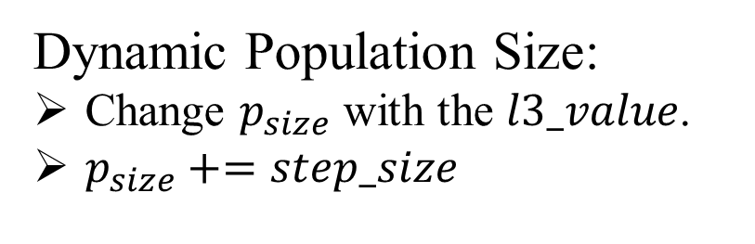
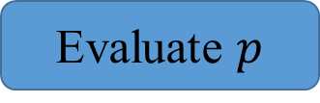
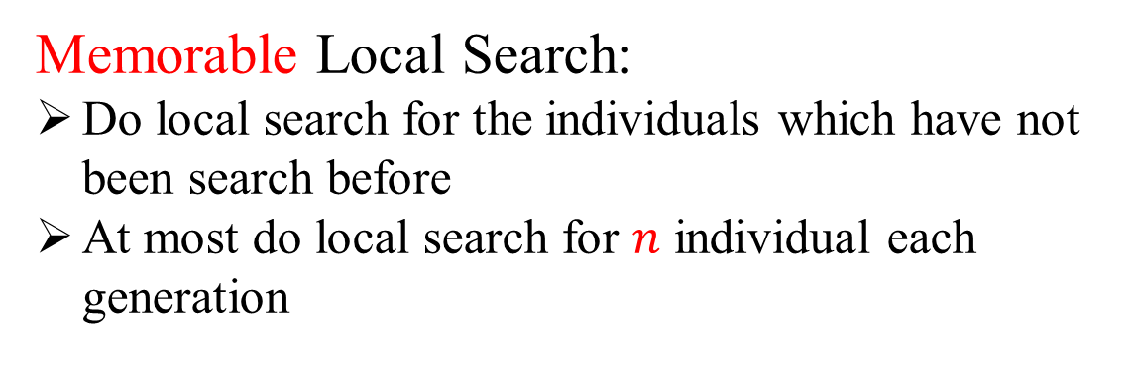
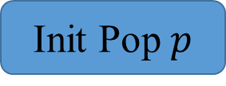
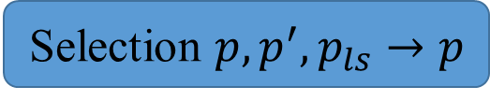
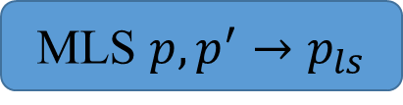
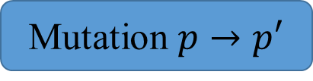
EAMLS:
Initialization Method:
Stochastic initialization
Binary Representation
Every gene of an individual takes 0 or 1 with equal probability
Init Pop $p$
Evaluate $p$
Memorable Local Search:
Do local search for the individuals which have not been search before
At most do local search for $n$ individual each generation
Mutation $p→p′$
# Generation < G
MLS $p,p^{′}→p_{ls}$
Selection $p,p^{′},p_{ls}→p$
Dynamic Population Size:
Change $p_{size}$ with the $l3_value$.
$p_{size}+=step_size$
Output Best Solution
[1] H. Zhang, J. Liu, and X. Yao, “A hybrid evolutionary algorithm for reliable facility location problem,” in Parallel Problem Solving from Nature – PPSN XVI, T. B¨ack, M. Preuss, A. Deutz, H. Wang, C. Doerr, M. Emmerich, and H. Trautmann, Eds. Cham: Springer International Publishing, 2020, pp. 454–467.

Slide 5
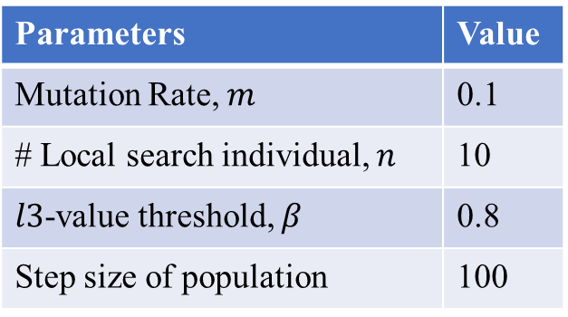
Reproduction Result of EAMLS:
Runtime Environment:
All programs have been written in C++ 11 and executed on an Intel(R) Core(TM) i5-10400F CPU working at 2.90 GHz on Windows 10 20H2, using a single thread.
Parameters Setting (Same as ones in [1]):
Parameters | Value
Mutation Rate, $m$ | 0.1
# Local search individual, $n$ | 10
$l3$-value threshold, $β$ | 0.8
Step size of population | 100
Instance Scale (# nodes) | # Generation | Population Size
10 | 10 | 20
50 | 20 | 20
100 | 50 | 100
Wilcox Sign Rank test is done with the level of significance 0.05.
[1] H. Zhang, J. Liu, and X. Yao, “A hybrid evolutionary algorithm for reliable facility location problem,” in Parallel Problem Solving from Nature – PPSN XVI, T. B¨ack, M. Preuss, A. Deutz, H. Wang, C. Doerr, M. Emmerich, and H. Trautmann, Eds. Cham: Springer International Publishing, 2020, pp. 454–467.

Slide 6
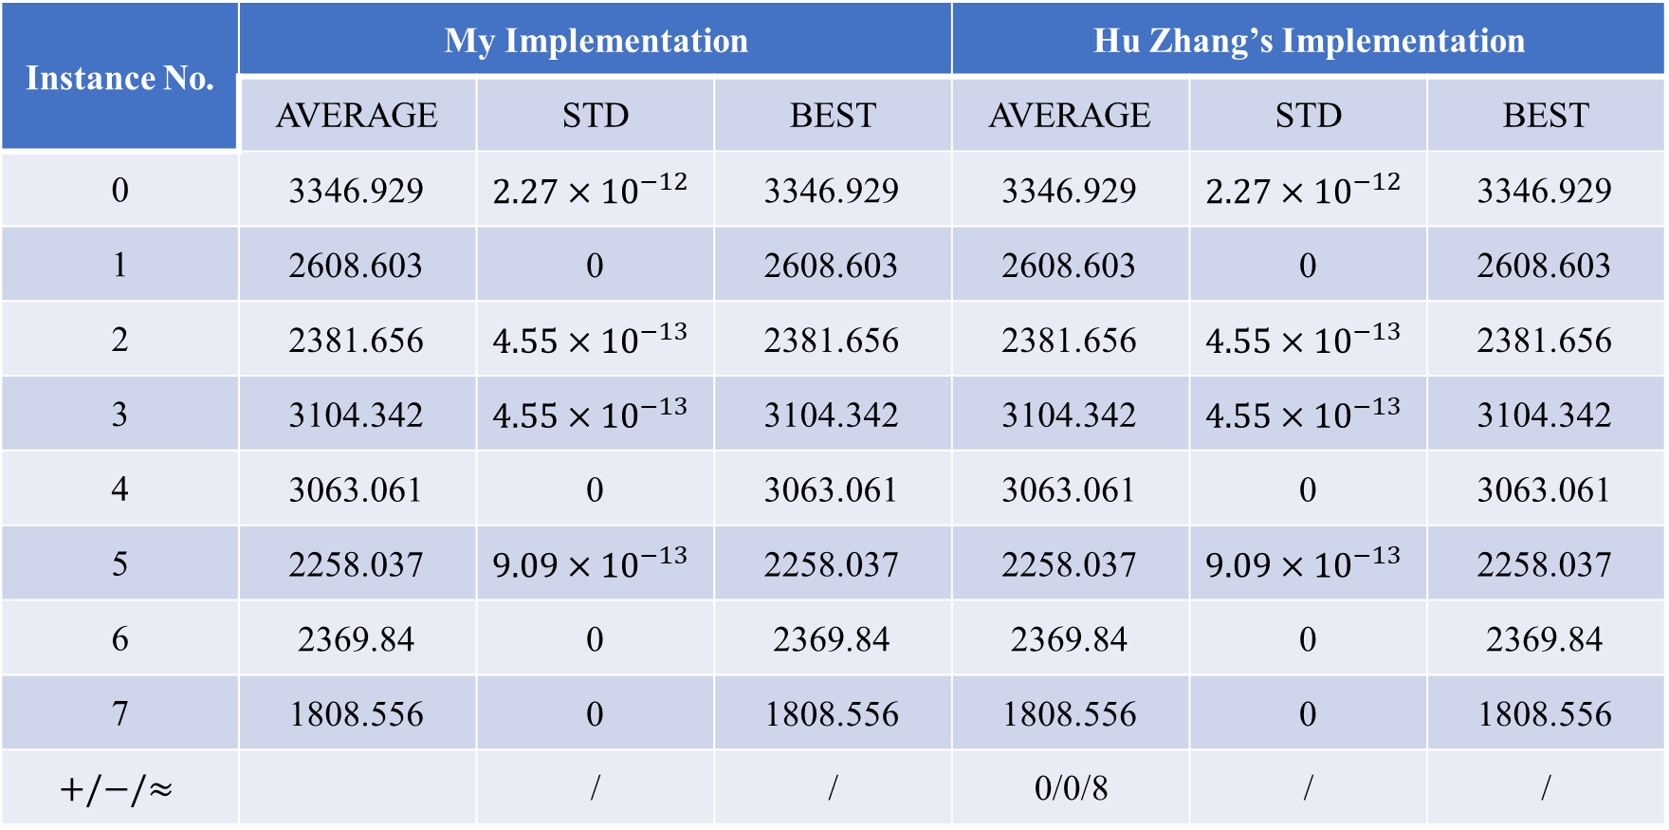
Reproduction Result of EAMLS:
10 nodes instances:
Instance No. | My Implementation |  |  | Hu Zhang’s Implementation
 | AVERAGE | STD | BEST | AVERAGE | STD | BEST
0 | 3346.929 | $$2.27×{10}^{−12}$$ | 3346.929 | 3346.929 | $$2.27×{10}^{−12}$$ | 3346.929
1 | 2608.603 | 0 | 2608.603 | 2608.603 | 0 | 2608.603
2 | 2381.656 | $$4.55×{10}^{−13}$$ | 2381.656 | 2381.656 | $$4.55×{10}^{−13}$$ | 2381.656
3 | 3104.342 | $$4.55×{10}^{−13}$$ | 3104.342 | 3104.342 | $$4.55×{10}^{−13}$$ | 3104.342
4 | 3063.061 | 0 | 3063.061 | 3063.061 | 0 | 3063.061
5 | 2258.037 | $$9.09×{10}^{−13}$$ | 2258.037 | 2258.037 | $$9.09×{10}^{−13}$$ | 2258.037
6 | 2369.84 | 0 | 2369.84 | 2369.84 | 0 | 2369.84
7 | 1808.556 | 0 | 1808.556 | 1808.556 | 0 | 1808.556
$$+/−/≈$$ |  | / | / | 0/0/8 | / | /

Slide 7
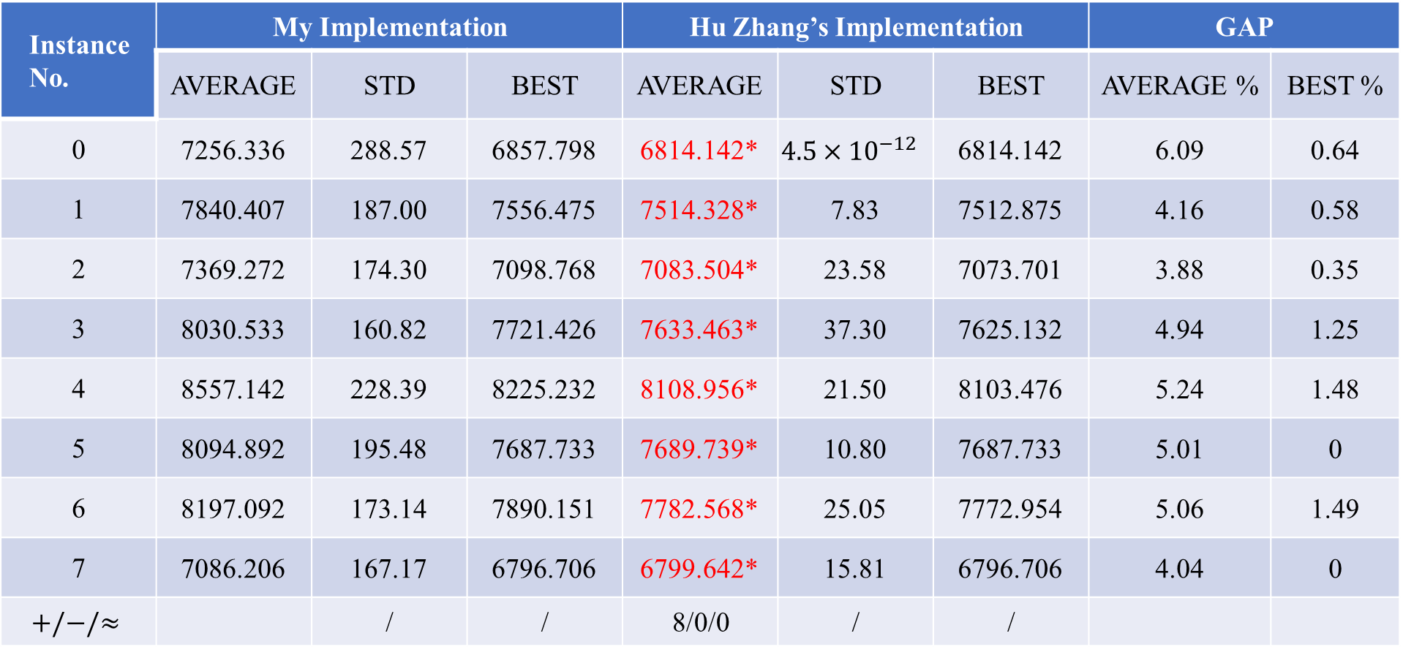
Reproduction Result of EAMLS:
50 nodes instances:
Instance No. | My Implementation |  |  | Hu Zhang’s Implementation |  |  | GAP
 | AVERAGE | STD | BEST | AVERAGE | STD | BEST | AVERAGE % | BEST %
0 | 7256.336 | 288.57 | 6857.798 | 6814.142* | $$4.5×{10}^{−12}$$ | 6814.142 | 6.09 | 0.64
1 | 7840.407 | 187.00 | 7556.475 | 7514.328* | 7.83 | 7512.875 | 4.16 | 0.58
2 | 7369.272 | 174.30 | 7098.768 | 7083.504* | 23.58 | 7073.701 | 3.88 | 0.35
3 | 8030.533 | 160.82 | 7721.426 | 7633.463* | 37.30 | 7625.132 | 4.94 | 1.25
4 | 8557.142 | 228.39 | 8225.232 | 8108.956* | 21.50 | 8103.476 | 5.24 | 1.48
5 | 8094.892 | 195.48 | 7687.733 | 7689.739* | 10.80 | 7687.733 | 5.01 | 0
6 | 8197.092 | 173.14 | 7890.151 | 7782.568* | 25.05 | 7772.954 | 5.06 | 1.49
7 | 7086.206 | 167.17 | 6796.706 | 6799.642* | 15.81 | 6796.706 | 4.04 | 0
$$+/−/≈$$ |  | / | / | 8/0/0 | / | /

Slide 8

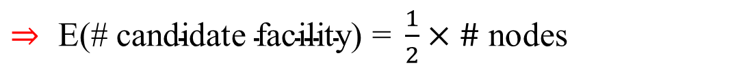


Idea 1: Change Initialization
Initialization Method in [1]:
Stochastic initialization
Binary Representation
Every gene of an individual takes 0 or 1 with equal probability
$⇒ \text{E}\text{(\# }\text{candidate} \text{facility}\text{) = }\frac{1}{2}×\#$ nodes
# Candidate Facility
Position of Candidate Facility
Change:
Make # candidate facility more diversity
# nodes $≤μ$
按照$m∈\{2,3,…,\# node\}$生成facility位置随机的个体, 剩余部分的个体$按照m=uniform[2, \#node]$生成facility位置随机的个体
$μ<$# nodes $<2μ$
按照$m∈\{2,4,…,2⌊\frac{\#node}{2}⌋\}$生成facility位置随机的个体, 剩余部分的个体$按照m=uniform[2, \#node]$生成facility位置随机的个体
# nodes $≥2μ$
$a=\left\lfloor \frac{\#node}{μ}\right\rfloor ,$按照$m∈\{2,2+a,2+2a,…\}(m≤\#node)$生成facility位置随机的个体, 剩余部分的个体$按照m=uniform[2, \#node]$生成facility位置随机的个体

Slide 9
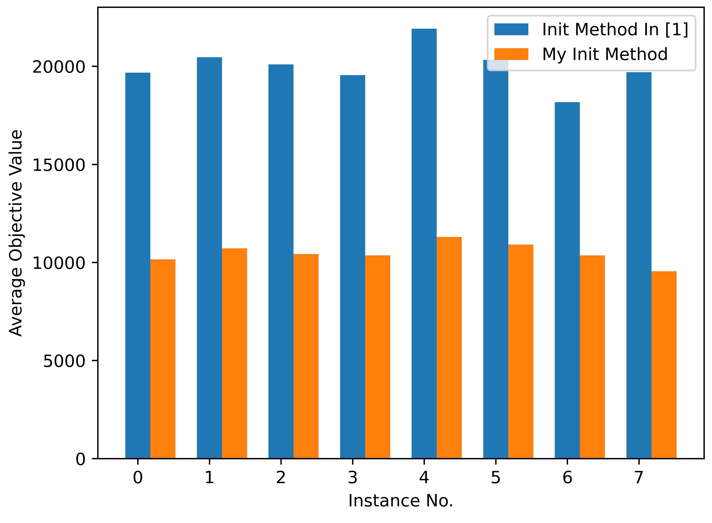
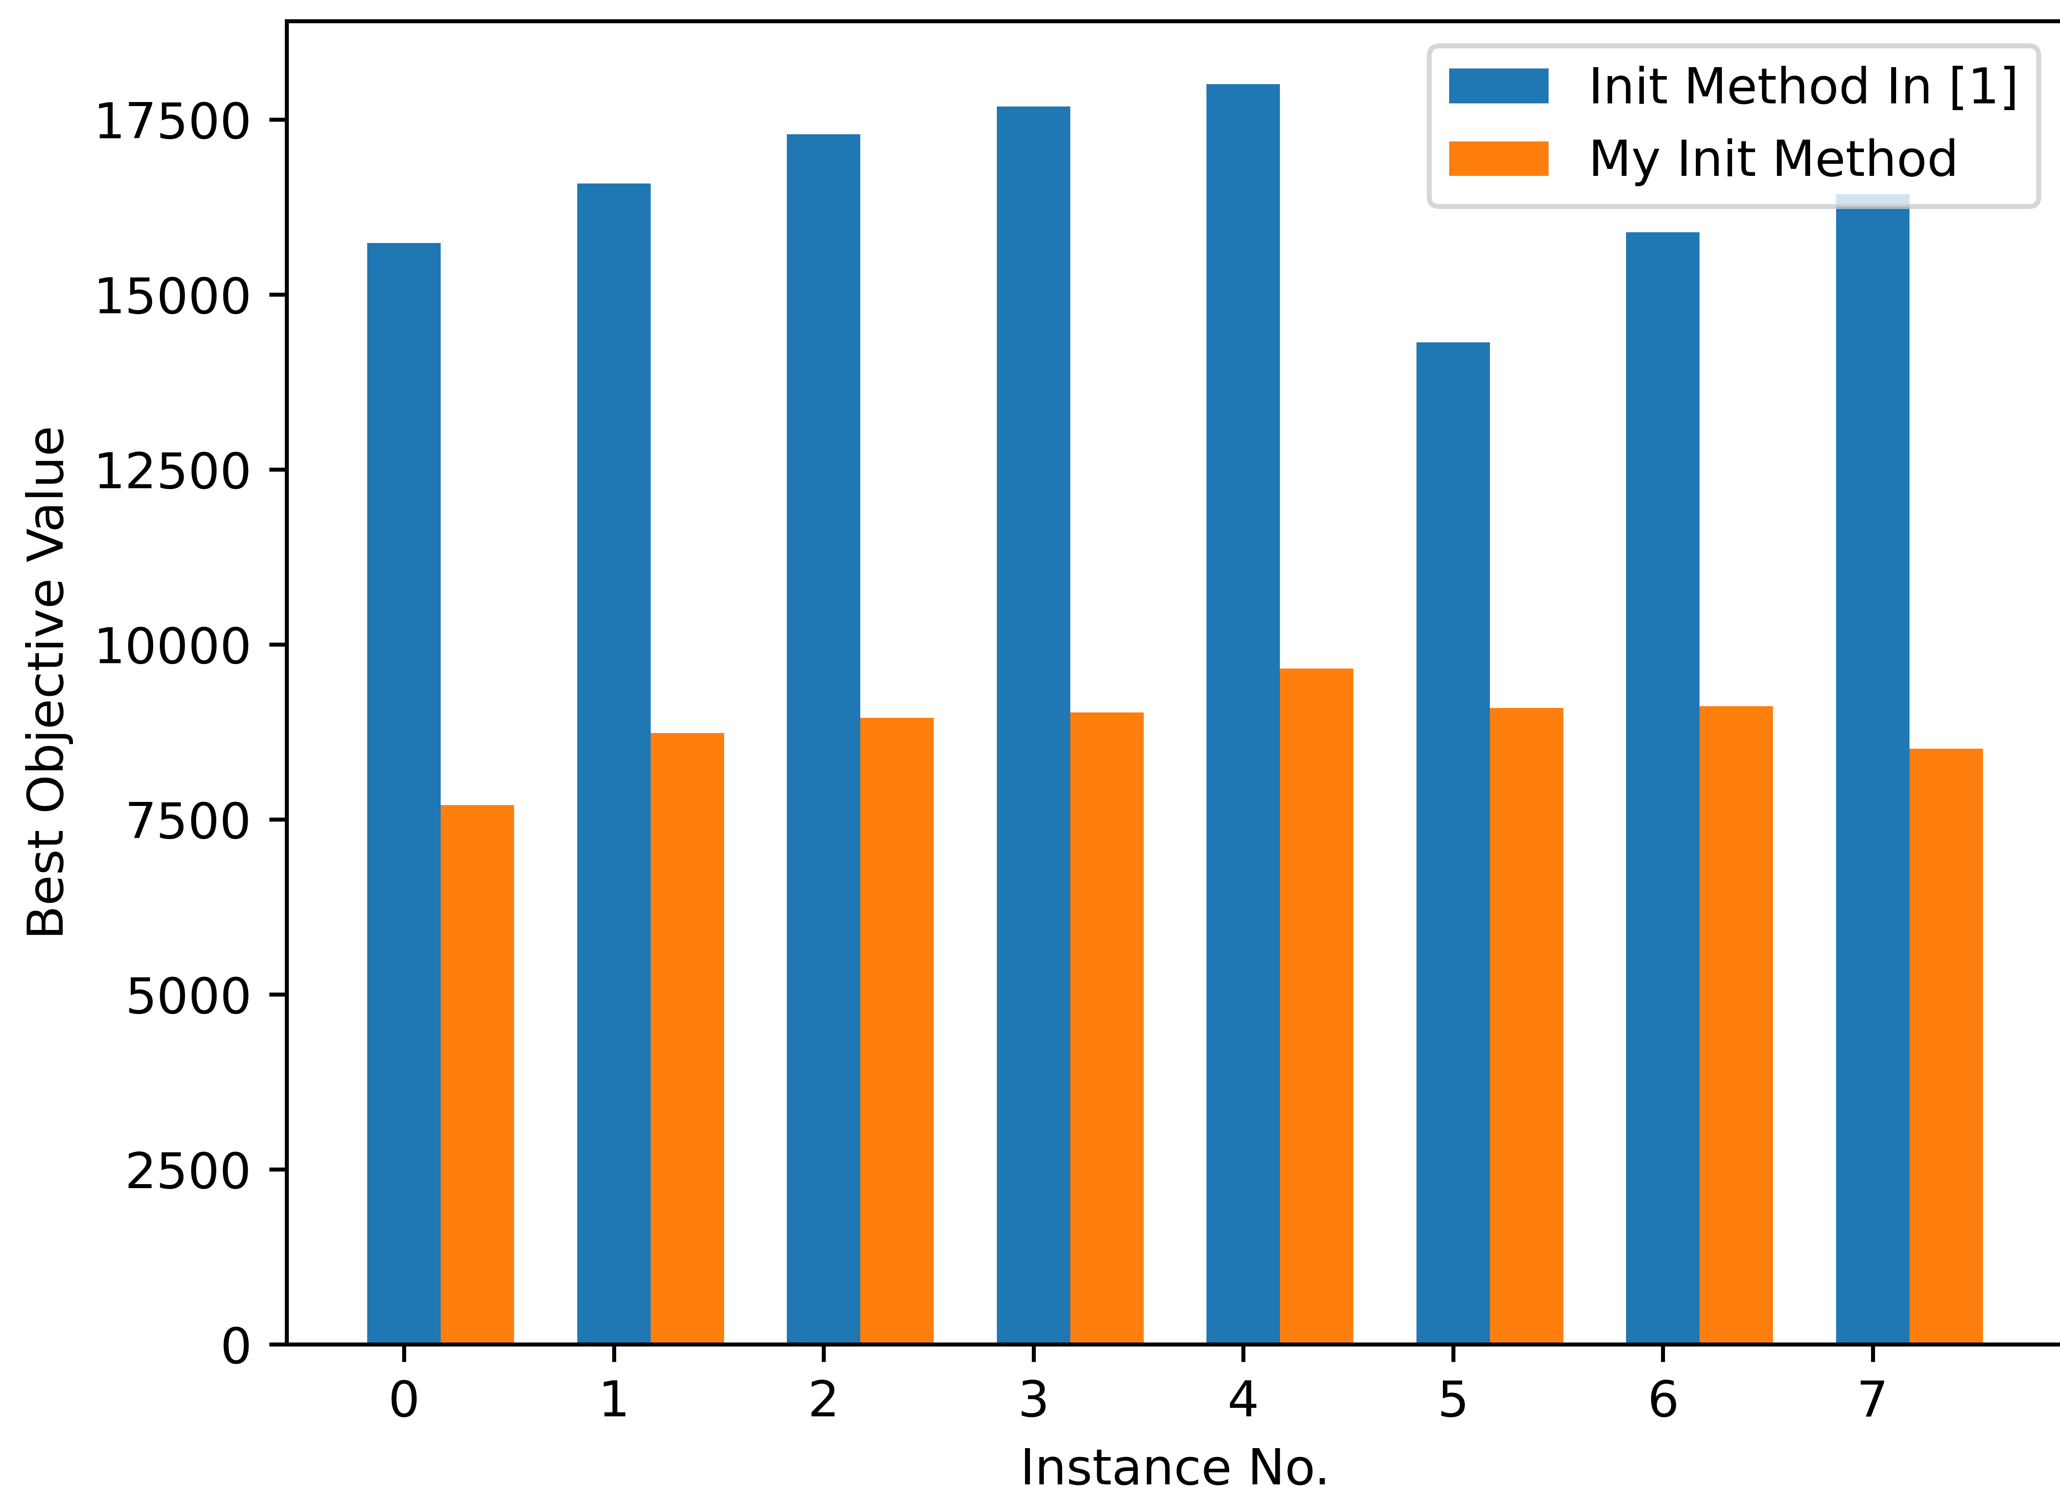
Experimental Result:
50 node instances:
[1] H. Zhang, J. Liu, and X. Yao, “A hybrid evolutionary algorithm for reliable facility location problem,” in Parallel Problem Solving from Nature – PPSN XVI, T. B¨ack, M. Preuss, A. Deutz, H. Wang, C. Doerr, M. Emmerich, and H. Trautmann, Eds. Cham: Springer International Publishing, 2020, pp. 454–467.

Slide 10
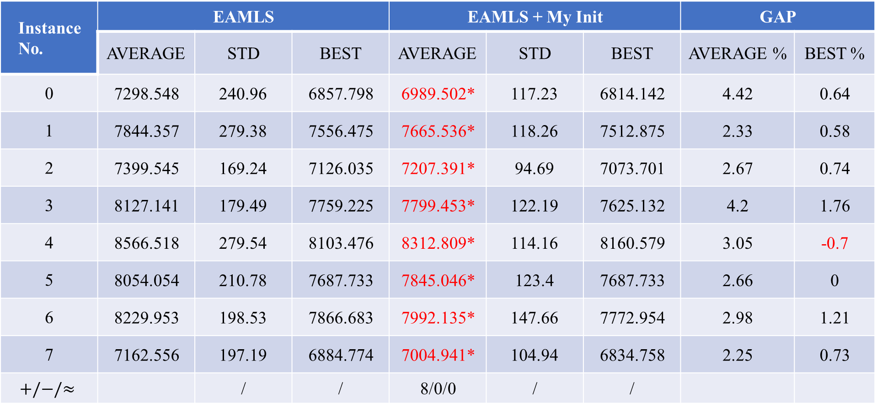
Experimental Result:
50 nodes instances:
Instance No. | EAMLS |  |  | EAMLS + My Init |  |  | GAP
 | AVERAGE | STD | BEST | AVERAGE | STD | BEST | AVERAGE % | BEST %
0 | 7298.548 | 240.96 | 6857.798 | 6989.502* | 117.23 | 6814.142 | 4.42 | 0.64
1 | 7844.357 | 279.38 | 7556.475 | 7665.536* | 118.26 | 7512.875 | 2.33 | 0.58
2 | 7399.545 | 169.24 | 7126.035 | 7207.391* | 94.69 | 7073.701 | 2.67 | 0.74
3 | 8127.141 | 179.49 | 7759.225 | 7799.453* | 122.19 | 7625.132 | 4.2 | 1.76
4 | 8566.518 | 279.54 | 8103.476 | 8312.809* | 114.16 | 8160.579 | 3.05 | -0.7
5 | 8054.054 | 210.78 | 7687.733 | 7845.046* | 123.4 | 7687.733 | 2.66 | 0
6 | 8229.953 | 198.53 | 7866.683 | 7992.135* | 147.66 | 7772.954 | 2.98 | 1.21
7 | 7162.556 | 197.19 | 6884.774 | 7004.941* | 104.94 | 6834.758 | 2.25 | 0.73
$$+/−/≈$$ |  | / | / | 8/0/0 | / | /

Slide 11
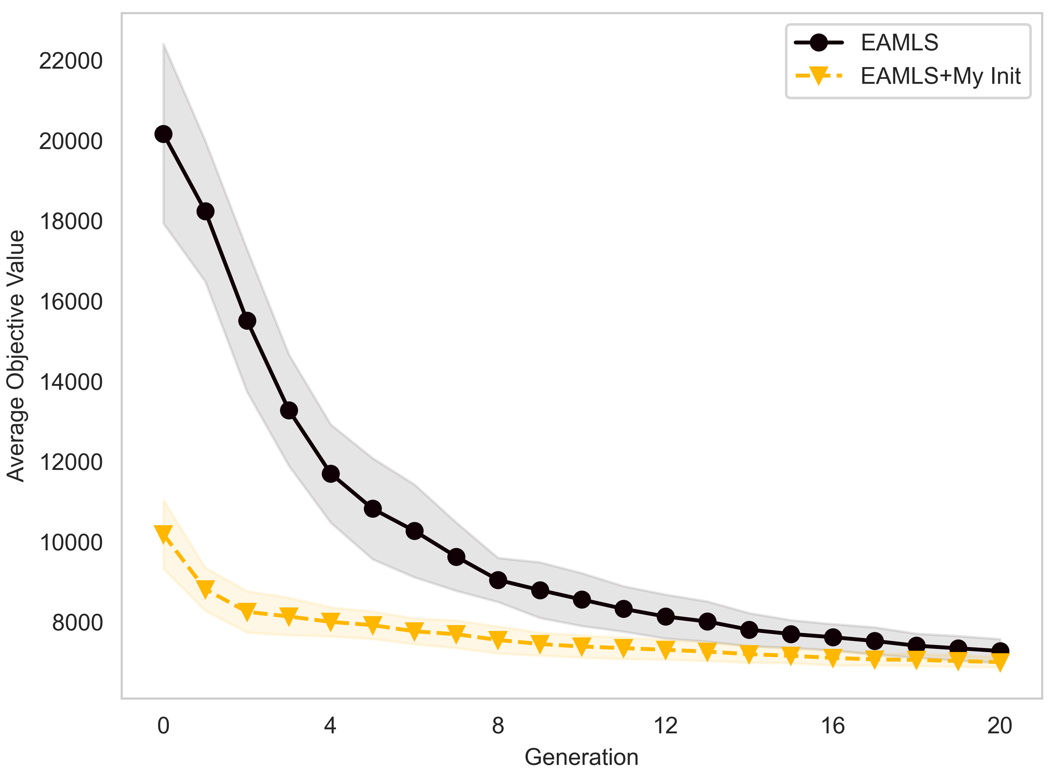
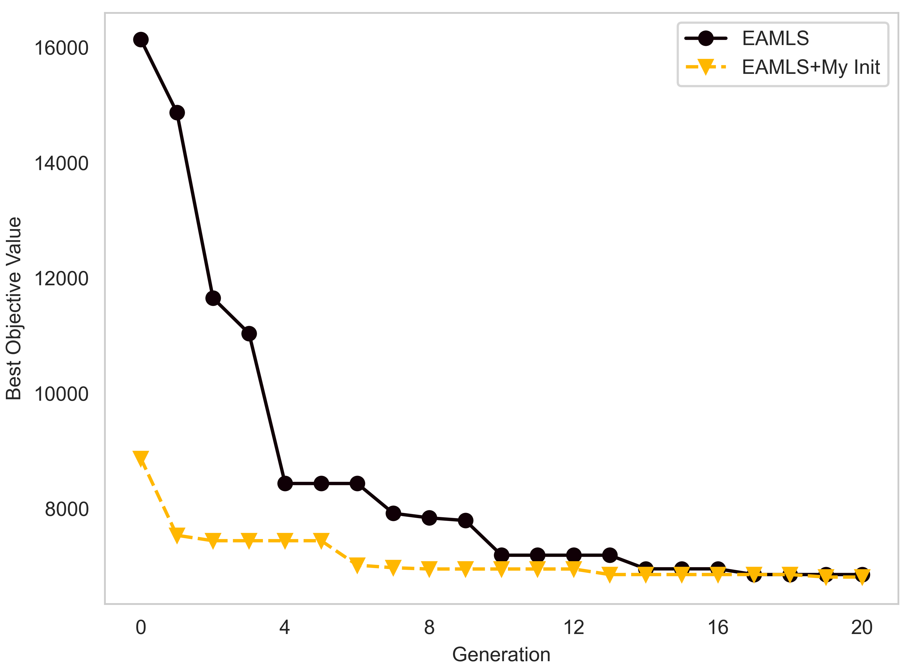
Experimental Result:
50_0 instance:

Slide 12
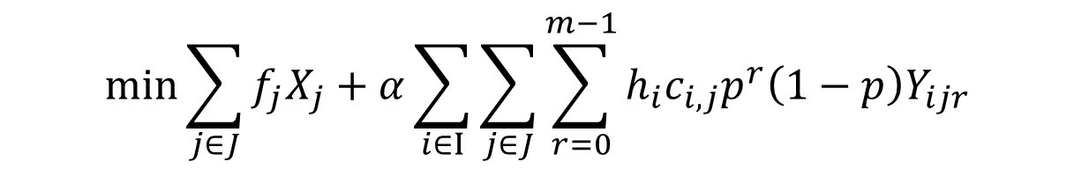
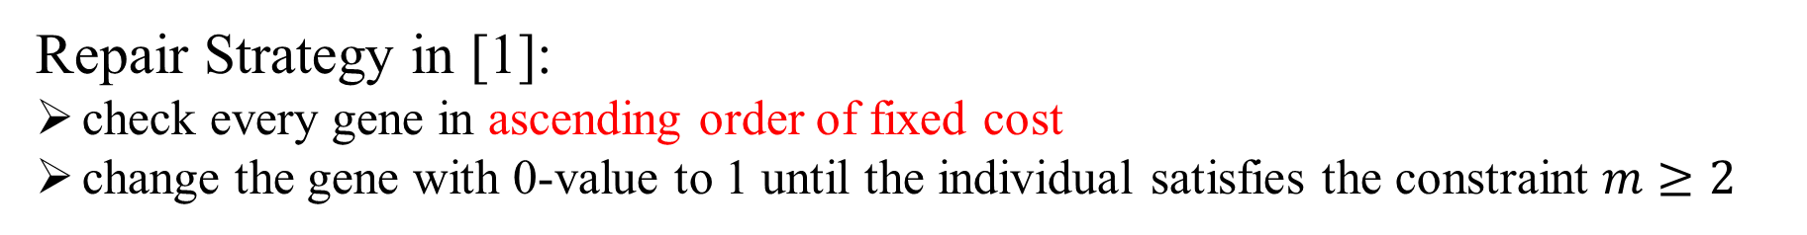
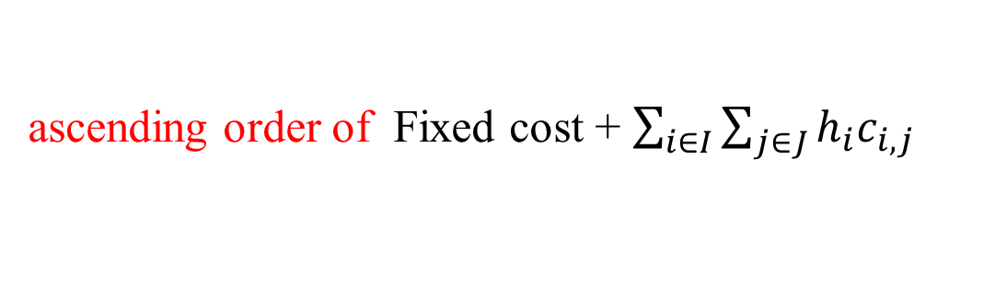
Idea 2: Change Repair Strategy
Repair Strategy in [1]:
check every gene in ascending order of fixed cost
change the gene with 0-value to 1 until the individual satisfies the constraint $m≥2$
$$\min{\sum_{j∈J}{f_{j}X_{j}}+α\sum_{i∈I}{\sum_{j∈J}{\sum_{r=0}^{m−1}{h_{i}c_{i,j}p^{r}\left(1−p\right)Y_{ijr}}}}}$$
Change:
ascending order of Fixed cost + $\sum_{i∈I}{\sum_{j∈J}{h_{i}c_{i,j}}}$

Slide 13
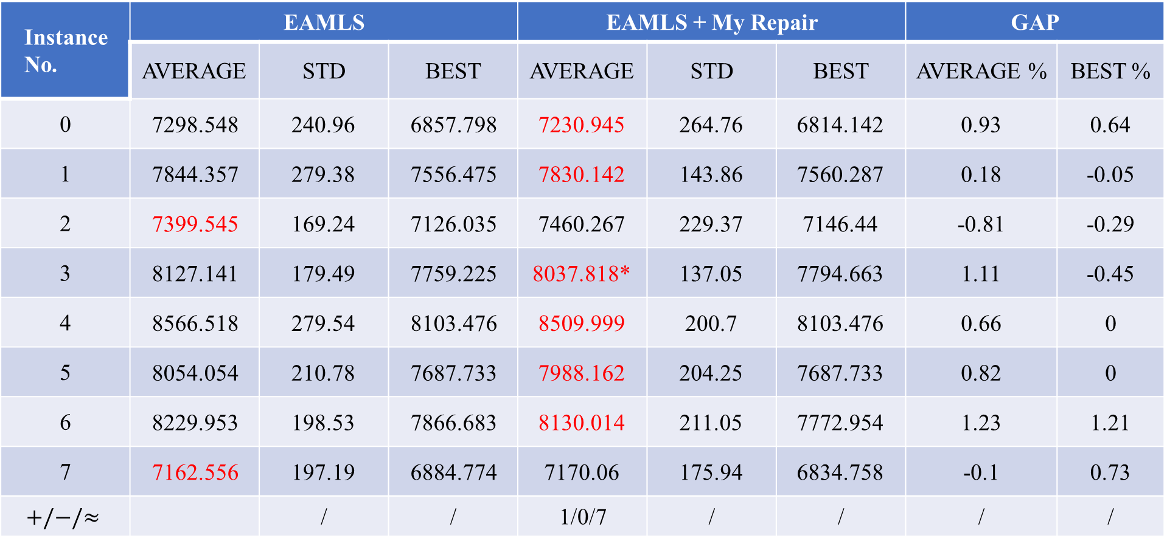
Experimental Result:
50 nodes instances:
Instance No. | EAMLS |  |  | EAMLS + My Repair |  |  | GAP
 | AVERAGE | STD | BEST | AVERAGE | STD | BEST | AVERAGE % | BEST %
0 | 7298.548 | 240.96 | 6857.798 | 7230.945 | 264.76 | 6814.142 | 0.93 | 0.64
1 | 7844.357 | 279.38 | 7556.475 | 7830.142 | 143.86 | 7560.287 | 0.18 | -0.05
2 | 7399.545 | 169.24 | 7126.035 | 7460.267 | 229.37 | 7146.44 | -0.81 | -0.29
3 | 8127.141 | 179.49 | 7759.225 | 8037.818* | 137.05 | 7794.663 | 1.11 | -0.45
4 | 8566.518 | 279.54 | 8103.476 | 8509.999 | 200.7 | 8103.476 | 0.66 | 0
5 | 8054.054 | 210.78 | 7687.733 | 7988.162 | 204.25 | 7687.733 | 0.82 | 0
6 | 8229.953 | 198.53 | 7866.683 | 8130.014 | 211.05 | 7772.954 | 1.23 | 1.21
7 | 7162.556 | 197.19 | 6884.774 | 7170.06 | 175.94 | 6834.758 | -0.1 | 0.73
$$+/−/≈$$ |  | / | / | 1/0/7 | / | / | / | /

Slide 14










Idea 3: Change Local Search
Neighborhood in [1]:
The set of individuals whose Hamming distance is 1 from that individual
$$1,0,0,1,1,0,1$$
$$⇒$$
$$0,0,0,1,1,0,1$$
$$1,1,0,1,1,0,1$$
$$……$$
Add:
Same $m$ value, but different position
$$1,0,0,1,1,0,1$$
$$⇒$$
$$0,1,0,1,1,0,1$$
$$0,0,1,1,1,0,1$$
$$……$$

Slide 15
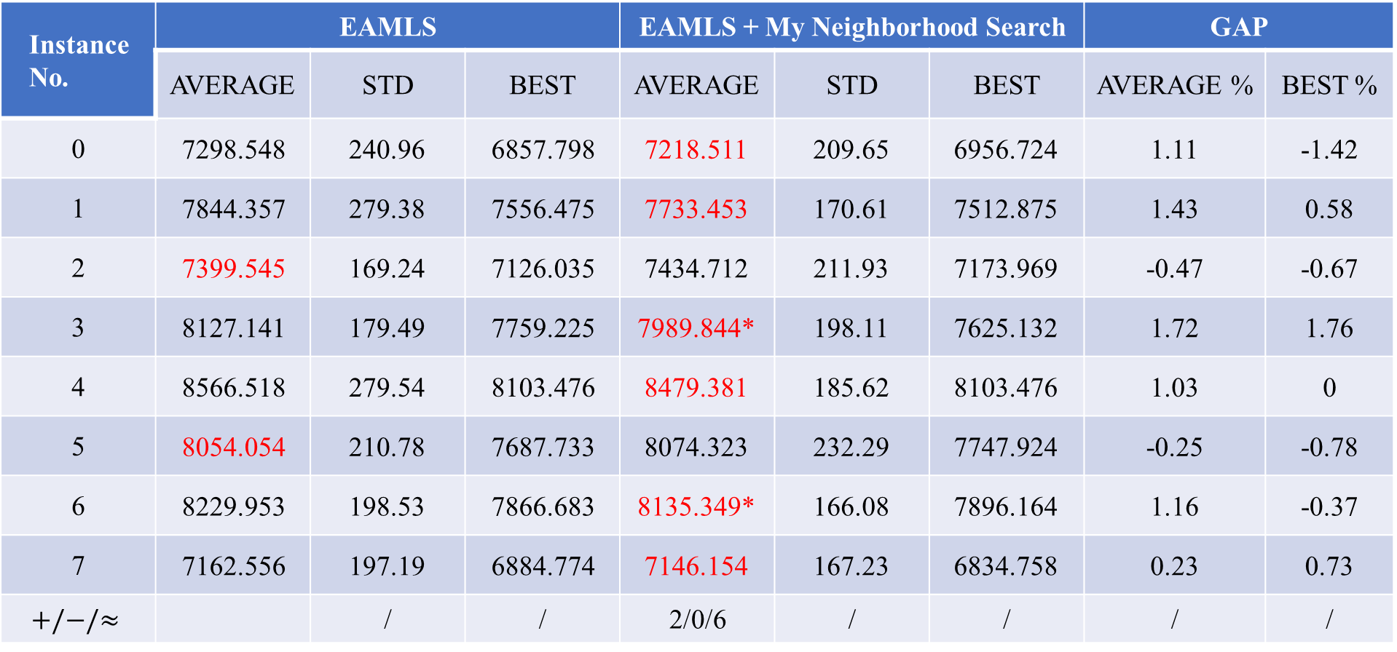
Experimental Result:
50 nodes instances:
Instance No. | EAMLS |  |  | EAMLS + My Neighborhood Search |  |  | GAP
 | AVERAGE | STD | BEST | AVERAGE | STD | BEST | AVERAGE % | BEST %
0 | 7298.548 | 240.96 | 6857.798 | 7218.511 | 209.65 | 6956.724 | 1.11 | -1.42
1 | 7844.357 | 279.38 | 7556.475 | 7733.453 | 170.61 | 7512.875 | 1.43 | 0.58
2 | 7399.545 | 169.24 | 7126.035 | 7434.712 | 211.93 | 7173.969 | -0.47 | -0.67
3 | 8127.141 | 179.49 | 7759.225 | 7989.844* | 198.11 | 7625.132 | 1.72 | 1.76
4 | 8566.518 | 279.54 | 8103.476 | 8479.381 | 185.62 | 8103.476 | 1.03 | 0
5 | 8054.054 | 210.78 | 7687.733 | 8074.323 | 232.29 | 7747.924 | -0.25 | -0.78
6 | 8229.953 | 198.53 | 7866.683 | 8135.349* | 166.08 | 7896.164 | 1.16 | -0.37
7 | 7162.556 | 197.19 | 6884.774 | 7146.154 | 167.23 | 6834.758 | 0.23 | 0.73
$$+/−/≈$$ |  | / | / | 2/0/6 | / | / | / | /

Slide 16
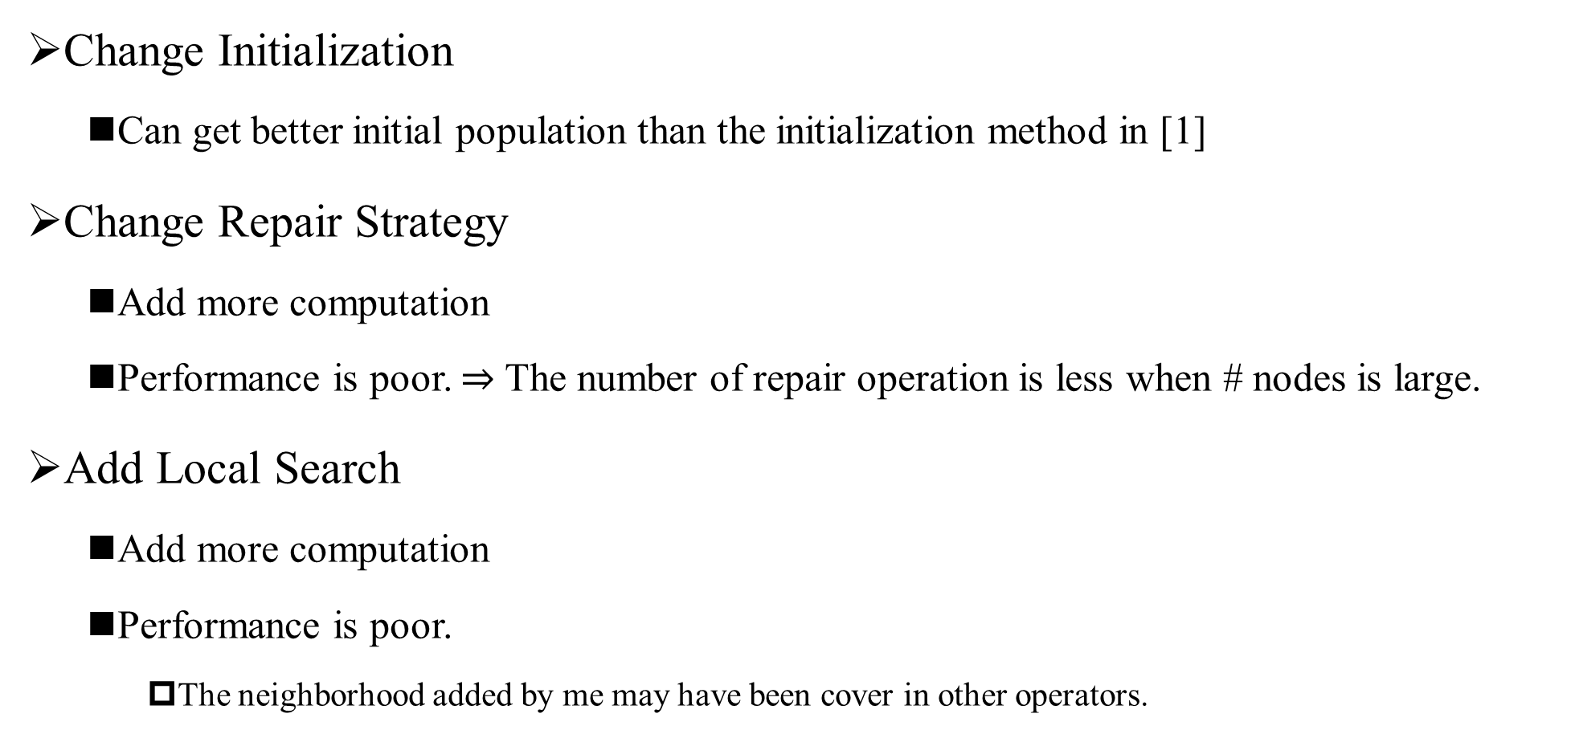
Conclusion:
Instance No. | Avg # Repair
0 | 0
1 | 0
2 | 0
3 | 4
4 | 0
5 | 0
6 | 0
7 | 0
Change Initialization
Can get better initial population than the initialization method in [1]
Change Repair Strategy
Add more computation
Performance is poor. $⇒$ The number of repair operation is less when # nodes is large.
Add Local Search
Add more computation
Performance is poor.
The neighborhood added by me may have been cover in other operators.

