Slide 1
Student Success Predictor
A comparative study of machine learning algorithms for early academic risk prediction
[Team Member 1 & Team Member 2 - add names] - [University name - add] - [Submission date - add]

Slide 2
Problem Statement
Schools need early signals about students who may need academic support - not post-exam judgment.
Common shortcut: using intermediate grades (G1/G2) which 'explain' the final grade but arrive too late.
This project enforces an honest early scenario: no grade feature at all.

Slide 3
Motivation & Research Objectives
Evaluate classic ML algorithms on a public, openly licensed dataset (UCI Student Performance).
Prevent data leakage through an audited, code enforced feature policy.
Report every metric honestly (including the weak ones) with full reproducibility.
Deliver an interactive app that can only show measured results.

Slide 4
Research Questions
RQ1 - How do Logistic Regression, Decision Tree and Random Forest compare in early risk prediction?
RQ2 - How much performance does adding G1/G2 inject (quantification of leakage)?
RQ3 - Which metric best serves 'identifying students who need support' under class imbalance?

Slide 5
Dataset & Features
UCI Student Performance - student-mat.csv: 395 students, 33 columns, 0 missing values.
Target: at_risk if G3 < 10 - class balance: 265 not_at_risk vs 130 at_risk.
Features used (early scenario): 30 demographic, social and school-context columns.
Excluded (leakage): G3 (defines target), G1 & G2 (unavailable early).

Slide 6
Data Preprocessing
Numeric: median imputation + standardization.
Categorical: most-frequent imputation + one-hot encoding (handle_unknown='ignore').
All preprocessing fitted on the TRAINING split (ColumnTransformer inside a sklearn Pipeline).
Tuning: GridSearchCV, 5-fold CV on training data only; the test split is used once at the end.

Slide 7
Algorithms compared
Logistic Regression - regularized linear baseline (C in {0.1, 1, 10}).
Decision Tree - interpretable pruning-sensitive rules (depth/min-samples tuned).
Random Forest - bagged ensemble of trees (n_estimators in {200, 400}, depth/min-samples tuned).
All three use class_weight='balanced' for the imbalanced at-risk class.

Slide 8
Experimental Setup (reproducible)
Random seed 42; stratified split 316 train / 79 test.
Class balance (train): {'not_at_risk': 212, 'at_risk': 104}, (test): {'not_at_risk': 53, 'at_risk': 26}.
Positive class: at_risk; scoring: F1 of the positive class.
Environment: Python 3.13.5, scikit-learn 1.9.1.

Slide 9
Evaluation metrics
Accuracy / Precision / Recall / F1 (positive class
ROC-AUC and confusion matrices.
Permutation importance on the held-out split (no causal interpretation).
Training time measured under identical conditions.

Slide 10
Results - Random Forest
Accuracy: 0.696
Precision (at_risk): 0.542
Recall (at_risk): 0.500
F1 (at_risk): 0.520
ROC-AUC: 0.644
Fit+C V time: 4.3 s (test predict: 0.0141 s)

Slide 11
Results - Logistic Regression
Accuracy: 0.582
Precision (at_risk): 0.387
Recall (at_risk): 0.462
F1 (at_risk): 0.421
ROC-AUC: 0.594
Fit+C V time: 3.92 s (test predict: 0.0066 s)

Slide 12
Results - Decision Tree
Accuracy: 0.582
Precision (at_risk): 0.387
Recall (at_risk): 0.462
F1 (at_risk): 0.421
ROC-AUC: 0.567
Fit+C V time: 0.54 s (test predict: 0.0069 s)

Slide 13
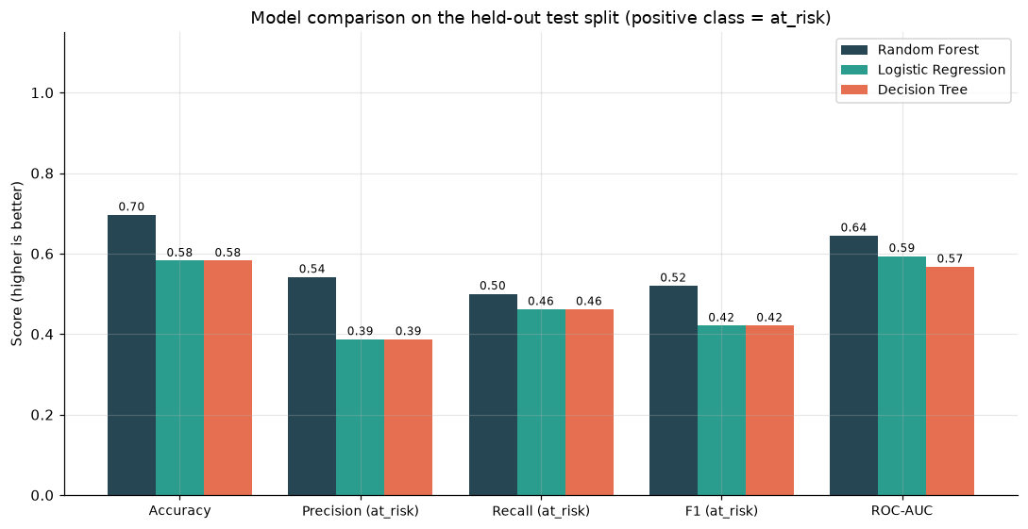
Model comparison (measured)

Slide 14
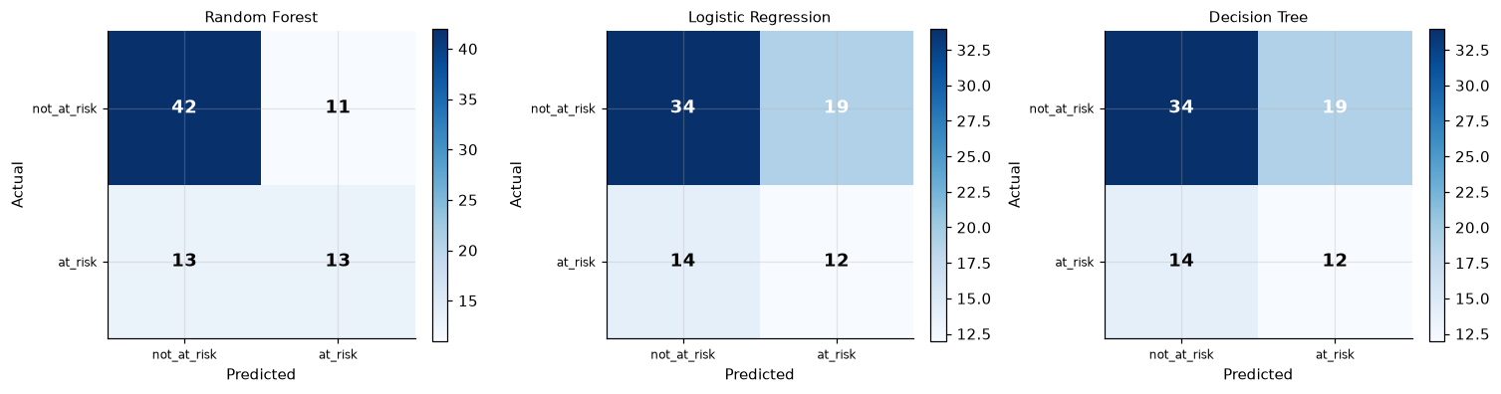
Confusion matrices (measured)

Slide 15
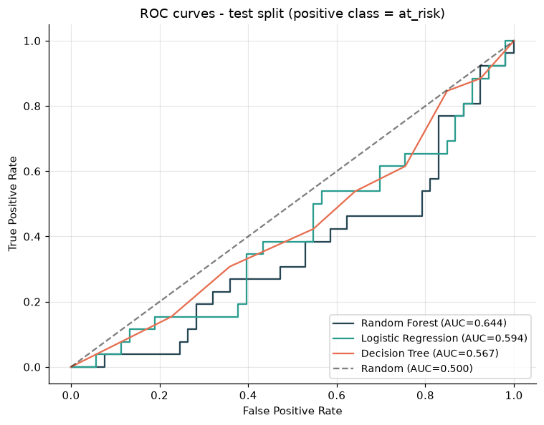
ROC curves (measured)

Slide 16
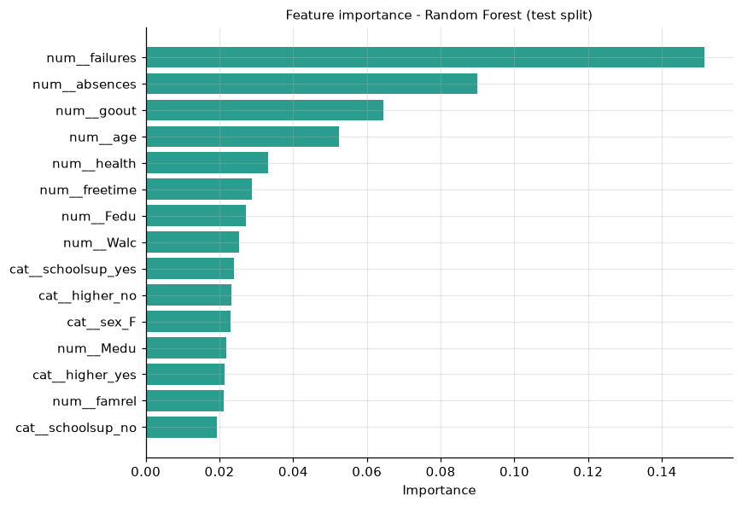
Feature importance (measured)

Slide 17
Leakage quantification (optional experiment)
With G1/G2 included (NOT comparable!):
Best model Decision Tree: accuracy 0.873, F1 0.833.
Early-scenario best F1: 0.520.
The gap is the 'shortcut' that G1/G2 provide near the end of the course.

Slide 18
Application demonstration
Streamlit dashboard: risk input form generated from the model schema, measured metrics, EDA, methodology and disclaimers.
Only artifacts produced by 'python -m src.train' are shown - no hardcoded numbers.
Missing artifacts -> clear setup instructions, never a fake prediction.

Slide 19
Limitations & Ethics
Small dataset (395 students, one subject, two schools, 2008).
Single-split evaluation - differences are noisy; CV F1 was similar across models.
Threshold G3 < 10 is a project-defined rule.
Predictive association only - no causality claims.
Fairness/bias caveats; educational prototype, not for real decisions.

Slide 20
Conclusion & Future Work
Random Forest delivered the best measured F1 and ROC-AUC, but no algorithm separates decisively at this scale.
Leakage-aware design is the real contribution: without it, metrics are optimistically inflated.
Future: repeated CV, calibration, fairness audit, cost-sensitive thresholds.

Slide 21
References (verified)
All entries below were verified against the official sources: the UCI
dataset page (2026 metadata) and the Crossref REST API (DOI resolution).
Verification date: 2026-10-18. Helper scripts used:
`research/verify_references.py` and `research/find_dois.py`.
1. Cortez, P., & Silva, A. M. G. (2008). Using data mining to predict
secondary school student performance. In A. Brito & J. Teixeira (Eds.),
(pp. 5–12). EUROSIS-ETI.
A. M. G. Silva, 2008).*
2. Cortez, P. (2008). *Student performance* [Dataset]. UCI Machine Learning
Repository. https://doi.org/10.24432/C5TG7T
3. Romero, C., & Ventura, S. (2010). Educational data mining: A review of
the state of the art. *IEEE Transactions on Systems, Man, and

