Slide 1
Tower Of Hanoi
CS-212

Slide 2
Team members :
Youssef Aly 200014226 Mohaned Mohamed Emad 200013207 Youssef Mohamed 200017720

Slide 3
What is Tower of Hanoi…?
The Tower of Hanoi (also called The problem of Benares Temple or Tower of Brahma or Lucas' Tower and sometimes pluralized as Towers, or simply pyramid puzzle) is a mathematical game or puzzle consisting of three rods and a number of disks of various diameters, which can slide onto any rod. The puzzle begins with the disks stacked on one rod in order of decreasing size, the smallest at the top, thus approximating a conical shape. The objective of the puzzle is to move the entire stack to the last rod, obeying the following rules:
Only one disk may be moved at a time.
Each move consists of taking the upper disk from one of the stacks and placing it on top of another stack or on an empty rod.
No disk may be placed on top of a disk that is smaller than it.

Slide 4
Let’s Code….

Slide 5
Creation of the 3 main stacks …

Slide 6
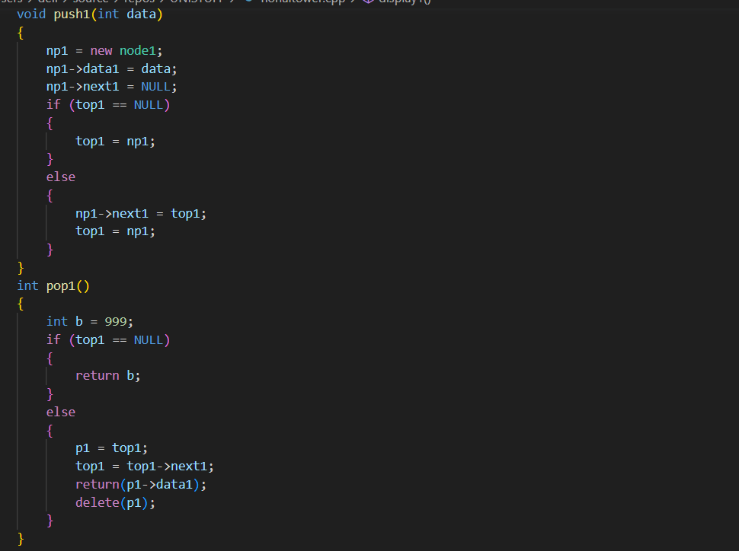
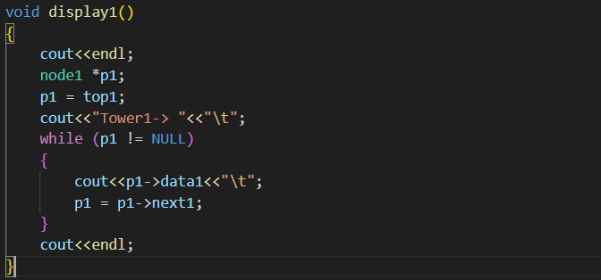
Implementation of first stack:

Slide 7
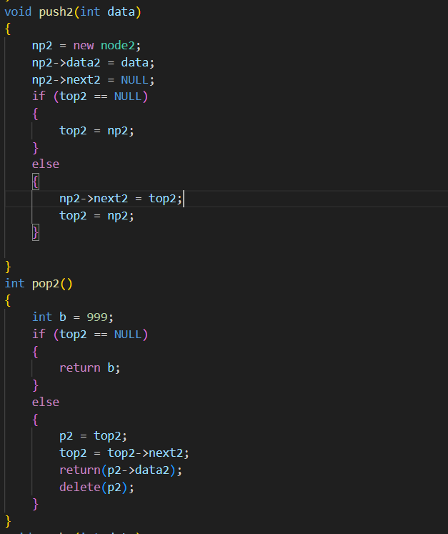
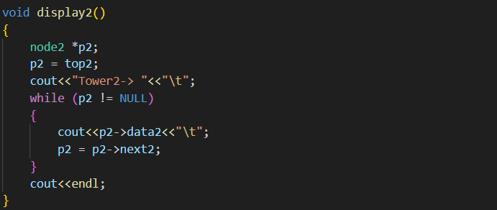
Implementation of second stack:

Slide 8
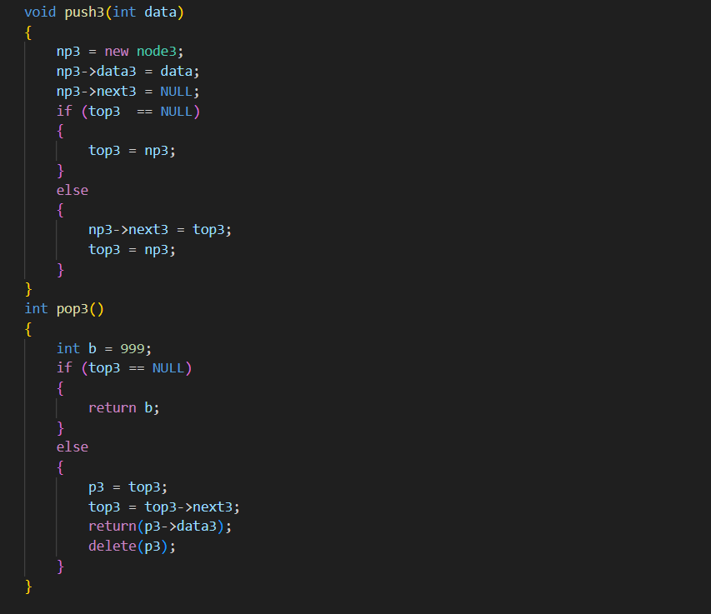
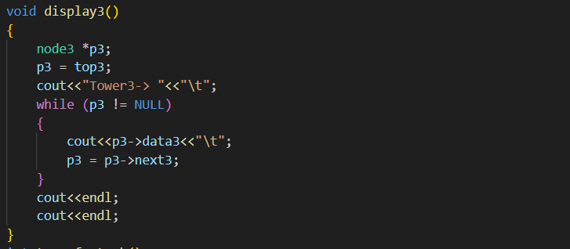
Implementation of third stack:

Slide 9
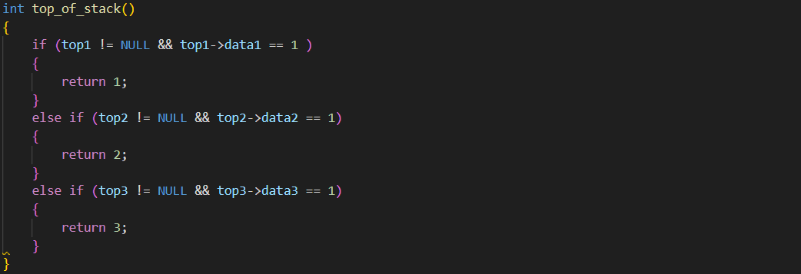
Function to check top of the stack..

Slide 10
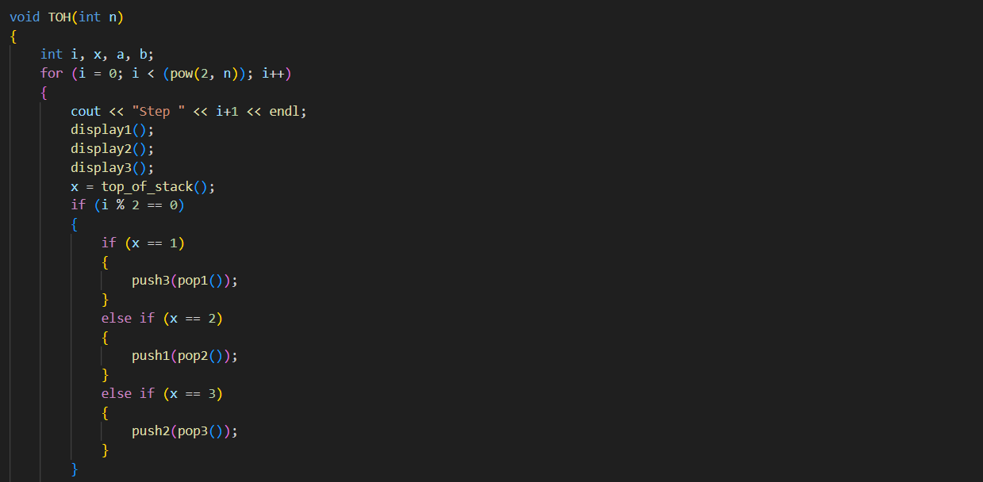
Tower of Hanoi function :

Slide 11
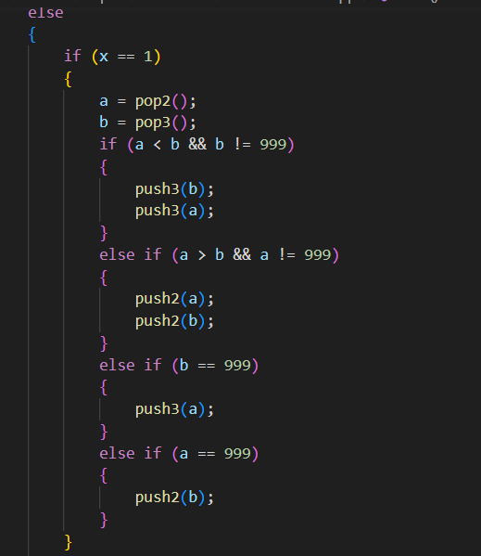
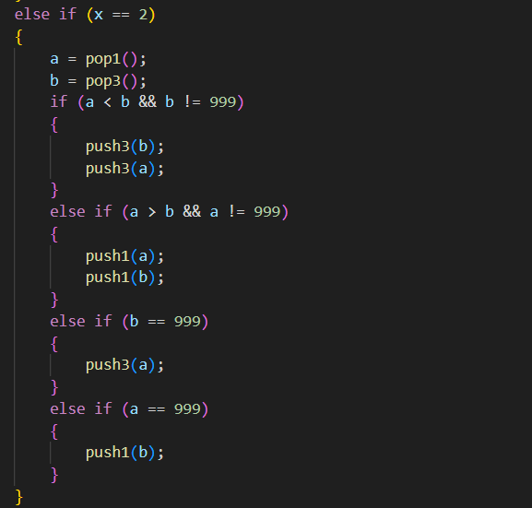
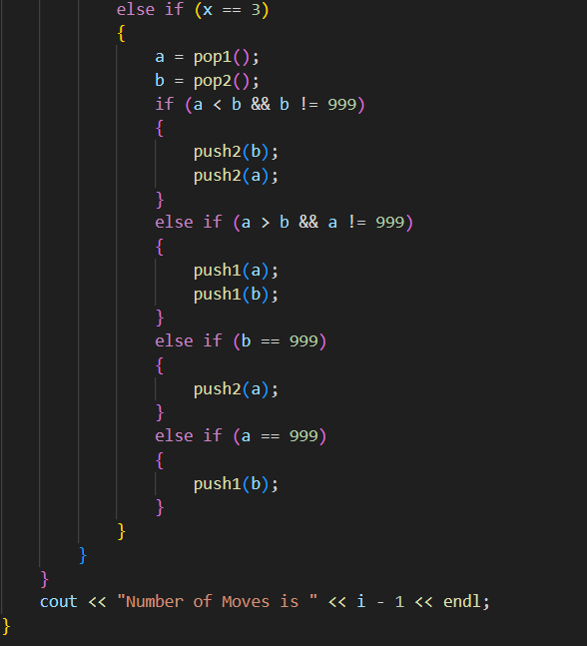
Tower of Hanoi function…

Slide 12
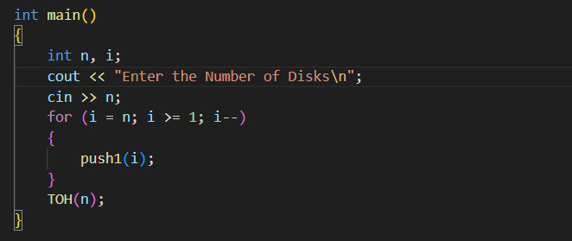
Main Function:

Slide 13
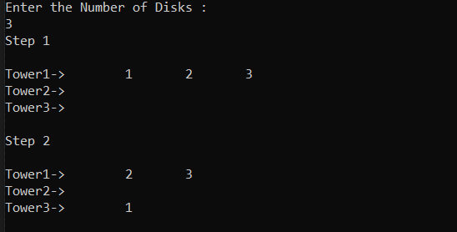

Now lets see the output: If we enter number of disks for example,3, there will be 8 steps to solve the game.

Slide 14
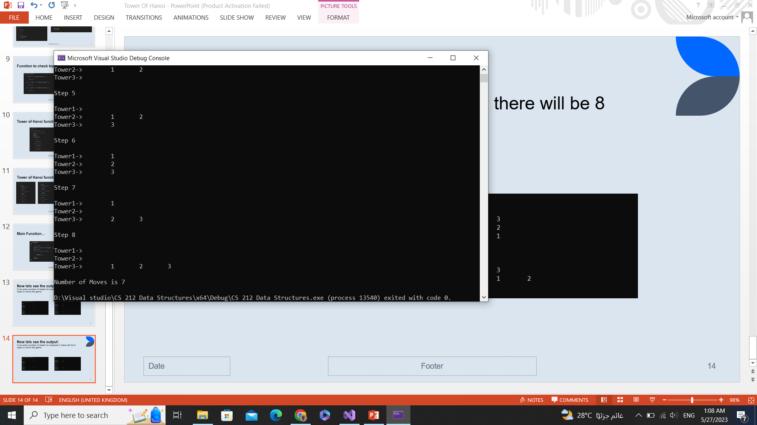
Now lets see the output: If we enter number of disks for example,3, there will be 8 steps to solve the game.

Slide 15
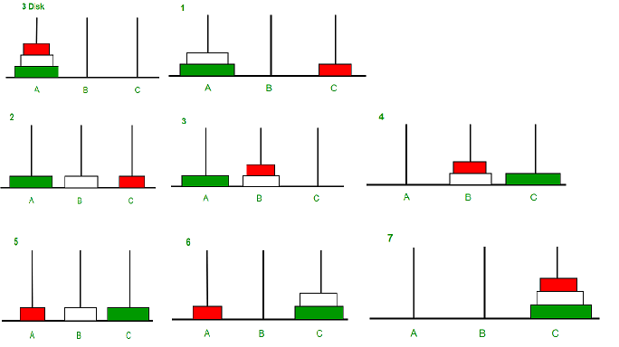

Slide 16
For better view look at the following link :
https://github.com/Joe52525/Tower-of-Hanoi/blob/main/honaitower.cpp

Slide 17
The End
Thanks

