Slide 1
Explaining the Acronym Soup of AI, OSS, and RAG
@JoeMayo on X

Slide 2
Overview
What is Retrieval Augmented Generation (RAG)?
Why RAG?
A RAG Process
What is Generellem Open-Source?
Generellem Architecture
Code?
Resources

Slide 3
What is RAG?
Acronym for Retrieval Augmented Generation (RAG)
Large Language Model (LLM)
“RAG is a process that uses external documentation to modify queries to an LLM, specifying a preference for information from the external documentation.”

Slide 4
Why RAG?
Improves the quality of the response
Adds information that the LLM doesn’t know about
Lets you use your own intellectual property (IP) safely
Don’t need the expense, resources, and time to train a new LLM
Can use current data that doesn’t get stale

Slide 5
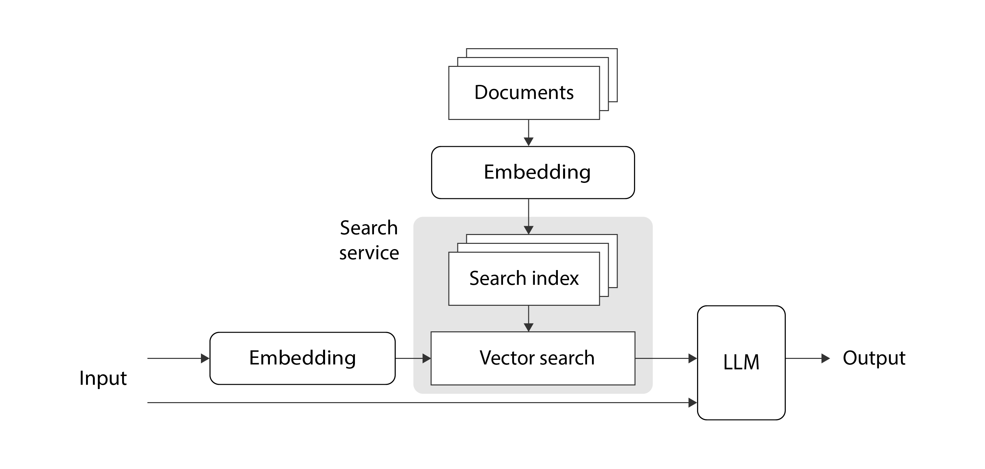
A RAG Process
Inspired by Retrieval-Augmented Generation (RAG)/Bea Stollnitz at https://bea.stollnitz.com/blog/rag/

Slide 6
What is Generellem Open-Source?
An opinionated Framework for building plug-and-play RAG processes

Slide 7
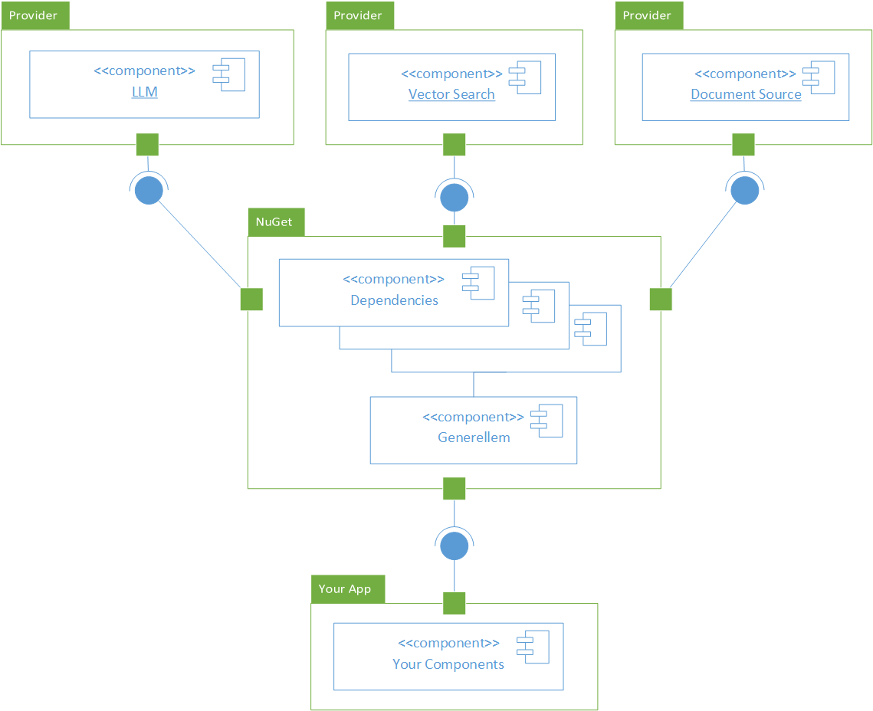
Architecture

Slide 8
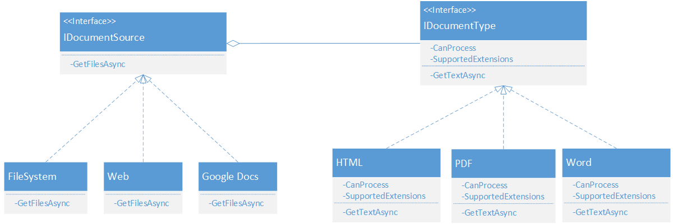
Document Sources

Slide 9
Ingestion
Acquires documents
You specify what documens
Initial ingestion does is full scan
Can subsequently scan
Picks up deltas
Only adds, updates, and deletes

Slide 10
Resources
GitHub
https://github.com/JoeAtGenerellem/generellem
Bea Stollnitz’s blog post on RAG
https://bea.stollnitz.com/blog/rag/
Joe Mayo
@JoeMayo on X
Generellem, Inc.
https://generellem.ai/

