Slide 1
Seattle Neighborhood Clustering
By: Joe Battafarano

Slide 2
Why Research your Neighborhood?
Individuals/Families:
Cost savings
Time savings
Increase happiness
Meet needs and not comprise wants
Residential leases are annual commitments
Businesses:
Cost savings
Know competition
Know venue compliments
Commercial leasing are long-term commitments
Reach target audience

Slide 3
Data Acquisition
Seattle Neighborhoods: 118 scraped from Wikipedia
Location Mapping: Latitude and Longitude obtained via GeoPy
Seattle Venues: 3370 obtained via Foursquare Explore Endpoint
Seattle Venues Pricing and Rating: 1113 obtained via Foursquare Details Endpoint

Slide 4
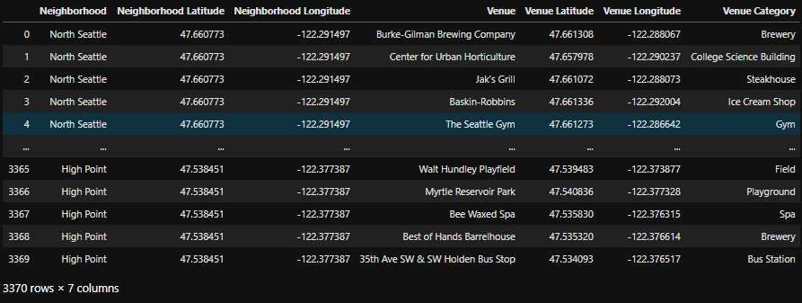
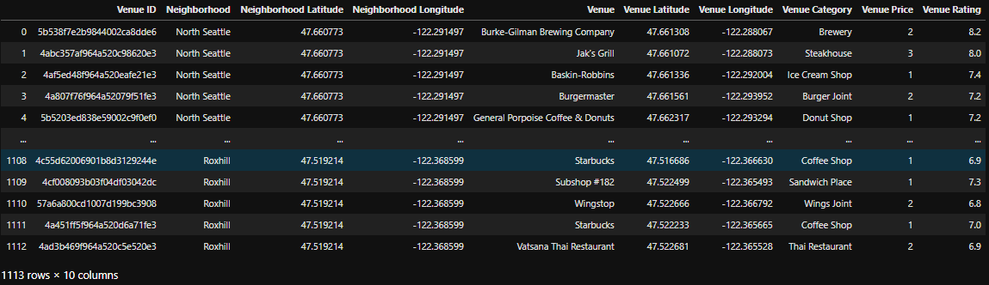
Data Previews
Seattle Venues:
Seattle Venues PnR:
Notes:
PnR stands for Pricing and Ratings

Slide 5
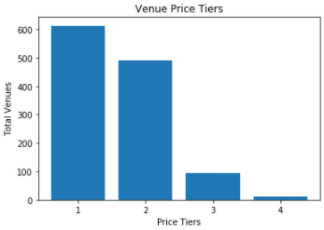
Pricing
Tiers 1 and 2 make up over 90% of venues
Pricing averages per neighborhood will be used to demonstrate cost of living
Tier 1: $0 - $10
Tier 2: $10 - $20
Tier 3: $20 - $30
Tier 4: $30 - $40

Slide 6
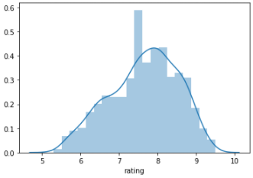
Rating
Most venues have “acceptable” ratings, hinting at lack of importance?
Close to normal distribution
Range: 5.3 to 9.5
Mean: 7.6
Median: 7.7

Slide 7
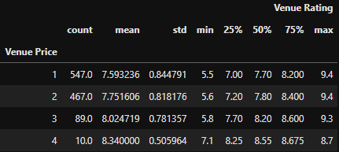
Pricing and Rating
As price increases each quartile increases
As price decreases maximum rating increases
Low correlation: 0.16

Slide 8
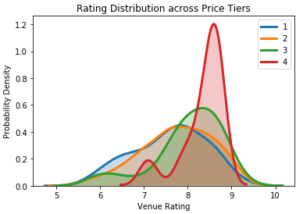
Pricing and Rating
Tier 4 has the best ratings, but consists of far fewer venues
Most venues have great ratings between 7 to 9
Lower price tiers have many lower rating venues, but higher density at higher rankings
Notes:
Probability Density functions can exceed 1 as they do not represent cumulative probability which can only go to one

Slide 9
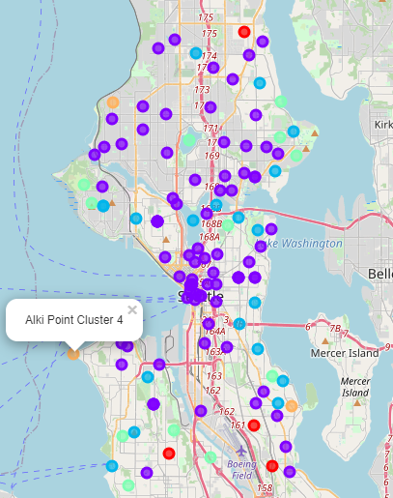
Most Common Venues Clustering
Cluster 1: All central Seattle, common venues include parks, trails, and coffee shops
Cluster 4: Costal neighborhoods with a beach and unique set of venues
Without pricing and rating many clusters become homogenous especially in densely packed areas

Slide 10
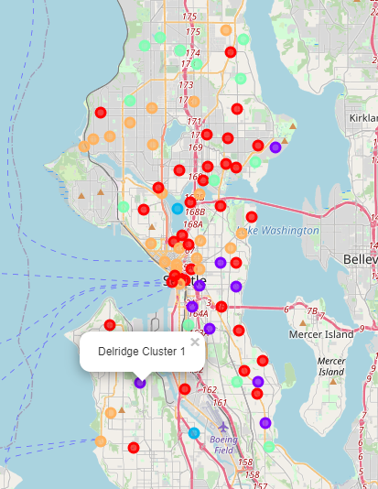
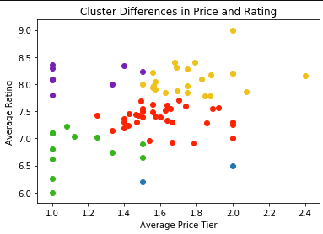
Pricing and Rating Clustering
Central Seattle is split into multiple clusters
Higher Rating/Lower Costs and Lower Rating/Higher Costs clusters begin to form
Clusters begin to become more widespread across Seattle focusing less on venue frequency

Slide 11
Conclusion
Businesses:
Small to medium businesses can seek advantages in low costs, lower ranked clusters 0 and 3
Medium to Large can push boundaries and grow in clusters 0, 1, 4
Able to identify frequency of similar and complimentary venues
Individuals/Families:
Able to find neighborhoods with similar venues at lower cost
Widespread cluster locations yields more options to meet needs and wants
Find the highest ranked venues at the lowest possible cost
Avoid overpaying for rent in areas that lack venue preferences
Notes:
All clusters referring to price and rating clusters

