Slide 1

Showcase for Data Visualisations for Workforce Planning
Project 3b:
Lakshay Bhala,
Laura Camilleri,
Joe Baxendale,
Ghadah Abugharrarh

Slide 2
Mission Statement
To design a reusable component that when given generic data, it can be used for visualisation of scheduling systems in any domain.

Slide 3
Showcase Demo
Now we will present to you our proposed solution…

Slide 4
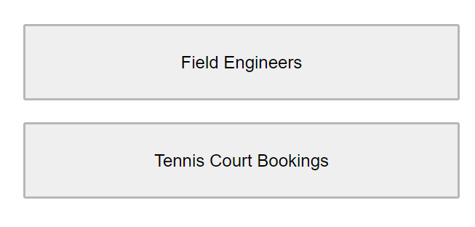
Domains of Work
The two domains we have chosen to be used as an example for the presentation of the Gantt chart component.

Slide 5
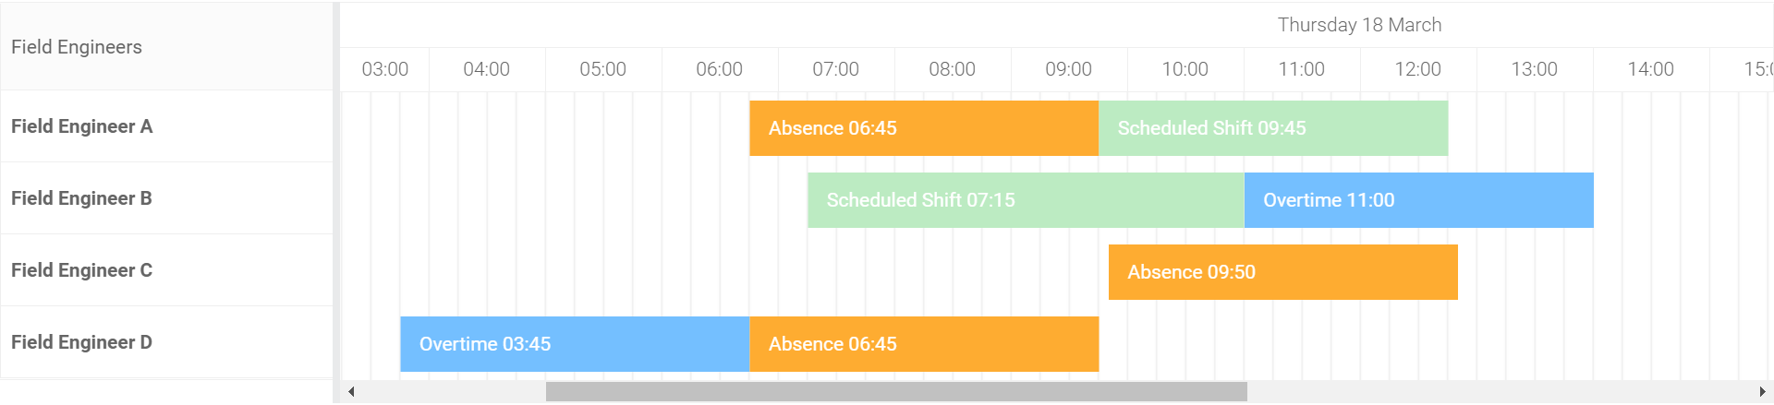
Gantt Chart Component
Interactive with drag functionality.
Shifts/tasks discriminated by type and colour.

Slide 6
Gantt Chart
Field Engineer
Tennis Courts
Time horizon zoomable by day or week view.
Can add new bars onto the chart – customised labels for domain of work.

Slide 7
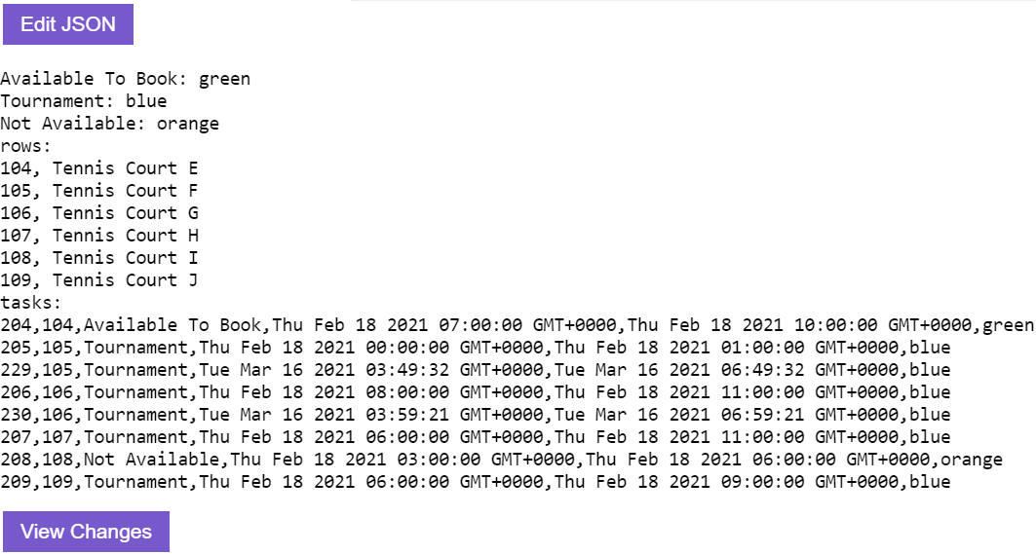
Gantt Chart – JSON Test Harness
Be able to display and edit JSON data (without it being saved) for the purposes of visualisation.

Slide 8
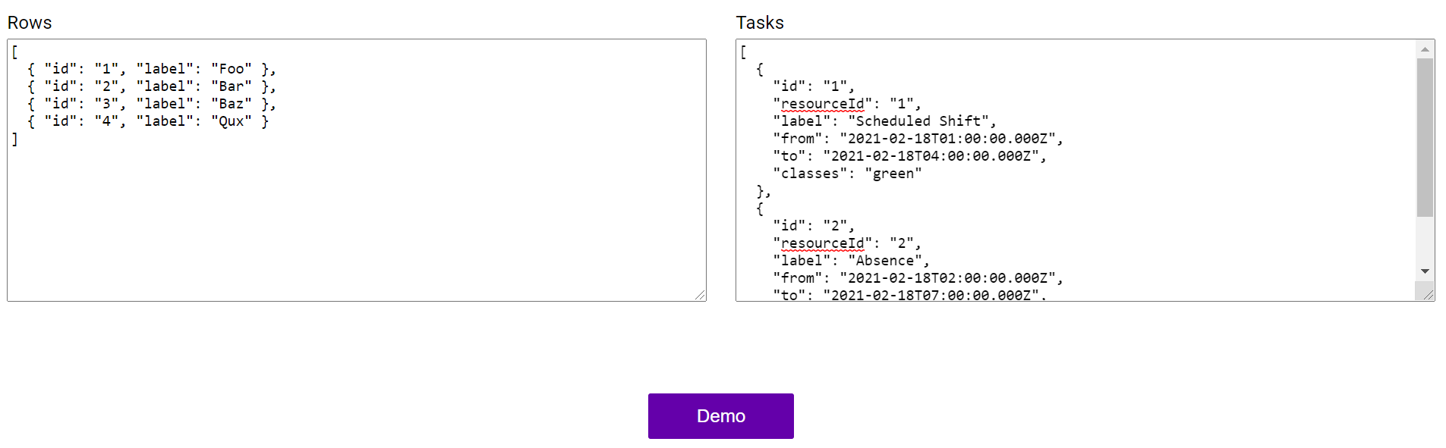
Gantt Chart – Test the JSON Data
Input JSON data for a new Gantt chart to render.

Slide 9
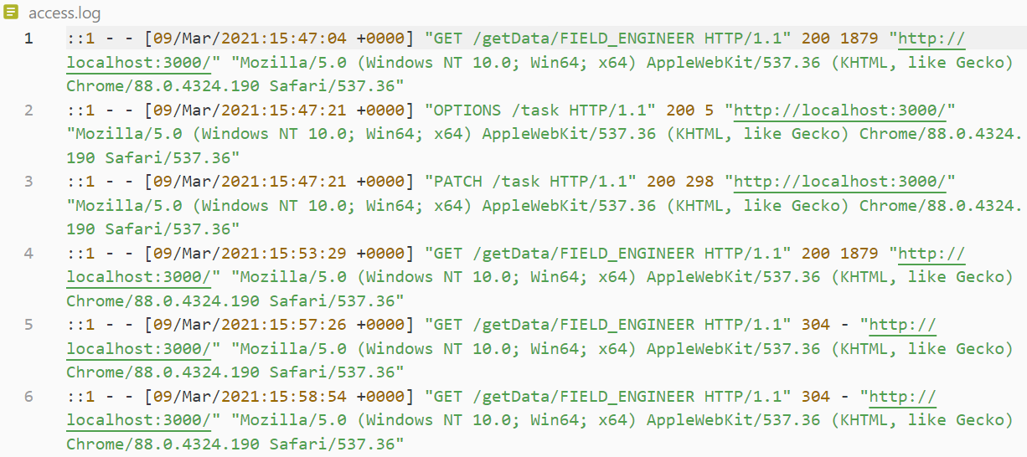
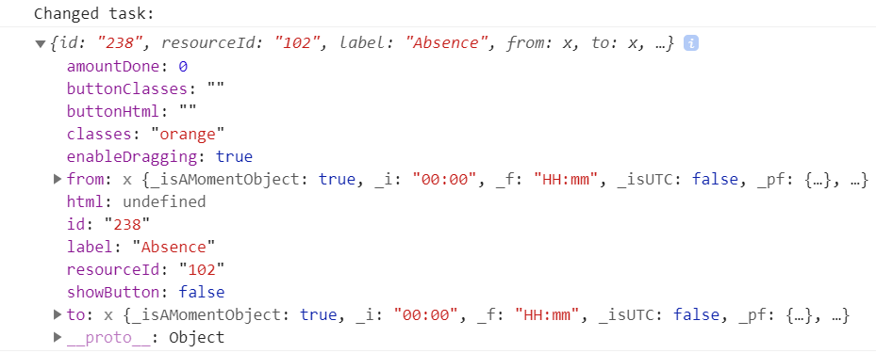
Gantt Chart – Logging
Logs to show when task has been moved and its information.

Slide 10
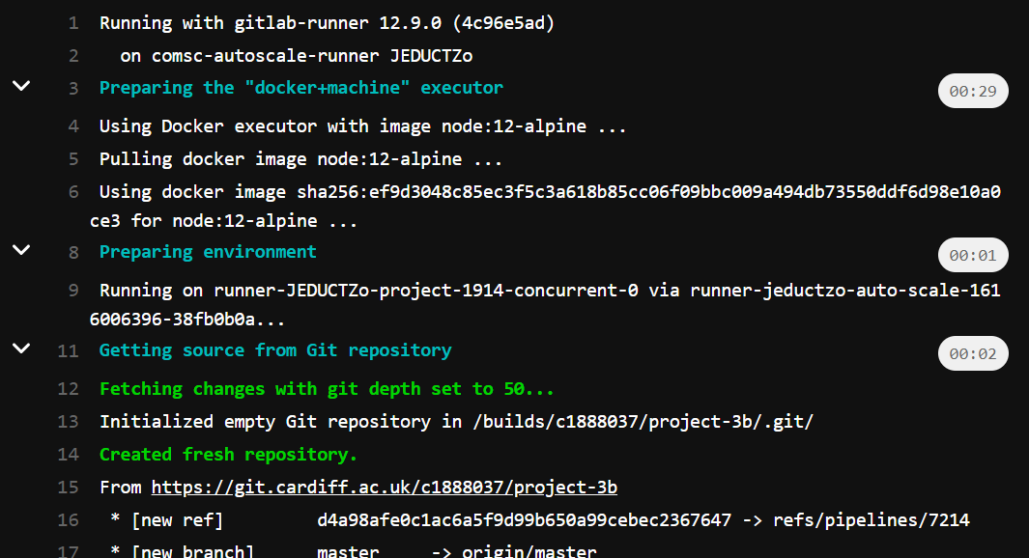
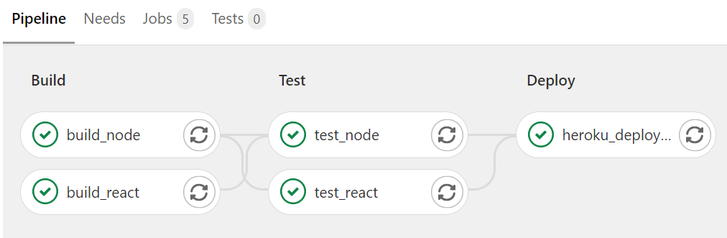
CI/CD Pipeline
The pipeline used to build, test, and deploy the application.

Slide 11
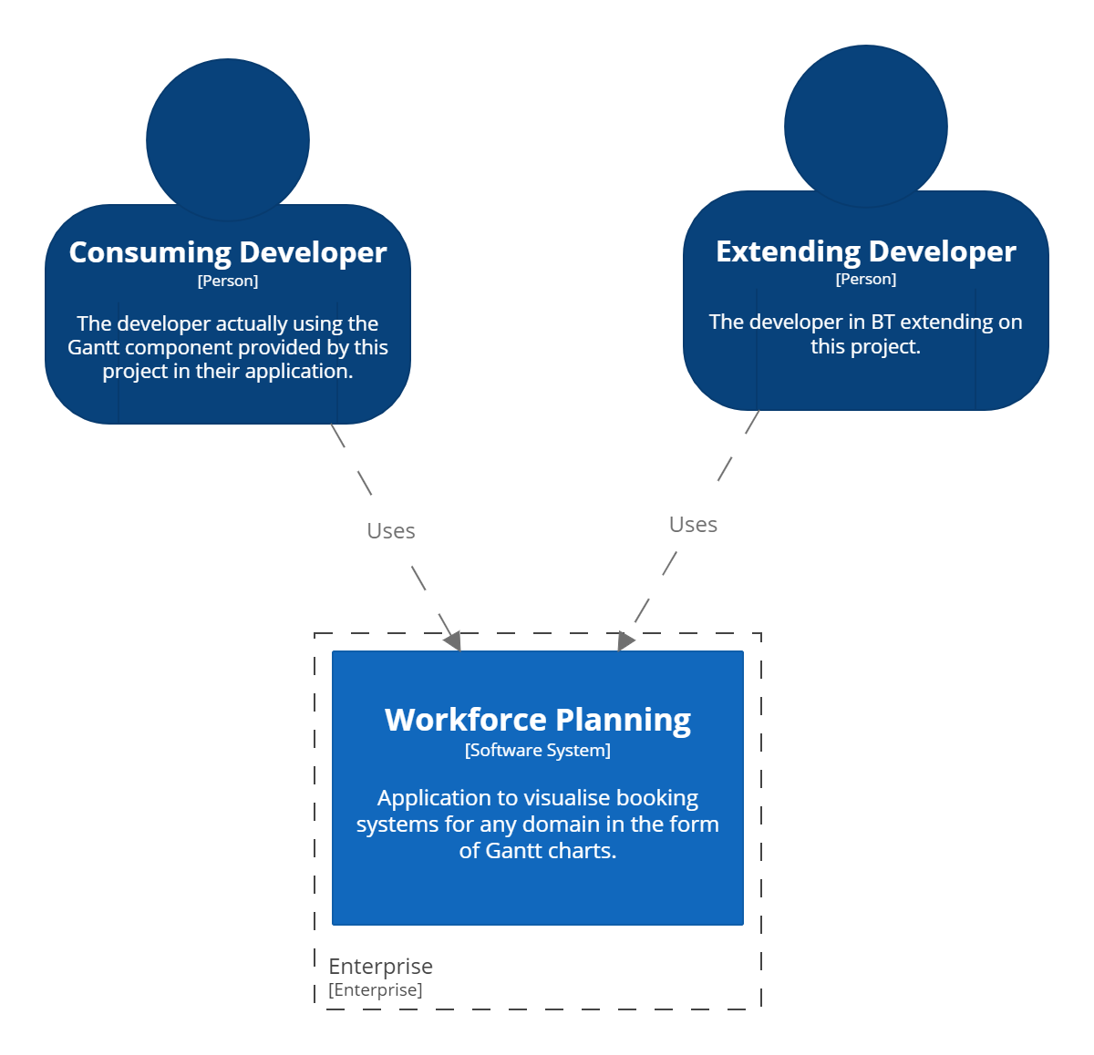
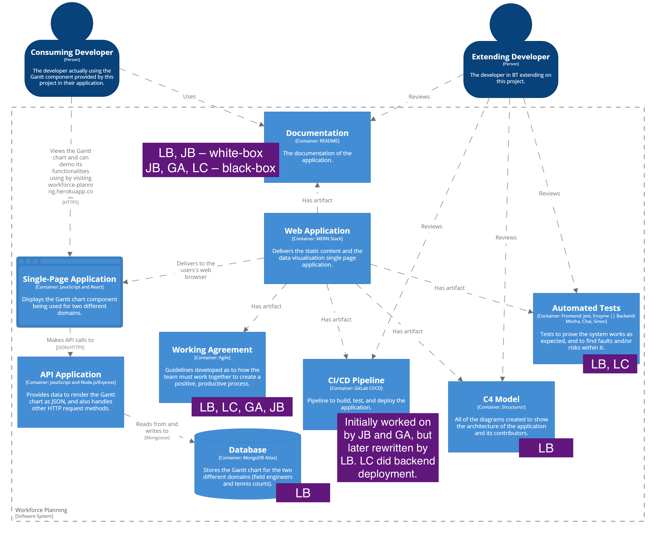
Architecture and Contribution Map
C4 Structurizr diagrams to illustrate the architecture and its artefacts, along with their contributors.

Slide 12
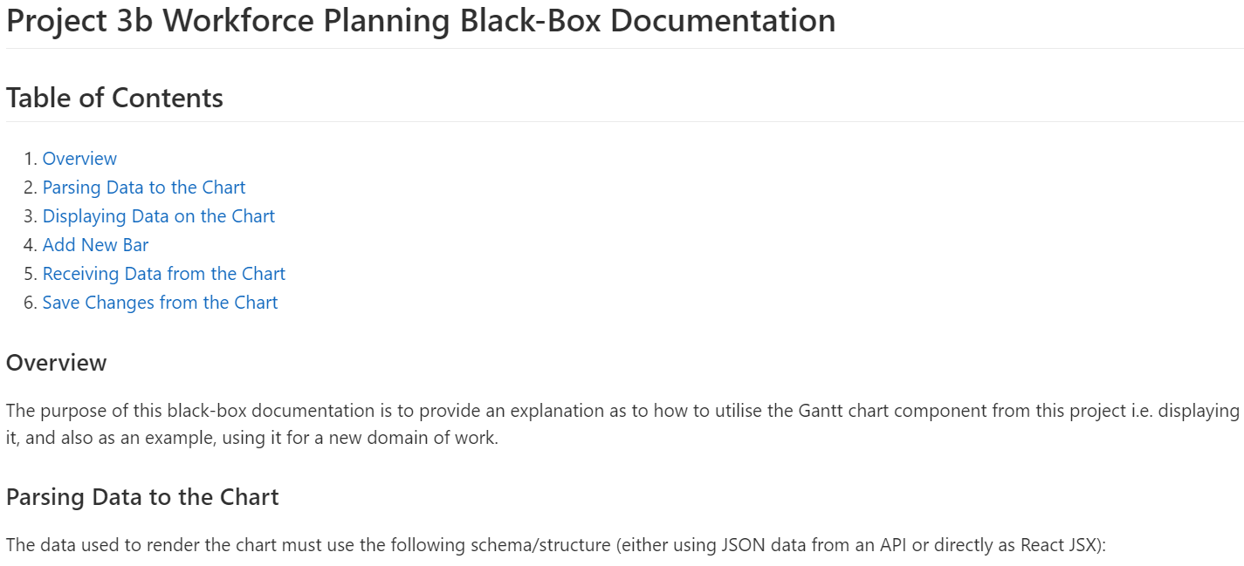
Black-Box Reuse
The documentation to be used for the consuming developer.

Slide 13
Thank You!
Thank you for listening to the highlights reel of this project.

