Slide 1
Fight wildfires with software
GMAAS team
NASA Space Apps 2017
Dublin

Slide 2
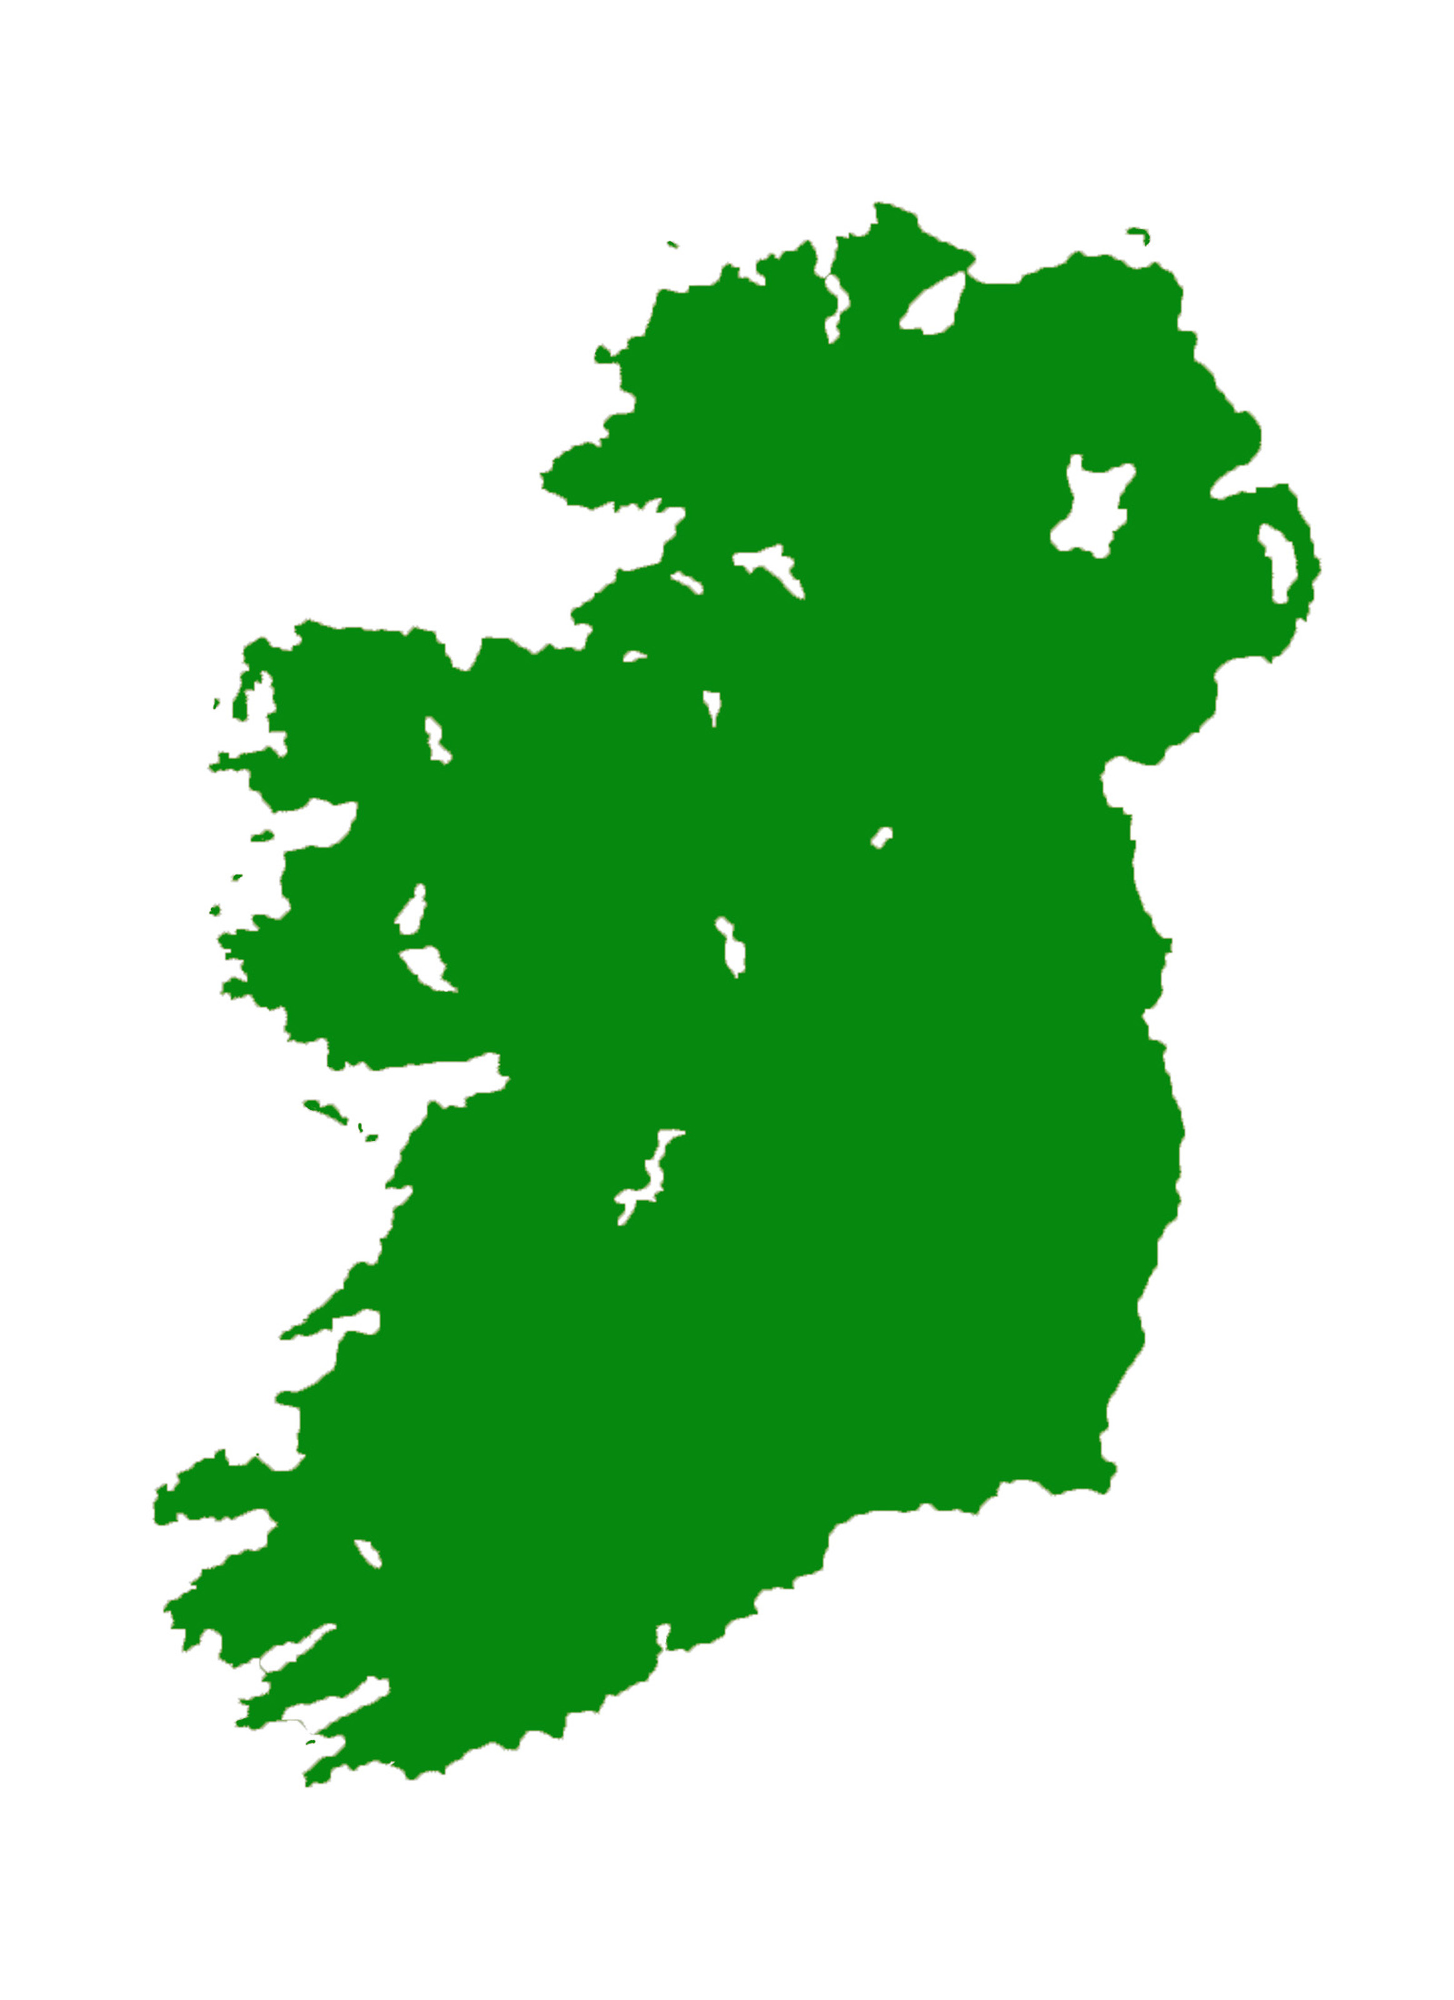

Wild fires is a problem!

Slide 3
How can YOU help?
Be Aware
Know the behavior
Know the dangers
Know how to evacuate
Solution?
Simulations!

Slide 4
How can YOU help?
Report
If you see the fire, let people know
Solution?
One-click reporting!

Slide 5
Our solution
Simple interface to run simulations
Report in a few clicks
Real maps from Google, reverse engineered using image processing
Based on cellular automata fire spread model: http://nifty.stanford.edu/2007/shiflet-fire/
Two prototypes: C# for desktop, JavaScript for web

Slide 6
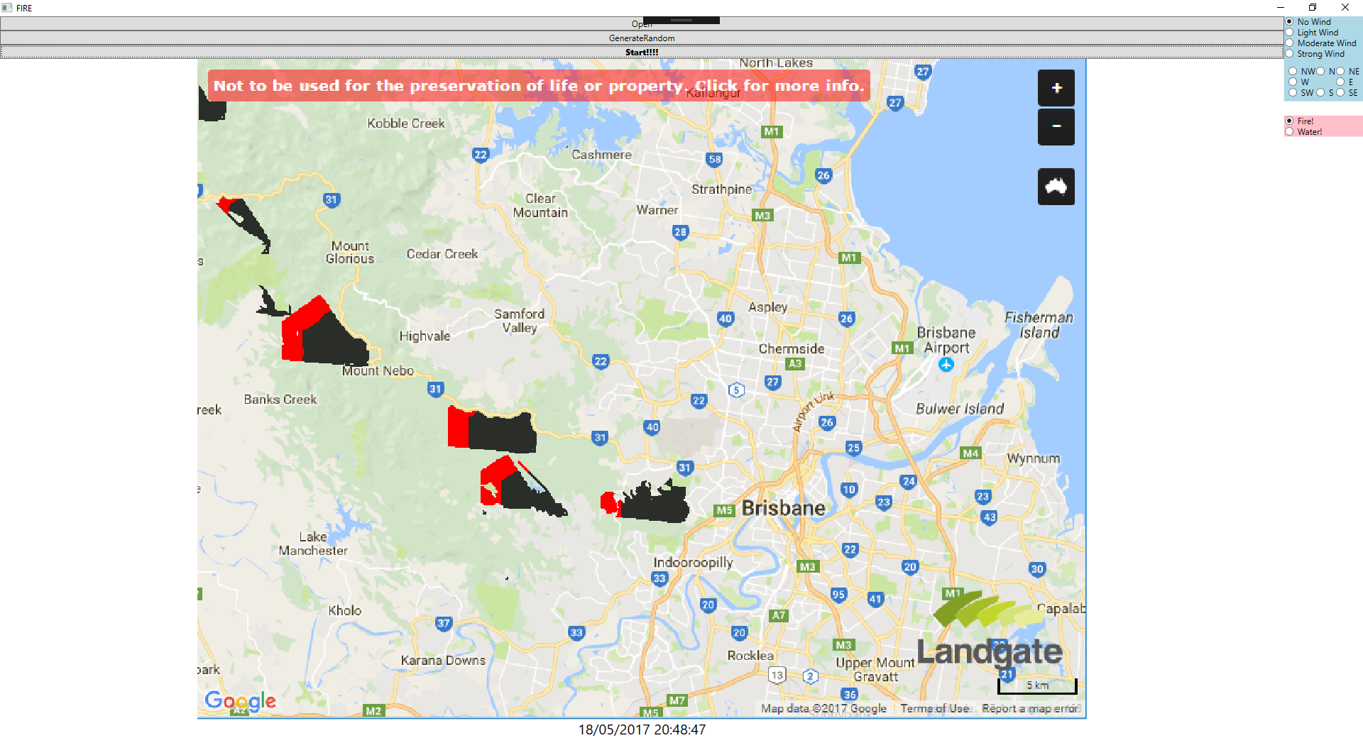

Slide 7
Demo

Slide 8
Future plans
Release and spread the word
https://github.com/SeppyB/NASA-Fire-Simulation
Improve simulation model: uneven terrain, rain, different types of vegetation
Connect with fire departments
Consider other natural disasters: landslides, floods

