Slide 1
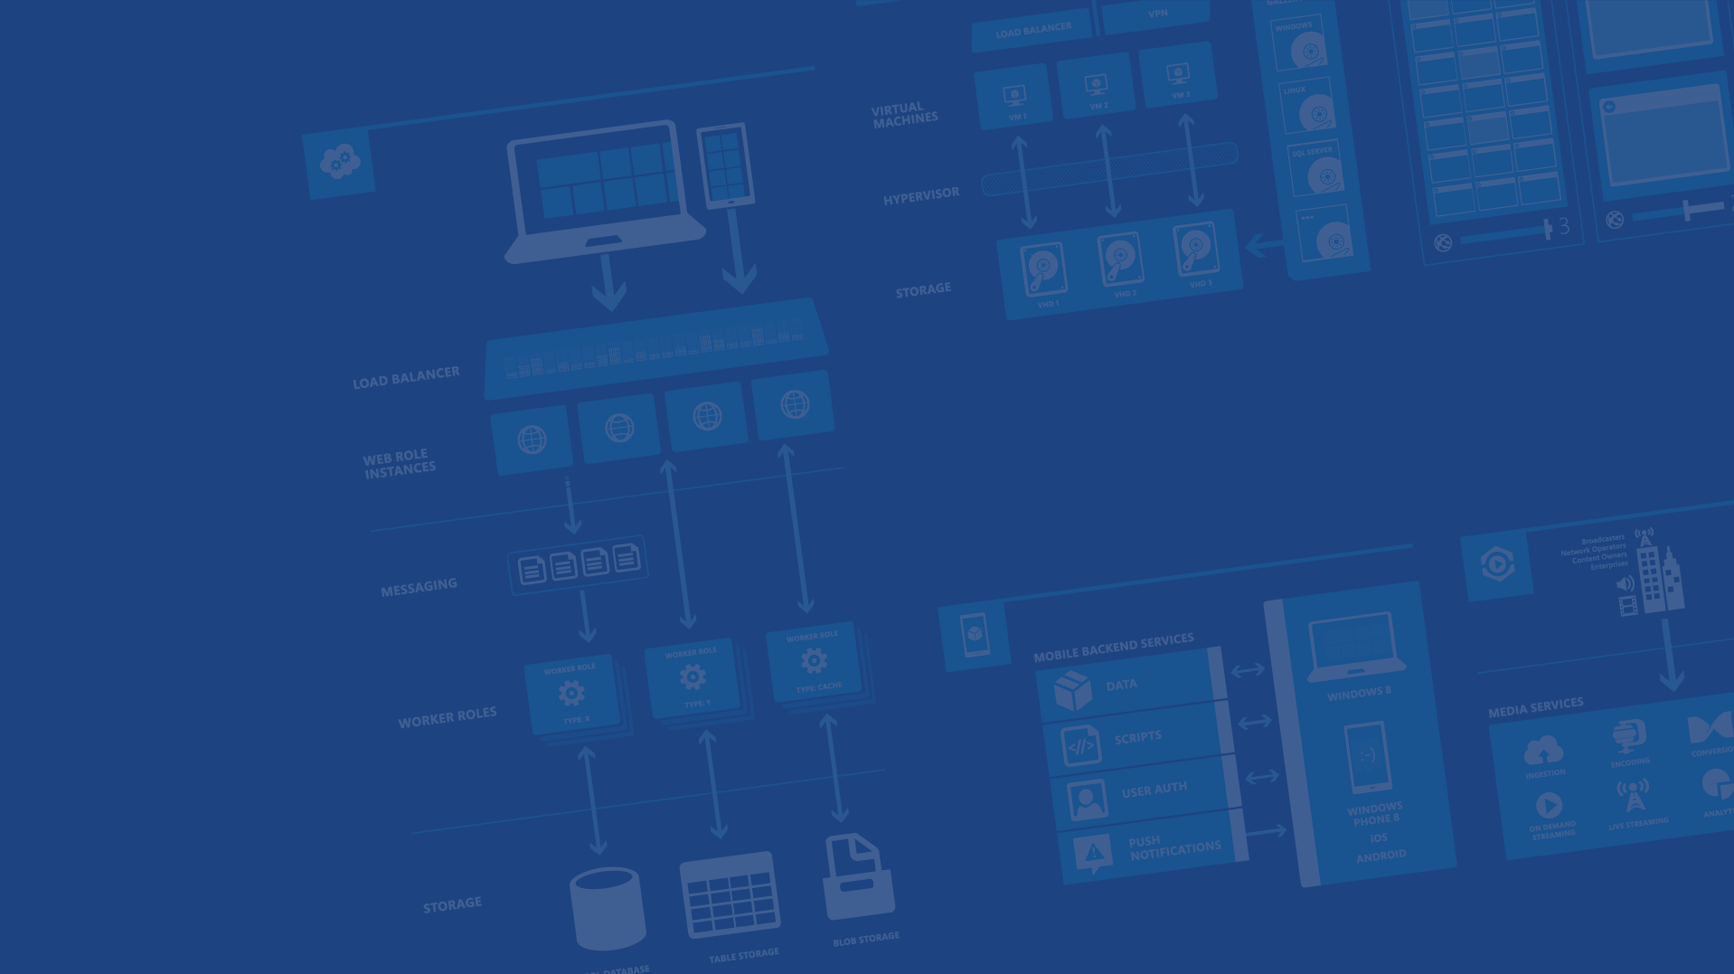
Azure Websites
Presenter Name
Position or role
Microsoft Azure

Slide 2
Agenda
Site creation
Language Support
Deployment
Source Control Integration
Scale
Web Jobs
Site Slots
Traffic Manager
Backup
Hybrid Connections
Redis Cache

Slide 3
Fastest way to build for the cloud

Slide 4
Demo
Azure Website Creation

Slide 5

Develop apps with…
.NET
Python
Node.js
Java
PHP

Slide 6
Demo
Language Support
Notes:
FTP files (ASP, Node, PHP, etc.) to new website created in demo 1

Slide 7
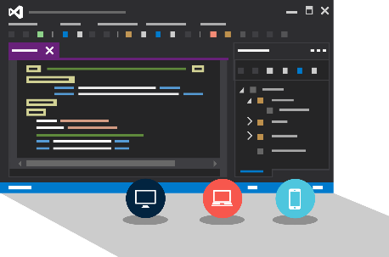
Visual Studio + Azure Websites
Create Azure Resources during File / New
Create Azure Website during deploy
Manage with Server Explorer

Slide 8
Demo
Visual Studio Support
Notes:
File / New Web Application
Show Host In The Cloud dialog
Select Empty web site (for quick create)
Right-click project, select Publish
Show Azure Website creation
Cancel publish
Show Azure Websites in Server Explorer
Right-click one Website and show settings

Slide 9

Choose your own Adventure!
Visual Studio
Online
CodePlex
Git
GitHub
BitBucket
DropBox
FTP
Notes:
Slide Objectives:
Objective #1
Transition:
Transition statement(s) to setup the slide
Speaking Points:
Speaking Point #1
Speaking Point #2
Notes:
Any notes go here

Slide 10
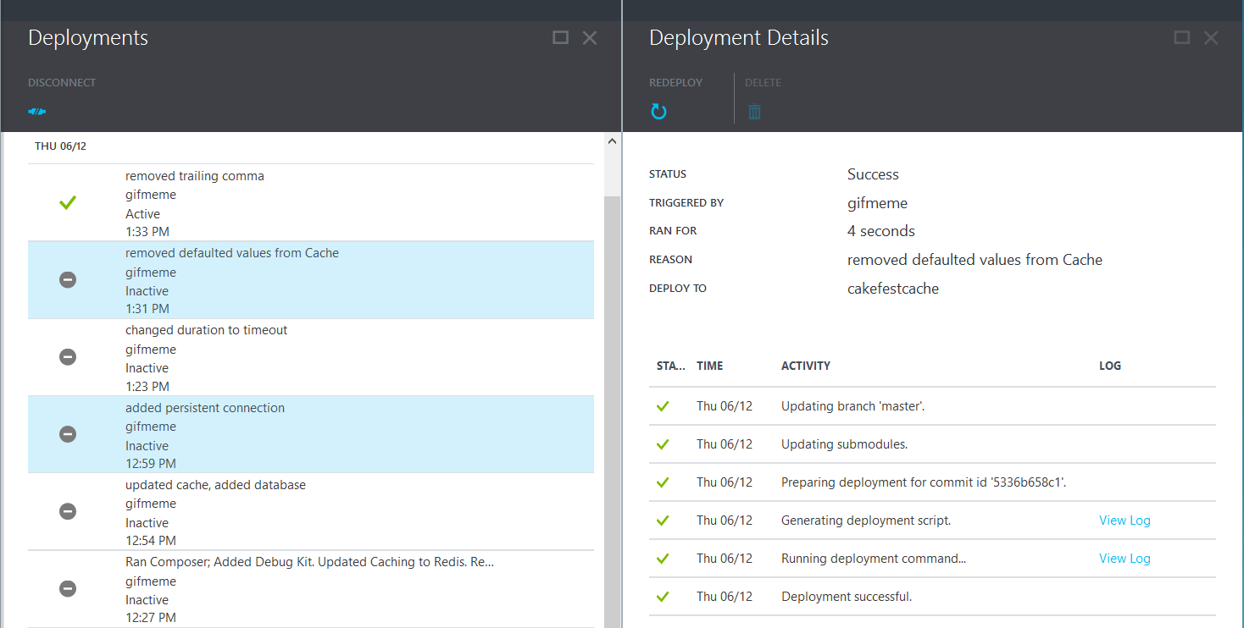
Deployments

Slide 11
Scale

Slide 12
Manual Scaling
Instance Count
1
6
Instances

Slide 13
AutoScale

Slide 14
AutoScale

Slide 15
AutoScale

Slide 16
Auto-Scaling (Metric)
Instance Count
2
6
Instances
[Metric]
60
80
Percent
CPU Percentage | Memory Percentage | Disk Queue Length | HTTP Queue Length | Data In | Data Out

Slide 17
Demo
Manual Scale
Auto Scale

Slide 18
Auto-Scale Considerations
Only Scales the Web Tier
Scale Up/Down is not instantaneous

Slide 19
Site Slots

Slide 20
Staging

Slide 21
Staging

Slide 22
Staging

Slide 23
Staging

Slide 24
Web Jobs

Slide 25
WebJobs

Slide 26
WebJobs

Slide 27
Traffic Manager

Slide 28
14 regions worldwide in 2014
Azure
Websites footprint

Slide 29
Intelligent customer routing with Traffic Manager
www.yourapp.com

Slide 30
Intelligent customer routing with Traffic Manager
www.yourapp.com

Slide 31
Backup

Slide 32
Backups
Websites Files
Websites Settings Manifest
Database (Optional)

Slide 33
Hybrid Connections

Slide 34



Hybrid Connections
Corporate Network
Microsoft SQL Server
Web Sites
Hybrid Connection Manager
Other published resources
Hybrid Connection
Mobile Services

Slide 35
Redis Cache

Slide 36

Redis Cache Service
Full Functionality Redis Cache Cluster
Master/Slave Configuration
Up to 26GB
SSL Supported

Slide 37
Demo
Redis Cache

Slide 38
Application Insights

Slide 39
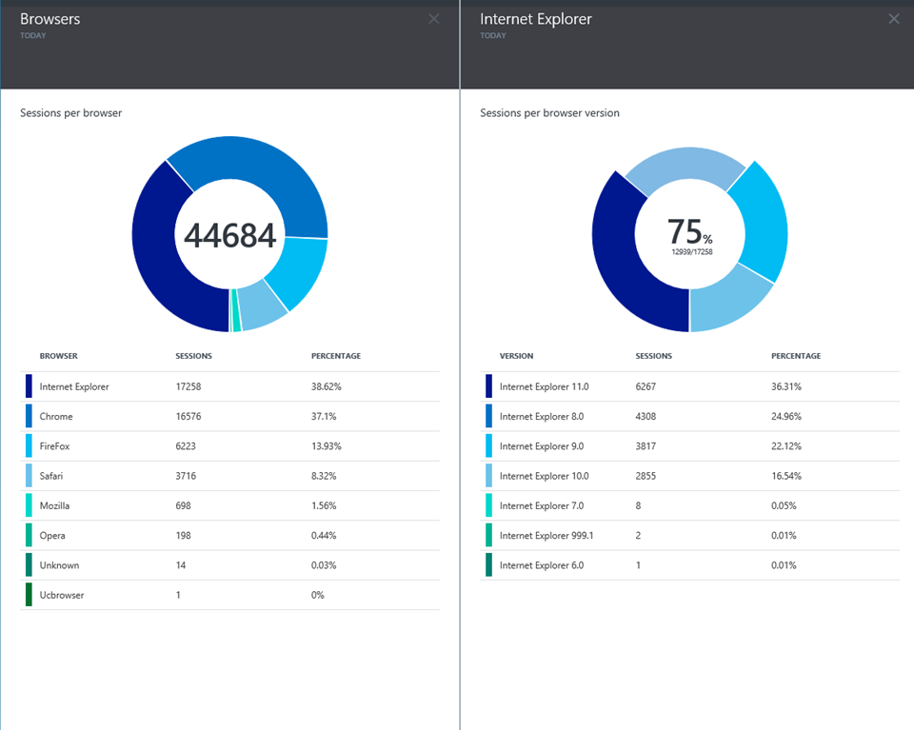
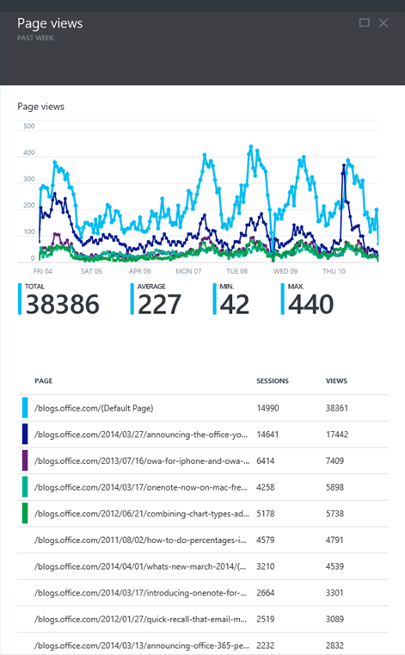
Application Insights

Slide 41

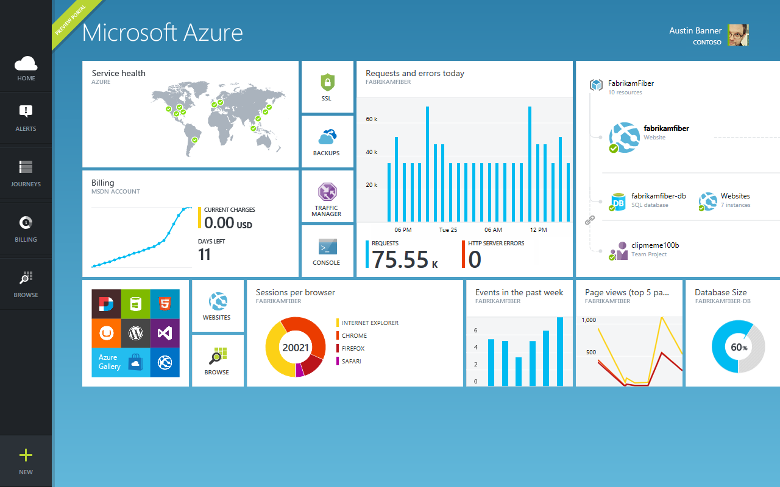
Get started
Visit azure.microsoft.com

Slide 42
Web Sites Service Architecture
Deployment
Server(s)
File Server
Publish Endpoint
Blob Storage
Application Database
Frontend (IIS ARR)
Microsoft Azure
Load Balancer
Metering
Runtime Database
API Endpoint

Slide 43
Debug Console (Kudu)
Environment
Debug Console
Diagnostics & Logs
Web Hooks
REST API
https://[website-name].scm.azurewebsites.net

Slide 44
Web Site
Web Site
Monaco
MSDeploy
Build/Upload Your Own
Kudu
Web Jobs
Gallery
Public Site Extensions
Private Site Extensions
Microsoft Azure Web Site

Slide 45
Customizing the Deployment
>: azure site deploymentscript –h
help:
help: Generate custom deployment script
help: Usage: site deploymentscript [options]
help:
help: Options:
help: --aspWAP <projectFilePath>
help: --aspWebSite
help: --node
help: --php
help: --python
help: --basic
Microsoft Azure Cross Platform Command-Line Tools

Slide 47
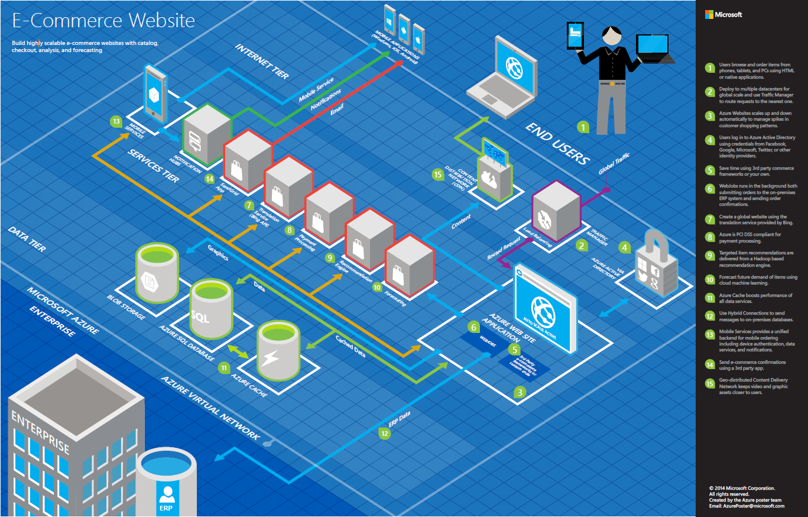

Slide 48
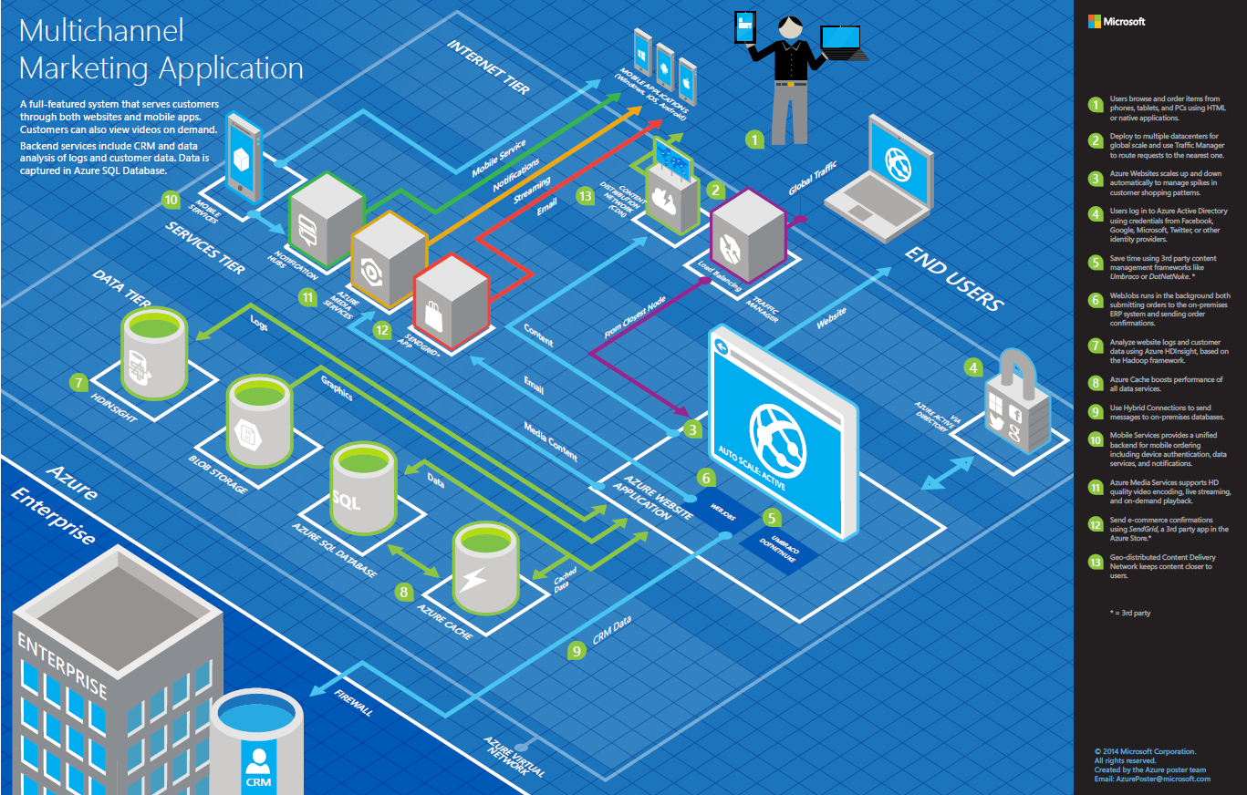

Slide 49
>57%
Greater than
1,000,000
>250k
Fortune 500 using Azure
Active websites
SQL Databases in Azure
>20
>1
TRILLION storage objects
>300
MILLION
AD users
MILLION
Developers registered with Visual Studio Online
>2
MILLION requests/sec
>13
BILLION
authentication/wk

Slide 50
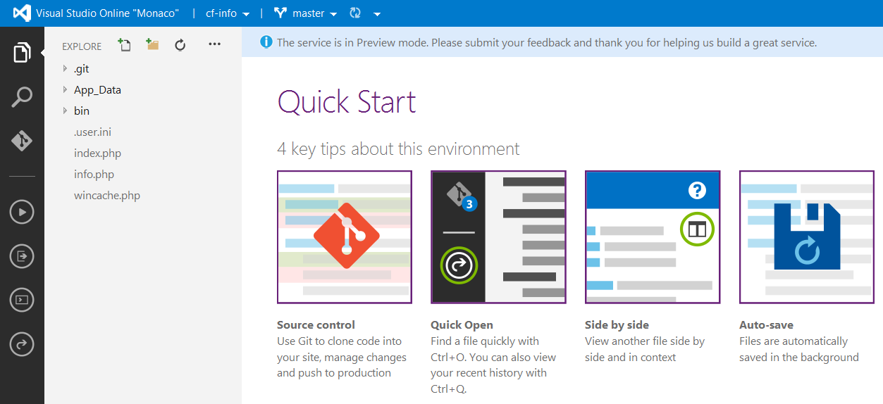
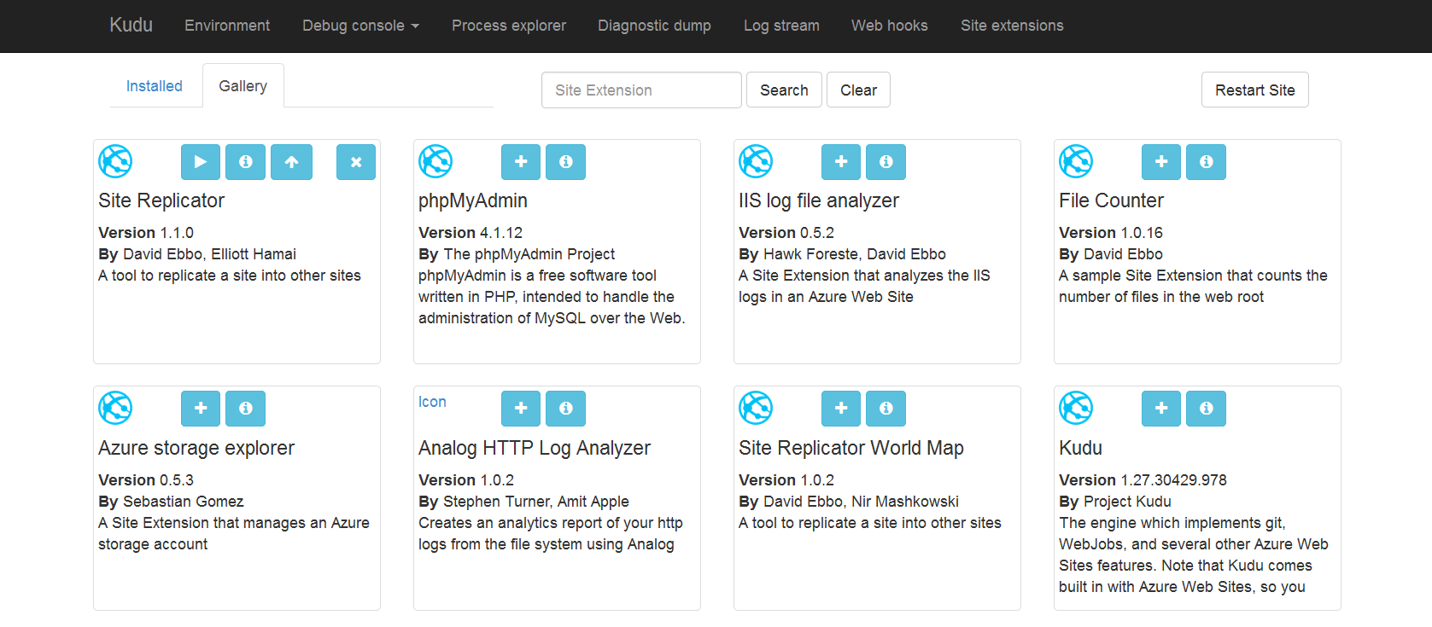
Site Extensions

Slide 51
WebSockets
Persistent Connection
Concurrent
Connections
5
35
350
Unlimited
Tier
Free
Shared
Basic / Standard
Premium

Slide 52


Web Hosting Plan
$
+
+
Azure Subscription
Pricing Tier
Geographic Region
Notes:
Web Hosting Plan is a scale unit for websites. It is comprised of a Geographic Region and a Pricing Tier within the same Azure Subscription. When you scale a site to either Basic or Standard all of the sites within the Web Hosting Plan will be placed on the same Virtual Machine.

