Slide 1
Central College News
Flash Weather Report Storyboard

Slide 2
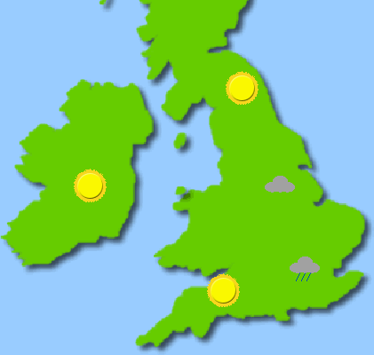
Monday
When the Monday button is clicked, this screen will show Mondays weather Report.

Slide 3

Tuesday
When the Tuesday button is clicked this will screen show Tuesdays Weather Report.

Slide 4

Wednesday
When the Wednesday button is clicked, this screen will show Mondays Weather Report.

