Slide 1
Central College News
Video News Report Storyboard

Slide 2
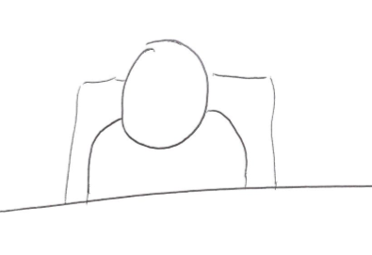
Scene One - Newsroom
The first scene will be a newsreader introducing the news report from a studio.

Slide 3
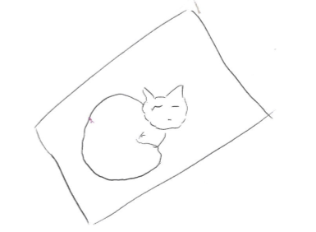
Scene Two – The Cats
The second scene will show cats sleeping and include commentary on how they have been spooked recently.

Slide 4

Scene Three – The Eyes
The third scene will show glowing eyes. The commentary will describe reports of a beast that has been spotted at night.

Slide 5
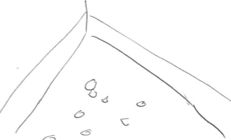
Scene Four – The Mess
The fourth scene will show a mess on the floor made up of dog food crumbs. The commentary will describe how the beast leaves a mess.

Slide 6
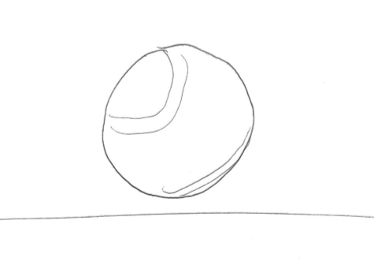
Scene Five – The Tennis Ball
The fifth scene will show a close up of a soggy tennis ball. The commentary will say that the beast leaves dribbly tennis balls lying around.

Slide 7
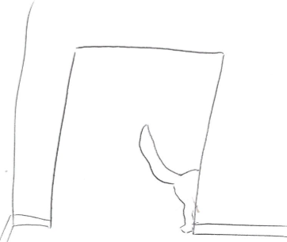
Scene Six – The Tail
The sixth scene will show a tail seen from behind a door frame. The commentary will say how some people say the beast is friendly.

Slide 8
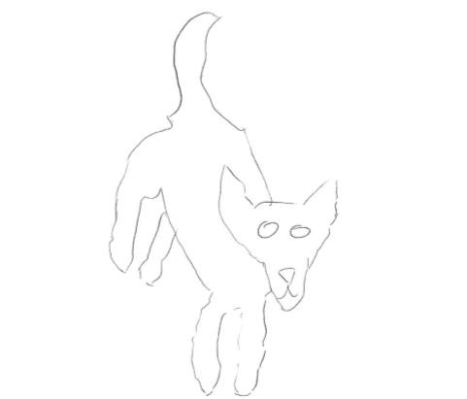
Scene Seven – The Approach
The seventh scene will show the beast running towards the camera.

Slide 9
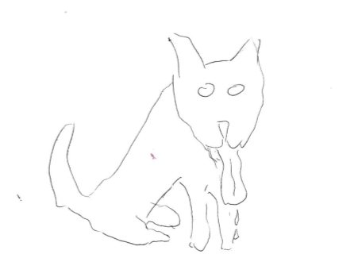
Scene Eight – The Placid Animal
The eighth scene will show the beast stood calmly in front of the camera. The commentary will say how the reporter found the beast to be placid.

Slide 10
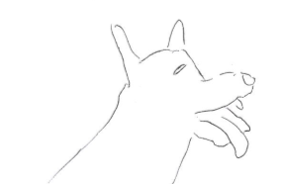
Scene Nine – The Yawn
The final scene will show the beast having a big yawn. The commentary will ask if the beast is really a danger.

