Slide 1

“AI” Focused Job Opportunities as of 05.19.2026
This Photo by Unknown Author is licensed under CC BY-SA-NC

Slide 2
Data Aggregation Process
All data comes from the LinkedIn Jobs search tool.
Data includes information on Global open roles.
Searches are based on keyword “AI”. This does not include a search using the key word AI ( without quotes).
“AI” searches render a smaller number of open roles compared to searches using AI.
Reasons –
“AI” with quotes: This is likely treated as an exact phrase search. The search engine looks for job postings that contain the exact term “AI” in the same order, without any variations. This can limit the results to those that match the phrase precisely.
AI without quotes: This search is more flexible. The search engine may include job postings that contain the term AI, but also variations of the term, related phrases, or even synonyms that the algorithm considers relevant. This can significantly increase the number of results because it’s not restricted to the exact phrase.

Slide 3
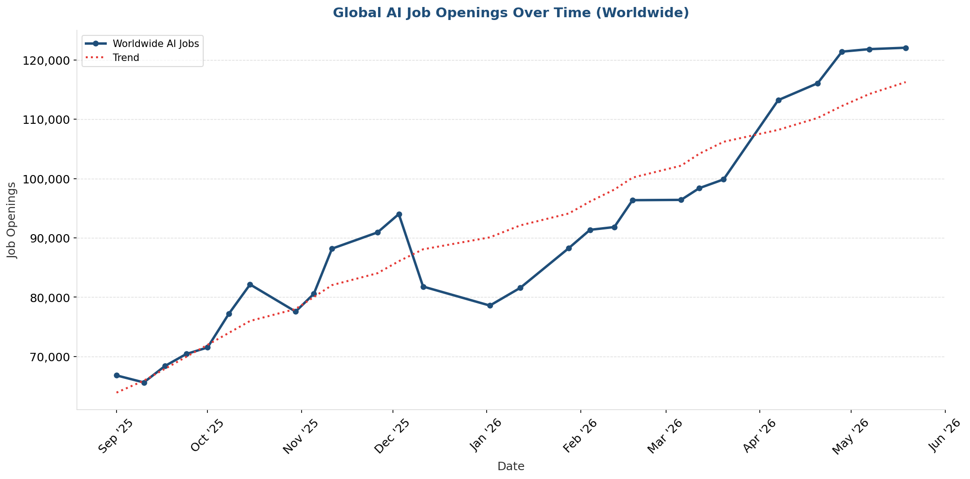
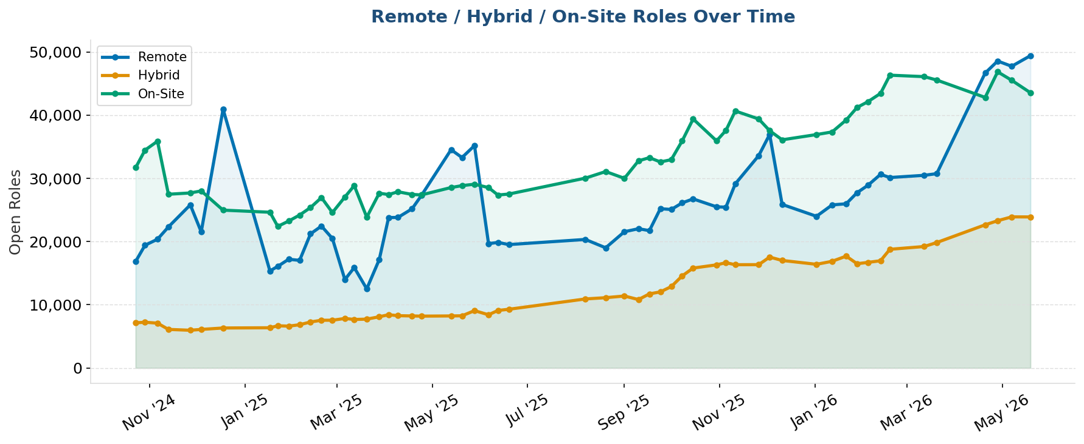
Global job data with “AI” as keyword

Slide 4
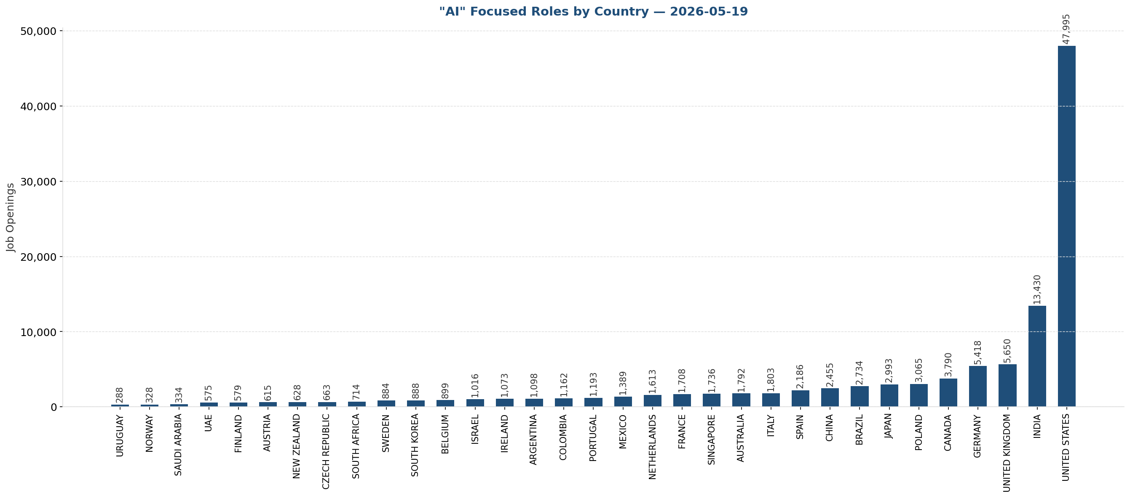
Global job data with "AI" as keyword by country

Slide 5
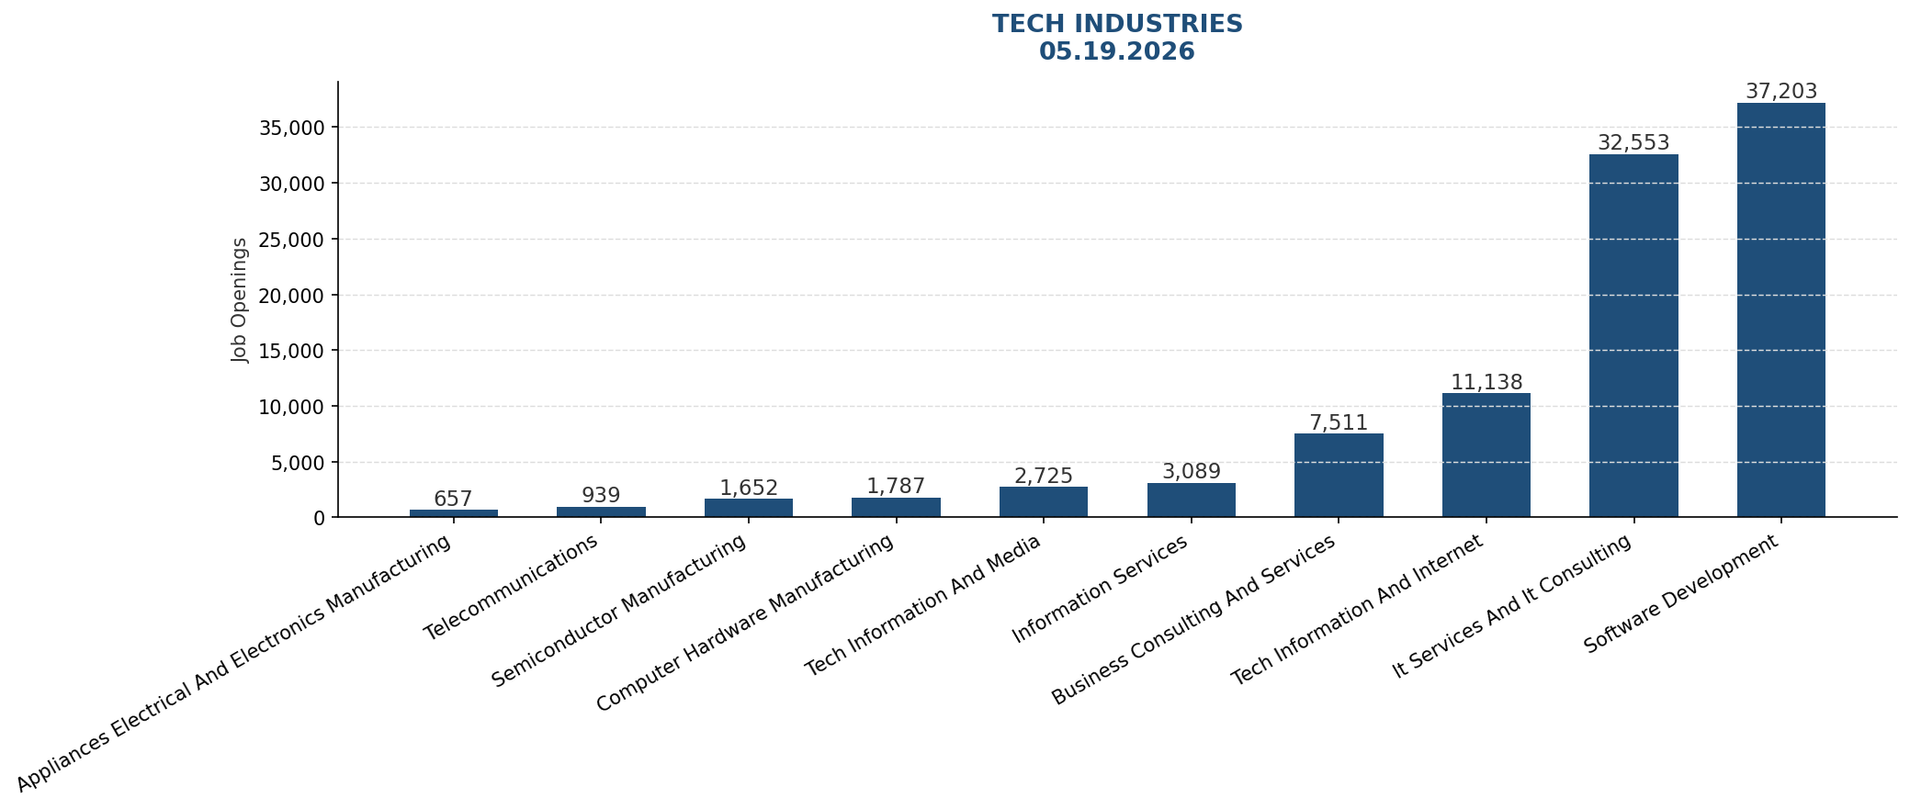
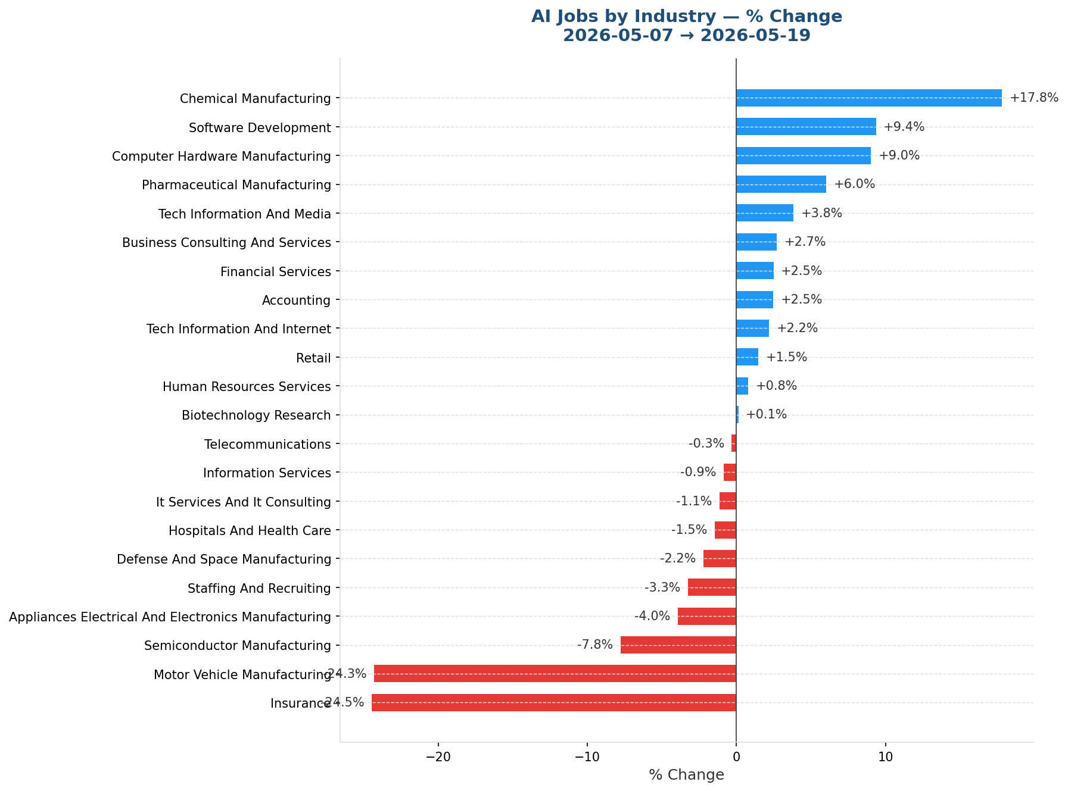
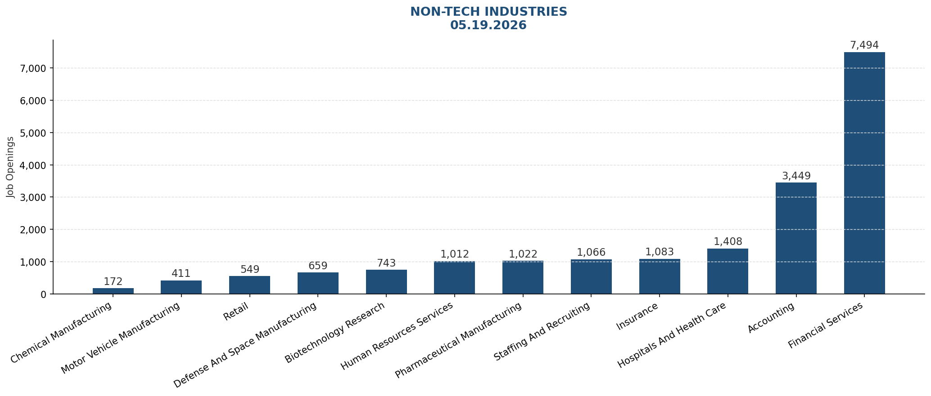
Global job data with "AI" as keyword – By Industry

Slide 6
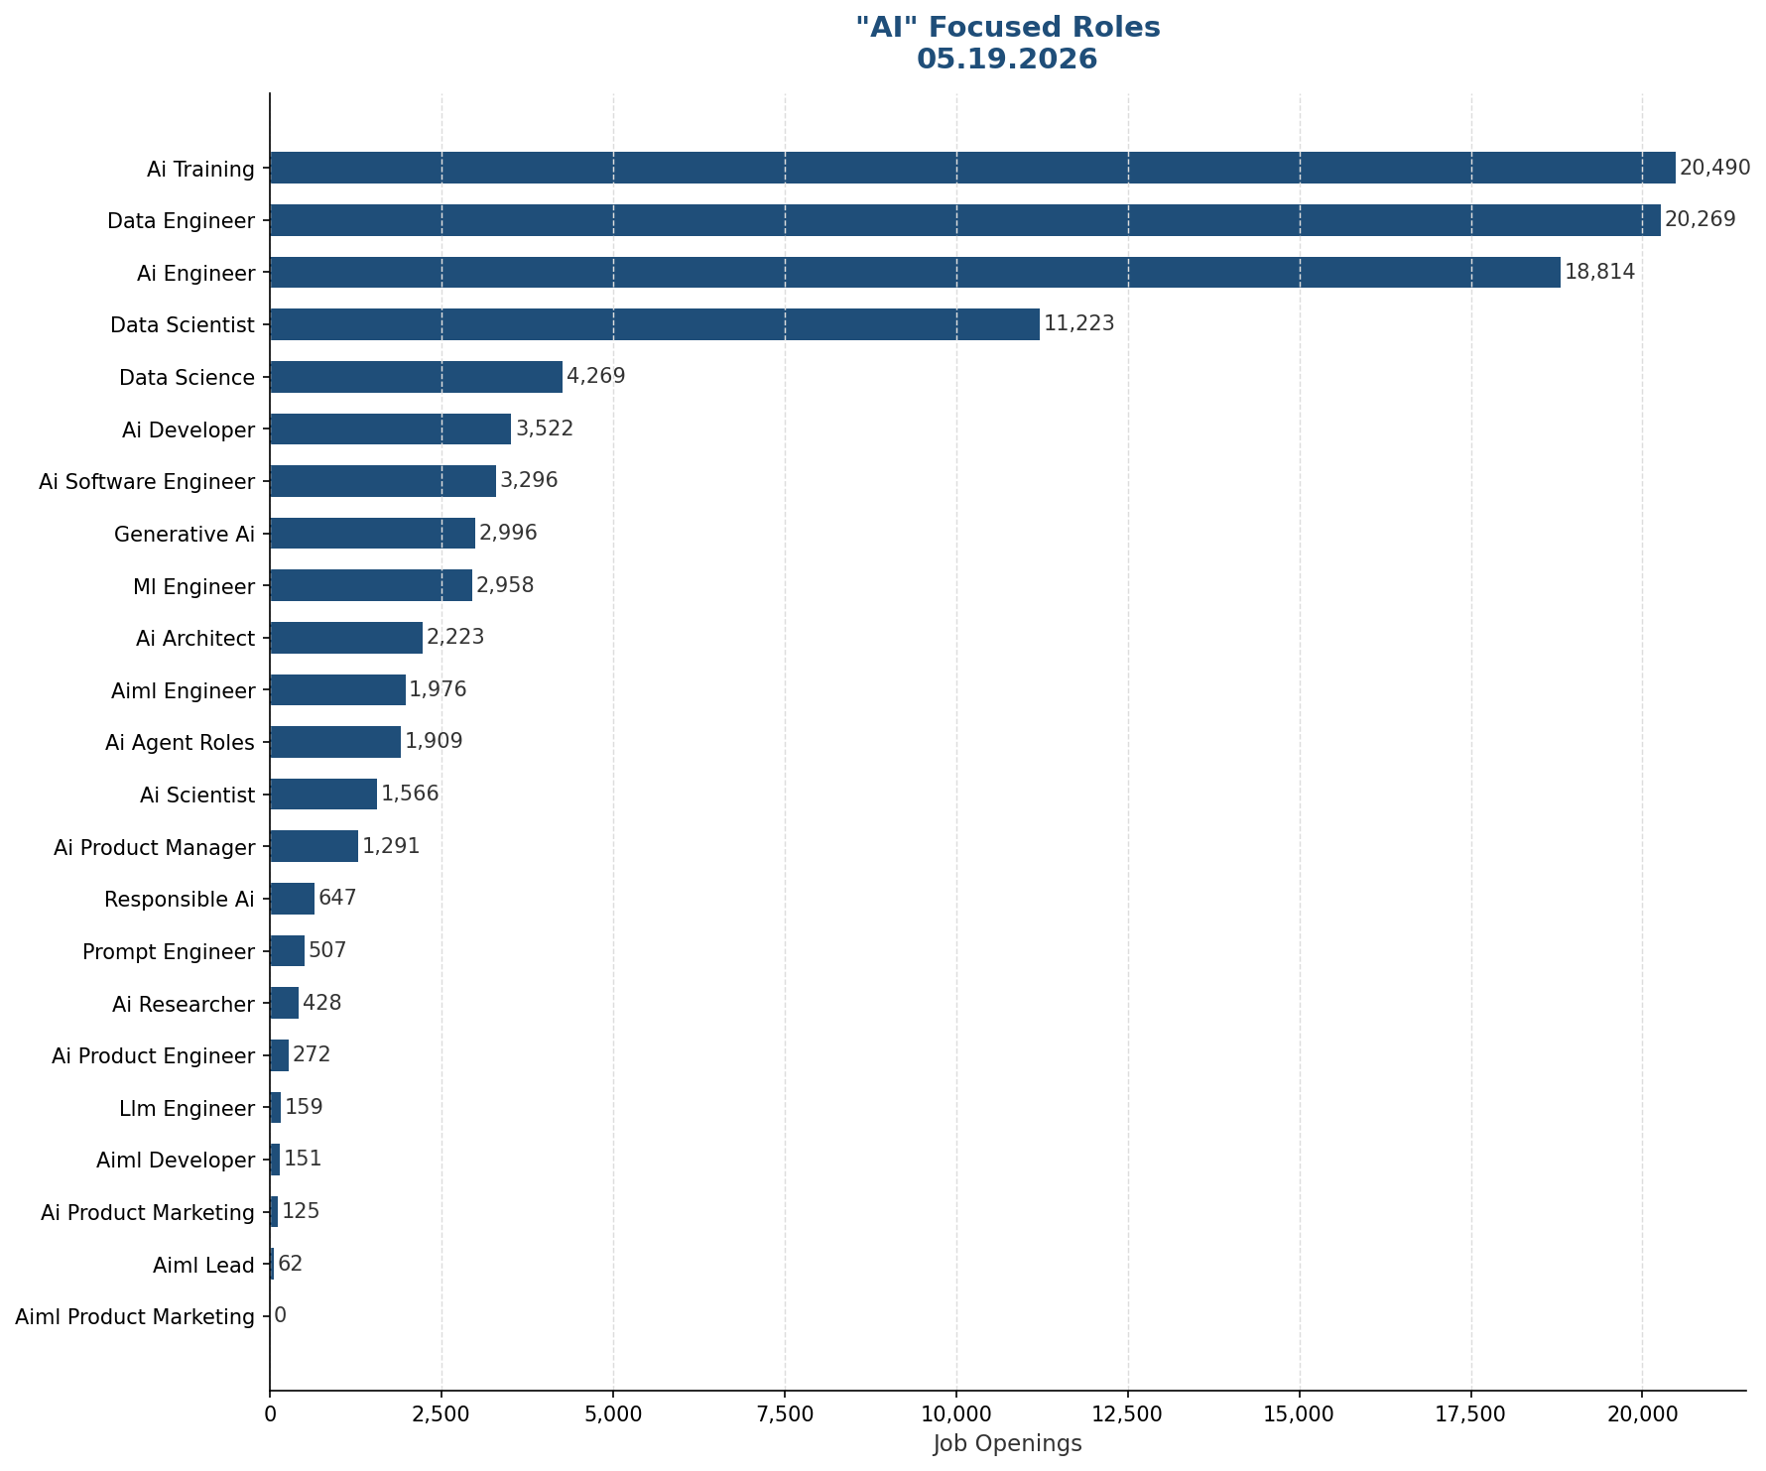
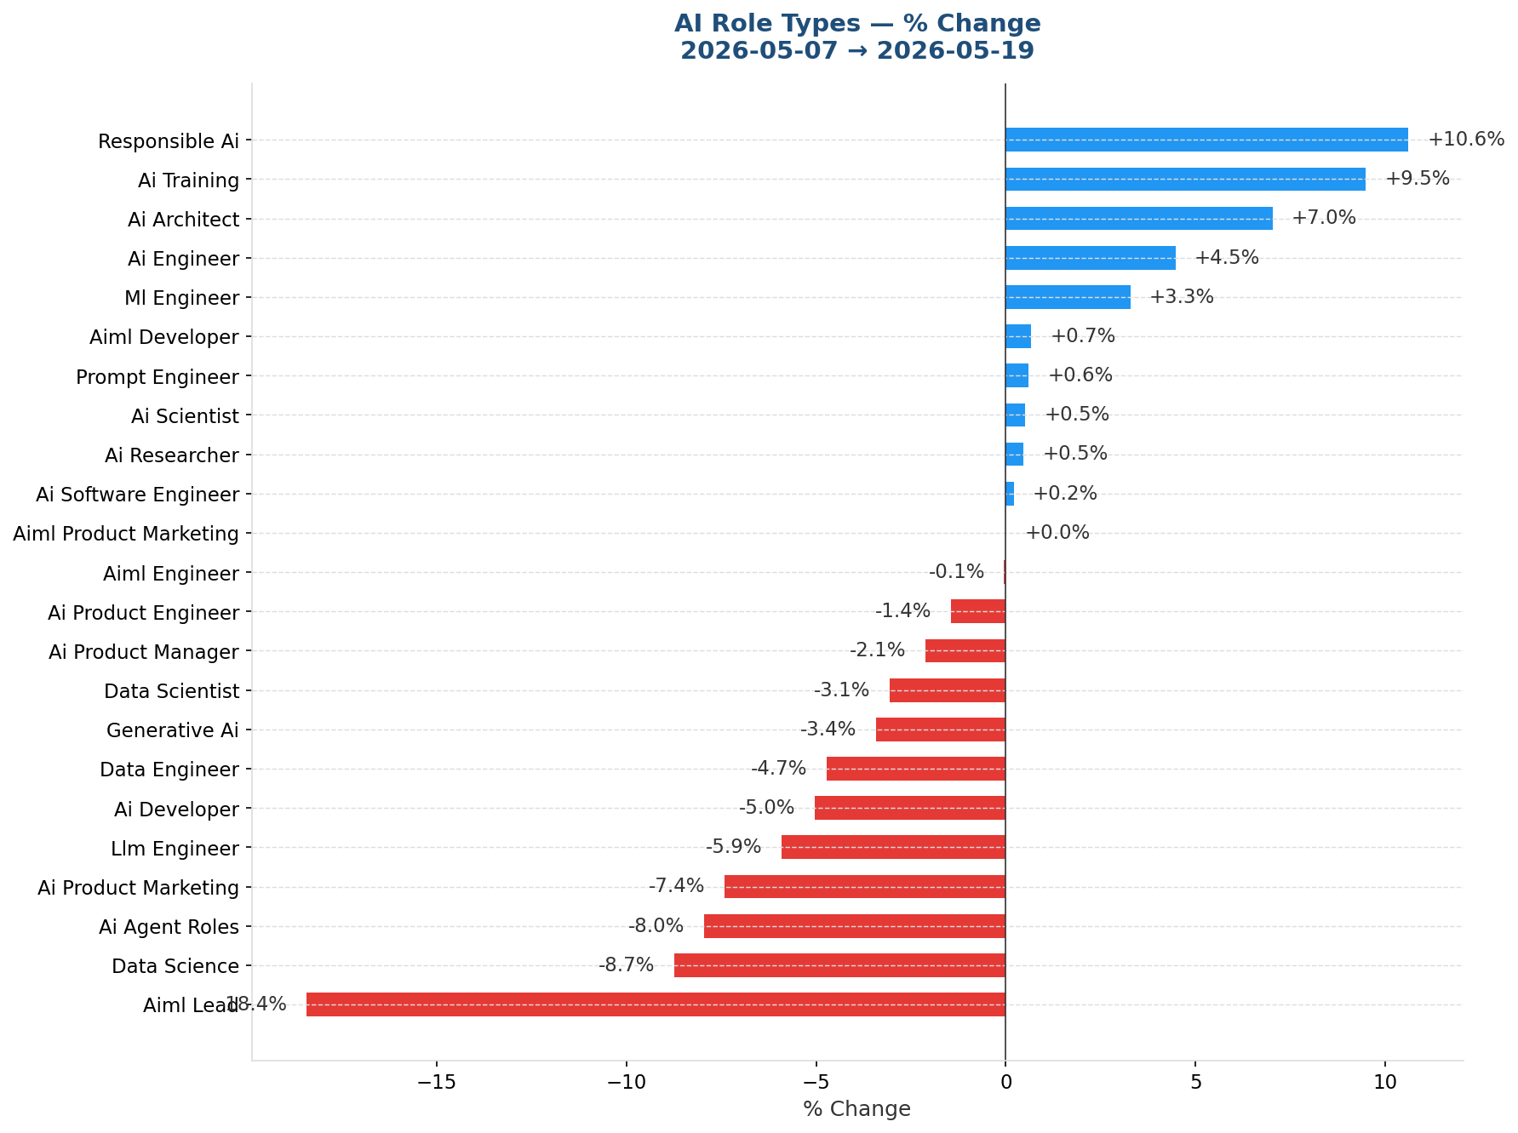
Global job data – AI titled roles

Slide 7
Keyword Search
Original keyword search | Adjusted keyword search
AI Product Marketing | "AI Product marketing" OR "Artificial Intelligence Product marketing" OR "AI marketing"
AI/ML Lead | "AI/ML Lead" OR "Artificial Intelligence lead" OR "Machine Leading Lead"
AI/ML Developer | "AI/ML Developer" OR "Developer AI/ML"
AI Agent roles | "AI Agent" OR "AI Agents"
AI Product Manager | "AI Product Manager" OR "Product Manager AI"
Prompt Engineer | "Prompt Engineer" OR "Prompt Engineering"
AI Researcher | "AI Researcher" OR "Researcher AI"
AI Scientist | "AI Scientist" OR "Scientist AI"
Responsible AI | "Responsible AI" OR "AI Governance" - the AI Governance is new
AI Architect | "AI Architect" OR "Architect AI"
AI Developer | "AI Developer" OR "Developer AI"
AI/ML Engineer | "AI/ML Engineer" OR "Engineer AI/ML"
ML engineer | "ML Engineer" OR "Engineer ML"
Generative AI | "Gen AI" OR "Generative AI"
AI Training | "AI Training" OR "AI Trainer"
AI engineer | "AI engineer" OR "Artificial Intelligence Engineer" OR "Engineer AI"
Data Science | "Data Science"
Data Scientist | "Data Scientist"
Data Engineer | "data engineer" OR "data engineering"
LLM Engineer | "LLM Engineer" OR "LLM Engineering"
AI Software Engineer | "AI software engineer" OR "AI software engineering" OR "software engineer AI"
AI Product Engineer | "AI product engineer" OR "Product engineer AI" OR "AI product engineering"
I adjusted my keyword search of AI titles based on below. This was done as I felt I was missing data points due to naming convention(s) used by differing companies.
Note- quotations around each group of words ensures the search renders roles specific to that title or the word grouping is in the job description.

Slide 8
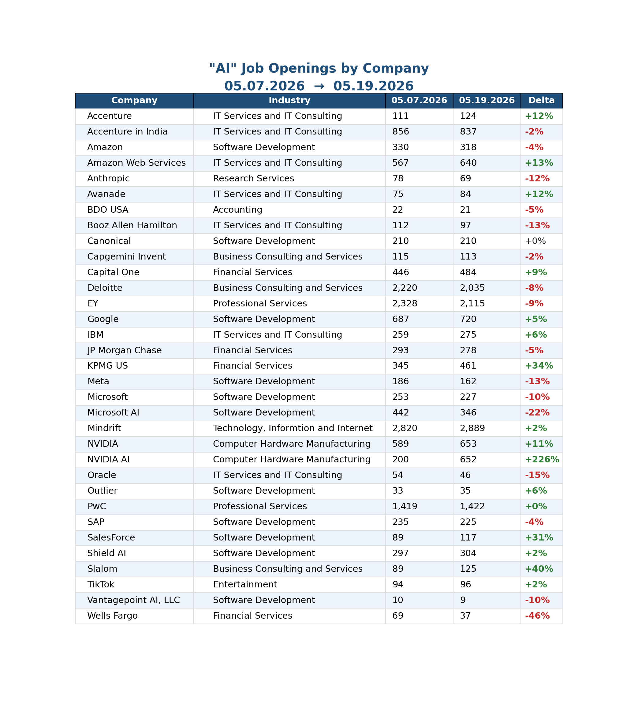
Global job data with "AI" as keyword –
Company highlights:

Slide 9
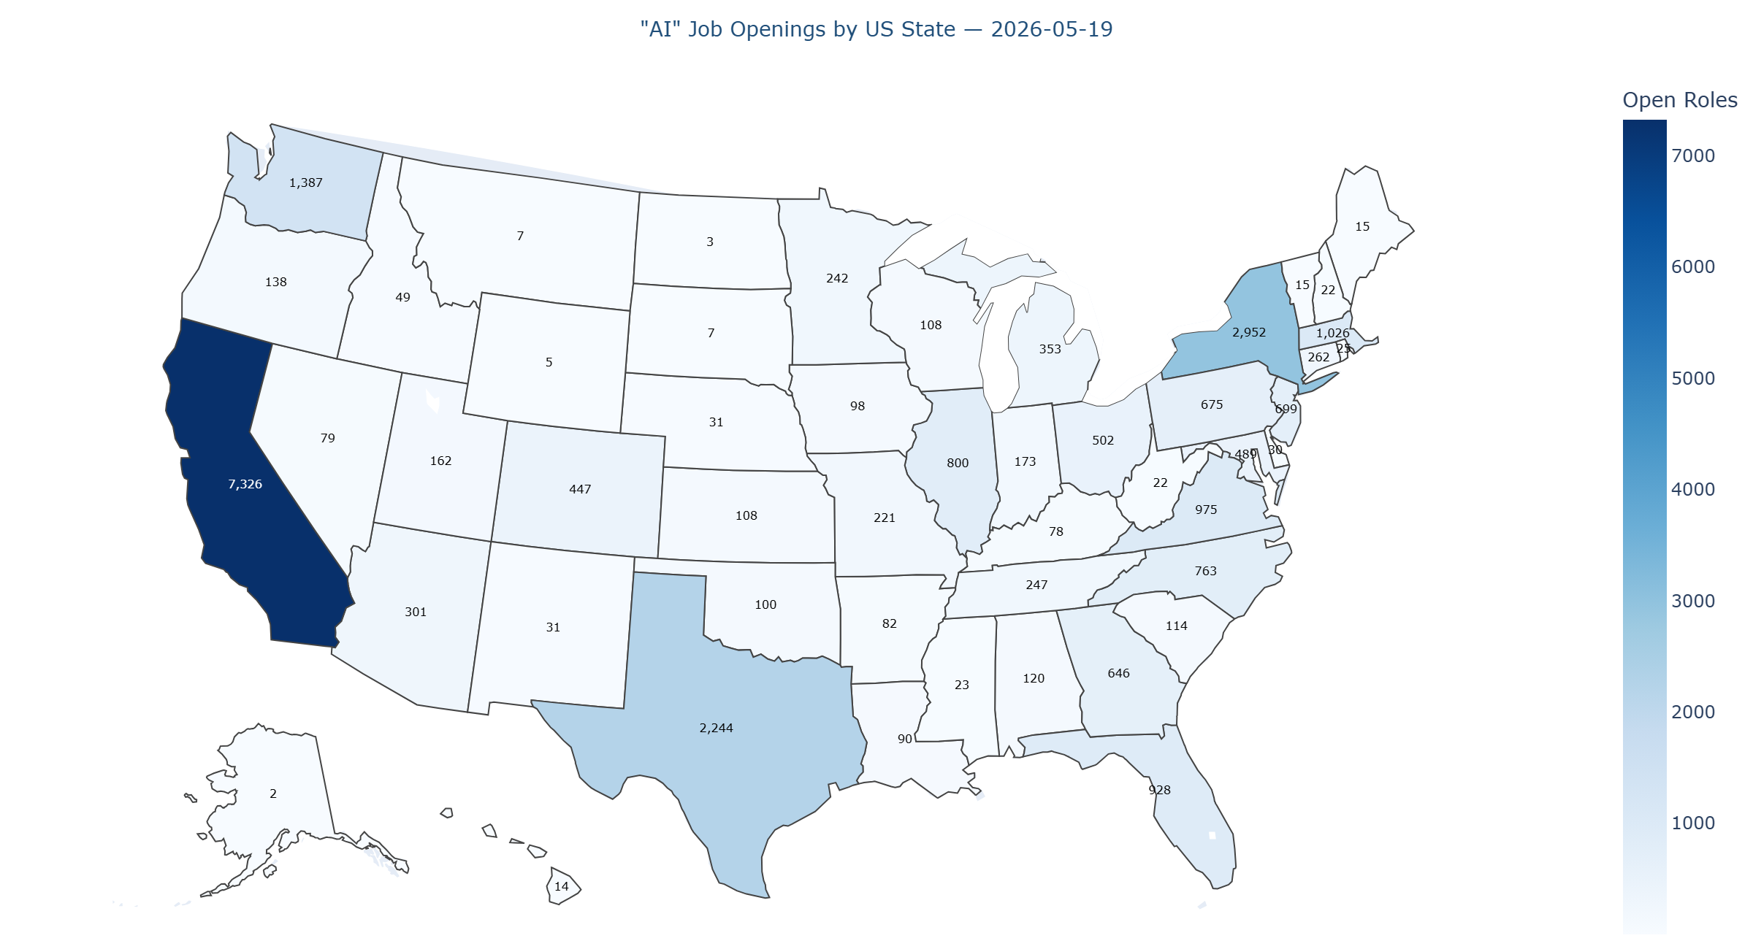
"AI" roles – United States
Remote roles are not included in the map visualization as they could be double counted. Meaning, the same role posted in multiple states.

Slide 10
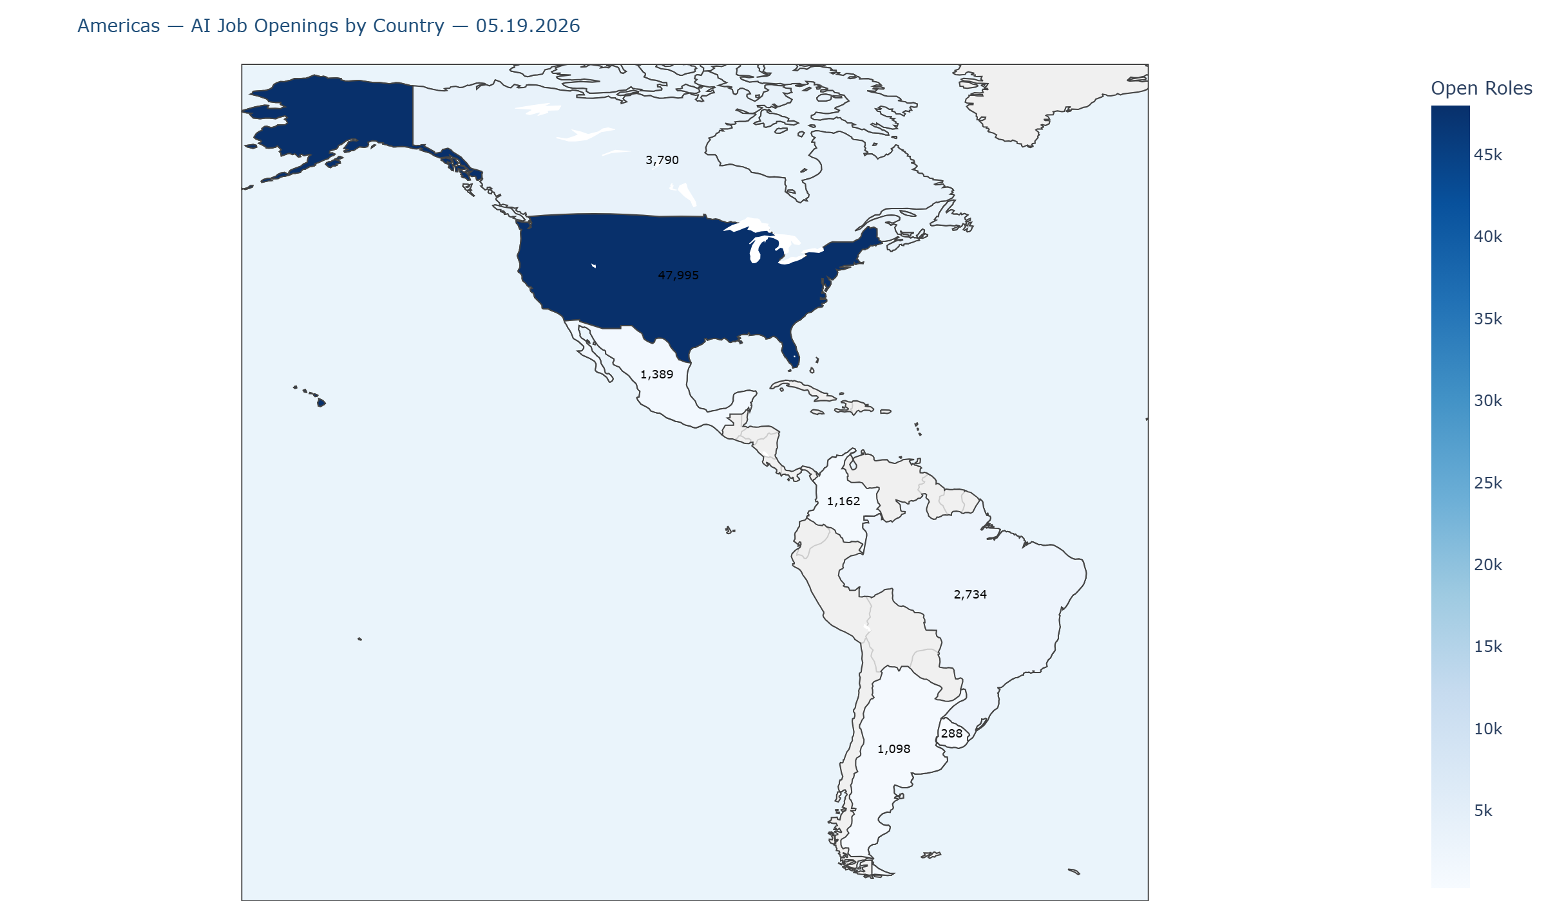
Americas — AI Job Openings by Country | 05.19.2026

Slide 11
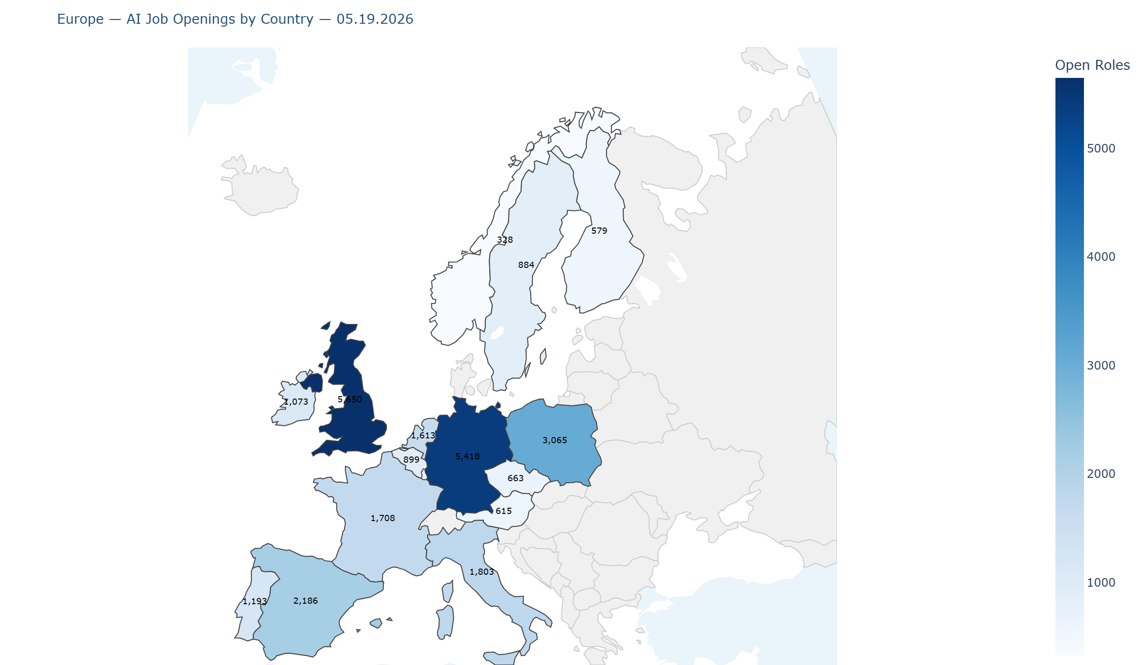
Europe — AI Job Openings by Country | 05.19.2026

Slide 12
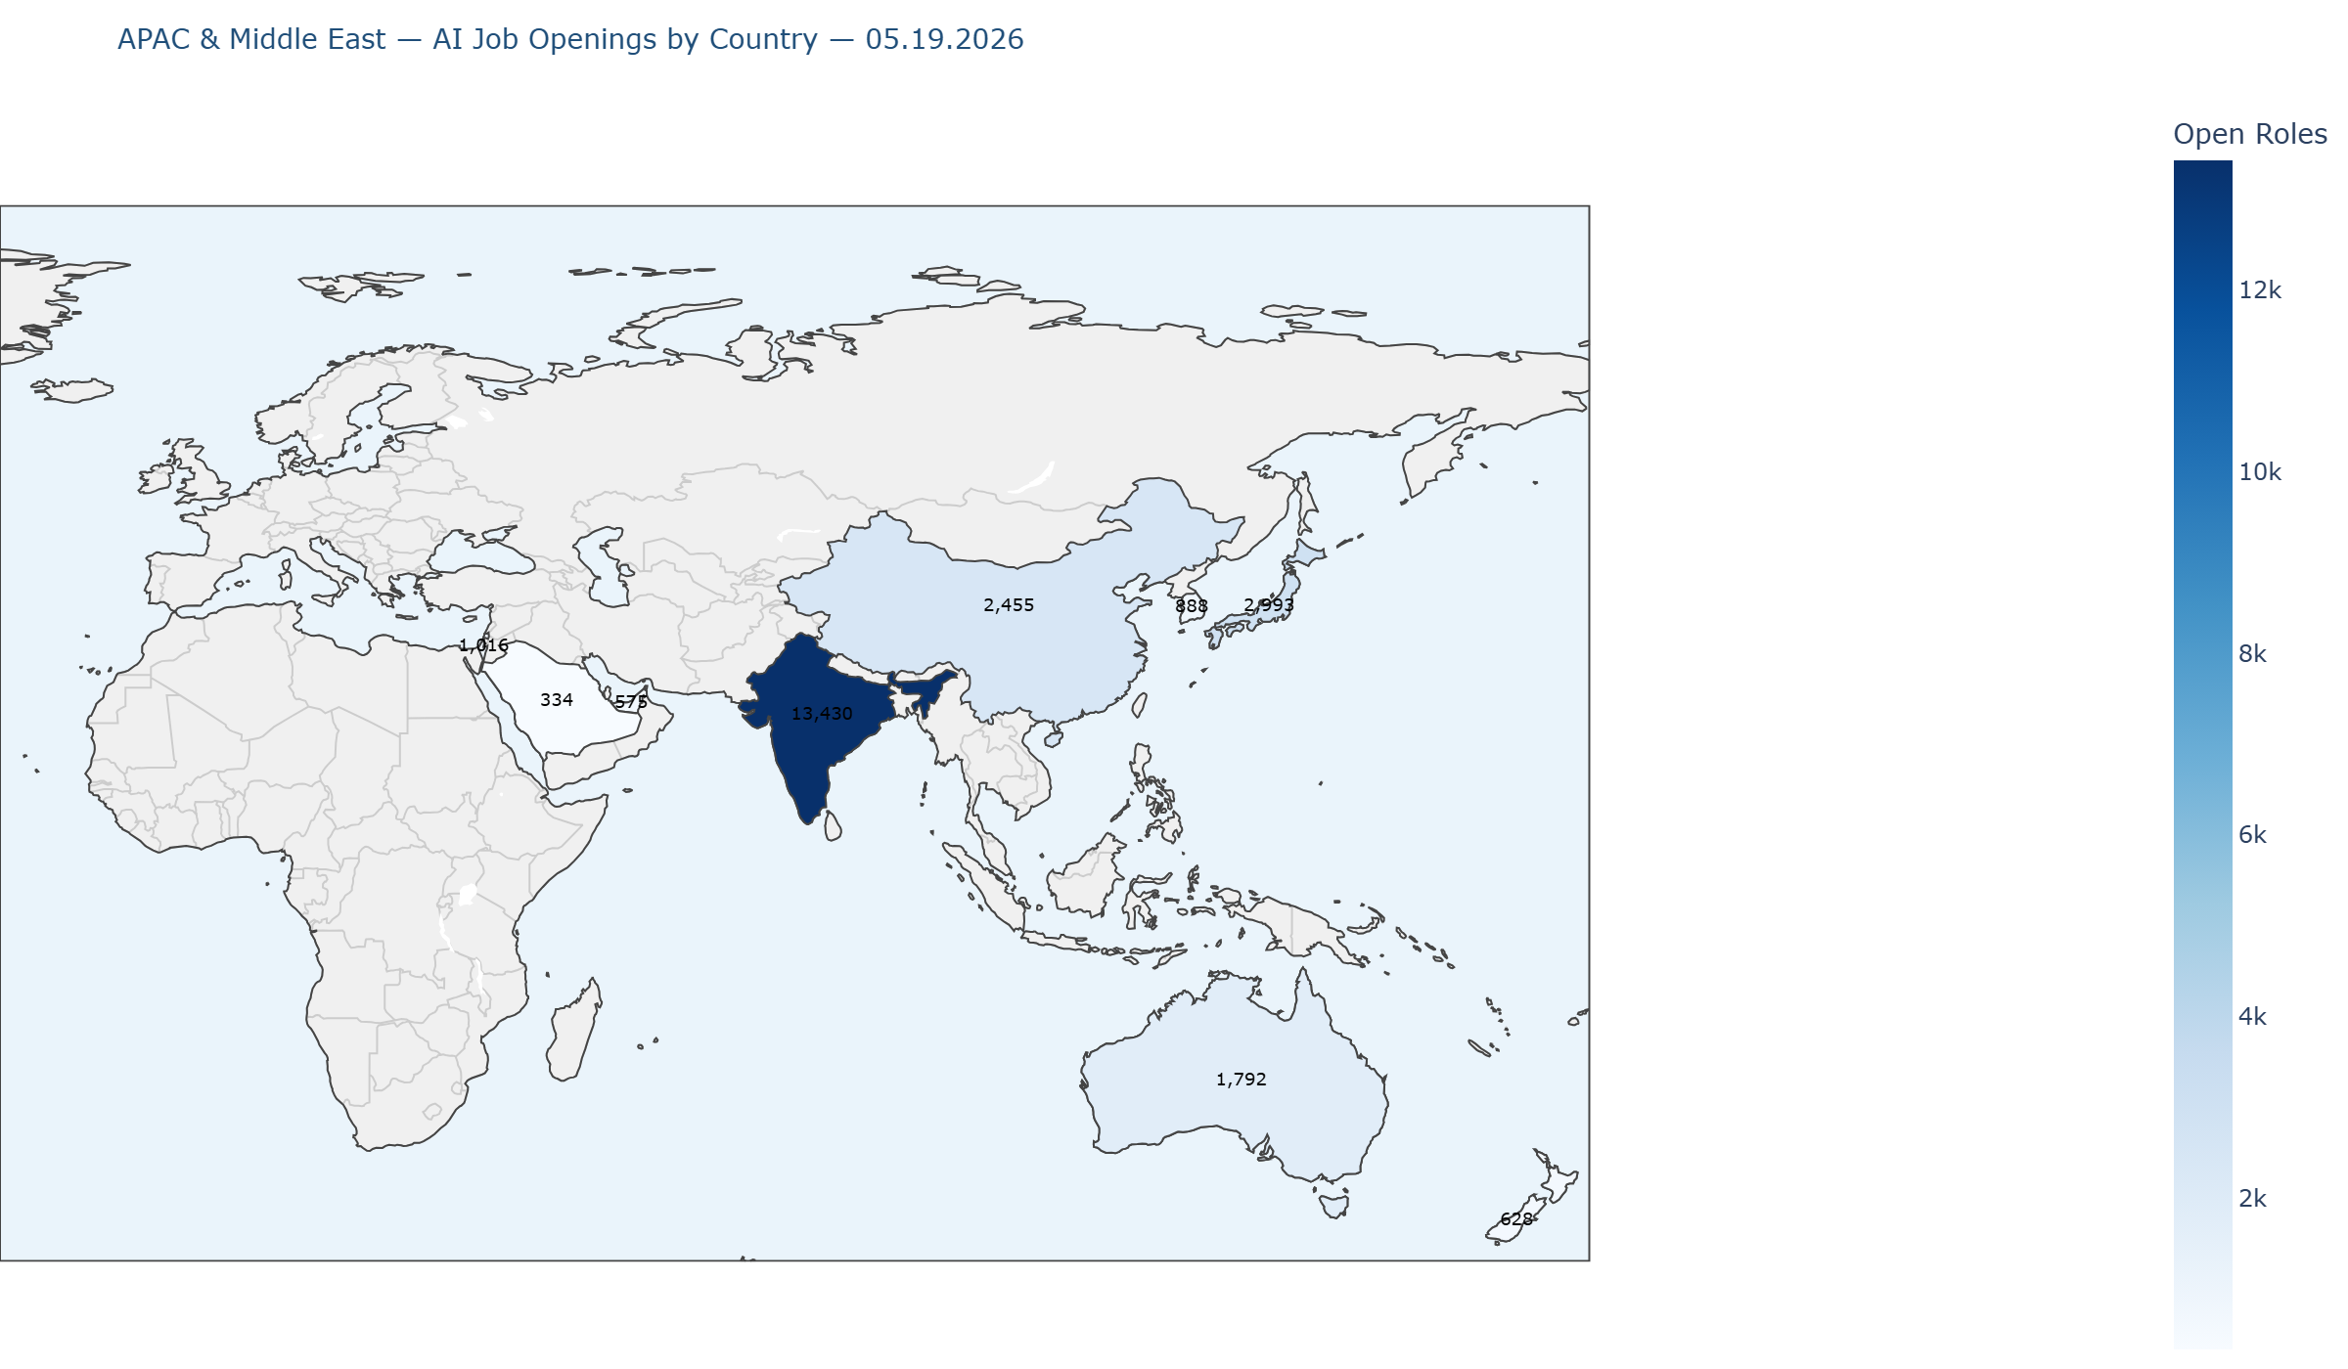
APAC & Middle East — AI Job Openings | 05.19.2026

