Slide 1
Maximizing Annual Memberships
Cyclistic Marketing Analyst Team
April 2023

Slide 2
Task
Develop strategies to maximizing the number of annual members for our bike-share program.
Approach
Analyze historical bike trip data to generate strategies for converting casual users to members.

Slide 3
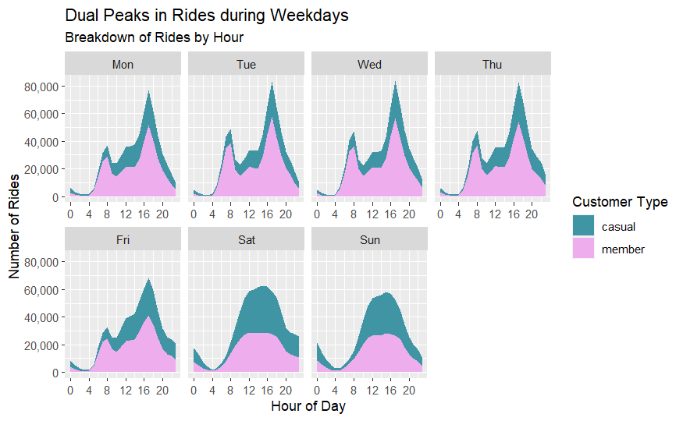
Similarities in behavior
Casual and member users both have peaks in usage during weekdays around the morning and evening.

Slide 4
Recommendation #1
Offer promotions during peak usage hours, such as discounted rates for members.

Slide 5
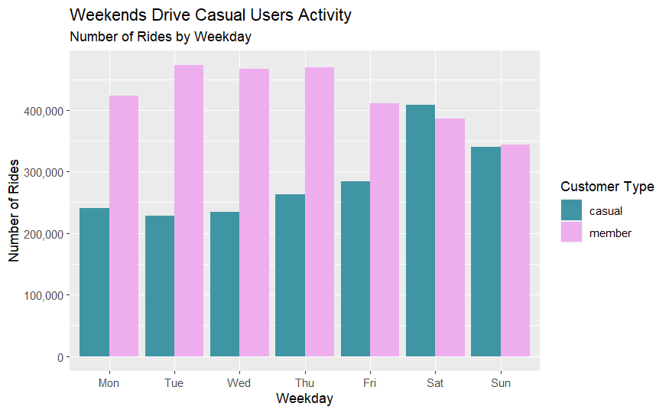
Differences in Frequency
Casual Users
Our casual users are most active during the weekends.
Members
There is a decline in the number of rides heading into the weekend.

Slide 6
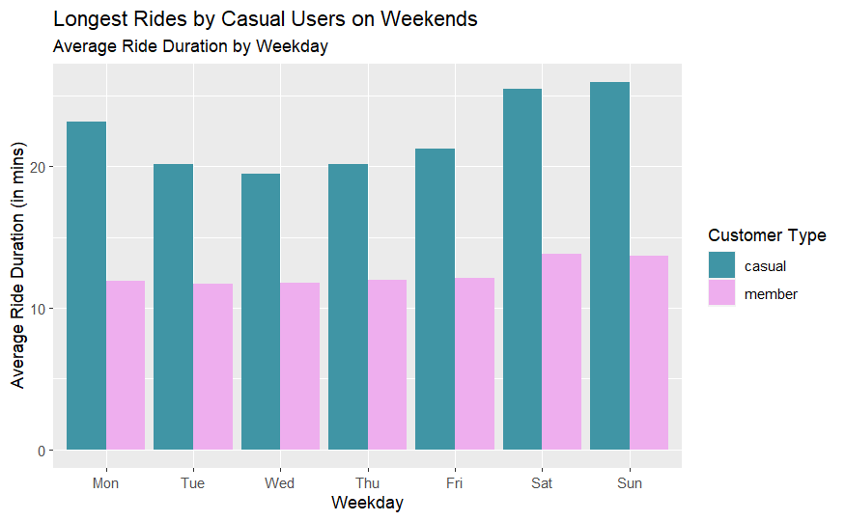
Difference in Ride Times
Casual Users
Our casual users had longest rides during the weekends
Members
In contrast, members show consistent ride times across weekdays indicating commuting patterns.
We observe a slight increase in ride duration amongst members on weekends.

Slide 7
Usage Patterns
Casual Users
Ride frequency and duration increase during weekends
This suggests that our service is a popular leisure activity during weekends, possibly influenced by tourism.
Members
Number of rides decreases over the weekend
Average ride duration increases during weekends
This pattern suggests members tend to take more leisurely rides on weekends.

Slide 8
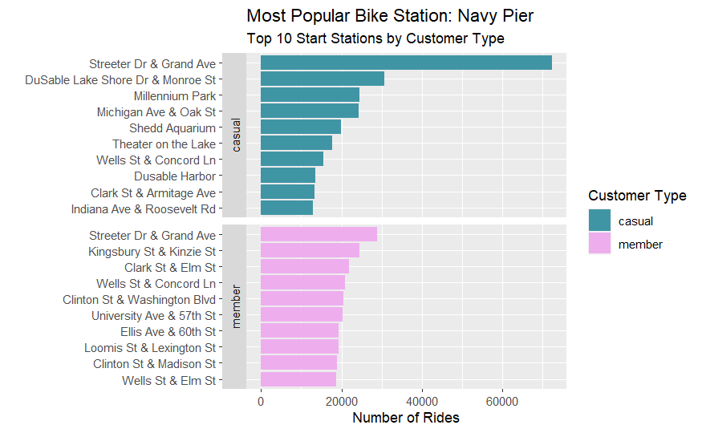
Top Location
Streeter Dr & Grand Ave Station is the most popular station amongst both users.

Slide 9
Recommendation #2
Implement specialized services or events for members during weekends, such as guided tours or group rides.
Hosting member-exclusive events at Navy Pier can increase the attractiveness of our membership option to casual riders and encourage current members to use the service more frequently on weekends.

Slide 10
Key Takeaways
In Summary
Casual riders are most active on the weekends.
Members show consistent ride times across weekdays indicating commuting patterns.
Members tend to take more leisurely rides on weekends, while casual riders may be influenced by tourism.
Streeter Dr & Grand Ave Station is the most popular station for both casual and member users, located in close proximity to Navy Pier.
Recommendations
Offering discounts during peak hours to incentivize casual users to convert to members.
Member events at Navy Pier on weekends can attract casual riders to become members and increase usage among existing members.

Slide 11
Thank You.

