Slide 1

Pointer 1
Computer Science Department
Eastern Washington University
Yun Tian (Tony) Ph.D.
CSCD 240 C and Unix

Slide 2
Recall
C Arrays
Two types
‘static’ Array
Dynamic Array
Their differences
How to use ‘static’ array in C program
CSCD 240 C and Unix

Slide 3
Today
Concept of address
Concept of pointers
How to define/declare pointers
How to use pointers?
CSCD 240 C and Unix

Slide 4
Motivation
Some C programming tasks are performed more easily with pointers.
Some tasks cannot be performed without using pointers.
Dynamic memory allocation.
Linked Structures like linked list and Tree
So it becomes necessary to learn pointers.
CSCD 240 C and Unix

Slide 5
Concept of Address
Every variable needs a memory location(as container),
We use the variable name to refer to the value stored in that container.
Every memory location has its address defined,
We can obtain the address by using ampersand (&) operator.
int age = 69;
Age is a variable, we use the variable name to refer to its value.
CSCD 240 C and Unix

Slide 6
Concept of Address
int age = 69;
age is a variable, we use the variable name to refer to its value,
That is, the variable name also refer to the value in container.
The box means the memory cells, the container, which holds the value of age
0x456789a0
age, 69
Outside of box means the memory address, an ID number assigned to this memory cell.
CSCD 240 C and Unix

Slide 7
Memory Allocation
int age = 69; in main() or in another function
The memory space (the box or the container below) for variable age is allocated automatically when system calls that function.
It is deallocated automatically once the function returns.
The box means the memory cells, the container, which holds the value of age
0x456789a0
age, 69
Outside of box means the memory address, an ID number assigned to this memory cell.
CSCD 240 C and Unix

Slide 8
Concept of Address
#include <stdio.h>
int main ()
{
int var1;
char arr[4] = { ’a’, ’b’, ’c’, ’d’};
printf("Address of var1 variable: %x\n", &var1 );
printf(”Value of arr: %x\n", arr );
printf("Address of arr[0] variable: %x\n", &arr[0] );
printf("Address of arr[1] variable: %x\n", &arr[1] );
printf("Address of arr[2] variable: %x\n", &arr[2] );
printf("Address of arr[3] variable: %x\n", &arr[3] );
return 0;
} //Demo pointerArray.c
CSCD 240 C and Unix

Slide 9
Concept of Address
Output of the program
Address of var1 variable: 5b7b8be8
Value of arr: 5b7b8be4
Address of arr[0] variable: 5b7b8be4
Address of arr[1] variable: 5b7b8be5
Address of arr[2] variable: 5b7b8be6
Address of arr[3] variable: 5b7b8be7
5b7b8be4
5b7b8be5
5b7b8be6
5b7b8be7
arr[0] | arr[1] | arr[2] | arr[3]
We observe that &arr[0] and arr return the same value.
That means the array name arr could be used as the array base address.
CSCD 240 C and Unix

Slide 10
Concept of Address
#include <stdio.h>
int main ()
{
int var1;
int arr[4];
printf("Address of var1 variable: %x\n", &var1 );
printf(”Value of arr: %x\n", arr );
printf("Address of arr[0] variable: %x\n", &arr[0] );
printf("Address of arr[1] variable: %x\n", &arr[1] );
printf("Address of arr[2] variable: %x\n", &arr[2] );
printf("Address of arr[3] variable: %x\n", &arr[3] );
return 0;
}
CSCD 240 C and Unix

Slide 11
Concept of Address
Output of the program
Address of var1 variable: 5cc9ebe0
Value of arr: 5cc9ebd0
Address of arr[0] variable: 5cc9ebd0
Address of arr[1] variable: 5cc9ebd4
Address of arr[2] variable: 5cc9ebd8
Address of arr[3] variable: 5cc9ebdc
5cc9ebd0
5cc9ebd4
5cc9ebd8
5cc9ebdc
arr[0] | arr[1] | arr[2] | arr[3]
We observe that &arr[0] and arr return the same value.
That means the array name arr could be used as the array base address.
CSCD 240 C and Unix

Slide 12
Concept of Address
What are the new output after we change the array type from char array to integer array?
What changes have you observed ?
CSCD 240 C and Unix

Slide 13
Concept of Pointer
A pointer is a variable whose value is the address of another variable.
Normally, a regular variable directly contains a specific value.
Use variable name to retrieve its value.
A pointer, on the other hand, contains an address of a variable.
CSCD 240 C and Unix

Slide 14
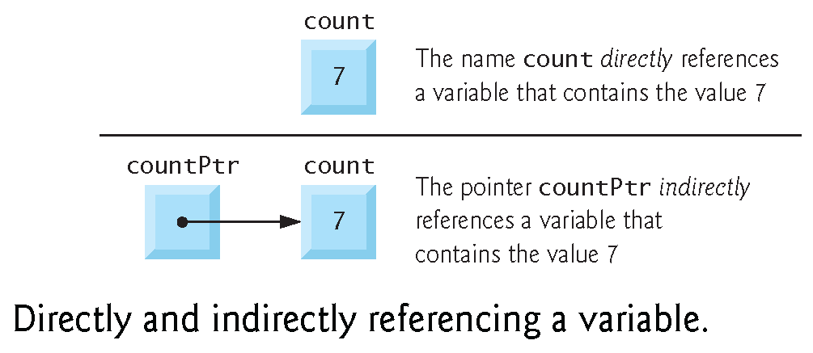
Concept of Pointer
In this sense, a variable name directly references a value, and a pointer indirectly references a value.
Referencing a value through a pointer is called indirection or dereferencing a pointer.
count
7
countPtr=&count
count
7
CSCD 240 C and Unix

Slide 15
Define Pointer Variables
Like any variable or constant, you must define a pointer before you can use it to store any variable address.
To define/declare a pointer variable,
type * ptrName;
type is the data type in the container at the address of ptrName; it must be a valid C data type
ptrName is the name of the pointer variable.
The asterisk * you used to declare a pointer.
CSCD 240 C and Unix

Slide 16
Define Pointer Variables
E.g.
int *ip;
pointer to an integer, variable ip should hold an address of another integer variable( array element).
double *dp;
pointer to a double
float *fp;
pointer to a float
char *ch
pointer to a character
CSCD 240 C and Unix

Slide 17
Initialize Pointer
int age=10; →memory allocated automatically
int * iptr; →in main or in the same function as previous statement.
iptr = &age;
After this assignment, iptr points to variable age.
0x0033448a
0x3456789c
iptr
0x0033448a
age, 10
CSCD 240 C and Unix

Slide 18
Initialize Pointer
In C programming, we usually don’t care about the specific value that a pointer variable holds(in binary format), but we really care about which variable it currently points to.
Next class, we will learn this,
int arr[4] = { 1, 2, 4, 9};
int *iptr = arr;
0x0033448a
0x3456789c
iptr
0x0033448a
age, 10
CSCD 240 C and Unix

Slide 19
Use Pointer
Typical way to use a pointer variable,
(a) we define a pointer variable
(b) assign the address of a variable to the pointer
(c) finally access the value at the memory address specified by the pointer variable.
We say ‘access the value that the pointer points to’.
CSCD 240 C and Unix

Slide 20
Use Pointer
Step (c) is done by using unary operator * that returns the value of the variable located at the address specified by its operand.
Dereferencing a pointer
E.g.
int a = 10;
int *ptr = &a;
int total=3 + *ptr;
*ptr = 100; //this changes the value of variable a
*ptr, return the value of variable a, because ptr points to a, or because ptr holds the address of variable a.
CSCD 240 C and Unix

Slide 21
Use Pointer
*ptr, is to dereference pointer ptr.
That is, it returns the value at the memory address held in the variable ptr.
More simply, *ptr, returns the value that ptr variable points to.
If you draw this picture above, actually *ptr operation, will follow the arrow from ptr box, and return the value in the box to which the arrow points.
0x0033448a
0x3456789c
ptr
0x0033448a
a, 10
CSCD 240 C and Unix

Slide 22
Use Pointer
int a = 10;
int b = 20;
int *ptr = &a;
ptr = &b; //this changes the value in ptr itself
//Making ptr points to b, not a any more.
*ptr = 300; //This changes what ptr points to.
0x0033448a
0x3456789c
ptr
0x0033448a
b, 300
CSCD 240 C and Unix

Slide 23
Use Pointer
int a = 10;
int b = 20;
int *ptr = &a;
ptr = &b;
*ptr = 300; //This changes what ptr points to.
printf(“%x”, ptr); //What does it display?
printf(“%d”, *ptr); //What does it display?
0x0033448a
0x3456789c
ptr
0x0033448a
b, 300
CSCD 240 C and Unix

Slide 24
Memory Allocation
int * iptr; in main or in a function,
The memory space for holding a memory address is allocated automatically for variable iptr.
When the function returns, that memory space (the box for iptr itself) is deallocated automatically. But, the memory that iptr points to is not included in this deallocation operation.
0x00833877
0x3456789c
iptr
0x00833877
age=65
CSCD 240 C and Unix

Slide 25
Before Initialized
int * iptr; in main or in a function,
After we create the pointer, before we initialize it, it could contains arbitrary(junk) memory address.
In other word, iptr right now points to arbitrary memory location.
If you dereference it before initialized, you may get Segmentation Fault.
Iptr
0x00833877
0x00833877
0x3456789c
Arbitrary Mem cell
CSCD 240 C and Unix

Slide 26
Demo
pointer1.c
CSCD 240 C and Unix

Slide 27
Summary
Concept of address
Concept of pointers
How to define/declare pointers
How to use pointers?
CSCD 240 C and Unix

Slide 28
Next Class
Pointer arithmetic
CSCD 240 C and Unix

