Slide 1

C Structure and typedef
Computer Science Department
Eastern Washington University
Yun Tian (Tony) Ph.D.
CSCD 240 C and Unix

Slide 2
Recall Last Lecture
File I/O
Strings
1D char array with ‘\0’ at the end
Or char * points to a piece of memory
CSCD 240 C and Unix

Slide 3
Today Lecture
Structure
typedef
CSCD 240 C and Unix

Slide 4
Structure
C arrays allow you to define type of variables that can hold several data items of the same type,
C structure is another user-defined data type available in C programming,
it allows you to combine data items of different kinds.
C Structure is like a Java class without methods(operations)
CSCD 240 C and Unix

Slide 5
Structure
Structures are used to represent a record,
Suppose you want to keep track of your books in a library.
You might want to track the following attributes about each book:
Title
Author
Subject
Book ID
CSCD 240 C and Unix

Slide 6
Examples of Structure
struct Book // Book here is structure tag,
{ // ‘struct Book’ together are used to define a type.
char title[50]; //member of structure, static array
char *author; //member of structure, char pointer
char subject[100];
int book_id;
};
struct Book myText; //define myText of type struct Book
struct Book mathText; // myText and mathText have same type
CSCD 240 C and Unix

Slide 7
Examples of Structure
//members can be structures
struct triangle
{
struct point ptA;
struct point ptB;
struct point ptC;
};
struct point
{
int x;
int y;
int z;
};
CSCD 240 C and Unix

Slide 8
Examples of Structure
//members can be self referential
struct chain_element
{
int data ;
struct chain_element ∗next ;
};
// what does this data structure look like? Looks familiar?
CSCD 240 C and Unix

Slide 9
Access Structure Members
To access any member of a structure variable, we use the member access operator (.)
The member access operator is coded as a period between the structure variable name and the structure member that we wish to access.
Like we learned in java.
myText.title; //value is supposed to be a char array name or base address.
CSCD 240 C and Unix

Slide 10
Structure as function argument
You can pass a structure variable as a function argument in very same way as you pass any other primitive variables.
You would access members in a structure variable as shown on previous slide.
Demo are shown later!
CSCD 240 C and Unix

Slide 11
Static Array of Structure
You can define array of structures in very similar way as you define array of other types. E. g.
char name[100];//can hold up to 100 characters
struct Book books[10];
//defines an array of structures, can hold up to 10 instances of struct Book type.
Both name and books array are static array, memory are allocated and deallocated automatically.
CSCD 240 C and Unix

Slide 12
Pointer to Structure
You can define pointers to structures in very similar way as you define pointer to any other primitive variable as follows, E.g.
char * name = (char *) malloc( 100 * sizeof(char) );
struct Book *bookPointer;
bookPointer = (struct Book *) malloc ( 10 *
sizeof(struct Book) );
//dynamic memory allocation, have to call free() to deallocate.
CSCD 240 C and Unix

Slide 13
Pointer to Structure
E.g.
struct Book *myText;
struct Book mathText; //memory allocated automatically for mathText;
//initialize myText, assign address of mathText to myText.
myText = & mathText;
Then, we can use myText to access members in mathText.
(*myText).title //dereference then member access
// retrieve the title of what myText point to
//type of the whole expression is supposed to be a char array, according to what we have defined on slide 6.
CSCD 240 C and Unix

Slide 14
Pointer to Structure
(*myText).title //dereference then member access
This format or syntax looks ugly.
NOTE: the () around *myText is required in this context.
Which means (*myText).title differs from *myText.title.
.(dot) has a higher precedence than * (dereferencing).
*myText.title is actually equivalent to *(myText.title). The latter is in wrong syntax because myText is not a structure variable and . operator only applied to a structure variable.
What does the syntax of *(mathText.title) look like ? //we have demo.
CSCD 240 C and Unix

Slide 15
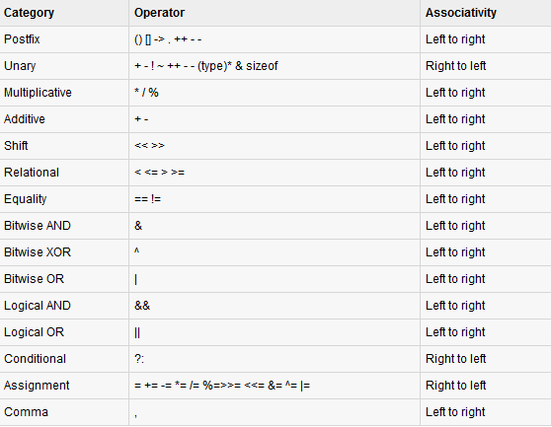
Pointer To Structures
CSCD 240 C and Unix

Slide 16
Pointer to Structure
(*myText).title //dereference then member access
This format or syntax looks ugly.
In c, we can use -> operator for structure pointers when accessing members.
access the members of a structure using a pointer to that structure.
HERE: (*myText).title is the same thing as myText->title
Both of two expressions return a char array.
-> operator combines two operations: deference first, then access the member to the right of the operator.
CSCD 240 C and Unix

Slide 17
Review pointer
int a[] = {2, 3, 4 ,5 };
int *p = a;
*p ++; //what is value of this expression here?
// *p ++ is equivalent to *(p++) according to precedence table
// return what p points to, then move p to next integer. the whole expression returns 2, then after this expression is executed, p points to integer 3 in the array a;
Two more questions
(*p) ++; //what is value of this expression?
*(p++); //what is value of this expression?
CSCD 240 C and Unix

Slide 18
Review pointer
int a[] = {2, 3, 4 ,5 };
int *p = a;
(*p) ++; //what is value of this expression?
dereference p first,
Meaning the value at the memory location that p points to( p holds) will be incremented by one.
The whole expression returns 2;
After this statement is executed, p stays the same place.
Pointing to the first element in array a;
But this array element has been changed in this statement.
CSCD 240 C and Unix

Slide 19
Demo of Structures
CSCD 240 C and Unix

Slide 20
Summary
Structures
How to define structure type?
Like a java object without methods in it.
Access members using .
→ operator only used with structure pointers
Very careful when dealing with pointer members in a structure instance.
Prepare memory FIRST for each pointer member before store data into them.
Inside a structure, we could have another structure variable or pointer.
CSCD 240 C and Unix

