Slide 1
Uh oh! I’m not feeling too well…
*cough cough*

Slide 2
When I got tested, the test came back positive!!

Slide 3
My roommates got scared of me and dont want me in our room!! Where should I go?!

Slide 4

Here is the Covid housing building! Here you will have food, clothes, and whatever else you need! And you do not need to worry about infecting others, because everyone here has covid!!

Slide 5
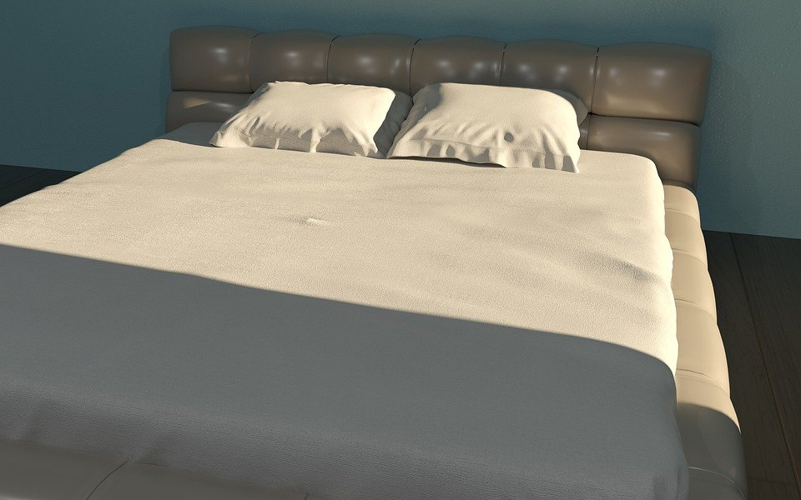
While you are at the covid housing building, you can just stay in bed and rest until you feel better. There will be no need to leave your room at all! You will have everything you need in your room so you would not have to leave at all! If you are hungry, people will bring you food, and if you have no more clothes, you will have a washer and dryer in your room.

Slide 6
I have quarantined in the covid housing building and now am I all better!! And I didnt spread the virus to anybody!

