Slide 1
Organised Access to Historical Student Data
PROPOSAL PRESENTATION
Zeyu Lin, Minh Tam Phan, Zeqi Fu

Slide 2
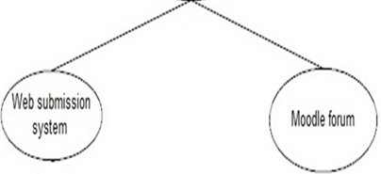
Motivation
Two data sources:
After an assignment is released, when do students begin to download resources and when do they submit?
Can’t answer, separate systems
Organised Access to Historical Student Data

Slide 3
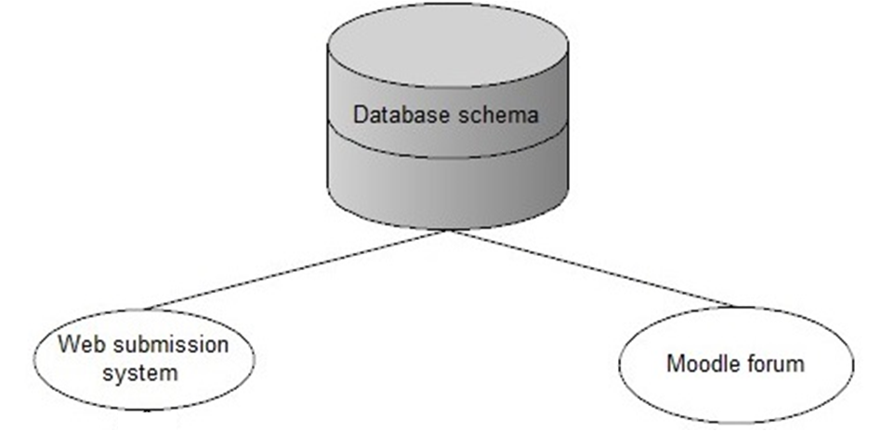
Motivation
A database schema that will take into consideration both systems and have the capability to answer a series of questions.
Organised Access to Historical Student Data

Slide 4
Motivation
Some example questions that the database schema will answer
1. List all the students who over the years have only worked a couple of days around the assignment hand in points. 2. Activities of students in the duration of assignment. 3. Show students behaviors with GPA higher than 6. 4. Do students hand in the first assignment on time or late? 5. Show all the students who submit this assignment after this date. 6. All the events of users in a given time 7. Course enrolment time and unenrolment time distribution 8. Assignment submission time distribution. 9. Number of students' course accesses on a date. 10. Number of accesses on single resources. 11. Overview forum activities of all students. 12. Are students busy on Monday?
Organised Access to Historical Student Data

Slide 5
Motivation
Why are these questions important?
Student behavior patterns
Identify at-risk students who are in danger of failing a course.
Know the frequency and time distribution of students' accesses to courses, resources.
Improve teaching practice and identify better ways to assess and evaluate student work.
Organised Access to Historical Student Data

Slide 6
Motivation
Potential of the work
Lecturers can use the application to know more about students' behaviors and improve teaching practice.
Ideally, the database schema should be extensible. In the future, we might add more data sources(e.g. student gpa) and expand the schema to allow it to answer more complicated questions.
Also, we are trying to design a schema that will not only be suitable for moodle, but also for other online learning management systems and other learning softwares.
Organised Access to Historical Student Data

Slide 7
Literature review
All the previous studies mainly fall into 4 categories.
The first type of studies
analyze some data of learning management systems
only focus on some particular questions and aspects of student behaviors
data collection and data analysis in these studies are not in a structured and orgranized way.
[3] Edwards, Stephen H., et al. “Comparing effective and ineffective behaviors of student programmers.”
[4] Nandi, Dip, et al. "How active are students in online discussion forums?.”
[5] Ceddia, Jason, Judy Sheard, and Grant Tibbey. "WAT: a tool for classifying learning activities from a log file
Organised Access to Historical Student Data

Slide 8
Literature review
The second type of studies
mainly focus on applying modern data mining techniques to analysing moodle data
the complex and specialised data mining techniques in these studies are incomprehensible to the general academic audience.
[8] Castro, Félix, et al. "Applying data mining techniques to e-learning problems.”
[9] Romero, Cristóbal, Sebastián Ventura, and Enrique García. "Data mining in course management systems: Moodle case study and tutorial.”
[10] Romero, Cristóbal, et al. "Data mining algorithms to classify students.”
Organised Access to Historical Student Data

Slide 9
Literature review
The third type of studies
propose learning analytics tools related with moodle.
support visualization, which facilitates the analysis of student activities.
However, they are all based on moodle and they do not support multiple data sources other than moodle.
[12] Zhang, Hangjin, and Kevin Almeroth. "Moodog: Tracking Student Activity in Online Course Management Systems.”
[13] Mazza, Riccardo, et al. "Moclog–monitoring online courses with log data.”
[14] Mazza, Riccardo, and Luca Botturi. "Monitoring an online course with the GISMO tool: A case study.”
[15] Dierenfeld, Helena, and Agathe Merceron. "Learning analytics with excel pivot tables.”
[16] Sampayo, F. C. "Analytics and Recommendations.”
Organised Access to Historical Student Data

Slide 10
Literature review
The fourth type of study
bears similarity with our work
proposes a data model to structure and export data that most learning management systems normally store in scattered places into a unified schema.
However, it does not present a complete software solution.
It does not combine several different data sources.
It does not provide an application which also provides login and visualization of data by using charts and reports.
[11] Krüger, André, Agathe Merceron, and Benjamin Wolf. "A data model to ease analysis and mining of educational data." Educational Data Mining 2010. 2010.
Organised Access to Historical Student Data

Slide 11
Literature review
In view of the strengths and shortcomings of all the previous work mentioned above,
our work will focus on designing a database schema that takes into consideration multiple data sources and has the capability to answer a series of complicated questions related with learning behaviors.
We will provide an application which is easy to use.
Complex processes such as data processing and data analysis are done in the background, being transparent to users.
The application will provide login function and data visualization by using charts and reports.
Organised Access to Historical Student Data

Slide 12
Research methodology
×
Controlled experiment: exploring relationship between variables
Case studies: know the reason and the way that certain phenomena happen.
Ethnography: observing and studying a group of people for the purpose of understanding their social behaviors.
Action research: solving a real-world problem while at the same time studying the experience of solving the problem
Survey: the selection of a representative sample from a well defined population, and the data analysis techniques used to generalize from that sample to the population, usually to answer base-rate questions.
×
×
×
√
Organised Access to Historical Student Data

Slide 13
Research methodology
Two types of surveys: Questionnaires and Interviews.
Interviews
Advantages:
allows the interviewer to probe or ask follow-up questions
much easier when we want opinions or impressions from respondents
Disadvantages:
resource-intensive: take huge amounts of time, interviewers have to be trained well beforehand
costly
Organised Access to Historical Student Data

Slide 14
Research methodology
We will use questionnaire.
cost-effective
not much difficulty in administration
We don't need many open-ended questions and opinions from the respondents because of the nature of our research(to evaluate whether what we built is useful and better than the current tools)
Disadvantage:
low response rate
Organised Access to Historical Student Data

Slide 15
Research methodology
The population for the survey: all the 26 academic staffs who give lectures.
The ideal sample size for the survey: 24 in order to get a confidence level of 95% and a confidence interval of 5.
We will send the questionnaire to all the 26 academic staffs since not all of them will reply. In order to improve the response rate, we will offer some inducements(e.g. lottery).
Organised Access to Historical Student Data

Slide 16
Research methodology
3 steps to carry out the survey
Design the questionnaire
Send out the questionnaire
Analyze the results of the questionnaire
Organised Access to Historical Student Data

Slide 17
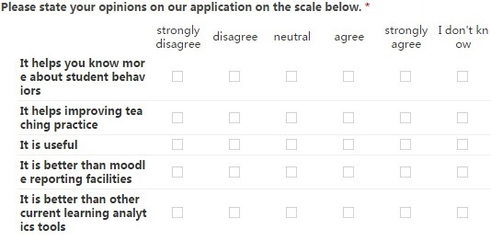
Research methodology
Design the questionnaire
Organised Access to Historical Student Data

Slide 18
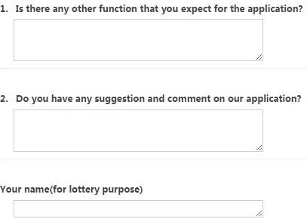
Research methodology
Design the questionnaire
Organised Access to Historical Student Data

Slide 19
Research methodology
(2)Send out the questionnaire
We will send emails to all the 26 academic staffs.
The reason for choosing email
it's not costly
easy to administer
The content of email:
the link to our application
the link to the questionnaire
brief introduction on the application and the purpose of the questionnaire
the inducement for the survey will be highlighted in order to increase the response rate.
Organised Access to Historical Student Data

Slide 20
Research methodology
(3) Analyze the results of the questionnaire
We will attach a mark to each option(-2 for strongly disagree, -1 for disagree, 0 for neutral, 1 for agree, 2 for strongly agree).
For each question
we will calculate the average mark of their answers.
The average mark of answers to each question indicates whether
what we built is useful and better than the current tools.
Organised Access to Historical Student Data

Slide 21
Research methodology
(3) Analyze the results of the questionnaire
Limitation:
The response rate determines the effectiveness
of the survey. A high response rate is crucial for
generalizing the sample to the population. That‘s
why we are offering inducement to increase the
response rate.
Organised Access to Historical Student Data

Slide 22
Architecture
3-tier architecture
Open source and Java-based technologies
Organised Access to Historical Student Data

Slide 23
Architecture
Why chose those technologies?
3-TIER ARCHITECTURE
  A modular system.
  Flexible, reusable, easily upgraded and replaced independently in response to technologies or requirements.
Organised Access to Historical Student Data

Slide 24
Architecture
Why chose those technologies?
PHP
  Widely and easily used scripting language in web development.
  Can be executed on server.
  Offer advanced features for professional programmers.
Organised Access to Historical Student Data

Slide 25
Architecture
Why chose those technologies?
JASPERREPORTS
  One of the most popular open source reporting engine.
  Entirely written in Java.
  Can consume data coming from any kind of data source.
  Support document formats such as HTML, PDF, Excel, OpenOffice and Word.
Organised Access to Historical Student Data

Slide 26
Architecture
Why chose those technologies?
JAX-WS(Java API for XML Web Services)
  Deployed on web server -> support remote call
HIBERNATE
  Map classes at data access layer consistently to tables in database.
  HQL -> language to support CRUD actions on data.
  An implementation of JPA(Java Persistence API) specification.
  High performance, scalable, reliable and extensible.
MYSQL
  Easy to use and set up.
  Light-weight -> suitable for small scale project.
  Support load balancing or sharding and transaction.
Organised Access to Historical Student Data

Slide 27
Progress to data
1) We have done the architecture design and confirmed the technologies to use. The design style is to provide clear information and have fewer secondary selection buttons.
2) We have done the database schema design after several meetings with the client.
3) We have written insertion scripts for current data and imported real data into the database schema.
4) We have implemented some basic functions of the system.

Slide 28
Progress to data
5) We have taken notes for all the client meetings and group meetings.
6) We have done the basic website UI design.
7) We provide the basic function demo in proposal presentation and keep eyes on complex business logic.

Slide 29
Next steps
Analysis and function design
Finish Business logic
API service provide basic data

Slide 30
Task allocation
Zeqi Fu will focus on the link between data and business logic and the link between business logic data and viewer layer which is Controller layer in MVC architecture.
Phan will keep eyes on further database design and business logic design which related to Model layer in MVC architecture.
Zeyu Lin will generate and design the website UI part which is View layer in MVC architecture.

Slide 31
Thanks for watching !

