Slide 1





Faculty of science
Mathematics Department
CDMS
Suez Canal University
CUSTODY DATABASE MANAGEMENT System
proposal
JOEGITHUBPRO.GITHUB.IO/CUSTODYDATABASEMANGMENTSYSTEM
STUDENT RESEARCH CONFERENCE 5TH
MAY 2023
1

Slide 2




ABOUT US
The technical team at Faculty of science, computer science and mathematics department, Suez Canal University is a group of students who were selected to work together to improve their skills and knowledge. By participating in the technical team, they aim to become valuable members of the university community.
Supervision
Dr. Dina Elmanakhly & Dr.Riham Moharam
Implementation team :
Youssef Mohamed - Team Lead
Eslam Eid & Basem Mohamed & Ahmed Salah
2

Slide 3

CONTENT
01
INTRODUCTION
02
OBJECTIVES & PROBLEM STATEMENTS
03
REGISTRATION AND AUTHENTICATION SYSTEM
04
USERS MANGMENT
05
HOME PAGE &BarCode -SEARCH system
06
ARCHITECTURE & TOOLS
07
NEXT STEPS
3

Slide 4


CDMS
INTRODUCTION
Custody modules refer to a software tool that enables a company to mange its assets in a transparent manner.
These assets may include machines, laptops, or other equipments that are allocated to employees.
Each university is responsible for the custody, care, maintenance, and control of property assigned to their respective area.
LEARN MORE
5th ASRC
4

Slide 5





GOALS AND OBJECTIVES
Objective 1
Objective 2
Objective 3
Easy tracking of university properties, ensures accountability.
Less chance for mismanagment of university assets.
Can assure proper support for maintenance and repair, asset sharing between departments made easy.
5

Slide 6

PROBLEM STATEMENTS
Devices loss
Device supervisor
Devices location
Received date
Difficulty accessing information
CDMS
6

Slide 7


FOR VISITING SITE
SCAN QR CODE
For more assets and information, scan here:
To Login...
Username : User
Password : 7nJ4oq7@f*Dg
Scan the QR code with your phone or tablet and you'll be able to browse our site on the go.
or
Visit Link :
joegithubpro.github.io/CustodyDatabaseMangmentSystem
JOEGITHUBPRO.GITHUB.IO/CUSTODYDATABASEMANGMENTSYSTEM
7

Slide 8
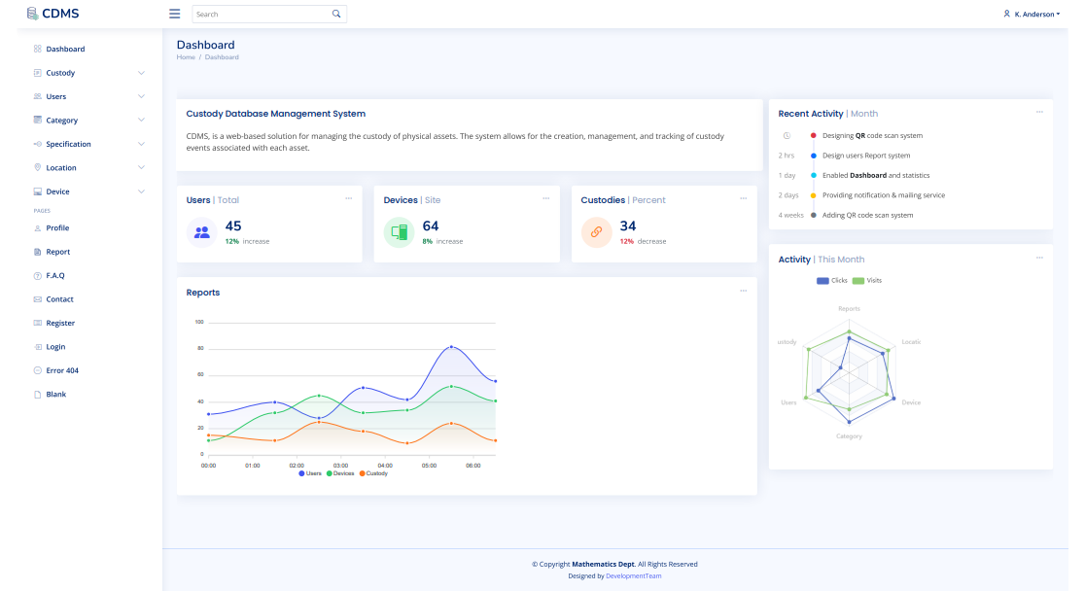
8

Slide 9
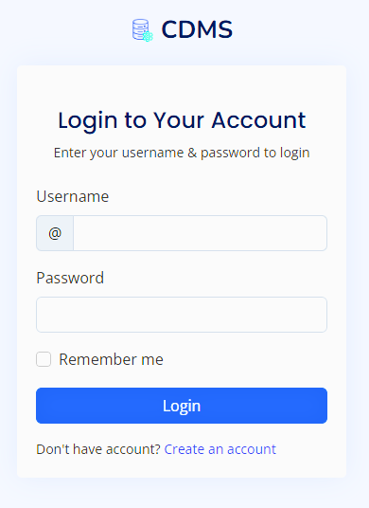
WARDIERE INC.
AUTHENTICATION
AND REGISTRATION SYSTEM
After opening the program's application interface, you will see a login page if you already have an account. If you do not have a previous account, you can proceed to new registration by browsing the following pages
2022
Company
9

Slide 10
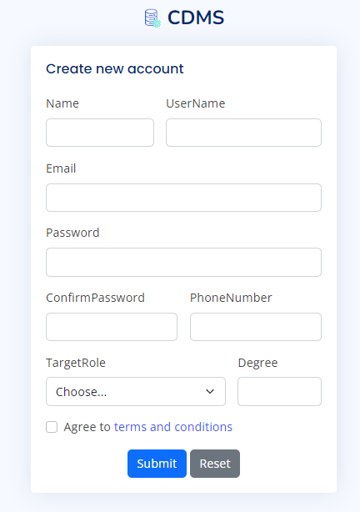
CDMS
REGISTRATION System
Registration of new users can only be activated for the administrator
To register, enter basic user information as follows:
username and email address
password phone and number
name and Degree
5th ASRC
LEARN MORE
10

Slide 11
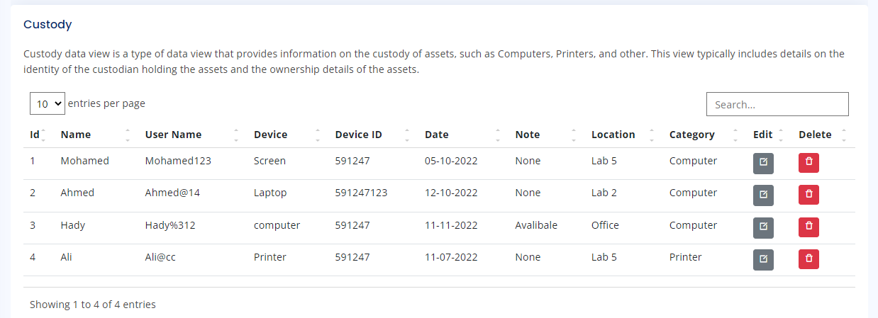
Description Here
The main view is represented by SponsorshipID, UserName, Name, DeviceName, DeviceID, Date, Note, LocationName, and CategoryName as the primary table. In addition, there are several functions available that can be accessed based on specific criteria or requirements.
HOME PAGE
5th ASRC
11

Slide 12

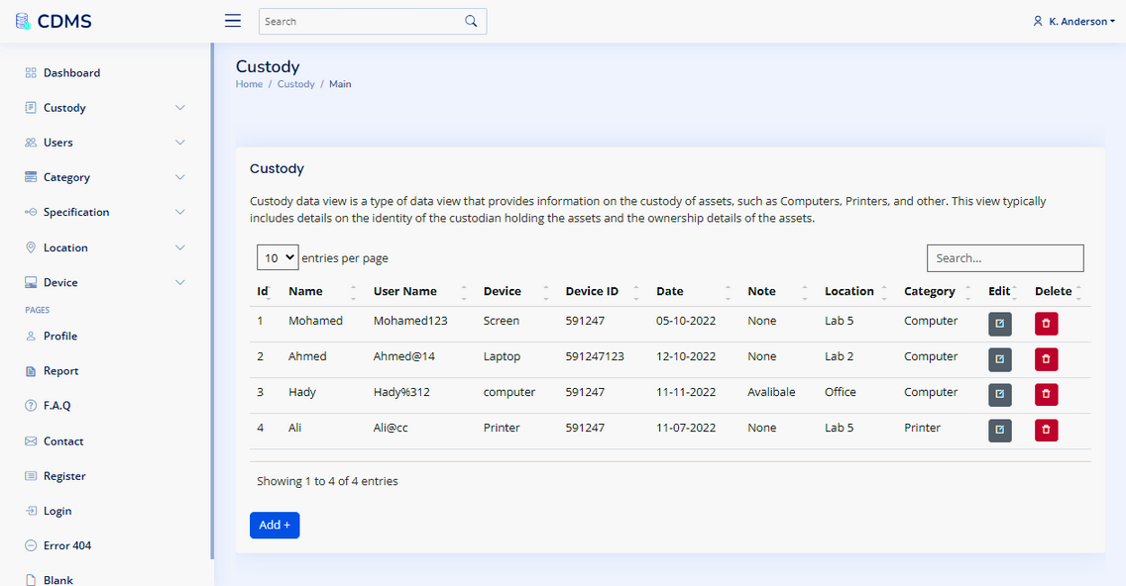
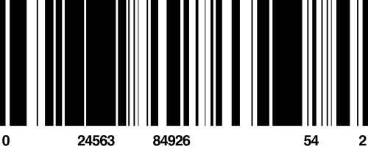
CDMS
BARCODE & SEARCH
System
There is more than one method in root view to achieve this:
Search by name
Search by username
Search by toponym Search by category NO.
Enter the device barcode
12
5th ASRC

Slide 13

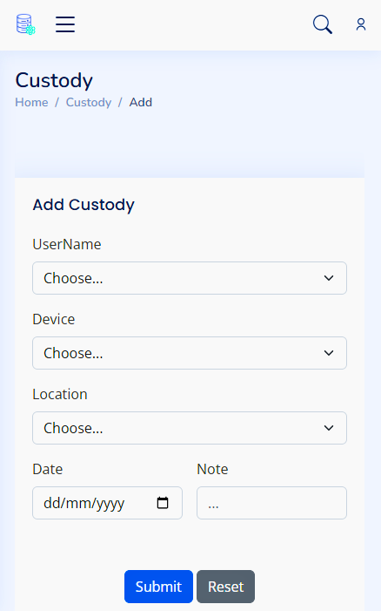
CDMS
ADDING & REMOVE CUSTODY
To add new custody just Select :
User Name & Device
Location & Date
and any note nedded
REMOVE
You can also delete any item from the root simply by selecting the row and then clicking Delete.
MORE INFORMATION
5th ASRC
13

Slide 14



CDMS
Notification
The admin has added the device to your custody.
MAILING & NOTIFICATION SYSTEM
When a device is added or removed from a user's care, the website automatically sends a notification to that user.
To improve the user experience, the administrator must be able to easily add, remove, or modify devices under the user's care. To ensure that the user is informed of changes, the website should send them an email notification when a device is added, removed or changed. The email should include details about the device and the changes you made. This helps the user to keep track of their devices and prevent unauthorized changes. By providing this feature, the website can increase user trust and satisfaction, resulting in higher engagement and loyalty.
LEARN MORE
5th ASRC
14

Slide 15

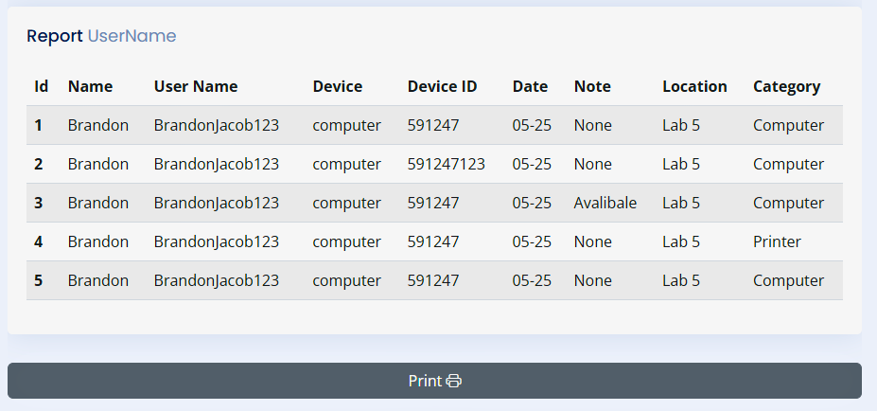
CDMS
REPORT
Report User Custody
LEARN MORE
5th ASRC
15

Slide 16
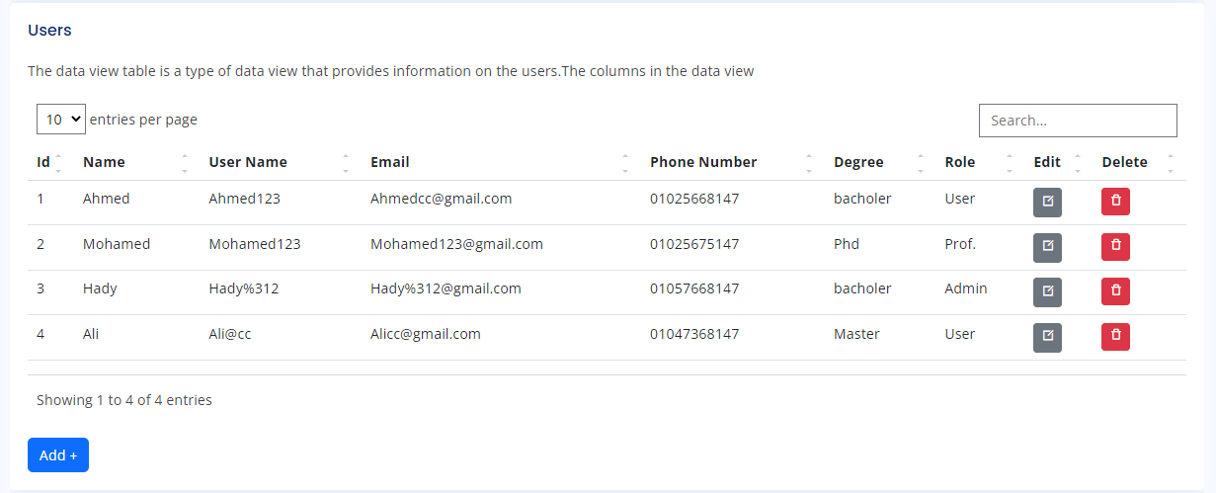
USERS MANAGEMENT
CDMS
Description Here
The user management system provide that the admin could see the complete information of all users and their statistics, as well as adding and deleting new users.
5th ASRC
MORE INFORMATION
16

Slide 17
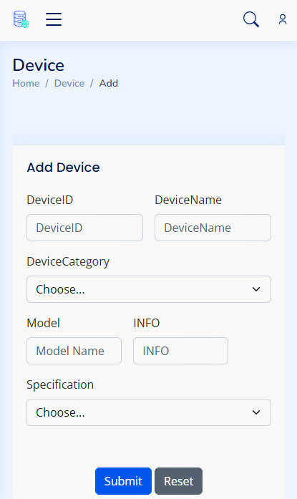
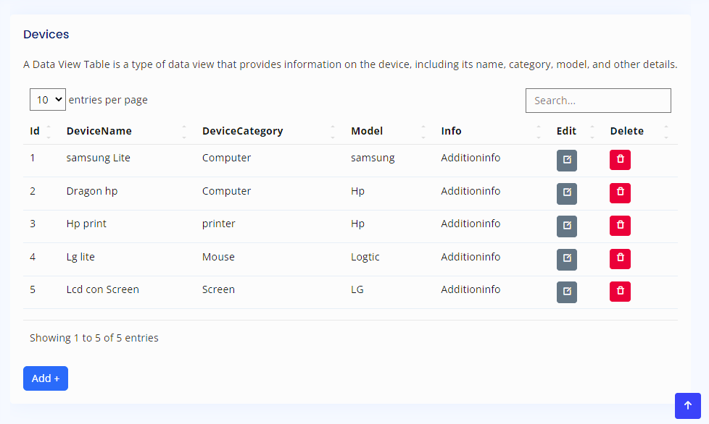
DEVICE
MANAGEMENT
17

Slide 18

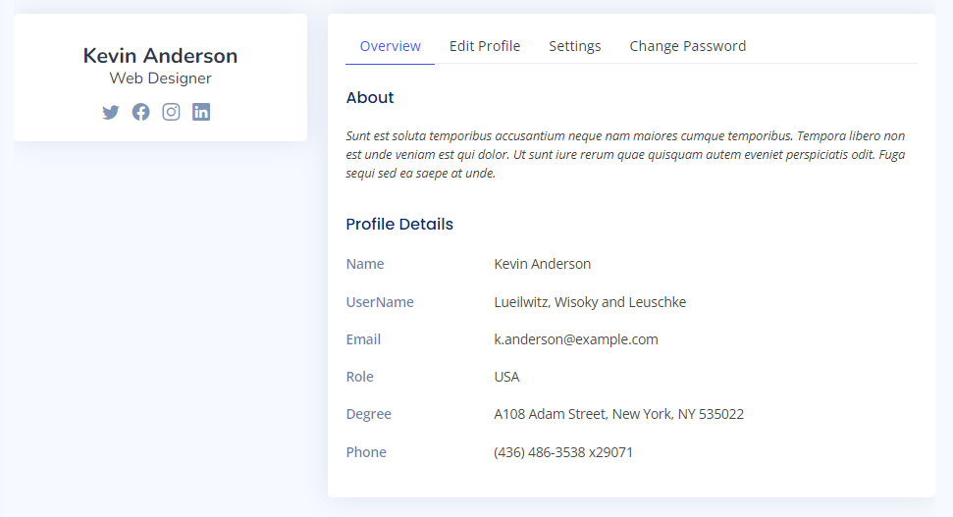



PROFILE
OVERVIEW
Get all personal information to survey it
EDIT
Edit tab enable for user to change any personal information
CHANGE PASSOWRD
Can change user password only by old password
18

Slide 19


CDMS
TARGETING SUSTAINABILITY
The reality and challenges of sustainable development...
Egypt's Vision 2030
May 2, 2023
5th ASRC
19

Slide 20



CDMS
ARCHITECTURE
This app built with web api architecture - three layers.
Database layer designed
separable at separate server
....
SQL Server 2019
Back end layer designed
separable at separate server
to make app more scalable
....
.Net framework 4.7.2
Front end proto type designed by api desktop app
and can by same api designed by web or mobile
....
js & c#
DATABASE
BACK-END
FRONT-END
5th ASRC
20

Slide 21




CDMS
SERVICE
Data Service
Desktop app
Web App
Sharing data to any client side. Data Provider Service supports web app, desktop app and mobile app.
Data Provider Service helps you share data across all of your clients in a simple, efficient way. It allows you to easily create a single source of truth for your application's data, without having to worry about how you're going to distribute it or manage it later on.
We all know that data is the new oil. And we all know that when it comes to data, nothing is as important as speed.
That's why we built CDMS, a desktop app that gets data from our online provider and syncs it with all your devices, so you don't have to worry about ever being without your critical data.
This web app is designed to be used by people who need to get data from multiple sources. It provides a convenient way for the user to access all their data in one place. The app will allow them to update their information on a regular basis and keep it up-to-date, so they never have to worry about whether or not they have the most current information available.
More Information ...
More Information ...
More Information ...
5th ASRC
21

Slide 22
CDMS
SCALABILITY
Horizontal
Vertical
75
Scalability with two phases vertical & horizontal :
Horizontal scaling involves publishing the entire application, including its components as data providers, back-end layers, and client-side approaches..
Vertical scaling to be publish one application and deal with all users and be supervised by Higher management as Suez canal university management , so every institution have its custodies and its users
50
25
0
NO. Of Users
LEARN MORE
5th ASRC
22

Slide 23








CDMS
We have to write decision log like :
System Architecture
" DDD - QRCS - ... "
system Structure
" DDD - QRCS - ... "
Log decision
" SQL - No SQL - ... "
Database
TECHNICAL ARCHITECTURE
" MVC- API - ... "
DESIGN PATTERN
PROGRAMMING PARADIGM
" OOP - FP- ... "
23
5th ASRC

Slide 24

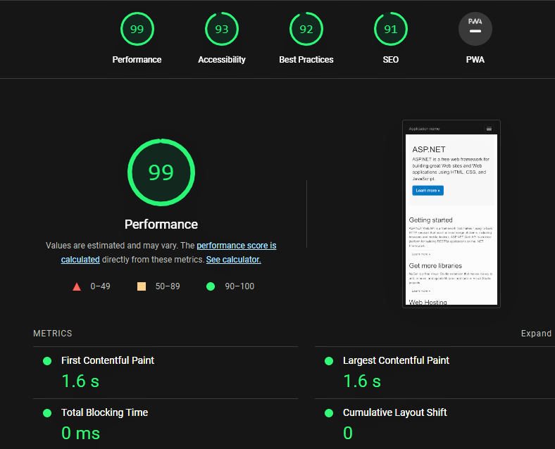
CDMS
CODE ANALYSIS & PERFORMANCE
TEST
Lines of Source code : 5669
Lines of Executable code : 1724
Depth of Inheritance : 4
Maintainability Index : 83
Class Coupling : 352
5th ASRC
24

Slide 25








TOOLS
CDMS
C SHARP
SECURITY
Back-end layer language
& Windows App
Authentication and Authorization By Access Token
ASP .NET
JAVASCRIPT
USED TOOLS
Back-end layer framwork
Front-end layer language
SQL SERVER
HTML
Data Base Mangment System
standard markup language for creating Web pages
GIT & GITHUB
CSS
DevOps tool used for source code management
describing the presentation of Web pages
5TH ASRC
25

Slide 26
NEXT STEPS
Now that you have all the information on web site and have finished with the deployment, it's time to start getting it up and running
With QR Code Scanner, you can easily embed a QR code into your website. When a person visits the site, they can use their smartphone to scan the QR code and get their personal information and other details. You can also use this tool to show off your product or service.
migrate monolith application to microservices application
This mobile application is an extension of the existing web application. The purpose of this application is to make it easy for users to access information and resources and products, services and programs.
MICROSERVICE
QR CODE SCAN
MOBILE
26

Slide 27


Thank You
joegithubpro.github.io
27

