Slide 1

What is Equanimity?
Equanimity is a Website where all the insurance companies are combined on, we offer a variety of categories and different types of insurance contracts to suit all the needs of our customers and offer them the best option to compare and choose from.

Slide 2
Our Mission
Our Vision
Advertisement
Eliminate traditionality
We advertise for all types of insurance companies on a single online platform to make it easier for the user in making a decision and use the competition to our advantage
eliminate the traditional way of buying insurances and change the conventional process into an online process
Safe payment
Time management
We offer our customers a safe paying process for the insurance contract they choose.
Get rid of any hassles that consume the customers time, you only need few minutes.
No pressure
Effectiveness
We give an opportunity for insurance seekers to compare and choose the best deals that suit them the most and take their time with doing so.
Easier for our customers to find the right deal by the help Equanimity in filtering and comparing the options for them.

Slide 3
Promoting strategy
Here You can Add Some Brief Text That will Explain Your Tittle This is Just a Demo Text So You Can Replace These Texts
our target audience
Social media marketing
Google AdSense
Build a relationship with people and gain their trust.
Advertise for our offers and deals different platforms and join events as a sponsor.
Promotes our service by displaying it before videos on platforms.
Cost efficiency
Youtube
Google Ads
We will only get charged when users watch at least 30 seconds,an entire video or interact with the Ad. in some way.
We will be using “True view” which is preferred by users to control the ads they see.
To stay on their mind by displaying targeted ads for visitors.

Slide 4
Features for users
Our new customers must save their information on our database to prevent unwanted or complex transactions, unregistered users can only view our website’s deals
1
Registeration
Rating
2
The user have the ability to give rating, the total ratings are calculated based on other customers’ ratings too.

Slide 5
allows the user to express his opinion, it is also a complementary function to the rating.
3
Review
View
4
permits the customer to check their account or for viewing information about the insurance and registered companies.
user can update their profile anytime also they can update their name and password.
5
Updating

Slide 6
allows the customer to save offers of their choice in a favorites list that is easily accessible from anywhere on the website.
6
Favoriting
Searching
7
Customers can easily search for a specific offer or company by its name through our search bar.
to filter out the offers based on price or rating or the providing company or category or all of them to help them find the most suitable offer.
8
Filtering

Slide 7
Features for company admin
1
Add New Insurances
Edit Insurances
2

Slide 8
3
Delete any insurances
Hide or Show insurances
4
5
Edit their public profile

Slide 9
6
View and Filter their insurances
View reviews of each insurance
7

Slide 10

What our admins can do
Those are the features that allows admins to manage the website
Add/Edit/Delete Category
Create/View company
Approve/suspend insurances
View/Delete
reviews

Slide 11
Strength
Insurance service is online.
Variety of deals and companies for the customer to choose from.
Advertising by online marketing instead of the traditional way(telesales)
Better than the hassle of dealing with tons of paperwork.
SWOT ANALYSIS
Weakness
S.W.O.T.
The struggle to gain the customer's trust out of the fear of being scammed.
Facing an advertising obstacle to be noticed since it is still a new and emerging idea to transform the process of buying insurances to online payment.
Being prone to technical errors unlike the traditional method
Opportunity
most of the Egyptian insurance companies don't provide the online services that we have if not any at all, will increase the probability of depending on us and increases our success rate
The prevalence of social media and the dependence on online shopping currently, will pave the way for our business to flourish.
Threats
The regulations and laws in the insurance industry might become a hindrance if it doesn't align with our policies.
Standing as an online service will always make us prone to the threat of being hacked.
The existence of some competitors that have functional similarity to us.

Slide 12
Strength
Insurance service is online.
Variety of deals and companies for the customer to choose from.
Advertising by online marketing instead of the traditional way(telesales)
Better than the hassle of dealing with tons of paperwork.
SWOT ANALYSIS
Weakness
S.W.O.T.
The struggle to gain the customer's trust out of the fear of being scammed.
Facing an advertising obstacle to be noticed since it is still a new and emerging idea to transform the process of buying insurances to online payment.
Being prone to technical errors unlike the traditional method
Opportunity
most of the Egyptian insurance companies don't provide the online services that we have if not any at all, will increase the probability of depending on us and increases our success rate
The prevalence of social media and the dependence on online shopping currently, will pave the way for our business to flourish.
Threats
The regulations and laws in the insurance industry might become a hindrance if it doesn't align with our policies.
Standing as an online service will always make us prone to the threat of being hacked.
The existence of some competitors that have functional similarity to us.

Slide 13
Strength
Insurance service is online.
Variety of deals and companies for the customer to choose from.
Advertising by online marketing instead of the traditional way(telesales)
Better than the hassle of dealing with tons of paperwork.
SWOT ANALYSIS
Weakness
S.W.O.T.
The struggle to gain the customer's trust out of the fear of being scammed.
Facing an advertising obstacle to be noticed since it is still a new and emerging idea to transform the process of buying insurances to online payment.
Being prone to technical errors unlike the traditional method
Opportunity
most of the Egyptian insurance companies don't provide the online services that we have if not any at all, will increase the probability of depending on us and increases our success rate
The prevalence of social media and the dependence on online shopping currently, will pave the way for our business to flourish.
Threats
The regulations and laws in the insurance industry might become a hindrance if it doesn't align with our policies.
Standing as an online service will always make us prone to the threat of being hacked.
The existence of some competitors that have functional similarity to us.

Slide 14
Strength
Insurance service is online.
Variety of deals and companies for the customer to choose from.
Advertising by online marketing instead of the traditional way(telesales)
Better than the hassle of dealing with tons of paperwork.
SWOT ANALYSIS
Weakness
S.W.O.T.
The struggle to gain the customer's trust out of the fear of being scammed.
Facing an advertising obstacle to be noticed since it is still a new and emerging idea to transform the process of buying insurances to online payment.
Being prone to technical errors unlike the traditional method
Here You can Add Some Brief Text That will Explain Your Tittle This is Just a Demo Text So You Can Replace These Texts
Opportunity
most of the Egyptian insurance companies don't provide the online services that we have if not any at all, will increase the probability of depending on us and increases our success rate
The prevalence of social media and the dependence on online shopping currently, will pave the way for our business to flourish.
Threats
The regulations and laws in the insurance industry might become a hindrance if it doesn't align with our policies.
Standing as an online service will always make us prone to the threat of being hacked.
The existence of some competitors that have functional similarity to us.

Slide 15
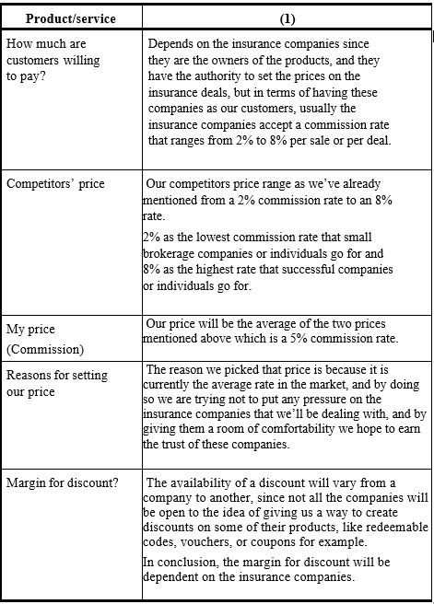
Pricing Strategy

Slide 16
Low Financial Cost
Since we are considered to be a startup as an E-Business we only have to pay approximately 3000 Egyptian Pound a year on virtual rent and there is no need to hire employees.
Placement section
Scalability
We don’t have to face issues like worrying about physical space.
It’s easy to increase our Ad budget and grow our business exponentially.

Slide 17
No other company or online platform gathers all of insurance companies in one place and broke for them all together.
advertising all the insurance deals and offers from most of the insurance companies.
Other websites with similar functionality don’t advertise for many companies online or offer them online payment and they don’t have different types of insurances.
So basically, we’ll best them in the number of insurance companies that we’ll advertise and broke for, in containing the different types of insurances, in the features that our website will provide and, in the marketing, and promoting field.
Competitive advantage

Slide 18
We have two types of customers,
the first one is:
The regular people that seek to buy an insurance:
•Legal Age: 18-65
•Gender: Male & Female
•Place: Egypt
The Second One is:
The Insurance companies that we will advertise and give them a platform to showcase and display their offers and deals.
Customer segmentation

Slide 19
Our business aims to create a platform where all the insurance companies exist on it, displaying their products and deals and for the regular people to have a place where they can feel safe and not have the fear of being scammed by giving them a place which will provide them the freedom to compare between different companies and various deals without feeling any pressure.
Product / Service

Slide 21

System analysis
User Requirements
Functional Requirements
Non-Functional Requirements
System Requirements

Slide 22
the purposes of use case diagrams
Used to gather the requirements of a system. Used to get an outside view of a system.
Use Case Diagram

Slide 23
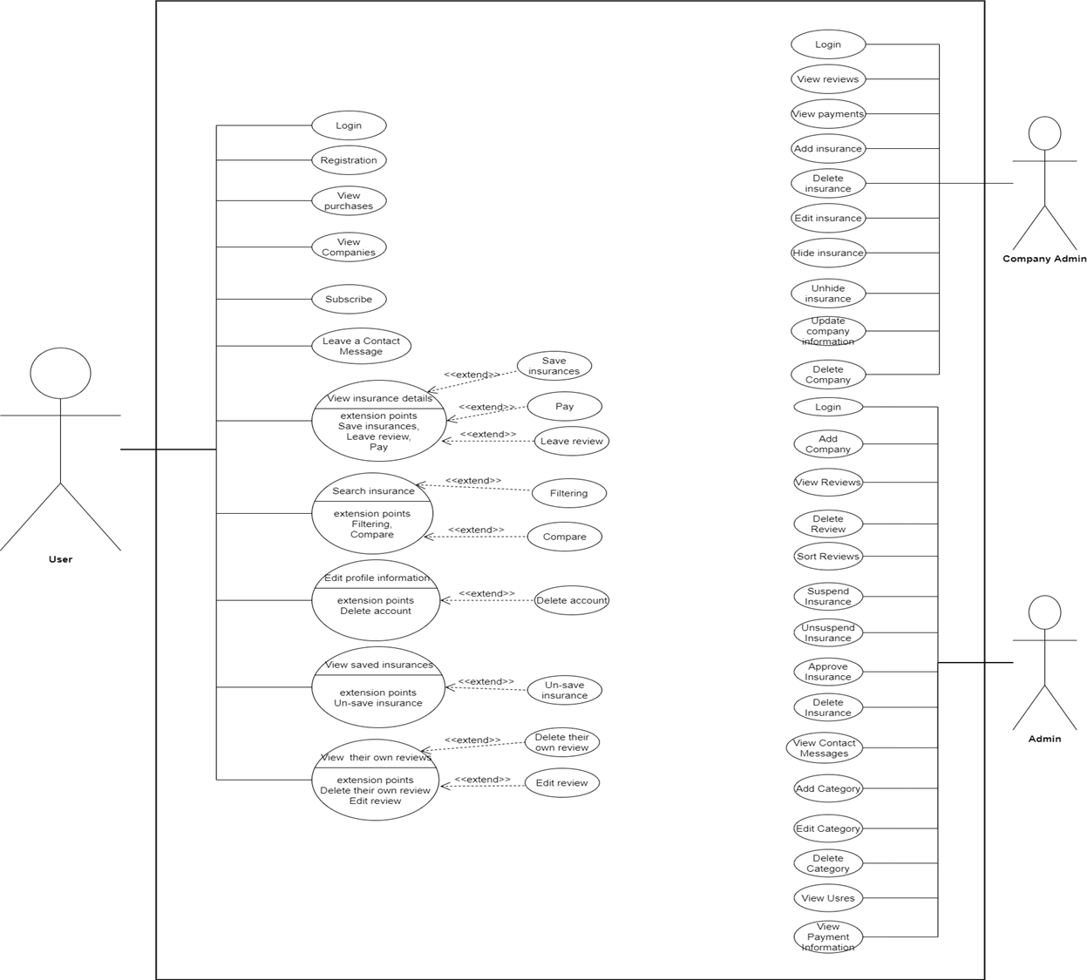

Slide 24
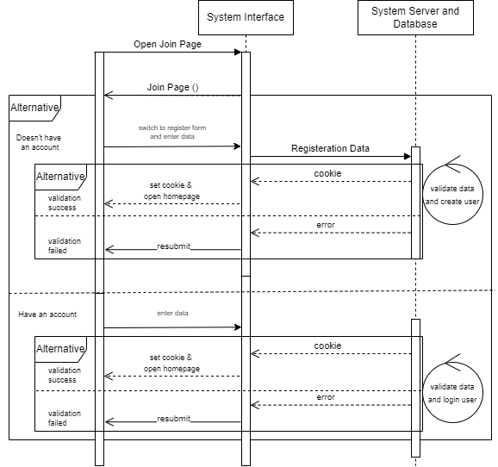
Use Case Diagram
Sequence Diagram
User Login

Slide 25
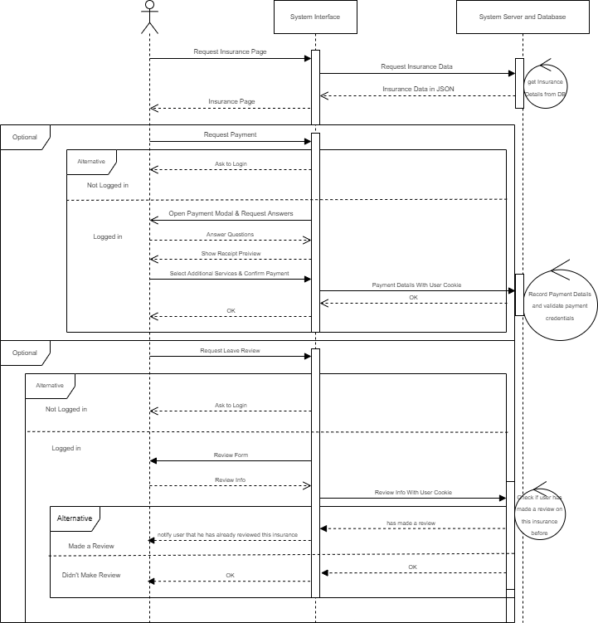
Sequence Diagram
Payment & Review

Slide 26
Symbols before act.diagram

Slide 27
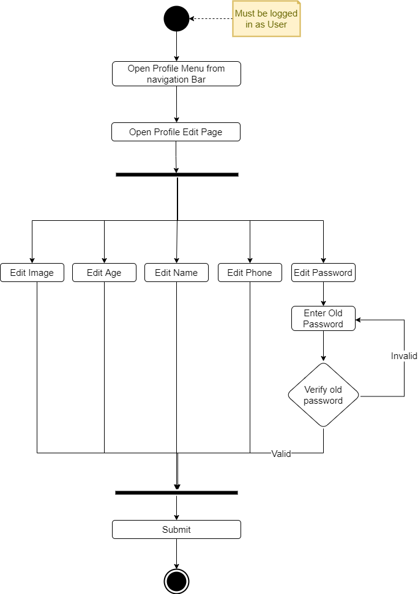
Activity Diagram
Edit Profile

Slide 28
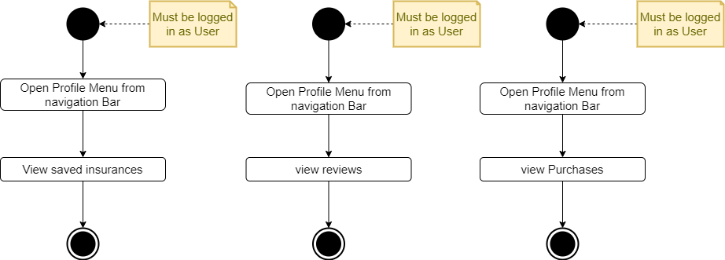
Use Case Diagram
Activity Diagram
User Reviews, Saved and Purchases

Slide 29
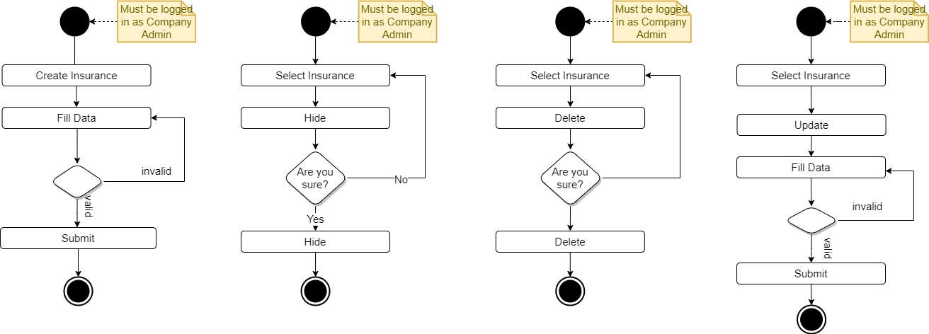
Use Case Diagram
Activity Diagram
Company Admin

Slide 30
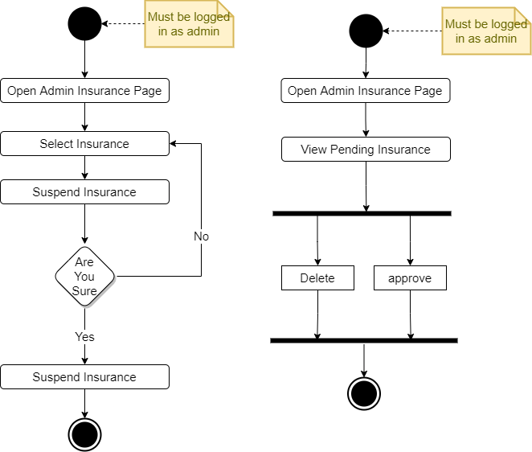
Use Case Diagram
Activity Diagram
Admin

Slide 31
ERD symbols

Slide 32
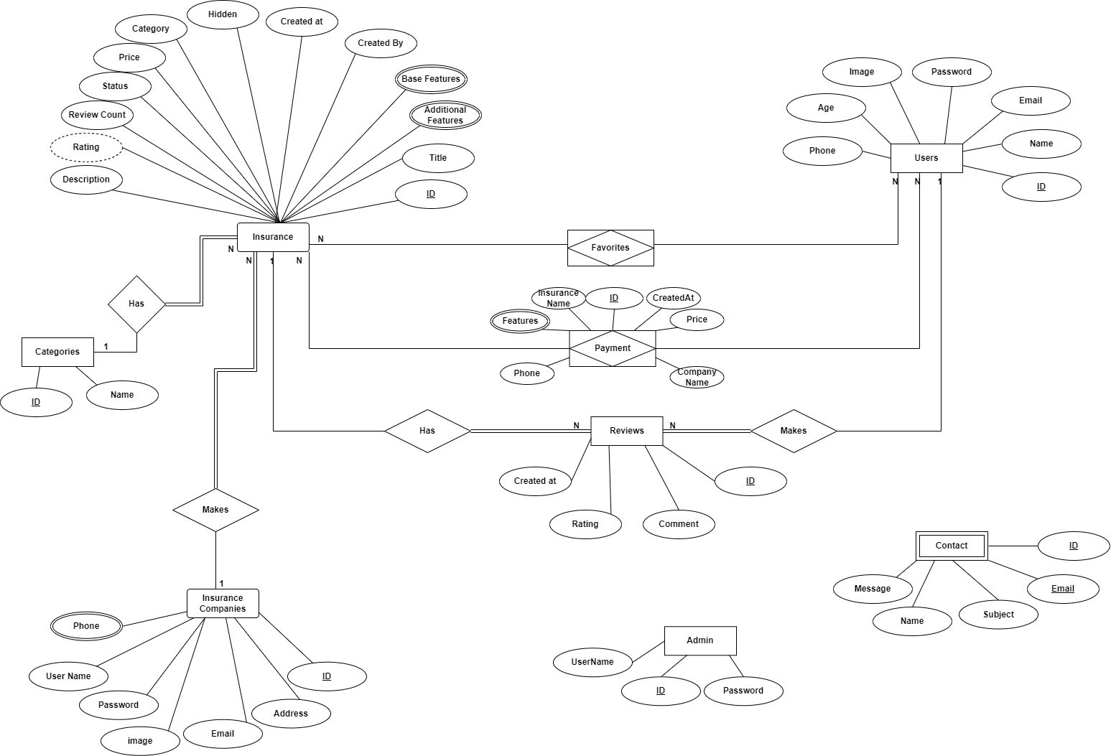
Use Case
ERD
Entities:
Insurance
User
Categories
insurance companies
Reviews
Admin
Contact
Favorites
Payment

Slide 33
Class Diagram

Slide 34
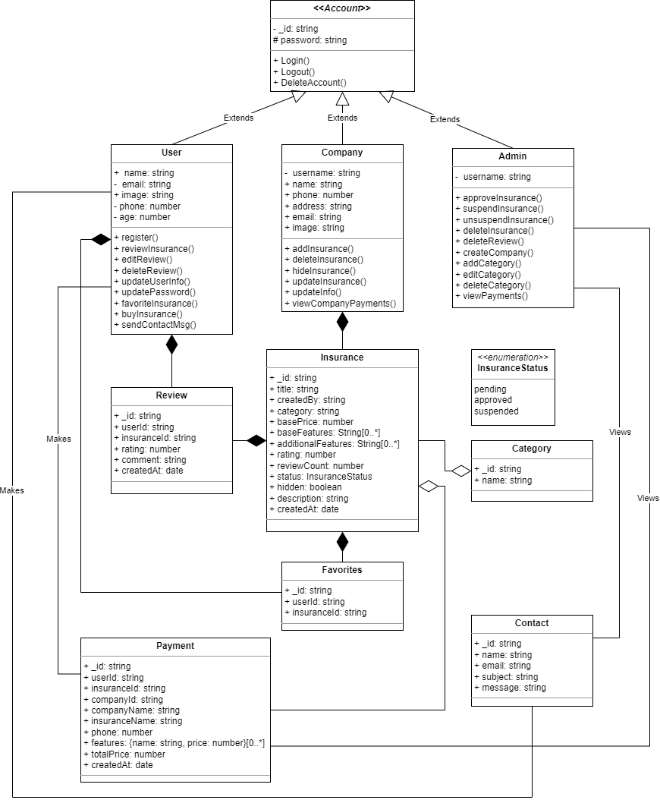
Use Case
Class Diagram

Slide 35
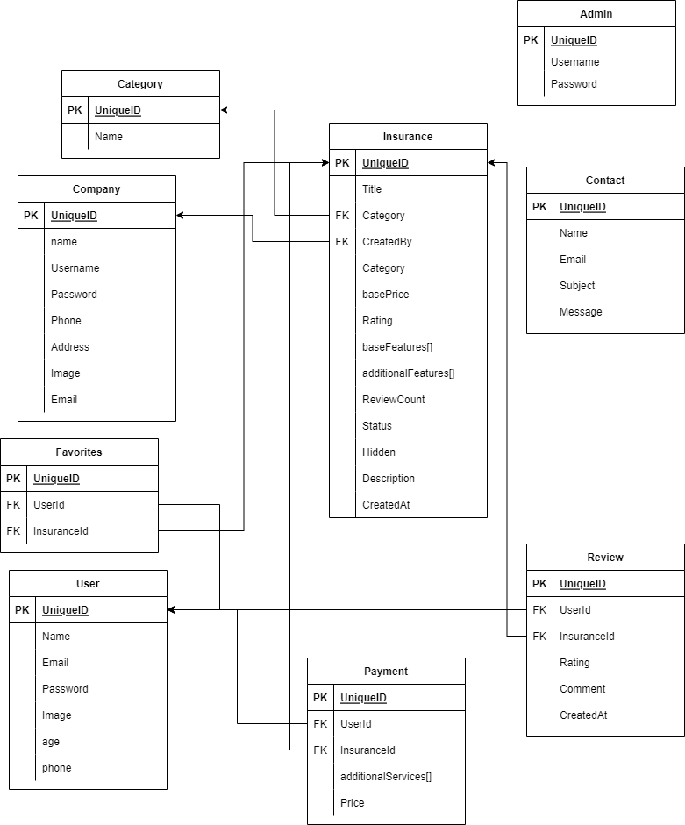
Use Case
Database Schema

Slide 36
Implementation

Slide 37




MERN
This summarises what helped us in the implementation process
MongoDB
Express
React
Node
offers scalable document-oriented database storage
It stores data in flexible documents rather than rows and columns meaning that the data are dynamic and schema-free
a back end web application framework
we used to it to create our API which would be able to serve both browsers and mobile applications
front-end library that is really efficient in both performance and development time.
it’s currently being utilized by famous companies including Facebook, Netflix, PayPal & NASA.
It’s reusable and mobile-development ready
Both express and react run on top of nodejs

Slide 38
Why use MERN stack ?
The speed of design and development of websites and web applications.
Reducing server costs.
The performance of greatly optimized web applications.
The ease of transposing a web application to a mobile application, thanks to React Native

Slide 39


How does it work ?
user connects to frontend server and downloads the SPA
the SPA communicates with the backend server using JSON messages over the internet
User
Front-end
Back-end

Slide 40
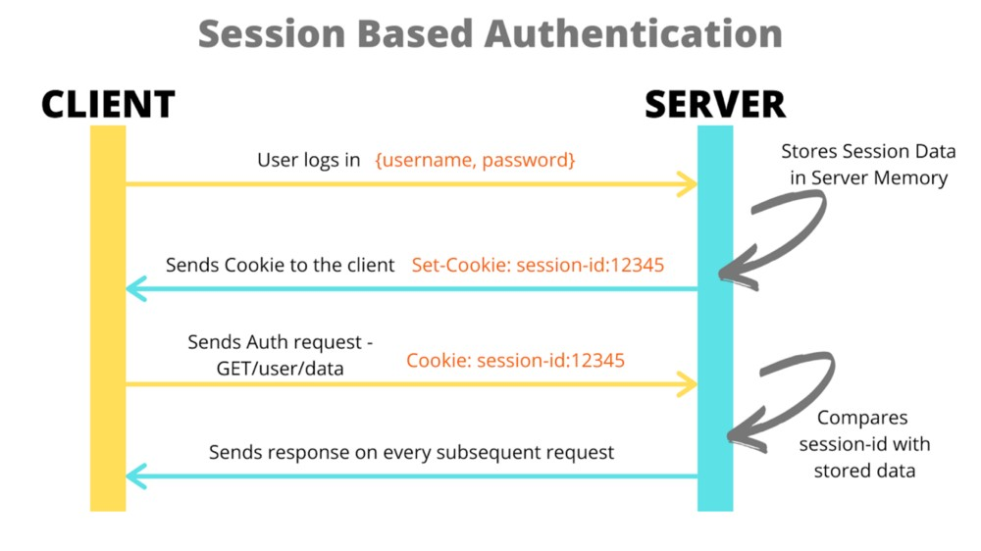
Authentication & Security

Slide 41
HOW OUR WEBSITE LOOKS LIKE

Slide 42
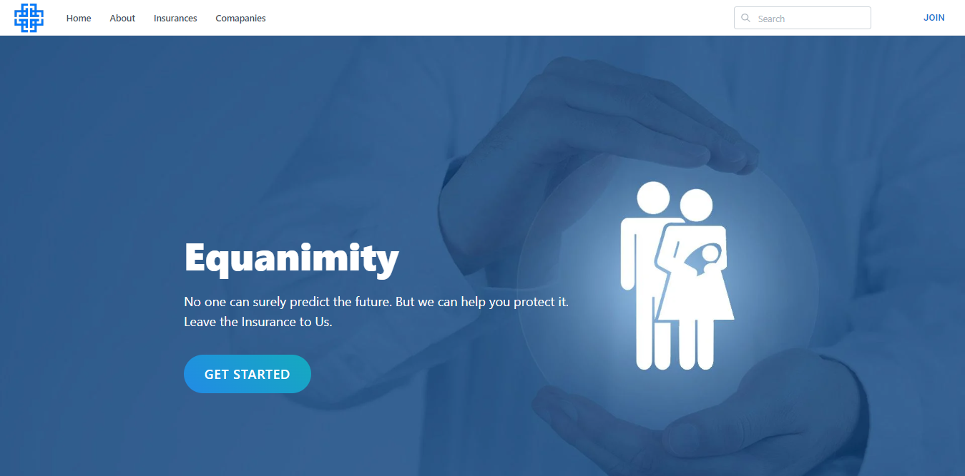

Slide 43
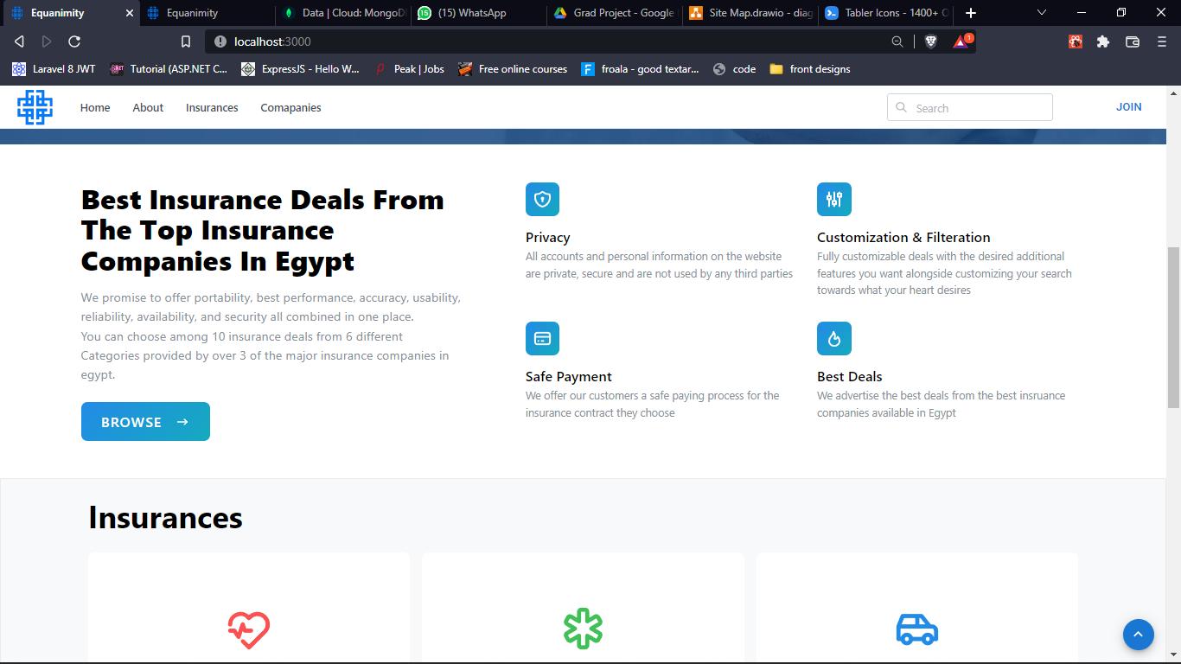

Slide 44
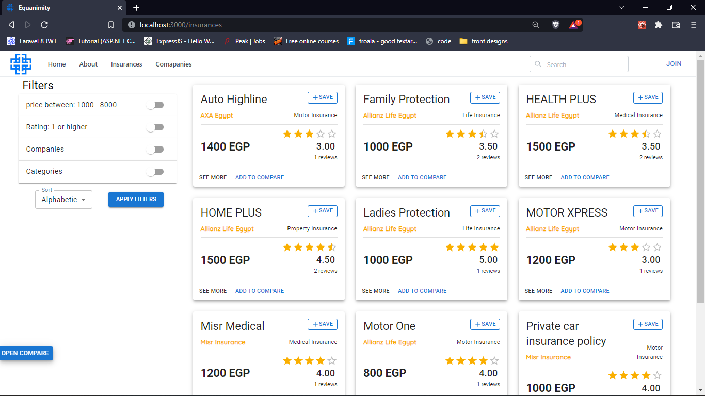

Slide 45
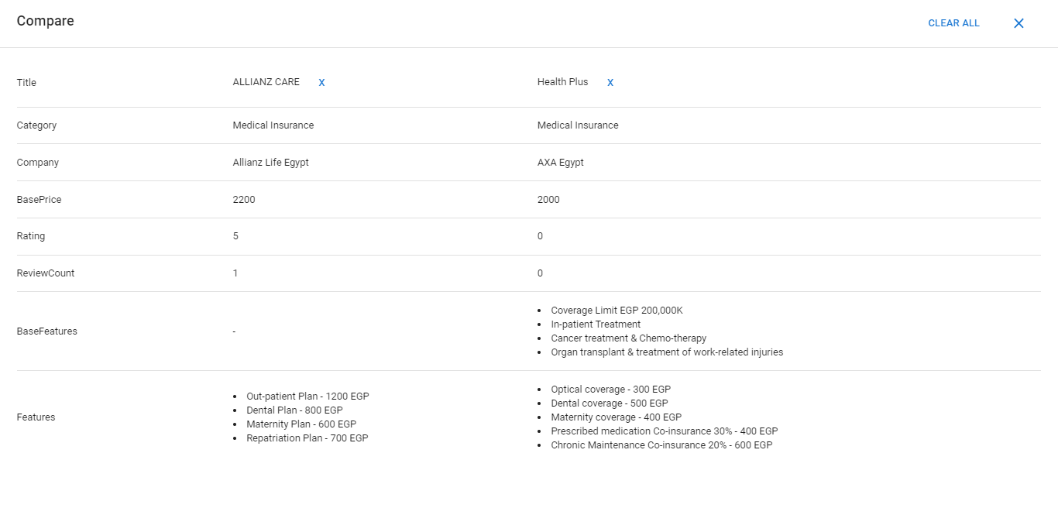

Slide 46
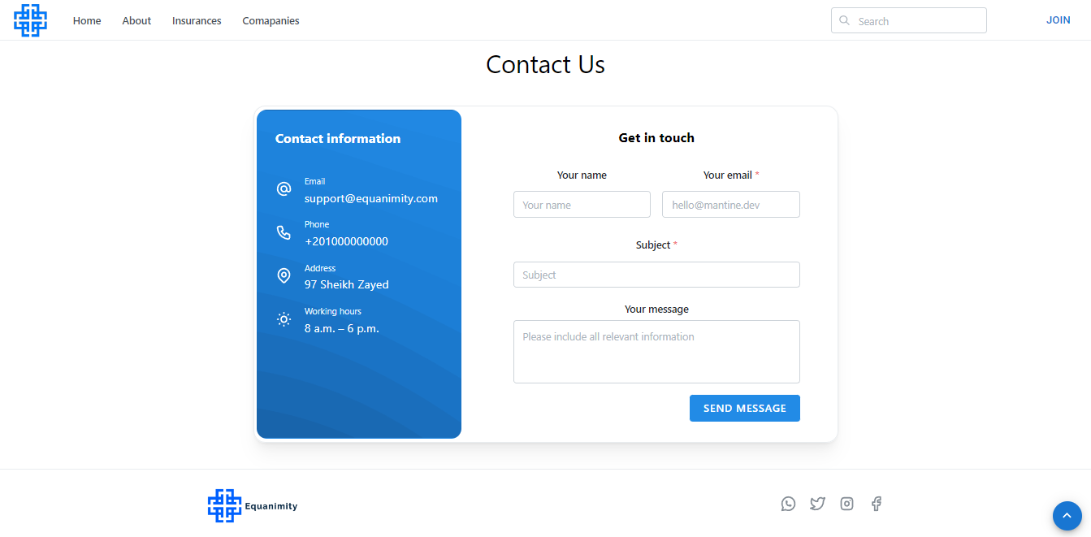

Slide 47
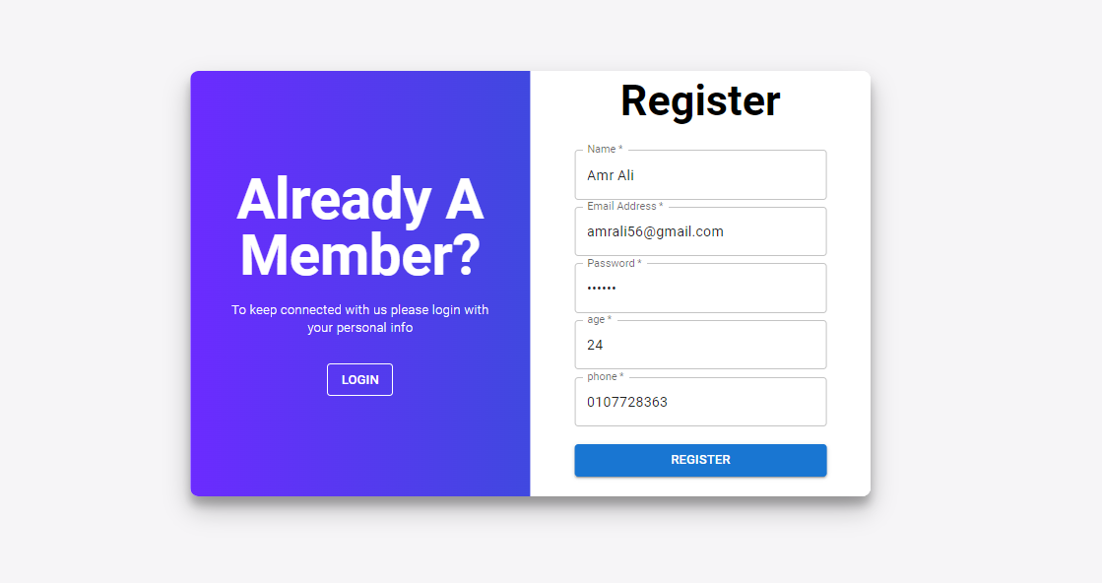

Slide 48
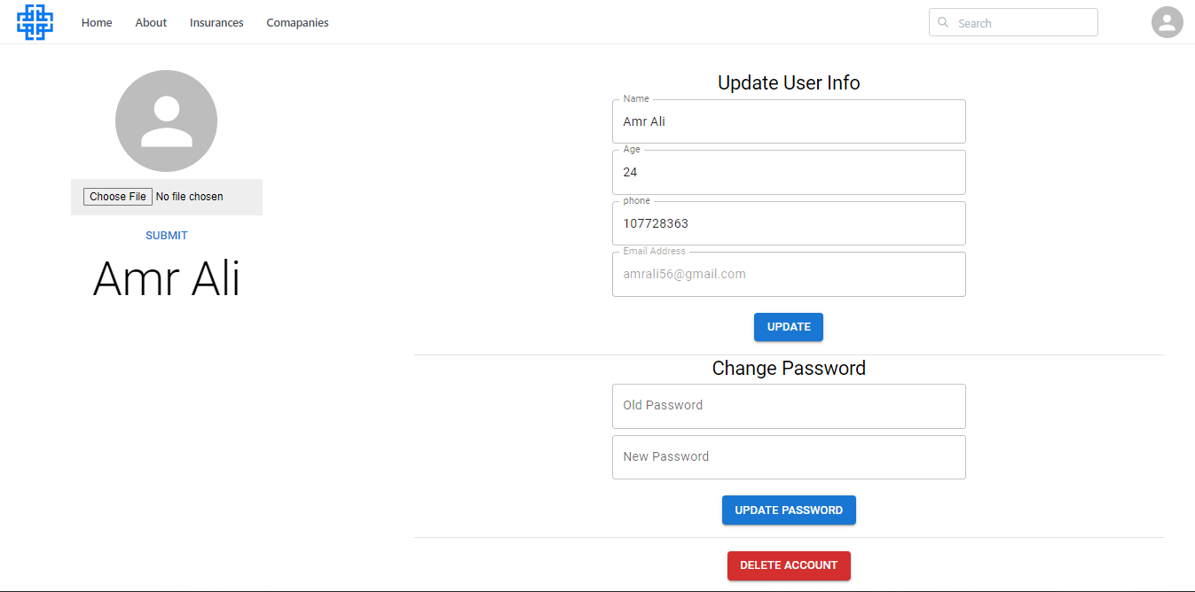

Slide 49
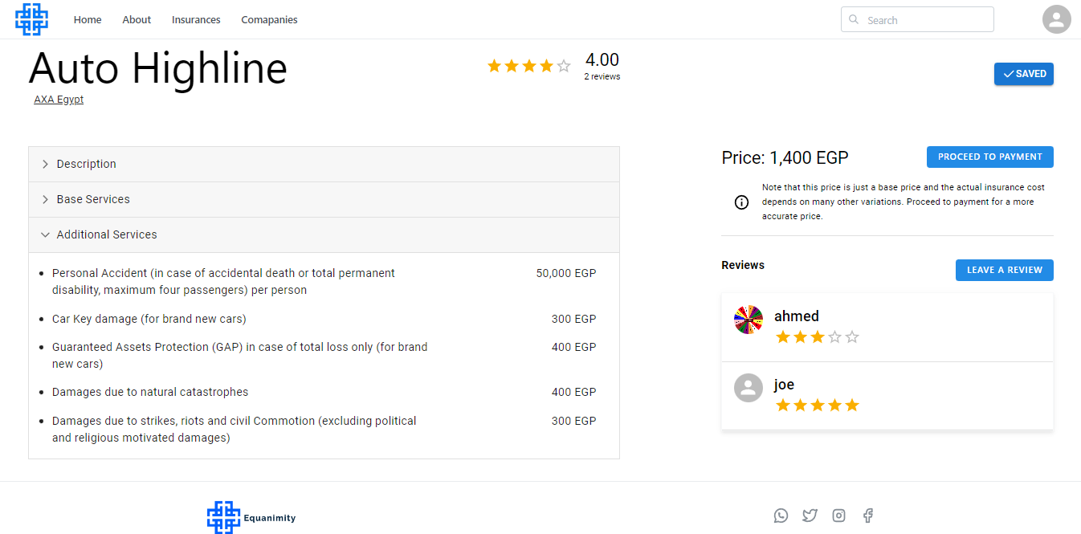
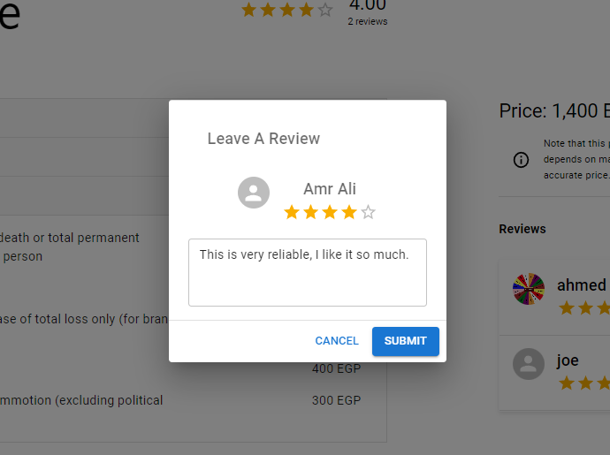
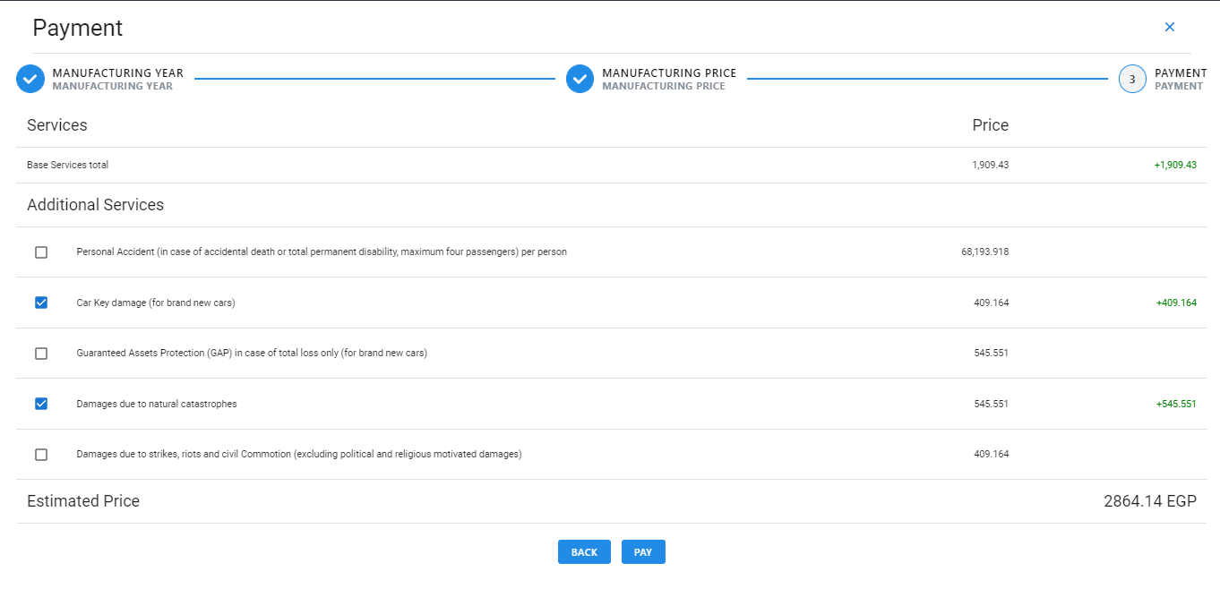
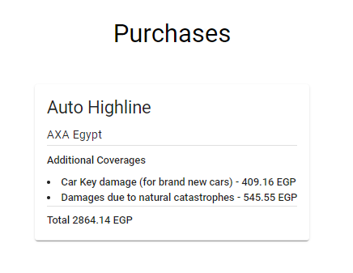

Slide 50
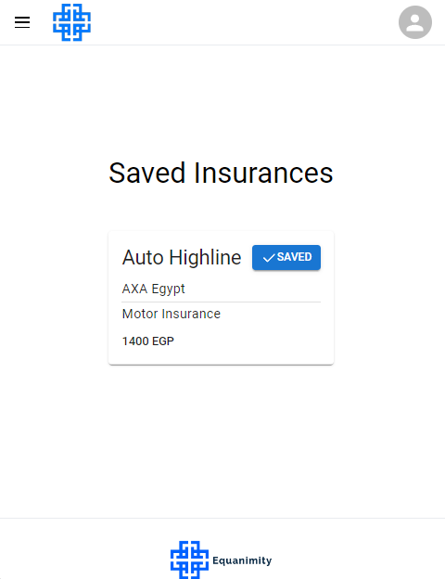
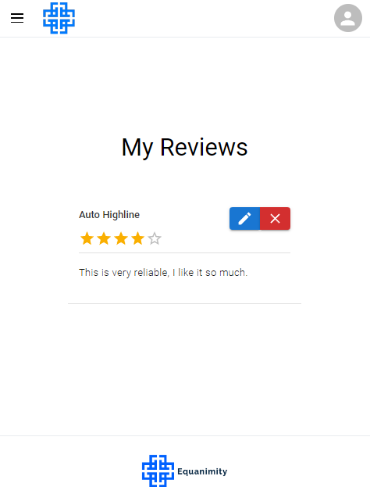
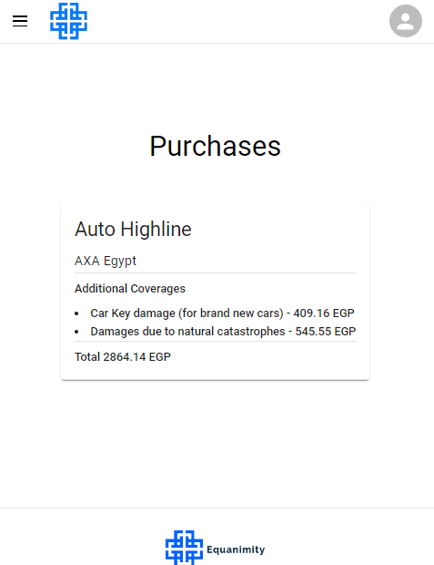

Slide 51
Company Admin

Slide 52
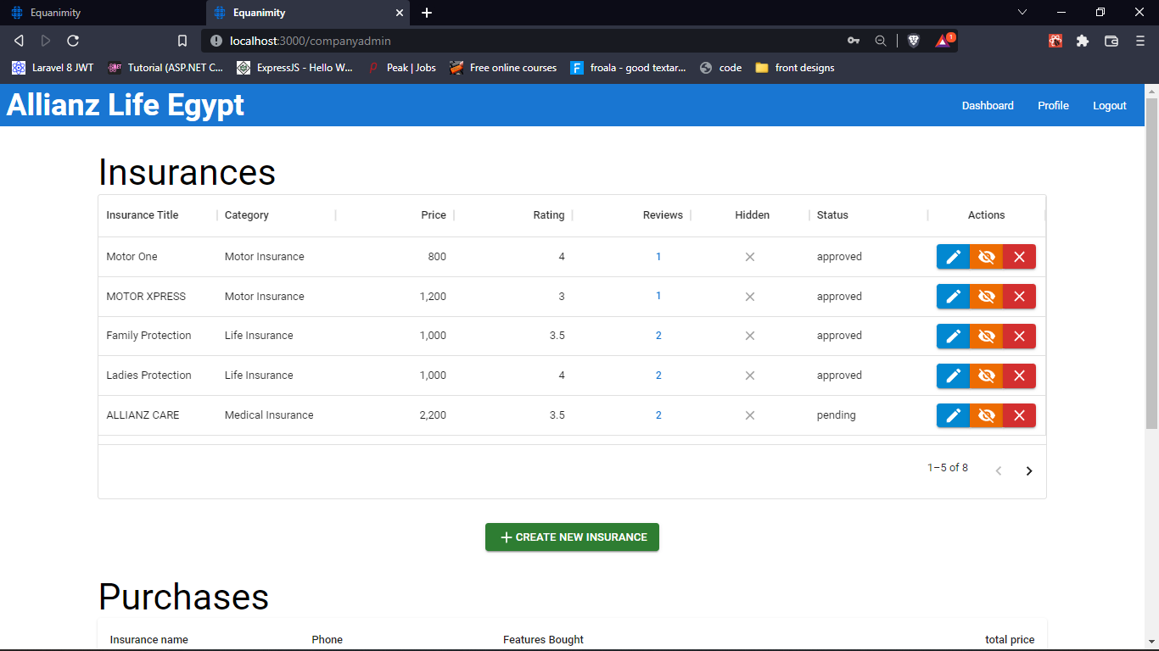

Slide 53
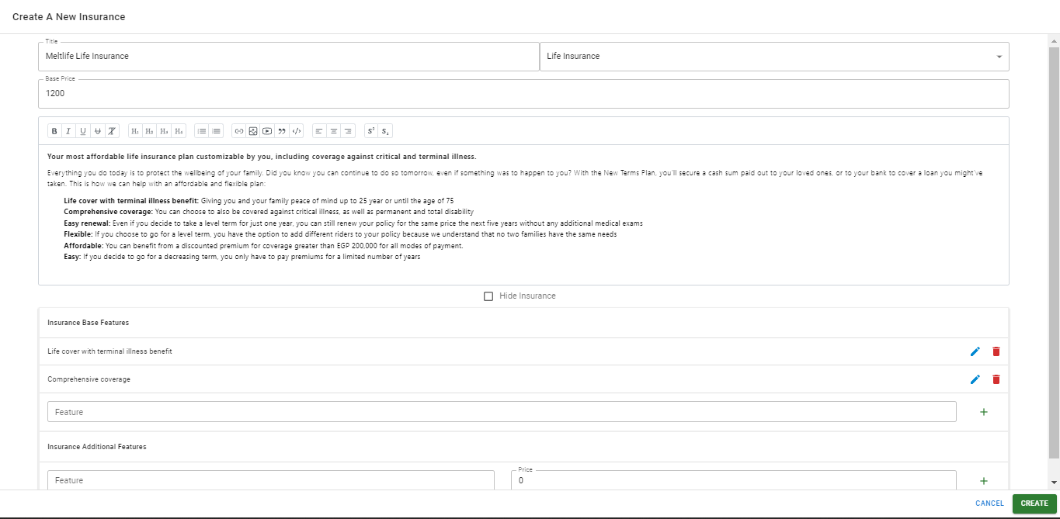

Slide 54
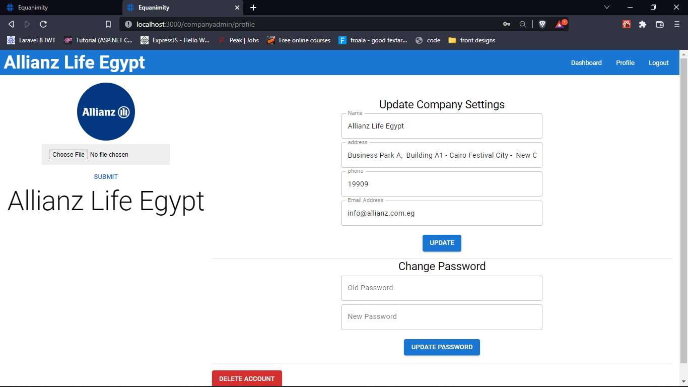

Slide 55
Admin Dashboard

Slide 56
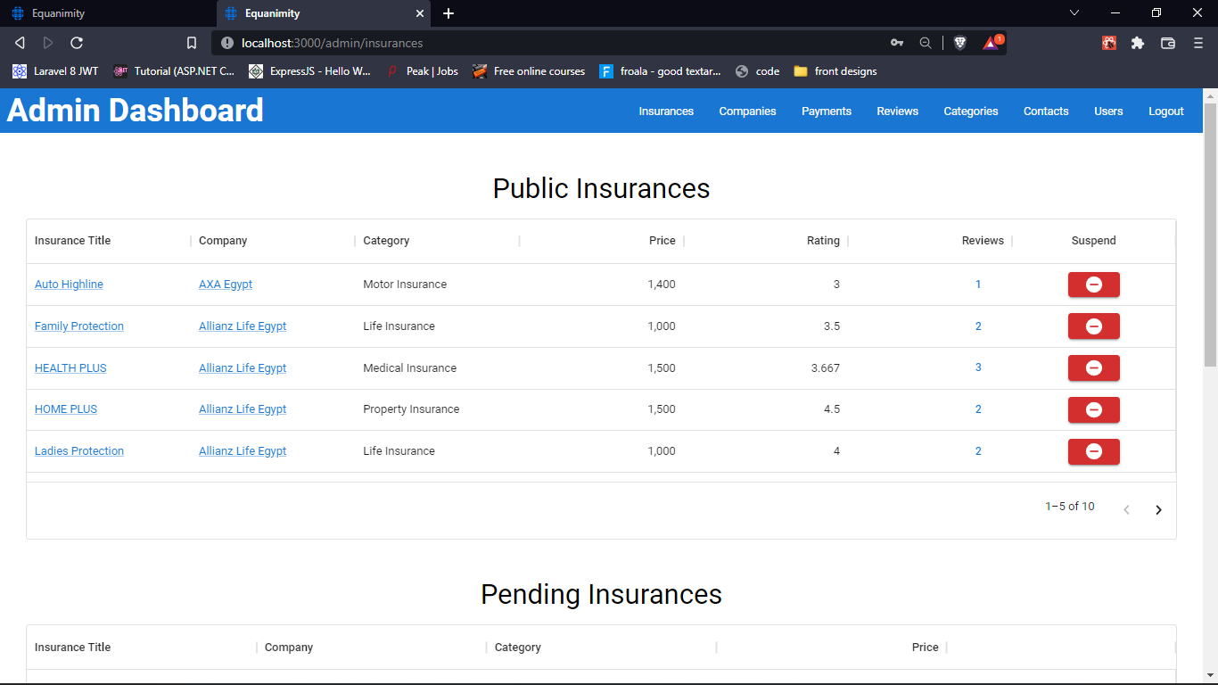

Slide 57
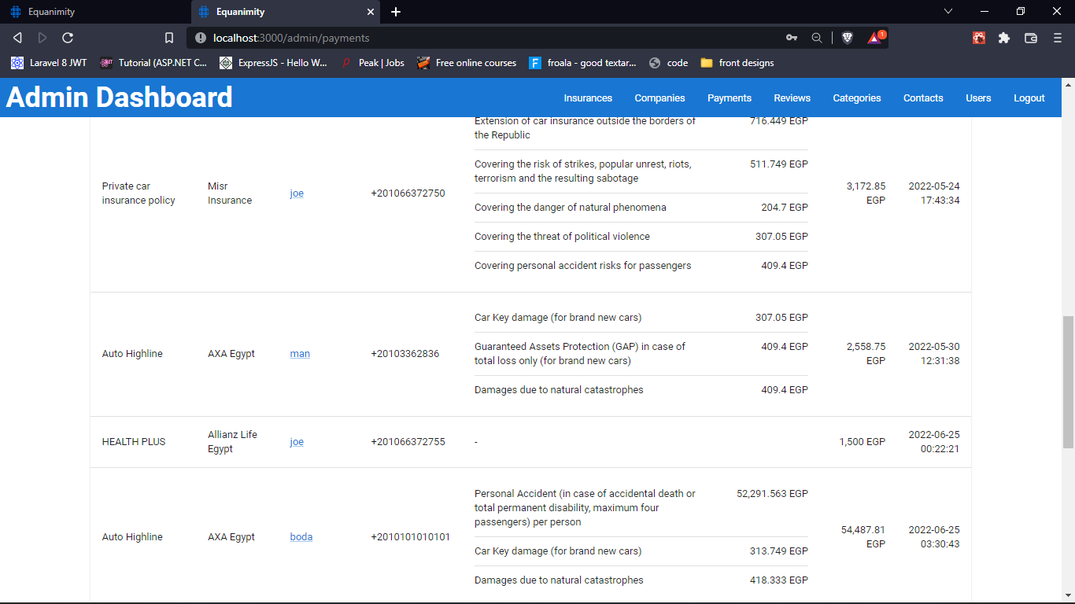

Slide 58
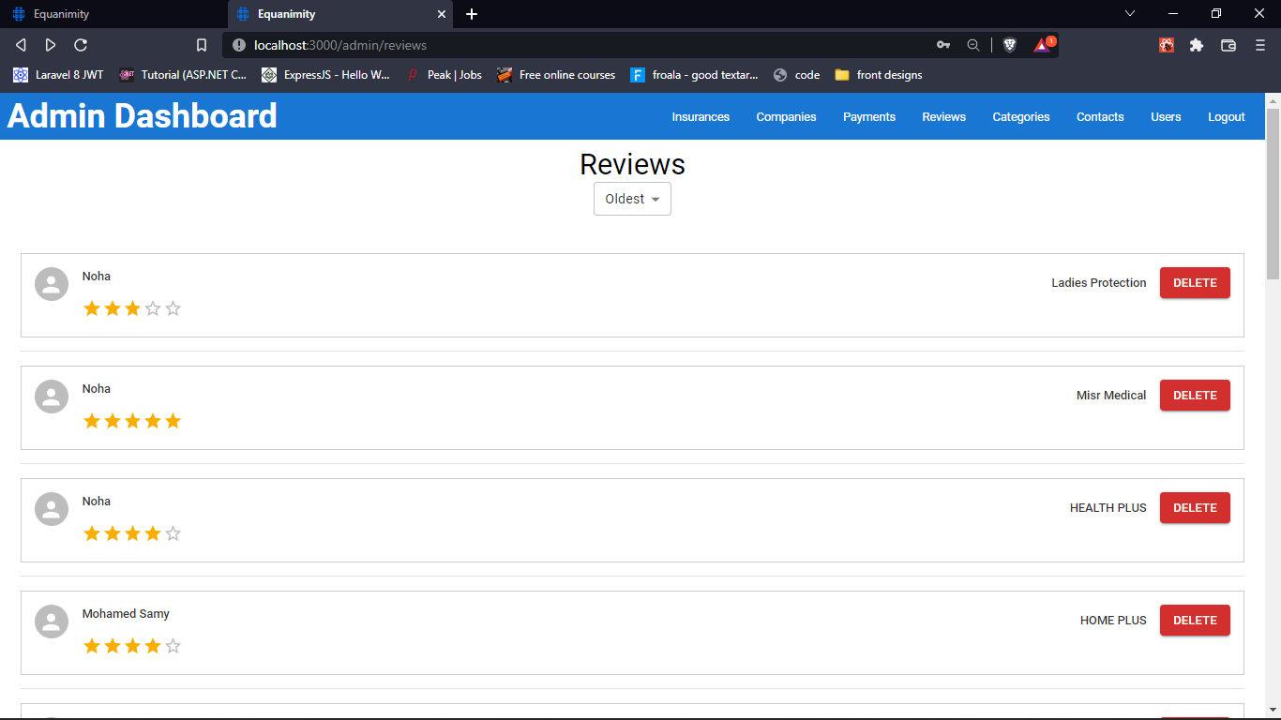

Slide 59
Thanks for listening.
Now we will present a live example of the website.

