Slide 1


Citizen Scientist

Slide 2

Overview of Features
RPG gamification elements
To include avatar design, cultivated identity around science and inquiry
Earn achievements and accessories for your avatar
Leaderboards
RSS Feed
Curated news feed of relevant health information based on patient medical history and educational interests
List of clinical trials that users can be part of
As healthy volunteers or as part of a specific patient population
Drug trials and natural history protocols
Targeted surveys that users can make money from
Survey questions designed by researchers, researchers pay CitSci, CitSci sends surveys to eligible users, users answer if they want to, proceeds go to users

Slide 3
Example of profile page

Slide 4


Meaningfully Incentivize Participation in Self-Management of Health
People would use an app that gets them money, and it can provide highly-relevant educational material simultaneously
Most clinical trials provide some sort of compensation
Gamification makes it less like a chore to engage with
For some, the growth of their character will provide a sense of pride in their contributions to the scientific community

Slide 5
RSS Feed: Tailored Communication
Medical literature is technical. How can patients get information that is actually useful to them?
In terms of technical detail:
PUBMED >> UPTODATE >> Citizen Scientist RSS Feed
Additionally, a users baseline level of knowledge about their medical conditions could be tested with a pretest of sorts. If a patient has hypertension and has no idea what that actually means, the RSS feed would start with more basic information before advancing
ACTIONABLE ITEMS are most important
You have Hypertension? Watch your intake of high-cholesterol and high salt foods.
You use IV Drugs? What are your triggers? Avoid them. Tally your Narcotics Anonymous meetings and PLAN THEM IN ADVANCE.

Slide 6
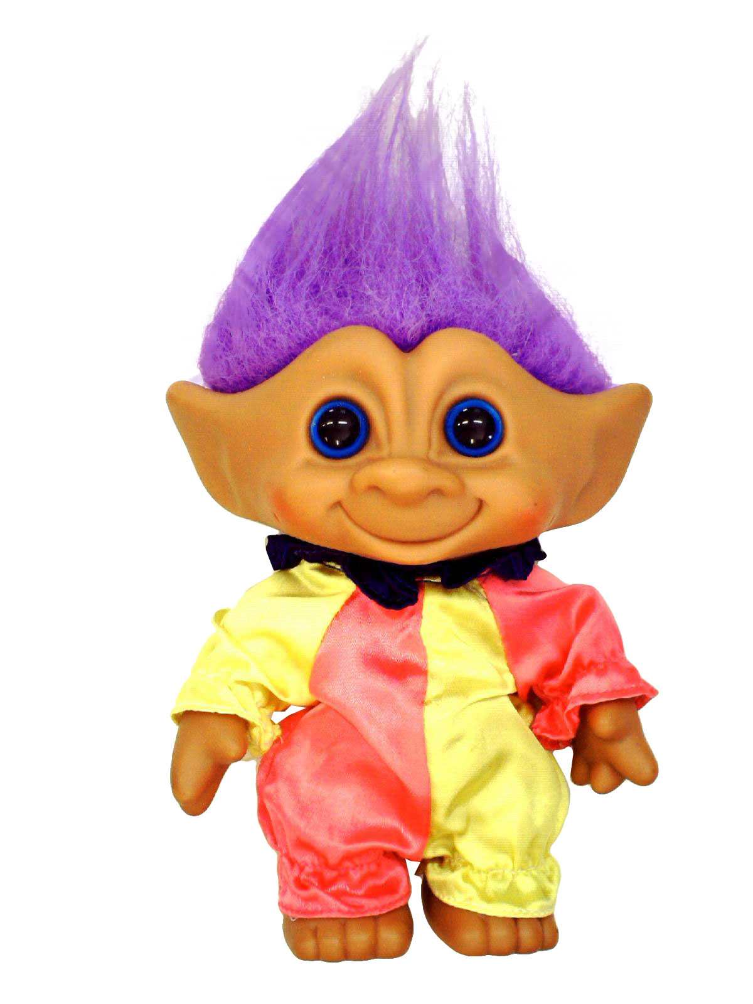
Spoof Accounts, Trolls, A-holes
Criticism: There will be people who might try to answer many surveys for money by providing information that makes them eligible for everything. How can we stop them?
Ans: Internal validation of survey answers. One cannot both be an IV drug-user and drug-free. Direct contradictions can either initiate account warnings, or audits, and potentially
Another Ans: A user can bring in their CitSci url to their primary care provider, their PCP can confirm the veracity of their profile, and they can have their account become a verified account. Verified accounts could get a cash bonus for becoming verified because the data they provide would become more clinically valid, and therefore worth more money.

Slide 7

Further Benefits of Verified Accounts
The patient could have their medical record in a url, if they are verified. It puts their record into a more convenient and portable format for them
I am one hundred and fifty thousand percent sure there is a HIPAA compliance problem somewhere in here, but this is a hackathon. If you want this sh** to actually work, pay me, and/or accept me to the Hopkins MSTP program pls

Slide 8
Medical Professional Opportunities for Involvement
Medical doctors and other medical professionals could get a specially verified account which would delineate them as medical professionals, and they could use this account to lend expertise to the CitSci service
Specialists could be called upon to give a catered message once a week or so to specific populations of patients
Migraine patients could get general advice from neurologists, Crohn’s patients from gastroenterologists, CHF patients from Cardiologists, etc… (not critical clinical decisions)
Basic dietary recommendations would be generally helpful as well

Slide 9
The Take-Home Message
The app would seek to democratize the process of medical research and provide ways for patients to become more aware and involved in their own care
The app would hopefully provide a much-needed influx of patients to clinical trials and would not rely on patients to skim through clinicaltrials.gov of their own volition
The app would make people some money, and for the first time, they actually get to be paid for their labor in being part of the product

Slide 10
Becoming a Citizen Scientist
Through becoming a Citizen Scientist, users get the opportunity to learn about medicine at a safe distance and in an unintimidating and immediately relevant way
Their input becomes part of the process of driving hypothesis generation
They get to be part of the ongoing effort to improve patient care and human health without going to professional school

