Slide 1
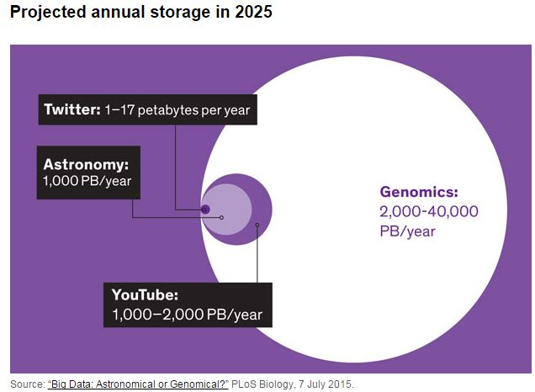
Why this topic ? Because ‘The Genomic Data Explosion’ is real . . .
This is a perfect field for examining
SQL approaches/enhancements at scale

Slide 2
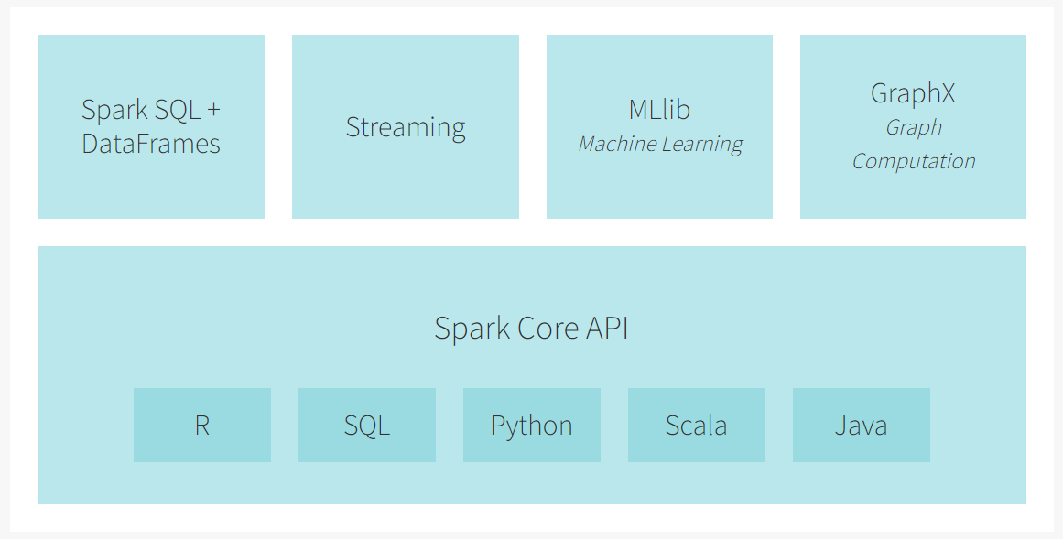
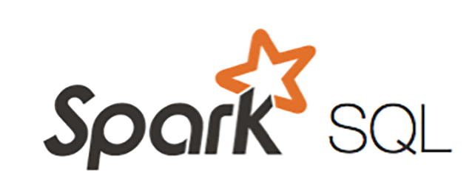
Our Foundation: In Memory Distributed Computing !
= an element contained within our project scope
The Spark Engine
Apache Spark is a unified analytics engine for large-scale data processing.
Notes:
Validate with Sudheer to confirm the data flow
Verify sources – note the big ones, small ones we show others

Slide 3
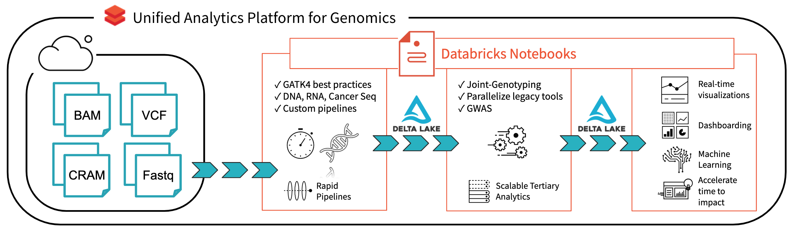
Notes:
Validate with Sudheer to confirm the data flow
Verify sources – note the big ones, small ones we show others

Slide 4
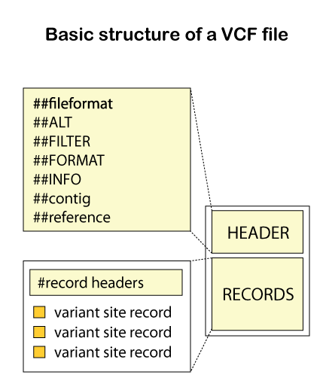
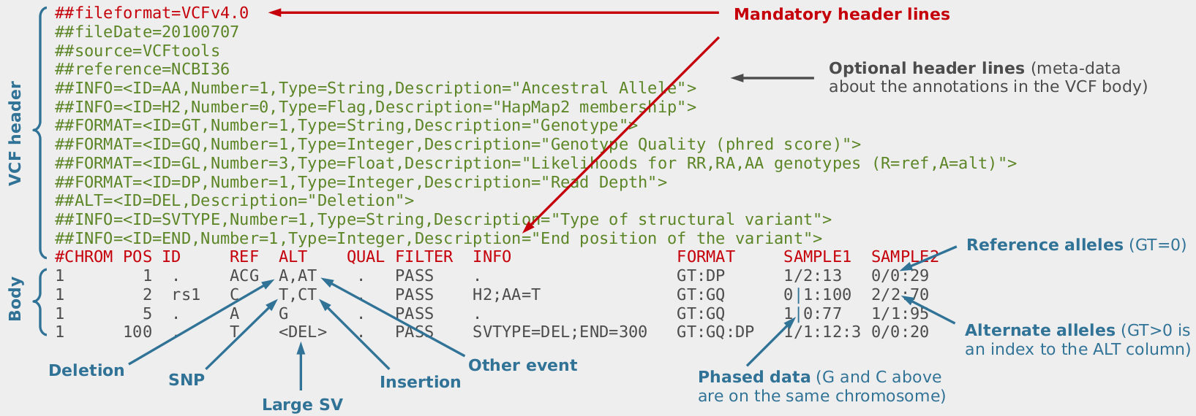
The Types Of Files We Are Looking At Are Complex !
We expect a fair amount of data manipulation and
SQL level filtering to even get our data in the right form !
We are ok with this, it will make us stronger

Slide 5
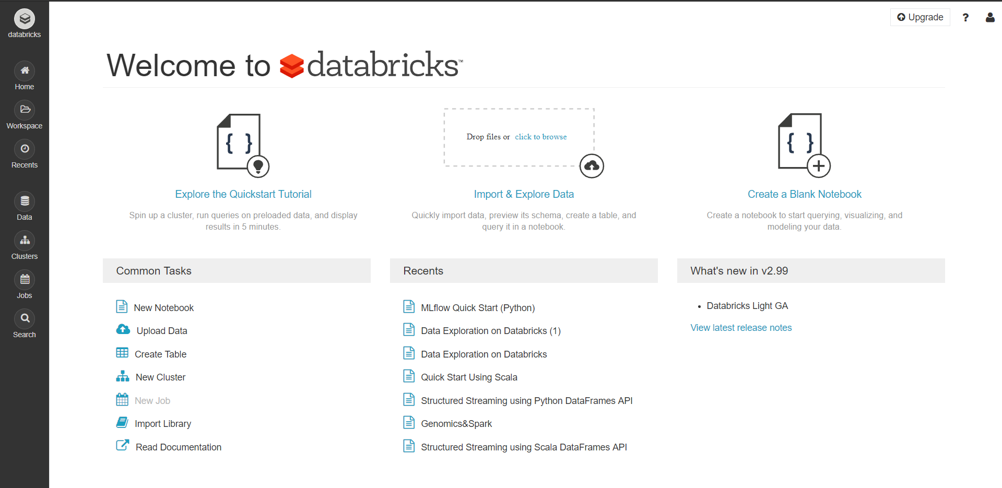
We will be primarily using Databricks (Community Edition)

Slide 6
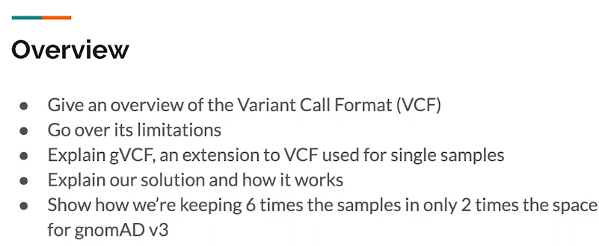
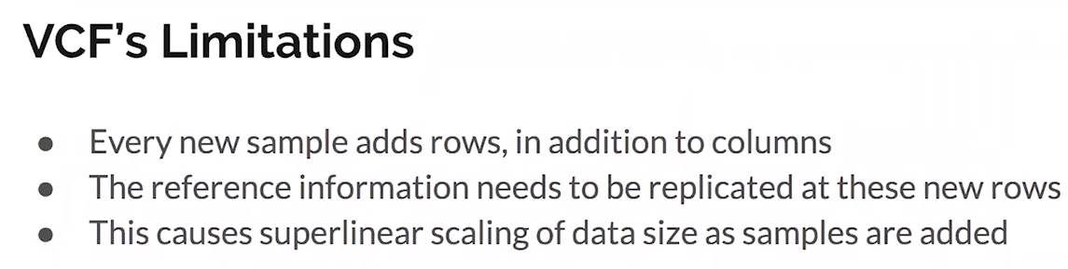
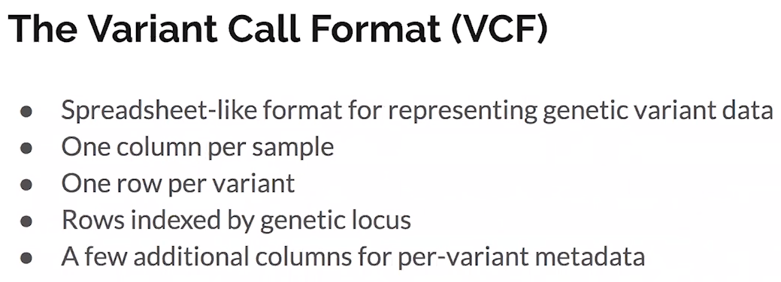
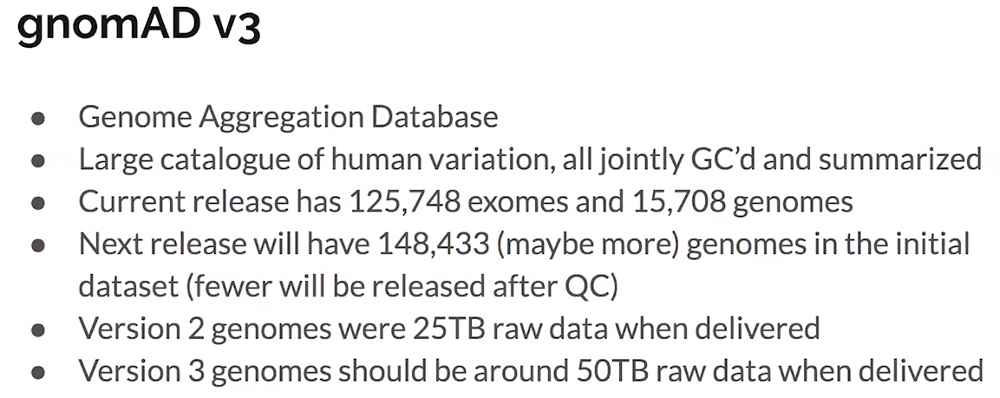
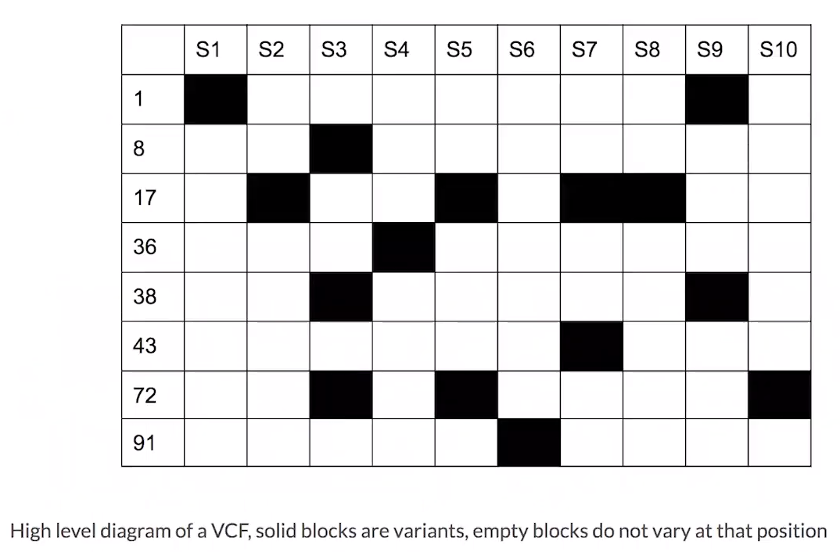
Notes:
Validate with Sudheer to confirm the data flow
Verify sources – note the big ones, small ones we show others

Slide 7
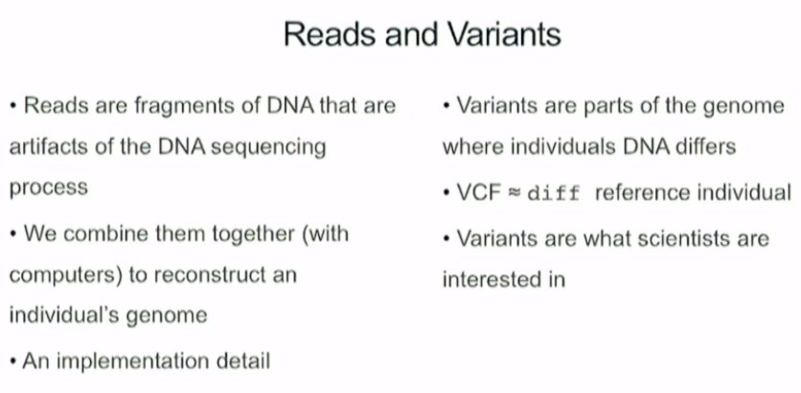
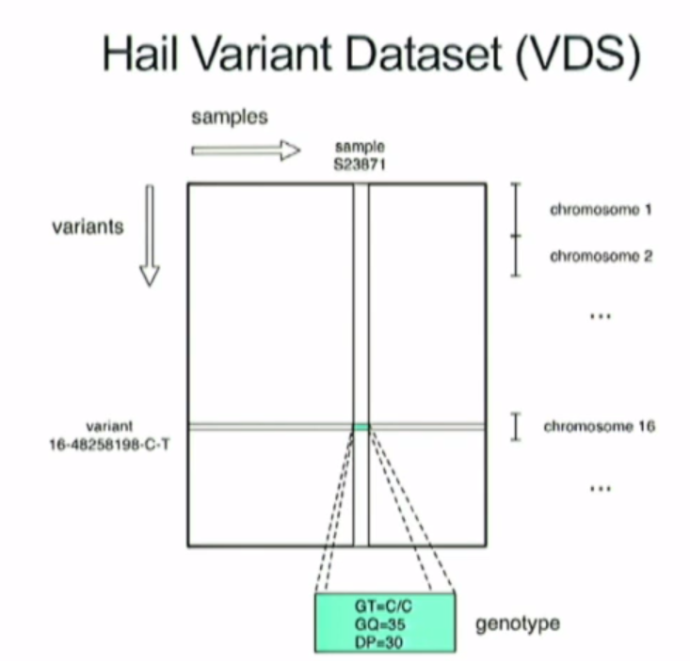
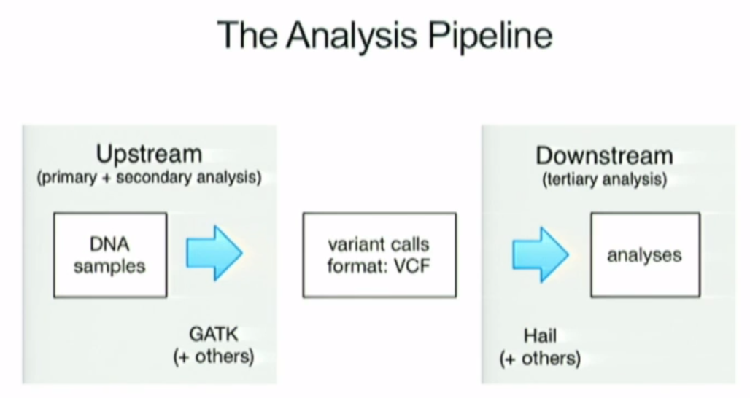
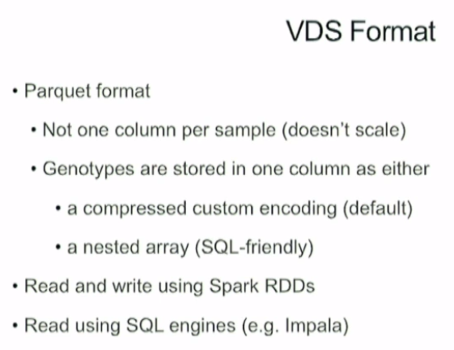
Notes:
Validate with Sudheer to confirm the data flow
Verify sources – note the big ones, small ones we show others

Slide 8
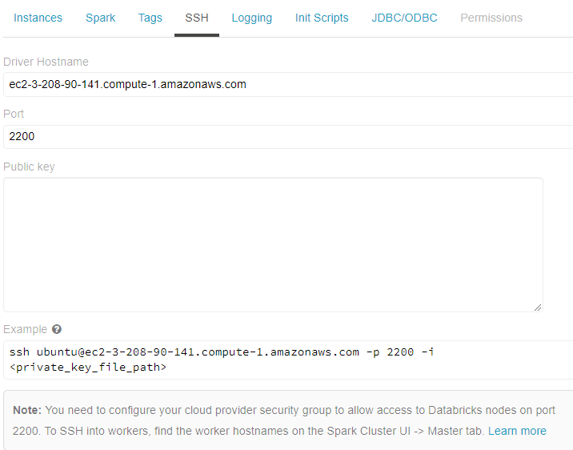
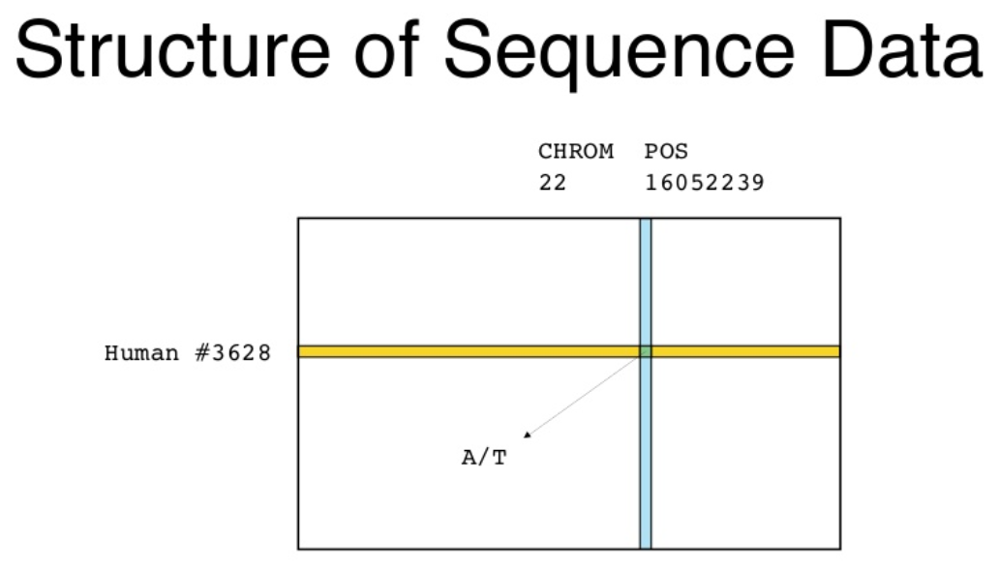
Notes:
Validate with Sudheer to confirm the data flow
Verify sources – note the big ones, small ones we show others

Slide 9
